Slide 1
SupplyTrace
Explainable purchasing decisions
Xianxin Kuang
Open Agent Hackathon 2026 · Track 02
Notes:
Track: The Agent That Can Explain Why. Submission owner Xianxin Kuang. Development used coding-agent assistance. See docs/BUILD-DISCLOSURE.md for pre-existing components and boundaries.

Slide 2
The delivery-date decision
A colleague asks for 30 units by Monday.
Stock
Commitments
Inbound
80 on hand includes 5 damaged units and a safety reserve.
Existing orders already need part of the same stock.
A shipment’s ETA differs from the date its units become usable.
A useful answer needs the source records, the date calculation and the reason for the decision.
Notes:
Problem framing is a design hypothesis for procurement and operations users. No customer interview or savings study is claimed. Fixture: data/synthetic.json.

Slide 3
A two-day change alters the answer
60 incoming units
ETA 25 Oct
+ 1 handling day
+ 1 buffer day
Usable 27 Oct
Original synthetic fixture, snapshot 22 October 2026. Existing commitments remain protected.
Notes:
Actual deterministic verifier fixture, tests/test_workflow.py. Request 30 units, as-of 2026-10-22. 2026-10-26 capacity 15 and cannot_promise. 2026-10-28 capacity 55 and can_promise. These are synthetic scenario results, not a customer outcome.

Slide 4
Every conclusion has inspectable evidence
01
Four approved reads
Inventory, orders, shipments and supplier terms.
02
Source references
Table, query, row IDs, retrieval time and record hash.
03
A dated calculation
Safety stock, future commitments and usable inbound dates.
04
A retained decision
Exportable evidence, prior decisions and a memory audit.
The application rejects missing, conflicting, stale or incomplete evidence instead of issuing a supported promise.
Notes:
Implementation: supplytrace/adapters.py, verifier.py and web/app.js. A SHA-256 digest proves local record consistency, not source truth. Sequential source queries are not an atomic cross-source snapshot.

Slide 5
The model has a narrow, testable role
Model tasks
Application controls
Order four allowed source reads.
Suggest neutral questions about displayed CSV rows.
Cite the original row positions.
Validate tools, SKU and model output.
Compute quantities and dates in code.
Keep human review notes separate.
Qwen3.5-4B through a local OpenAI-compatible endpoint. The model cannot submit arbitrary SQL or buy stock.
Notes:
Implementation: supplytrace/planner.py, review_assistance.py, assistant.py, verifier.py. CSV and procurement fixtures are separate data paths. A CSV review does not automatically modify the Zetaris sources.

Slide 6
Sponsor components in the working path
Zetaris
Four original CSV sources queried through the running official platform. Pagination and cursor closure verified.
Meterless
Run the pinned H-MEM reference engine to remember a decision, recall prior runs and inspect its ledger.
NVIDIA
RTX 4060 Laptop GPU accelerates local Qwen inference through Vulkan.
Live platform execution uses synthetic fixtures. Sponsor acceptance remains the organizer’s decision.
Notes:
Zetaris official SQL/API reference: https://github.com/zetaris/getting-started/blob/main/docs/guides/zetaris-lightning-sql-commands.md . Meterless source: https://github.com/Meterless/Meterless/tree/1742dec56a66e58eef9dda2d2b865823758ca8cd/engines/hmem . NVIDIA acceleration observed via local llama.cpp Vulkan runtime and process identity. No Nemotron/NIM/CUDA claim.

Slide 7
Architecture and technical stack
Browser
FastAPI
Model plan
Zetaris
Bilingual HTML / JS
Pydantic validation
Qwen / HTTPX
Four approved reads
Validated records → deterministic verifier → cited result
Meterless H-MEM / Node
Retained decisions and recall
SQLite + DuckDB / Arrow
Originals, review history and CSV analysis
One local Python worker. No cross-source transaction; every read has its own retrieval time.
Notes:
Implemented components, not a deployment diagram of a hosted service. Source: supplytrace/app.py, planner.py, adapters.py, verifier.py, memory.py and integrations/hmem.ts. The model selects the order of the allowed reads; application code constructs SQL.

Slide 8
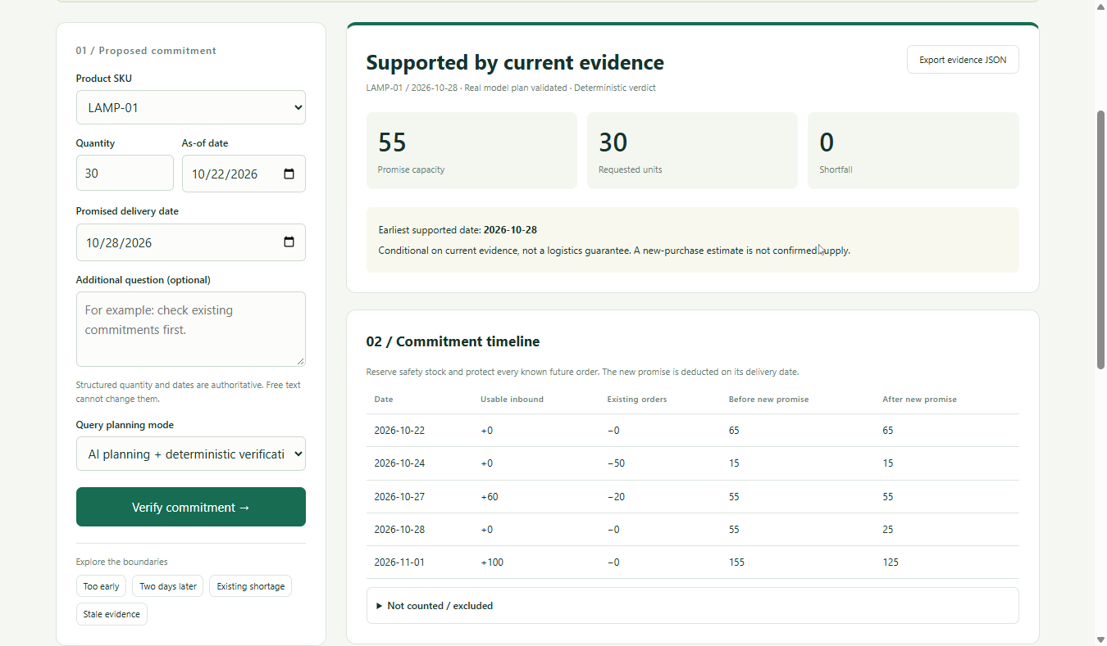
Inspect the result in the product
Sources, date calculation and decision history stay visible for review. Demo records are synthetic.
Notes:
The final slide requires an actual Egolite screenshot of the running product after live platform acceptance. A missing screenshot is a delivery blocker, not replaced with a synthetic interface.

Slide 9
Measured local behavior
500,000 rows
Source integrity
Exported original SHA-256 matched the input.
A killed parse recovered all 150,000 rows after restart.
25.5 s import
92.1 s analysis
55.2 s first export
Windows, one worker, shared 16 GB host. One retained run per scale case. No production throughput claim.
Notes:
Retained benchmark 6a8bf174-119d-4c2a-9cfc-c193126ad756. 500000 rows: parse 25.500s, analysis 92.094s, first export 55.156s, peak whole-service-tree RSS 228192256 bytes. One-key 250000 rows also completed. Initial full run later received HTTP 503 under rapid download interruption. Targeted follow-up verified 20 disconnects, handle count 409 to 417, and a separate restart recovered 150000 rows. This is shared-host evidence with uncontrolled OS cache, not production capacity.

Slide 10
The next test is with operators
Pilot question
Can an operator explain and verify a proposed delivery date using the evidence without reconstructing the calculation?
Measure review accuracy and elapsed time on real, permissioned records. Expand integrations after the pilot.
github.com/Kuang-xianxin/supplytrace
Current scope: one local workspace. No customer savings or business outcome has been measured.
Notes:
Planned work, not completed user research. Technical limits: local single-user scope, sequential platform reads, synthetic procurement fixtures, no autonomous procurement and no verified customer impact. Repository was created and verified as public on 2026-10-27.

