Slide 1
Improved Fourier-Mellin Invariant for Image Registration
Kuang Haofei

Slide 2
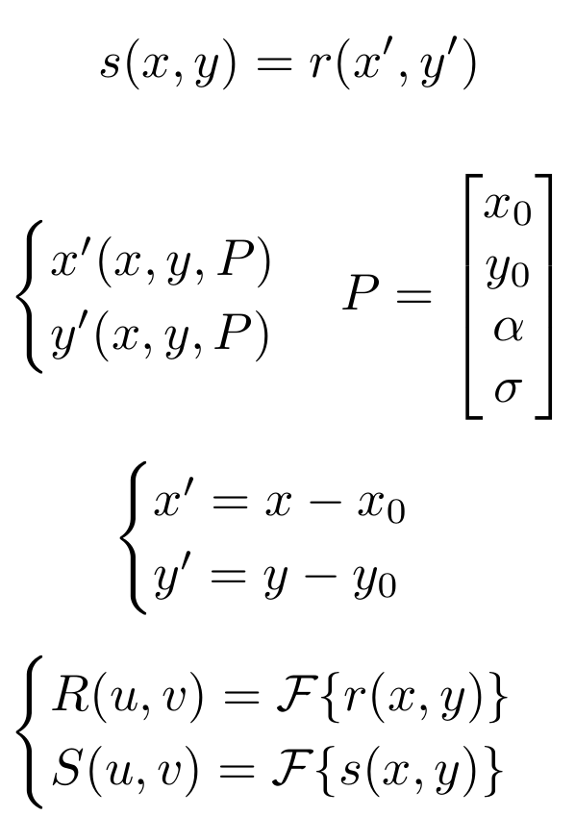
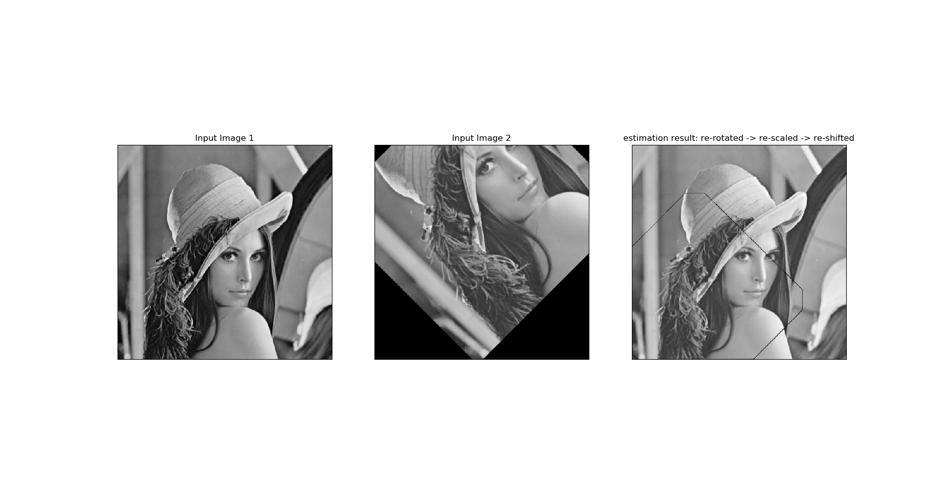
Introduction
Image Registration
Translation，Rotations and Scaling
T(P) ?

Slide 3
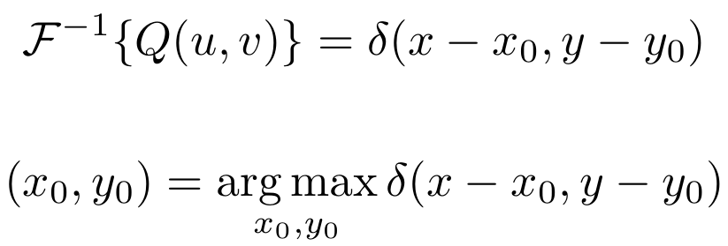
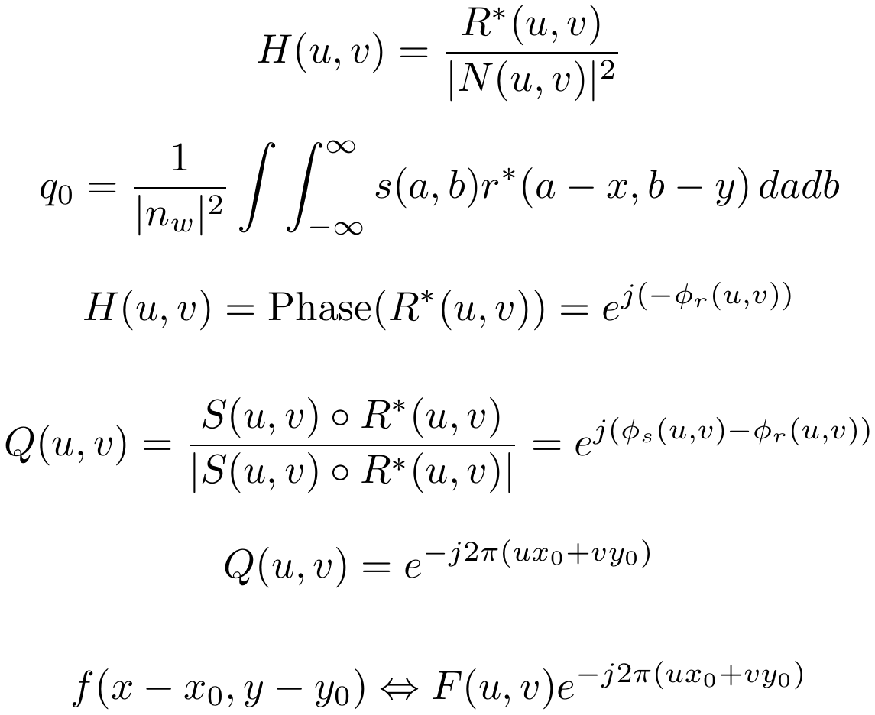
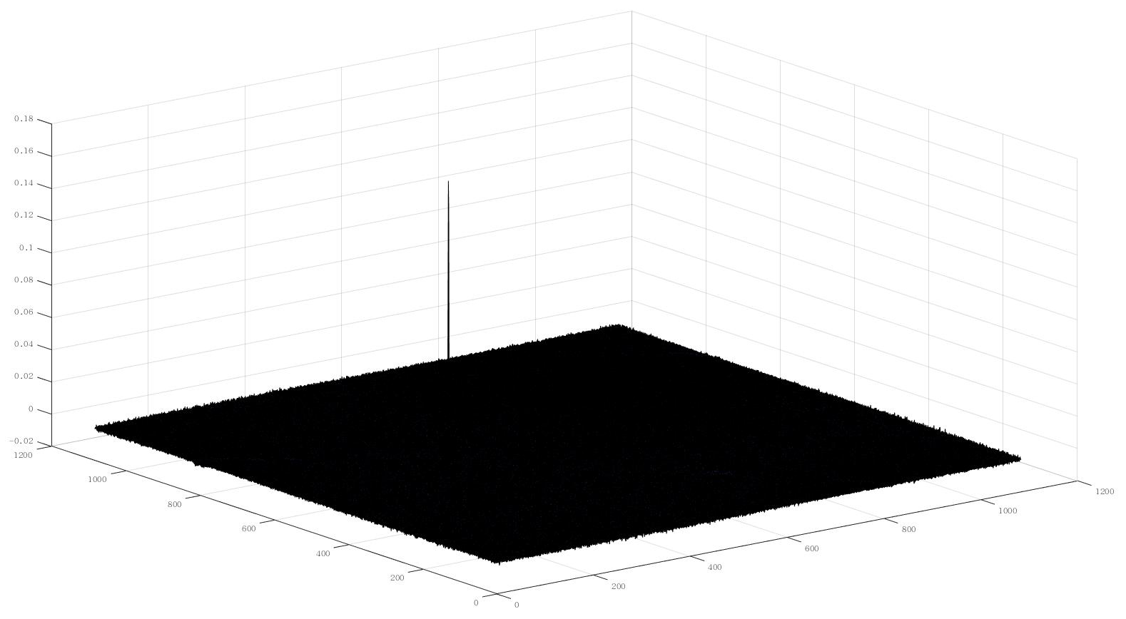
Preliminary
Phase Correlation
Chen, Qin-sheng, Michel Defrise, and Frank Deconinck. "Symmetric phase-only matched filtering of Fourier-Mellin transforms for image registration and recognition." IEEE Transactions on Pattern Analysis & Machine Intelligence 12 (1994): 1156-1168.

Slide 4
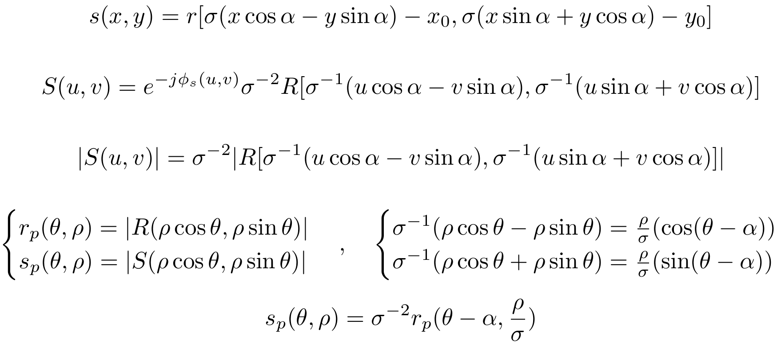
Implementation
Fourier-Mellin Invariant descriptor(FMI）
Calculate spectrum magnitude to remove translation
Cartesian coordinates to Polar coordinates
Chen, Qin-sheng, Michel Defrise, and Frank Deconinck. "Symmetric phase-only matched filtering of Fourier-Mellin transforms for image registration and recognition." IEEE Transactions on Pattern Analysis & Machine Intelligence 12 (1994): 1156-1168.

Slide 5
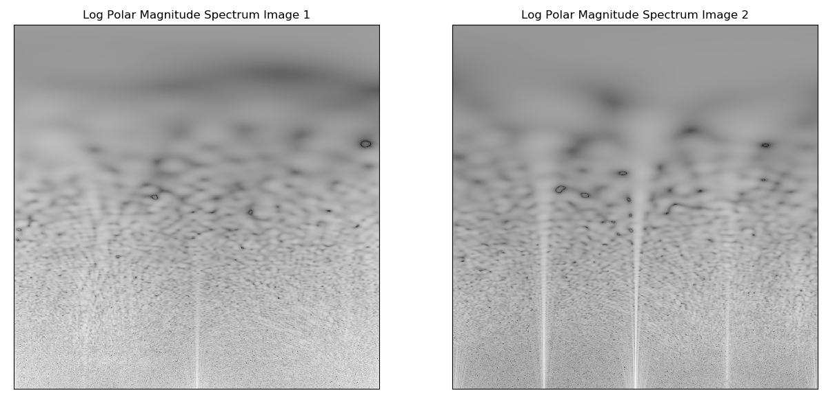
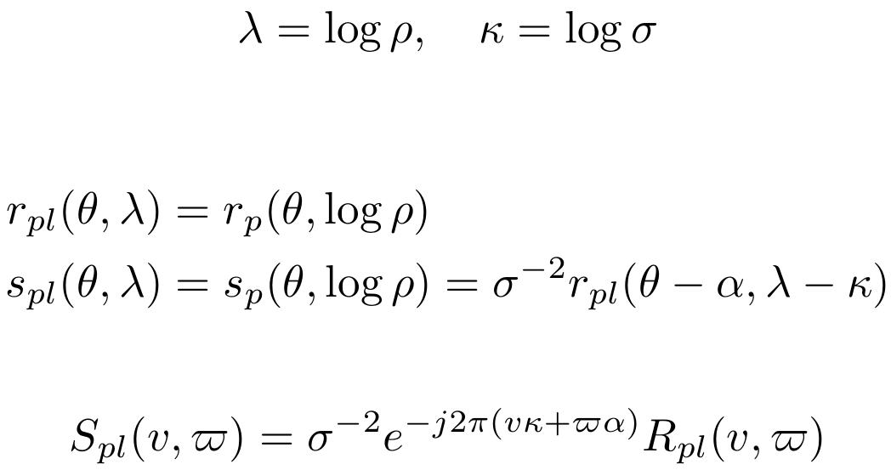
Implementation
Fourier-Mellin Invariant descriptor(FMI）
Polar coordinates to Polar-logarithmic coordinates
Chen, Qin-sheng, Michel Defrise, and Frank Deconinck. "Symmetric phase-only matched filtering of Fourier-Mellin transforms for image registration and recognition." IEEE Transactions on Pattern Analysis & Machine Intelligence 12 (1994): 1156-1168.

Slide 6
FMI Image Registration Pipeline

Slide 7
improved Fourier-Mellin Invariant descriptor(iFMI)
Improvement in contrast to FMI
A logarithmic representation of the spectral magnitude of FMI descriptor is used.
A filter on the frequency where the shift is supposed to appear is applied.
Bulow, Heiko, Andreas Birk, and Vikram Unnithan. "Online generation of an underwater photo map with improved Fourier Mellin based registration." OCEANS 2009-EUROPE. IEEE, 2009.

Slide 8
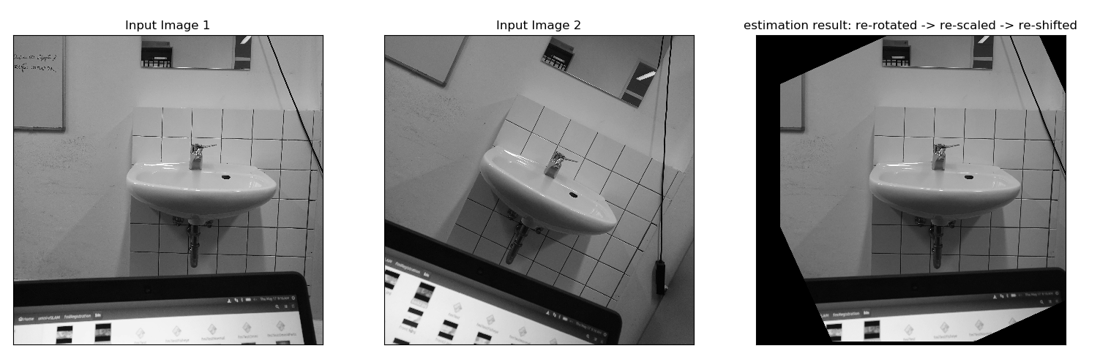

Image Registration Results

Slide 9
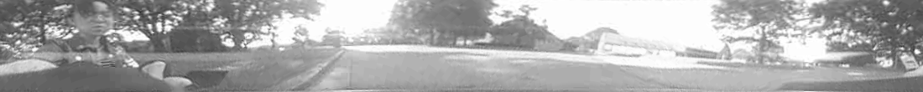
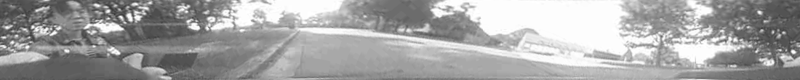

Visual Odometry with Omni-Camera
Finding correspondences
Calculate camera ray
Pose estimation
Rescaling

Slide 10
Thanks

