Slide 1

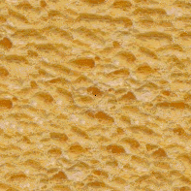
Texture Synthesis by
Non-parametric Sampling
Alexei Efros and Thomas Leung
UC Berkeley

Slide 2
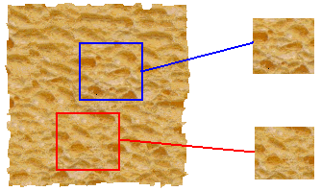
Goal of Texture Synthesis
input image
SYNTHESIS
True (infinite) texture
generated image
Given a finite sample of some texture, the goal is to synthesize other samples from that same texture.
  The sample needs to be "large enough"

Slide 3

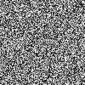

The Challenge
Texture analysis: how to capture the essence of texture?
Need to model the whole spectrum: from repeated to stochastic texture
This problem is at intersection of vision, graphics, statistics, and image compression
repeated
stochastic
Both?

Slide 4
Some Previous Work
  multi-scale filter response histogram matching [Heeger and Bergen,’95]
  sampling from conditional distribution over multiple scales [DeBonet,’97]
  filter histograms with Gibbs sampling [Zhu et al,’98]
  matching 1st and 2nd order properties of wavelet coefficients [Simoncelli and Portilla,’98]
  N-gram language model [Shannon,’48]
  clustering pixel neighbourhood densities [Popat and Picard,’93]

Slide 5
Our Approach
Our goals:
  preserve local structure
  model wide range of real textures
  ability to do constrained synthesis
Our method:
  Texture is “grown” one pixel at a time
  conditional pdf of pixel given its neighbors synthesized thus far is computed directly from the sample image

Slide 6
Motivation from Language
[Shannon,’48] proposed a way to generate English-looking text using N-grams:
  Assume a generalized Markov model
  Use a large text to compute probability distributions of each letter given N-1 previous letters
    precompute or sample randomly
  Starting from a seed repeatedly sample this Markov chain to generate new letters
  One can use whole words instead of letters too:
WE NEED
TO
EAT
CAKE

Slide 7
Mark V. Shaney (Bell Labs)
Results (using alt.singles corpus):
  “As I've commented before, really relating to someone involves standing next to impossible.”
  "One morning I shot an elephant in my arms and kissed him.”
  "I spent an interesting evening recently with a grain of salt"
Notice how well local structure is preserved!
  Now let’s try this in 2D...

Slide 8

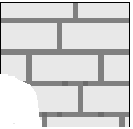
Synthesizing One Pixel
SAMPLE
p
Infinite sample image
Generated image
  Assuming Markov property, what is conditional probability distribution of p, given the neighbourhood window?
  Instead of constructing a model, let’s directly search the input image for all such neighbourhoods to produce a histogram for p
  To synthesize p, just pick one match at random

Slide 9

Really Synthesizing One Pixel
SAMPLE
p
finite sample image
Generated image
  However, since our sample image is finite, an exact neighbourhood match might not be present
  So we find the best match using SSD error (weighted by a Gaussian to emphasize local structure), and take all samples within some distance from that match

Slide 10

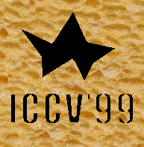
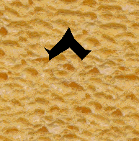
Growing Texture
  Starting from the initial configuration, we “grow” the texture one pixel at a time
  The size of the neighbourhood window is a parameter that specifies how stochastic the user believes this texture to be
  To grow from scratch, we use a random 3x3 patch from input image as seed

Slide 11
Some Details
Growing is in “onion skin” order
  Within each “layer”, pixels with most neighbors are synthesized first
  If no close match can be found, the pixel is not synthesized until the end
Using Gaussian-weighted SSD is very important
  to make sure the new pixel agrees with its closest neighbors
  Approximates reduction to a smaller neighborhood window if data is too sparse

Slide 12

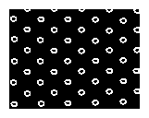
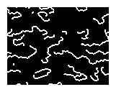
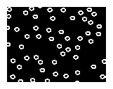
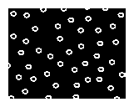
Randomness Parameter

Slide 13

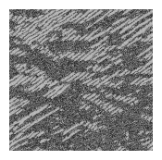
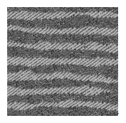
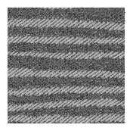
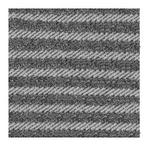

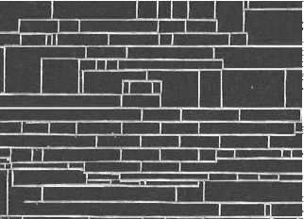
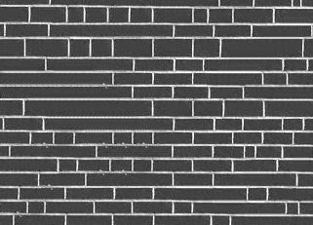
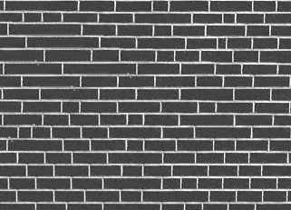
More Synthesis Results
Increasing window size

Slide 14


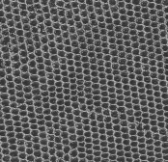
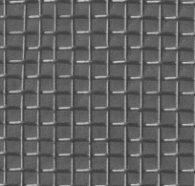
Brodatz Results
reptile skin
aluminum wire

Slide 15


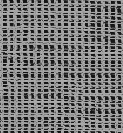
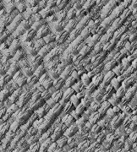
More Brodatz Results
french canvas
rafia weave

Slide 16


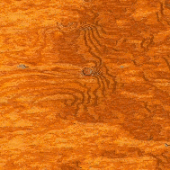
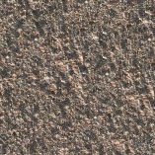
More Results
wood
granite

Slide 17
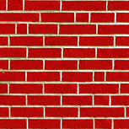
More Results
white bread
brick wall

Slide 18
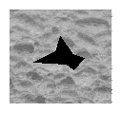
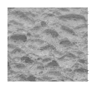
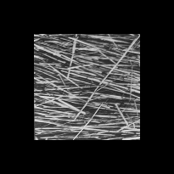
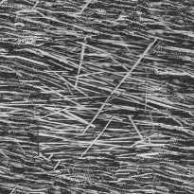
Constrained Synthesis

Slide 19

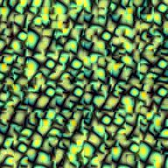
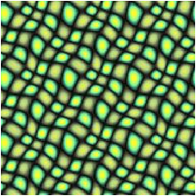
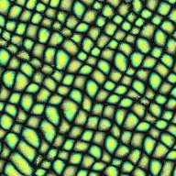
Visual Comparison
Synthetic tilable
texture
[DeBonet, ‘97]
Simple tiling
Our approach

Slide 20
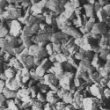
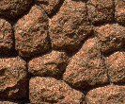
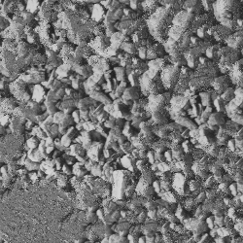
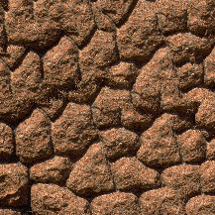
Failure Cases
Growing garbage
Verbatim copying

Slide 21
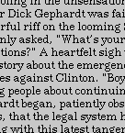
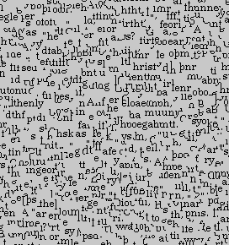
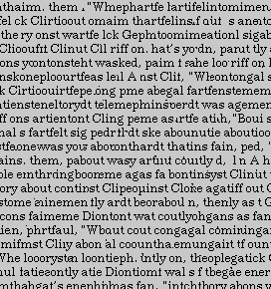
Homage to Shannon

Slide 22
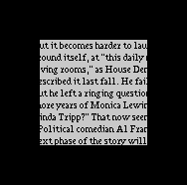
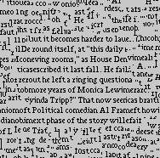
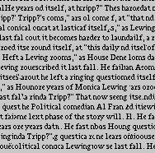
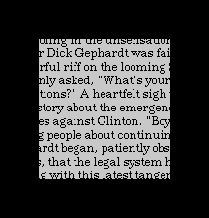
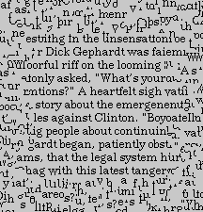
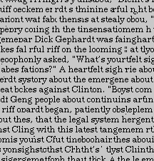
Constrained Text Synthesis

Slide 23
Applications
Occlusion fill-in
  for 3D reconstruction
region-based image and video compression
  a small sample of textured region is stored
Texturing non-developable objects
  growing texture directly on surface
Motion synthesis

Slide 24


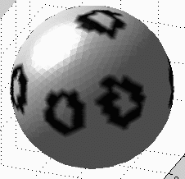
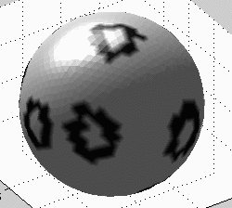
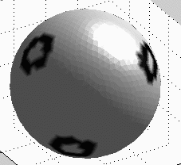
Texturing a sphere
Sample image
2D
3D

Slide 25
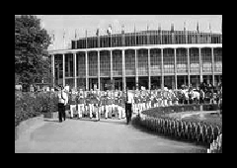
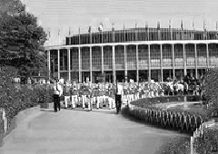
Image Extrapolation

Slide 26
Summary
Advantages:
  conceptually simple
  models a wide range of real-world textures
  naturally does hole-filling
Disadvantages:
  it’s greedy
  it’s slow
  it’s a heuristic
Not an answer to texture analysis, but hopefully some inspiration!

Slide 27
Acknowledgments
Thanks to:
  Alex Berg
  Elizaveta Levina
  Jitendra Malik
  Yair Weiss
Funding agencies
  NSF Graduate Fellowship
  Berkeley Fellowship
  ONR MURI
  California MIRCO

Slide 32

Texture Synthesis by
Non-parametric Sampling
Alexei Efros and Thomas Leung
UC Berkeley

