Slide 1
Biomedical Sensing Circuit
Low-noise, Low-power, 2-Stage Symmetric OTA
Kuangzheng Zhang
Jingmin Zhao

Slide 2
Introduction

Slide 3
Biomedical Signals
Biomedical Signals | Organ | Amplitude | Bandwidth
Electroencephalographic (EEG) | Brain | 10~20μV | Below 100Hz
Electrocardiogram (ECG) | Heart | 1~5mV | 0.05~100Hz
Electrocorticographic (ECoG) | Brain | below 100μV | 0.5~100Hz
Electromyography (EMG) | Muscle | 0.1~5mV | Up to 500Hz
Challenges:
The system must be very small to detect biomedical signals inside human body
Low amplitude and bandwidth for biomedical signals
Low power consumption to
lower temperature to protect tissue
proper functioning for many years using small battery
Low noise level for large DC current offset appears in the contact surfaces
Notes:
First, we want to introduce you some typical applications like EEG, ECG. The biosignals are always at extremely low amplitude and frequency like at mili-voltage level and below hundred Hz. This brings the requirements to lower power consumption and low noise response level. That is also the challenges in designing the biomedical sensing circuit.

Slide 4
Schematic and Analysis

Slide 5
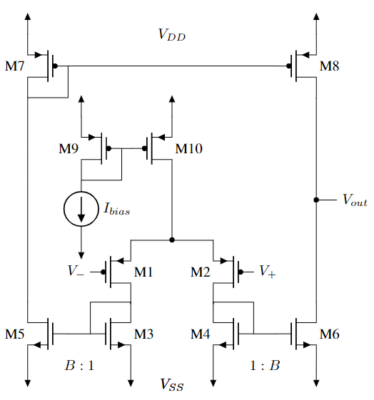


Schematic
2-Stage OTA
differential input, single-end output
4 Current Mirrors
M9,M10 / M3,M5 / M4,M6 / M7,M8
Duplicate current to every branch
Transconductance:
Gain:
Bandwidth:
Notes:
The Flicker noise or called 1/f noise is another major concern for a low-noise low-frequency circuit design, which can be eliminated by utilizing large gate area PMOS transistors as input devices. The reason for this consideration is the property of flicker noise is much lower in PMOS than in NMOS, also is inversely proportional to the gate area.

Slide 6
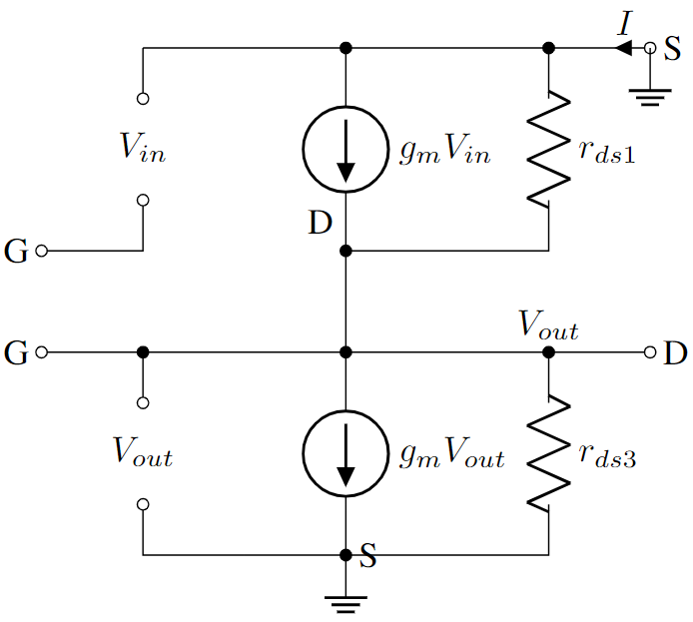
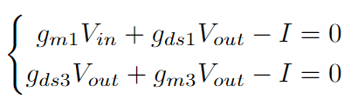
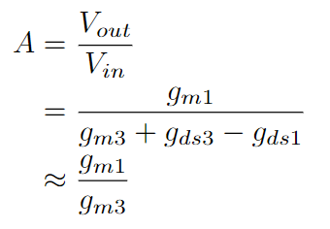
Small Signal Analysis: Stage 1

Slide 7
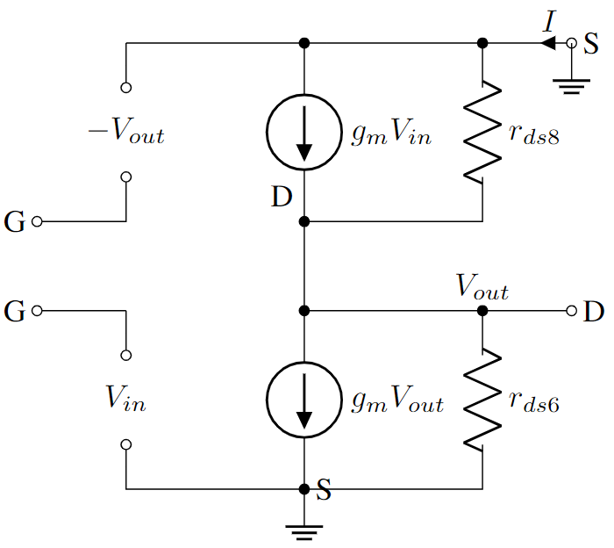
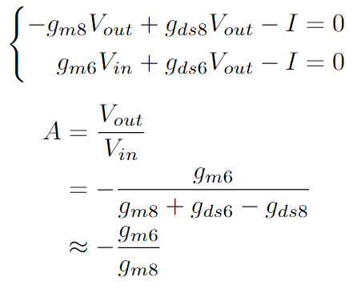
Small Signal Analysis: Stage 2

Slide 8
Schematic and Simulation

Slide 9
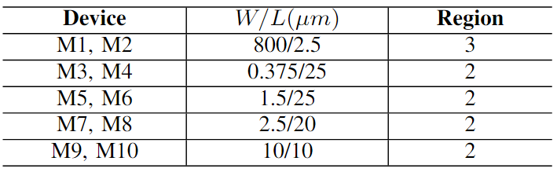
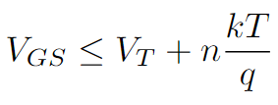
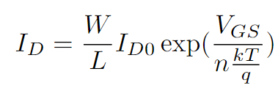
Schematic: Transistor Dimensions
Transistors should work in subthreshold or saturation region.
Supply Voltage/Current: 2.2V, 8uA.
Notes:
Next, we have to decide the dimensions of all transistors to make sure operating them in saturation region. Except the two largest transistors M1 and M2. These two very wide PMOS are operating in subthreshold region. Ideally, you can ignore the leakage subthreshold current and consider them as cut-off. But in practice, the leakage current is shown like this function. Very wide transistors in subthreshold region are commonly used in low power analog design to lower the power consumption. And it can still meet the function and performance requirements.

Slide 10
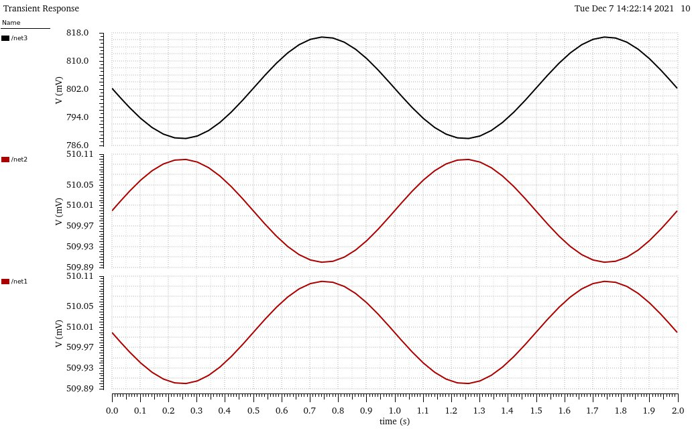
Simulation: Transient Response
Differential input with common mode bias:
Vin/2 (100 uV, 1 Hz)
180 degree difference
Single-end output: 30 mV swing without significant signal distortion.
Notes:
Here is the transient response curves. The bottom two red signals are the differential inputs with common mode bias. You can see, they have 180 degree of difference. The single-end output signal has 30 mV swing, demonstrating the amplification to the 100 micro-V input. There is no significant signal distortion. So we successfully amplify the signal.

Slide 11
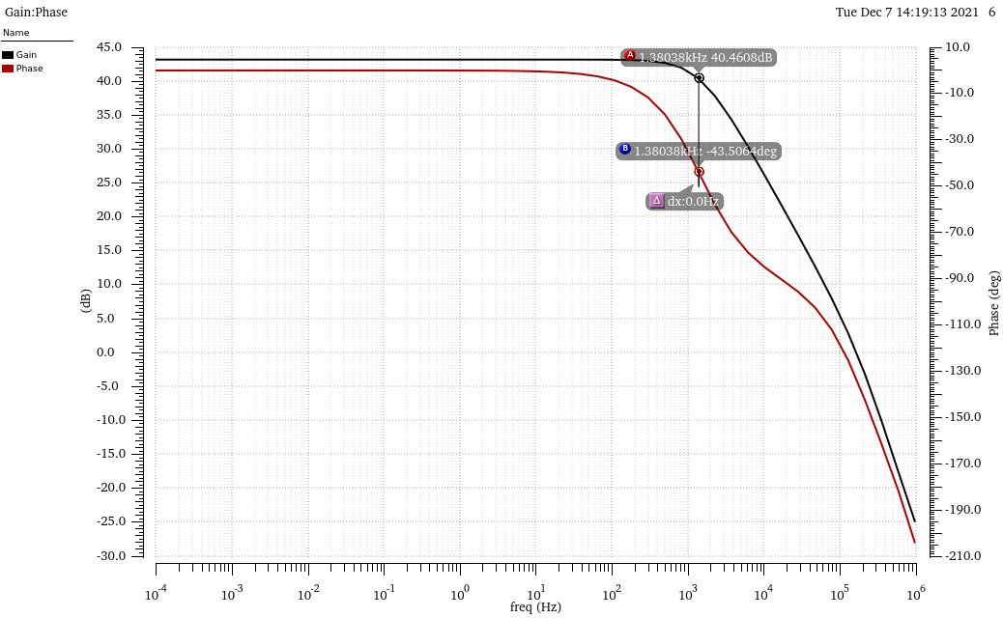
Simulation: Gain, Bandwidth
Midband Gain: 43.2 dB.
-3dB Bandwidth: 1.38 kHz (Load Cl = 3.2 pf).
Phase Margin: 48 degree.
Notes:
This figure shows the gain and phase response to the frequency sweep. The midband gain is 43.2 dB, with the bandwidth 1.38kHz. And the phase margin is 48 degree. This PM value should be around from 30 to 60. It means when the gain of amplifier is 0 dB, the difference between the phase lag and -180 degree. At this point, the output and input signals have the same amplitude. By the way It is not this point. It is about here. The higher PM is, the slower and stable the amplifier is.

Slide 12
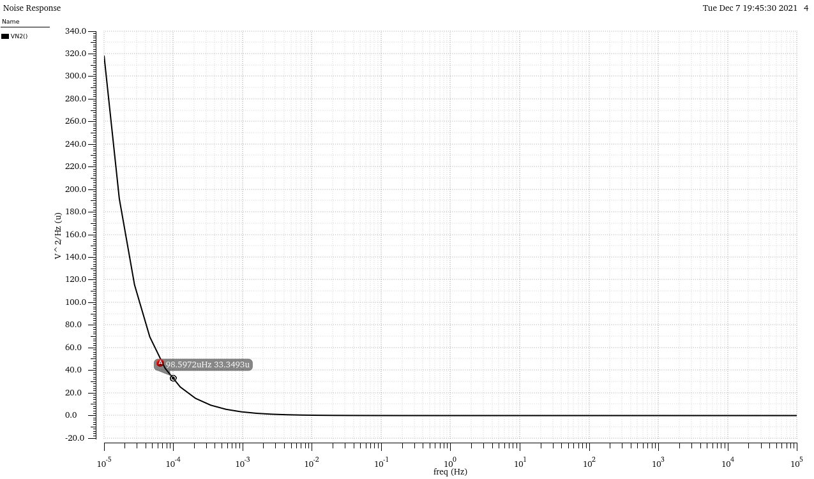
Simulation: Noise Response
Thermal Noise Level: 120 nV/sqrt(Hz).
Flicker Noise Corner: 0.1 mHz.
Integrated Input Referred Noise: 4.56 uVrms.
Notes:
This is the noise response curve. At the higher frequency side, the thermal noise is at very low level because of the very large transistors we have utilized. Aslo the flicker noise corner is at very low frequency around 0.1mHz. At lower side of this curve, the flicker noise is dominant and increase exponentially. The integration under this curve at the range of bandwidth is the input referred noise. In the noise summary report we got it as 4.56 microVrms. This value is acceptable in low noise circuit design.

Slide 13
Layout and Results

Slide 14
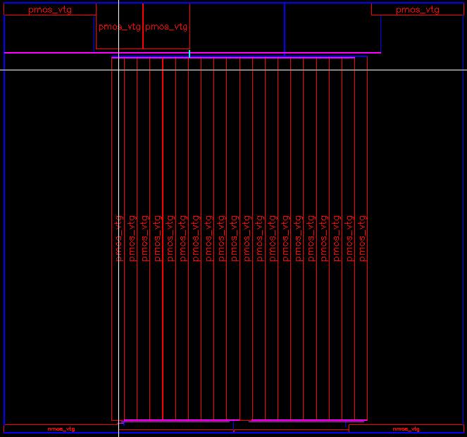
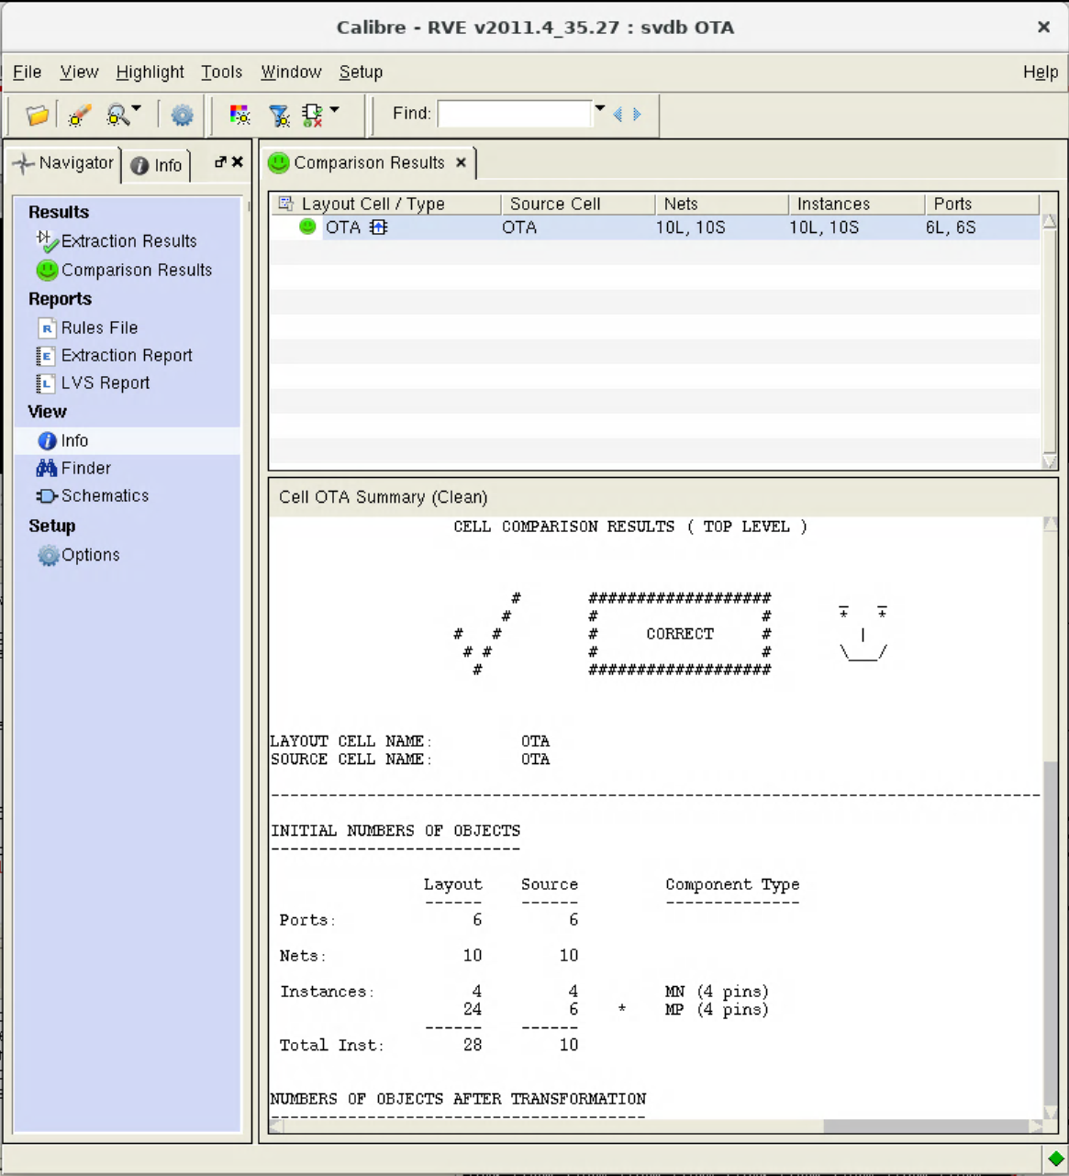
Layout
Notes:
We draw the layout using the 45nm technology library. And it passed both the DRC and LVS checks. Because the M1 and M2 are very large and we have to use muplitier like 10 PMOS in parallel as one single wide transistor. However, the layout drawing is not very compact and it can be further optimized. Then we measured the important parameters of this circuit and show the results.

Slide 15
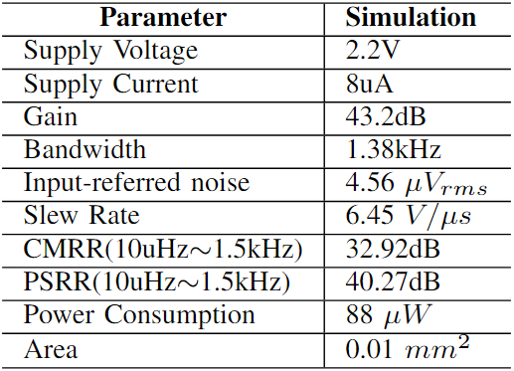
Layout
Notes:
The table here is the measured parameters from our design. Including Slew Rate, input-referred noise and the CMRR, PSRR value. The slew rate means how fast your amplifier is, and how fast the output signal changes. In the biosignal applications, the signals are usually at low frequencies and low amplitude. Hence, I think the value is good and not our main concern.

Slide 16
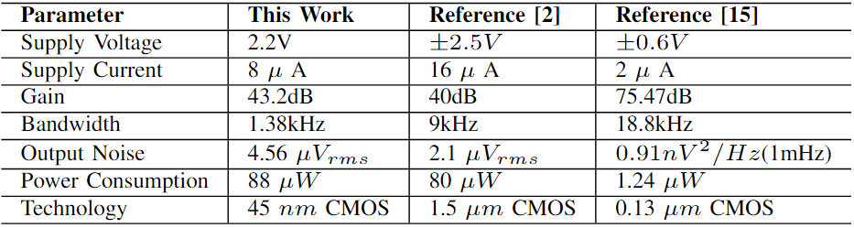
Conclusions
[2] Reid R Harrison and Cameron Charles. A low-power low-noise cmos amplifier for neural recording applications. IEEE Journal of solid-state circuits, 38(6):958–965, 2003.
[15] Dalila Salhi and Balwant Godara. A 75dB-gain low-power, low-noise amplifier for low-frequency bio-signal recording. In 2010 Fifth IEEE International Symposium on Electronic Design, Test & Applications, pages 51–53. IEEE, 2010.
Notes:
This table compares our design with other published works. As you can see, we met the requirements in terms of low power consumption, low supply current. And it realized effective amplification to the low frequency signals.

Slide 17
Thank You! KuangzhengZhang2023@u.northwestern.edu JingminZhao2022@u.northwestern.edu

