Slide 1
Cryptocurrency Price Prediction
EE475 Project
Kuangzheng Zhang
Jingmin Zhao

Slide 2
Introduction

Slide 3
Cryptocurrency
With the primary motivation to define a trustworthy exchange currency used as peer-to-peer electronic cash systems, the cryptocurrency attracted criticism from the economists and supervision regulations but attracted worldwide investors with rapidly growing market capitalization. The cryptocurrency consisting of binary data has the most attractive property of decentralization to secure the transaction records and verify the transfer of ownership, without any physical form.

Slide 4
Cryptocurrency Price Prediction
With the prices as well as the market size of cryptocurrencies increasing substantially, people are considering them as investment options such as Bitcoin which leads to the study in providing good predictions considering its trading markets. By extracting the structure and dimensional features from different data modeling methods, machine learning techniques are able to deliver acceptable timely prediction results with optimized investment strategy.

Slide 5
Dataset

Slide 6
From Nasdaq
Bitcoin Market Price USD
ETH/USD Exchange Rate
Bitcoin Total Transaction Fees USD
Bitcoin Cost Per Transaction
Bitcoin Number of Transactions
Bitcoin Number of Transaction per Block
Bitcoin Average Block Size
Bitcoin Number of Unique Bitcoin Addresses Used
Bitcoin Hash Rate
Bitcoin Difficulty
NASDAQ Composite (COMP)

Slide 7
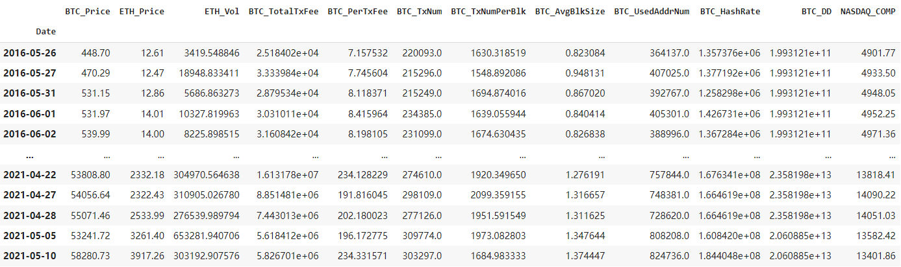
Combined Dataset

Slide 8
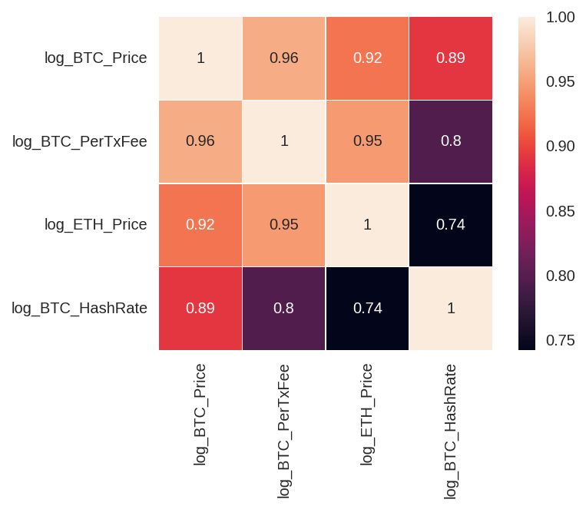
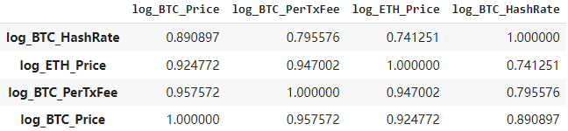
Feature Selection
Pairwise Relationships:

Slide 9
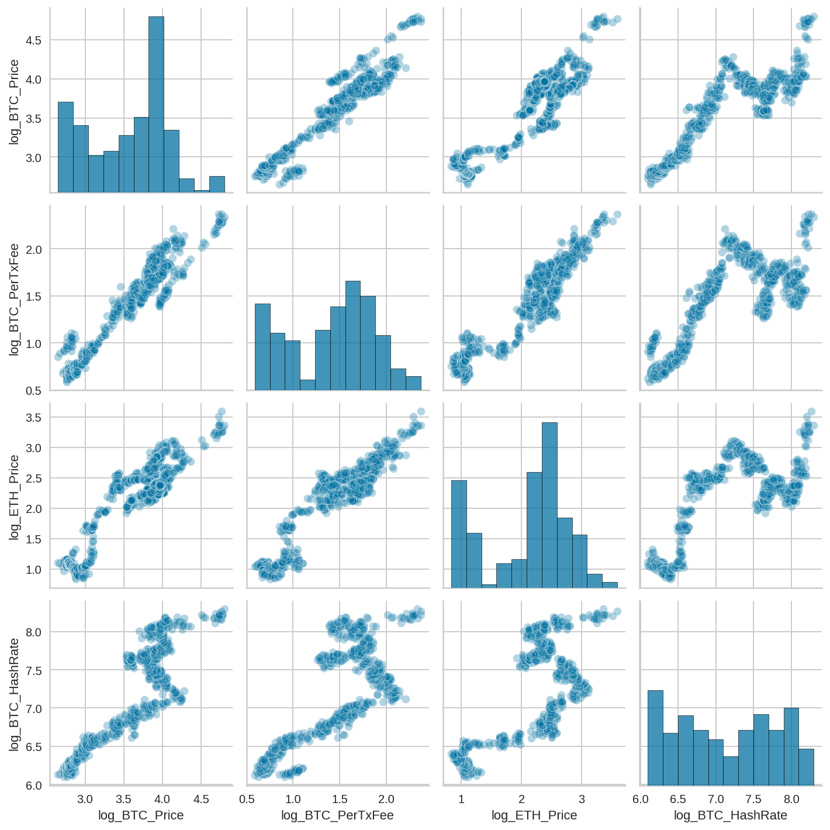
Feature Selection
Correlation Matrix:

Slide 10
Model Building

Slide 11
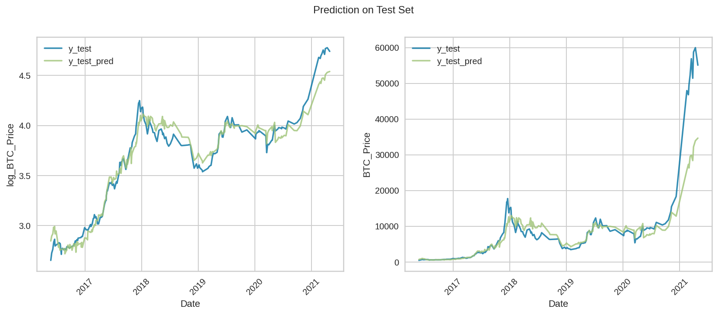
Linear Regression
Ordinary least squares

Slide 12
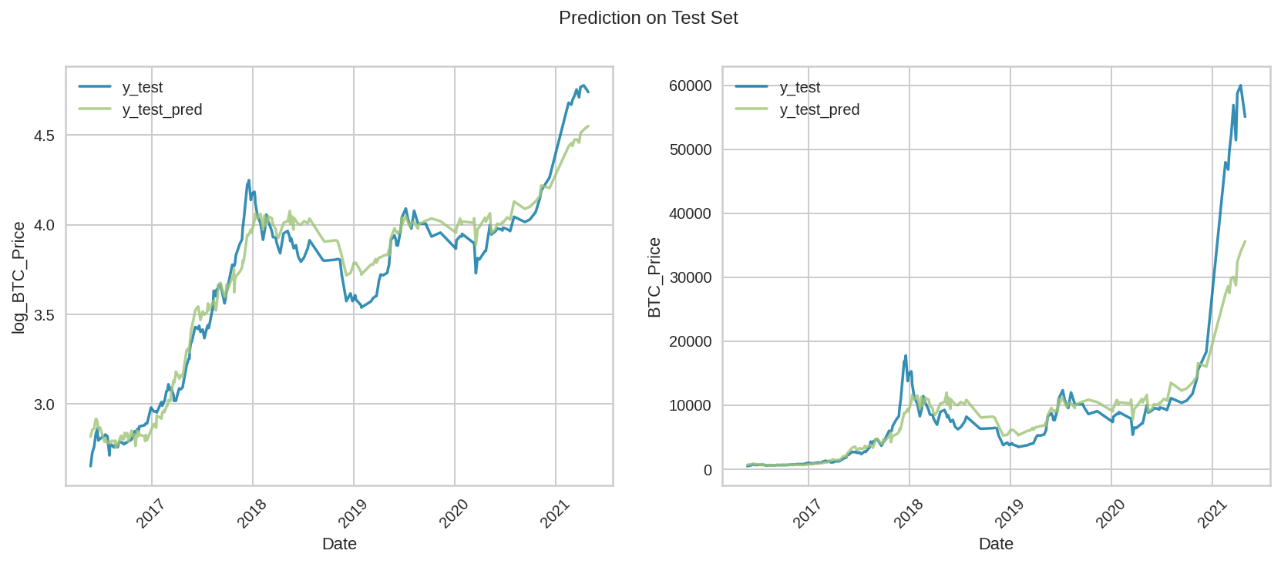
SGD
Linear model fitted by minimizing a regularized empirical loss with SGD.

Slide 13
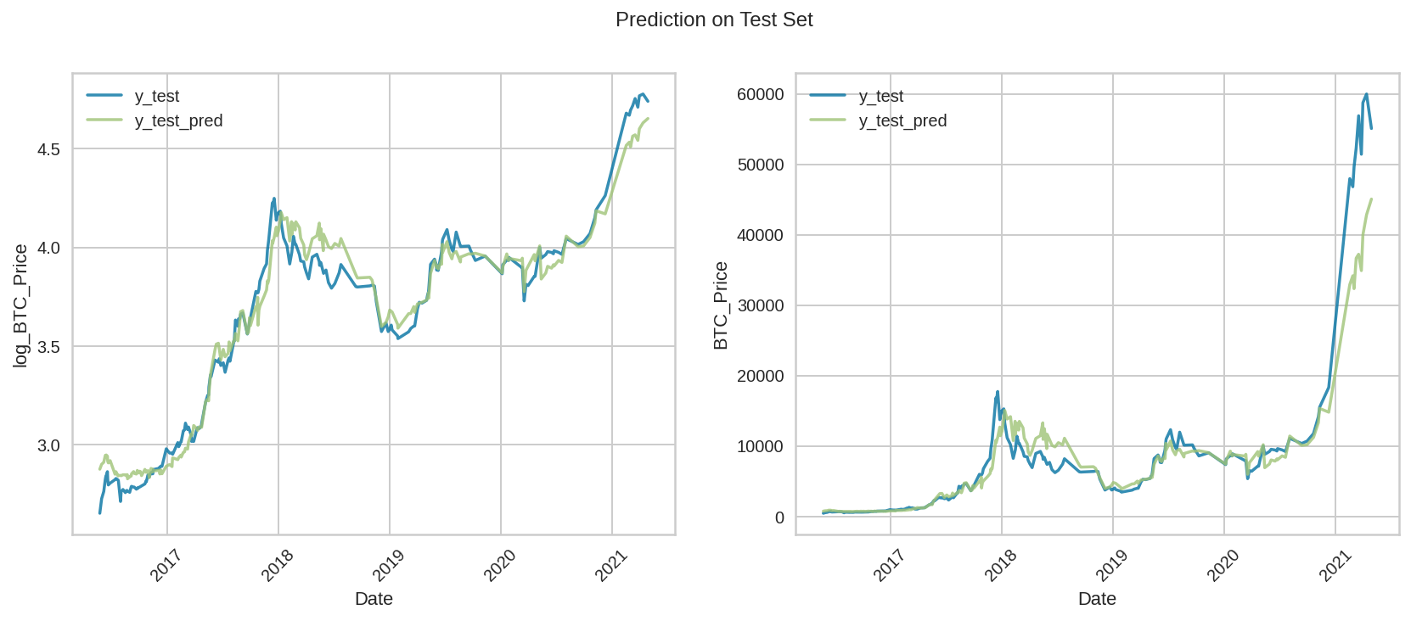
SVM using RBF kernel

Slide 14
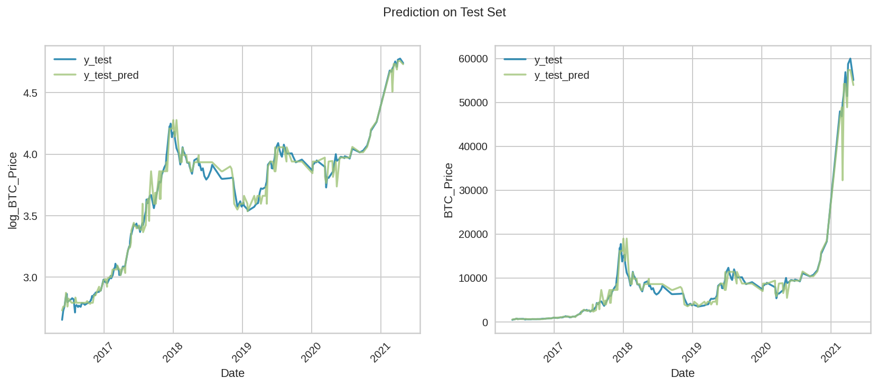
Decision Tree

Slide 15
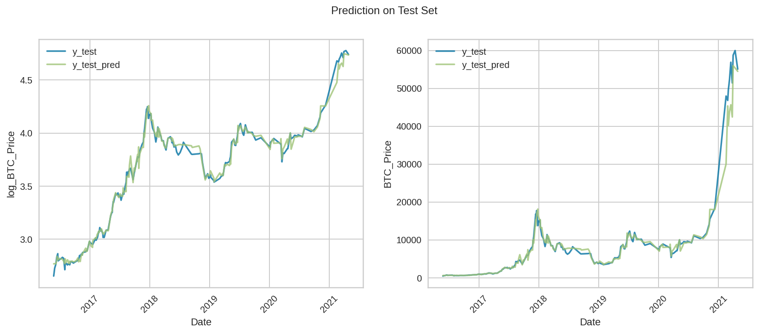
Random Forest

Slide 16
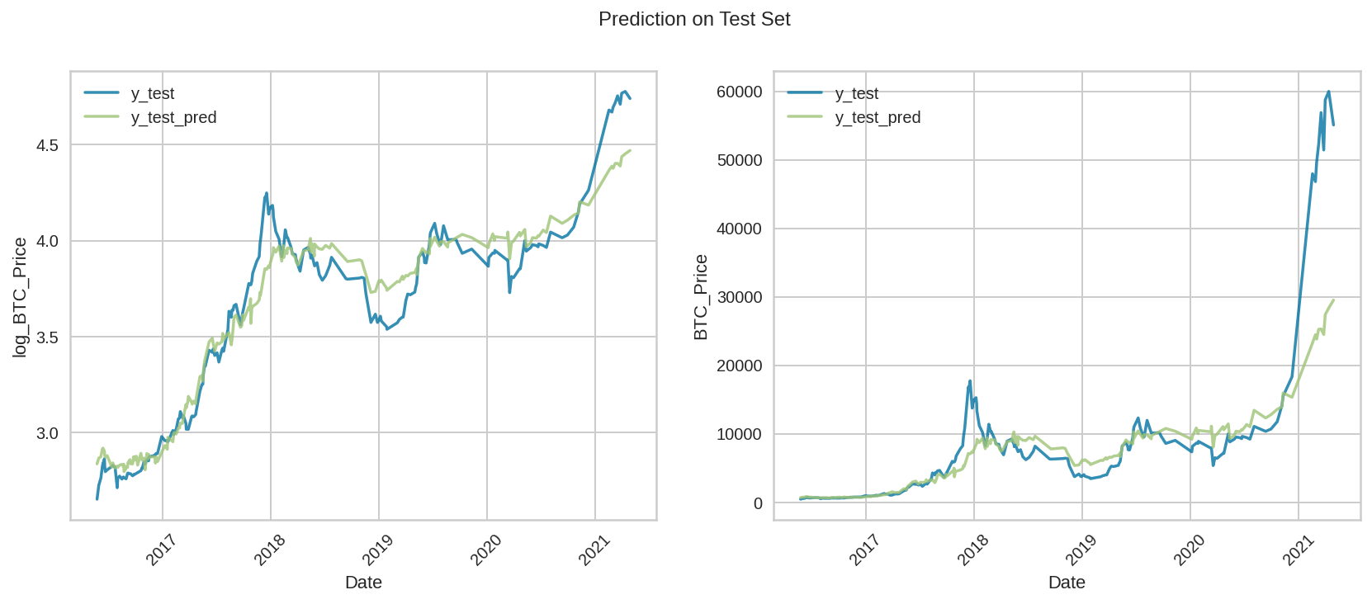
Neural Network

Slide 17
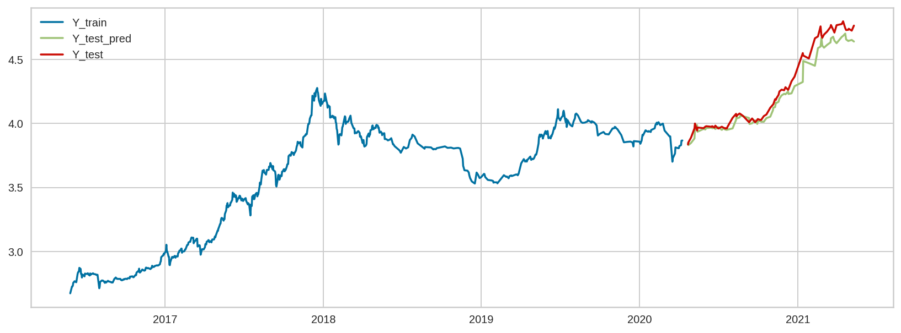
LSTM

Slide 18
Model Evaluation

Slide 19
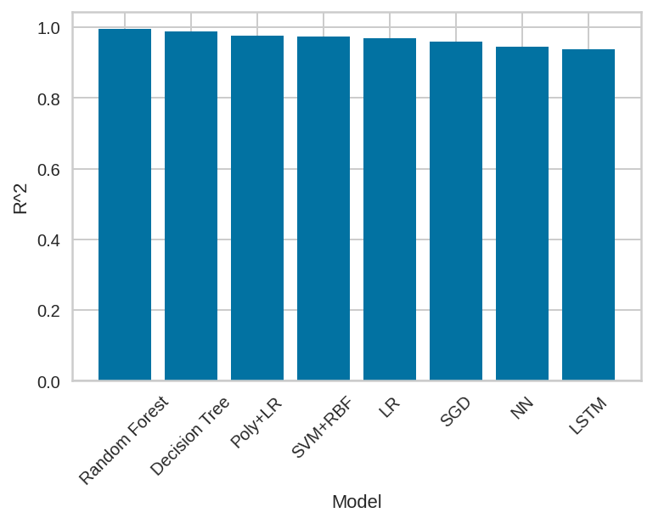
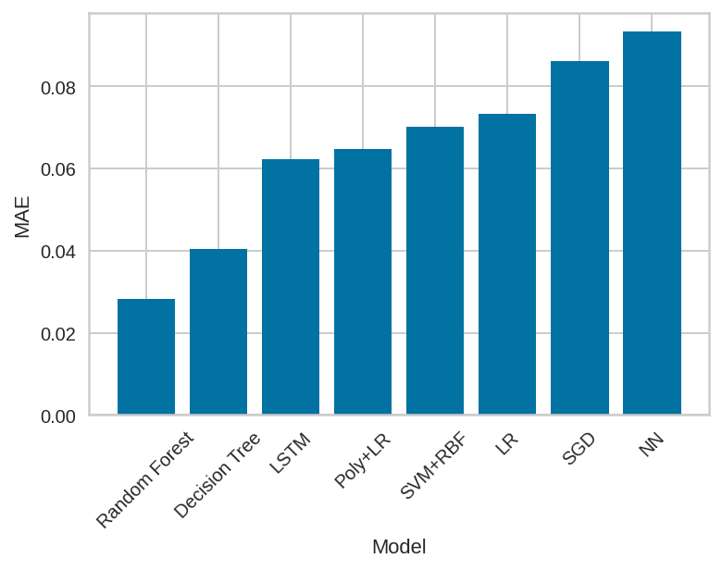
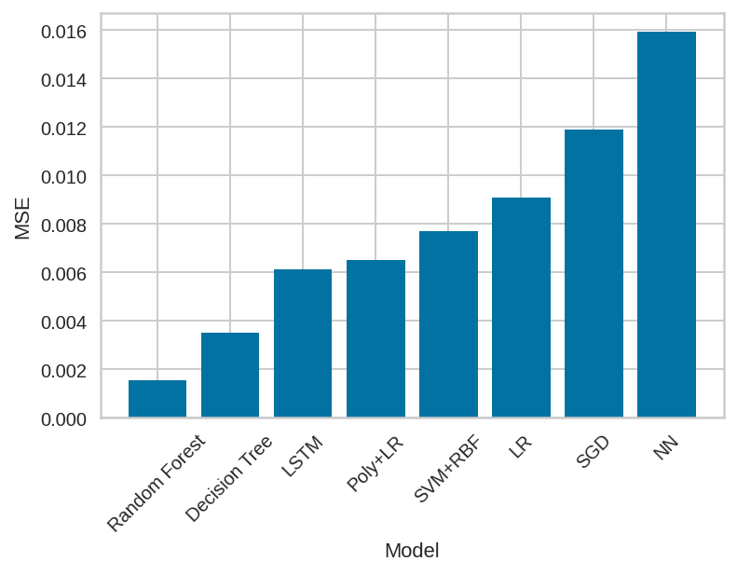
Model Evaluation

Slide 20
Thank You! KuangzhengZhang2023@u.northwestern.edu JingminZhao2022@u.northwestern.edu

