Slide 1
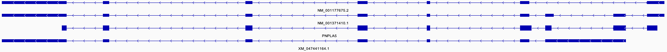
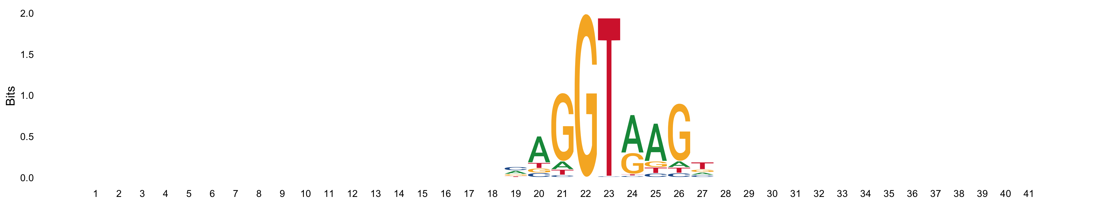
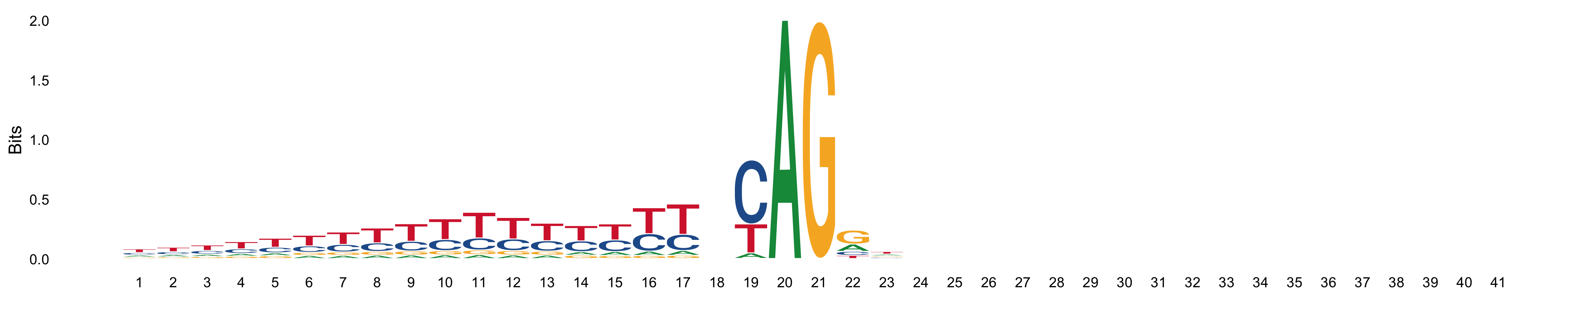

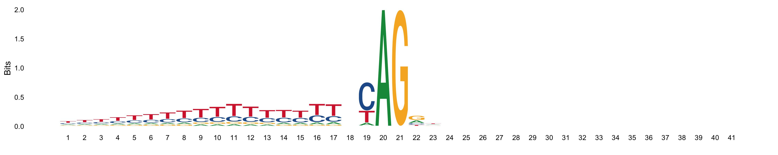
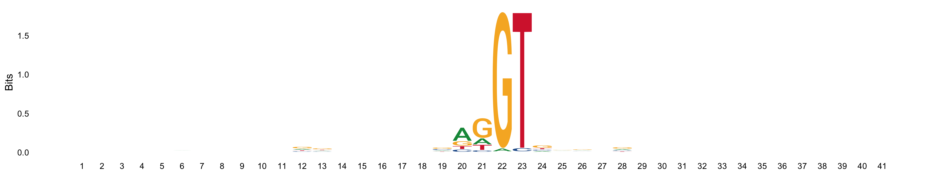
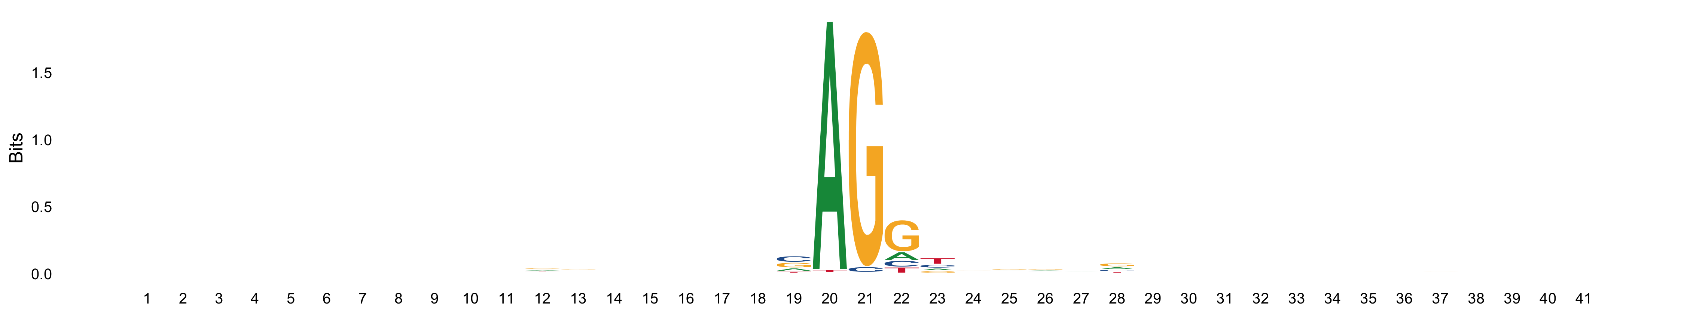
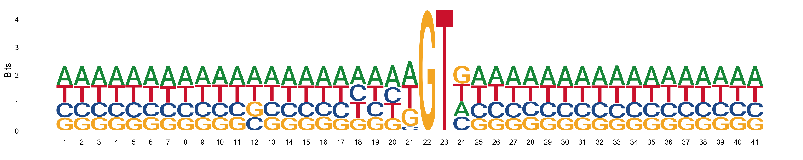
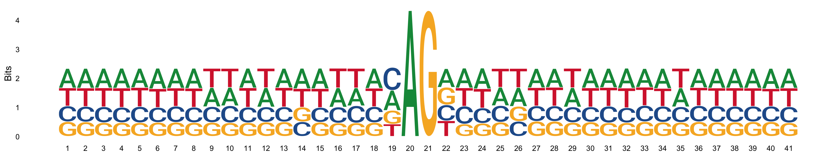
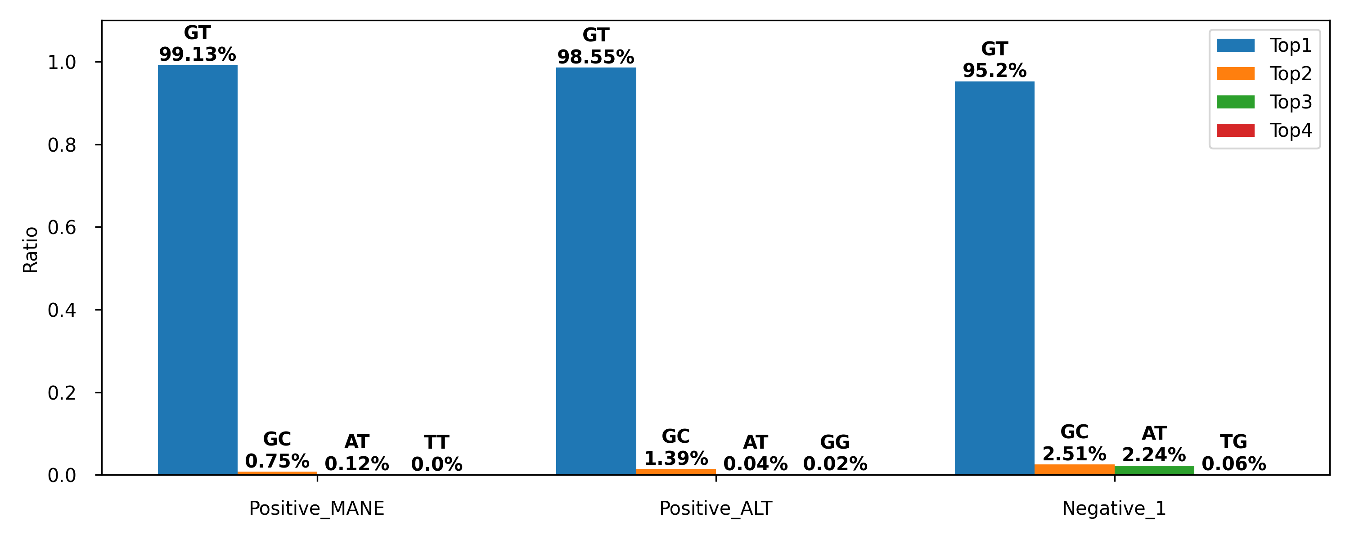
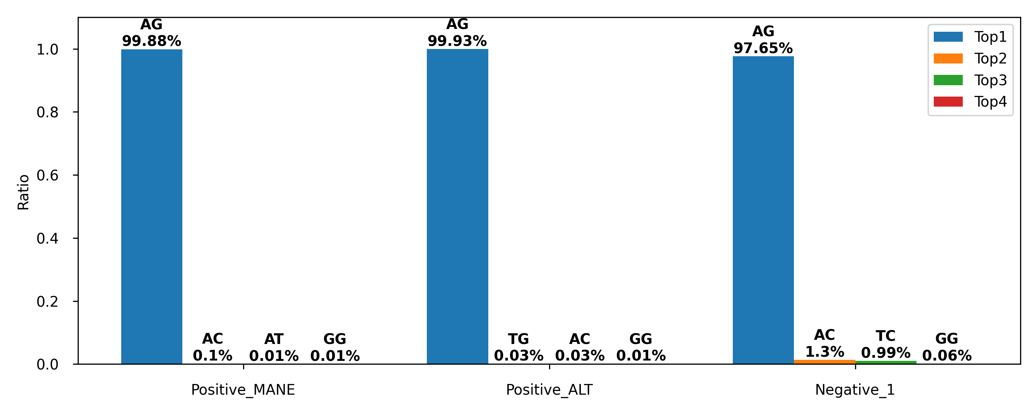
a
Positive_MANE
Positive_ALT
Negative_1
Negative_Random
PNPLA5
MANE
< < < < < < < <
< < < < < <
RefSeq
alternate
< < < < < < < < < <
< < < < <
> > > > >
> > > > > > > > > >
> > >
> > >
b
Donor
Acceptor
Positive_MANE
Positive_ALT
Negative_1
Negative_Random
c
Donor
Acceptor

