Slide 1
Conv(64, 1, 1)
+
Conv(64, 1, 1)
+
Conv(64, 1, 1)
+
Conv(64, 1, 1)
+
Conv(64, 1, 1)
+
Conv(64, 1, 1)
RB(N, W, D)
Input
Conv(N, W, D)
Cardinality = 16
Conv(64, 1, 1)
Batch Norm
ReLU
RB(64, 11, 1)
RB(64, 11, 5)
RB(64, 11, 10)
RB(64, 21, 15)
RB(64, 21, 20)
Conv(3, 1, 1)
Conv(N, W, D)
Cardinality = 16
RB(64, 11, 1)
RB(64, 11, 5)
RB(64, 11, 10)
RB(64, 21, 15)
RB(64, 21, 20)
Batch Norm
RB(64, 11, 1)
RB(64, 11, 5)
RB(64, 11, 10)
RB(64, 21, 15)
RB(64, 21, 20)
Softmax
ReLU
RB(64, 11, 1)
RB(64, 11, 5)
RB(64, 11, 10)
RB(64, 21, 15)
RB(64, 21, 20)
Output

Slide 2
Input
+
+
+
+
Forward connection
Conv(64, 1, 1)
Residual connection
Conv(64, 1, 1)
Conv(64, 1, 1)
Conv(64, 1, 1)
RU(N, W, D)
RU(64, 11, 1)
RU(64, 11, 10)
RU(64, 21, 20)
RU(64, 11, 1)
RU(64, 11, 10)
RU(64, 21, 20)
Conv(N, W, D)
group = 4
RU(64, 11, 1)
RU(64, 11, 10)
RU(64, 21, 20)
Batch Norm
RU(64, 11, 1)
RU(64, 11, 10)
RU(64, 21, 20)
ReLU
Conv(64, 1, 1)
Conv(64, 1, 1)
Conv(64, 1, 1)
Conv(N, W, D)
group = 4
RU(64, 11, 5)
RU(64, 21, 15)
Conv(3, 1, 1)
Batch Norm
RU(64, 11, 5)
RU(64, 21, 15)
RU(64, 11, 5)
RU(64, 21, 15)
Softmax
ReLU
RU(64, 11, 5)
RU(64, 21, 15)
Output

Slide 3
Conv(64, 1, 1)
+
Conv(64, 1, 1)
+
Conv(64, 1, 1)
+
Conv(64, 1, 1)
+
Conv(64, 1, 1)
RB(N, W, D)
Input
Conv(N, W, D)
Cardinality = 16
Conv(64, 1, 1)
Batch Norm
ReLU
RB(64, 11, 1)
RB(64, 11, 5)
RB(64, 21, 15)
RB(64, 21, 20)
Conv(3, 1, 1)
Conv(N, W, D)
Cardinality = 16
RB(64, 11, 1)
RB(64, 11, 5)
RB(64, 21, 15)
RB(64, 21, 20)
Batch Norm
RB(64, 11, 1)
RB(64, 11, 5)
RB(64, 21, 15)
RB(64, 21, 20)
Softmax
ReLU
RB(64, 11, 1)
RB(64, 11, 5)
RB(64, 21, 15)
RB(64, 21, 20)
Output
+
Conv(64, 1, 1)
RB(64, 11, 10)
RB(64, 11, 10)
RB(64, 11, 10)
RB(64, 11, 10)

Slide 4
+
+
Conv(64, 1, 1)
+
Conv(64, 1, 1)
+
Conv(64, 1, 1)
+
Conv(64, 1, 1)
RB(N, W, D)
Input
Conv(N, W, D)
Cardinality = 16
Conv(64, 1, 1)
Conv(64, 1, 1)
Batch Norm
ReLU
RB(64, 11, 1)
RB(64, 11, 10)
RB(64, 21, 15)
RB(64, 21, 20)
Conv(3, 1, 1)
Conv(N, W, D)
Cardinality = 16
RB(64, 11, 1)
RB(64, 11, 10)
RB(64, 21, 15)
RB(64, 21, 20)
Batch Norm
RB(64, 11, 1)
RB(64, 11, 10)
RB(64, 21, 15)
RB(64, 21, 20)
Softmax
ReLU
RB(64, 11, 1)
RB(64, 11, 10)
RB(64, 21, 15)
RB(64, 21, 20)
Output
Conv(64, 1, 1)
RB(64, 11, 5)
RB(64, 11, 5)
RB(64, 11, 5)
RB(64, 11, 5)

Slide 5
Conv(64, 1, 1)
+
Conv(64, 1, 1)
+
Conv(64, 1, 1)
+
Conv(64, 1, 1)
+
Conv(64, 1, 1)
+
Conv(64, 1, 1)
RB(N, W, D)
Input
Conv(N, W, D)
Cardinality = 16
Conv(3, 1, 1)
Conv(64, 1, 1)
Batch Norm
Flattened
ReLU
RB(64, 11, 1)
RB(64, 11, 5)
RB(64, 11, 10)
RB(64, 21, 15)
RB(64, 21, 20)
Fully connected
Conv(N, W, D)
Cardinality = 16
RB(64, 11, 1)
RB(64, 11, 5)
RB(64, 11, 10)
RB(64, 21, 15)
RB(64, 21, 20)
Batch Norm
RB(64, 11, 1)
RB(64, 11, 5)
RB(64, 11, 10)
RB(64, 21, 15)
RB(64, 21, 20)
Sigmoid
ReLU
RB(64, 11, 1)
RB(64, 11, 5)
RB(64, 11, 10)
RB(64, 21, 15)
RB(64, 21, 20)
Output

Slide 6
Conv(64, 1, 1)
+
Conv(64, 1, 1)
+
Conv(64, 1, 1)
+
Conv(64, 1, 1)
+
Conv(64, 1, 1)
+
Conv(64, 1, 1)
RB(N, W, D)
Input
Conv(3, 1, 1)
Conv(N, W, D)
Cardinality = 4
Conv(64, 1, 1)
Flatten layer
Batch Norm
Dropout layer (0.2)
ReLU
RB(64, 11, 1)
RB(64, 11, 5)
RB(64, 11, 10)
RB(64, 21, 15)
RB(64, 21, 20)
Conv(N, W, D)
Cardinality = 4
RB(64, 11, 1)
RB(64, 11, 5)
RB(64, 11, 10)
RB(64, 21, 15)
RB(64, 21, 20)
FC layer (2400, 1)
Batch Norm
RB(64, 11, 1)
RB(64, 11, 5)
RB(64, 11, 10)
RB(64, 21, 15)
RB(64, 21, 20)
Sigmoid
ReLU
RB(64, 11, 1)
RB(64, 11, 5)
RB(64, 11, 10)
RB(64, 21, 15)
RB(64, 21, 20)
Output

Slide 7
BAM
(Raw alignments)
SPLAM!
spliced alignments
Non-spliced alignments
All junctions
SPLAM! - CNN
Spurious spliced alignment filtration
Having any bad junctions?
Good junctions
Bad junctions
No
Yes
BAM
BAM
(Discarded alignments)
(Cleaned alignments)

Slide 8
A
B
Donor
Acceptor
Input
SPLAM
+
+
+
+
Forward connection
Conv(64, 1, 1)
Residual connection
200
200
200
200
Input sequence
Conv(64, 1, 1)
Conv(64, 1, 1)
Conv(64, 1, 1)
RU(N, W, D)
output
RU(64, 11, 1)
RU(64, 11, 10)
RU(64, 21, 20)
SpliceAI-10k
RU(64, 11, 1)
RU(64, 11, 10)
RU(64, 21, 20)
Conv(N, W, D)
group = 4
5000
200
N: intron length
200
5000
RU(64, 11, 1)
RU(64, 11, 10)
RU(64, 21, 20)
Batch Norm
Input sequence
RU(64, 11, 1)
RU(64, 11, 10)
RU(64, 21, 20)
ReLU
Conv(64, 1, 1)
Conv(64, 1, 1)
output
Conv(64, 1, 1)
Conv(N, W, D)
group = 4
RU(64, 11, 5)
RU(64, 21, 15)
SpliceAI-10k-Ns
Conv(3, 1, 1)
Batch Norm
RU(64, 11, 5)
RU(64, 21, 15)
5000
200
N: intron length
200
5000
RU(64, 11, 5)
RU(64, 21, 15)
Softmax
ReLU
Input sequence
NNNNN … NNNN
NNNNN … NNNN
RU(64, 11, 5)
RU(64, 21, 15)
Output
output

Slide 9
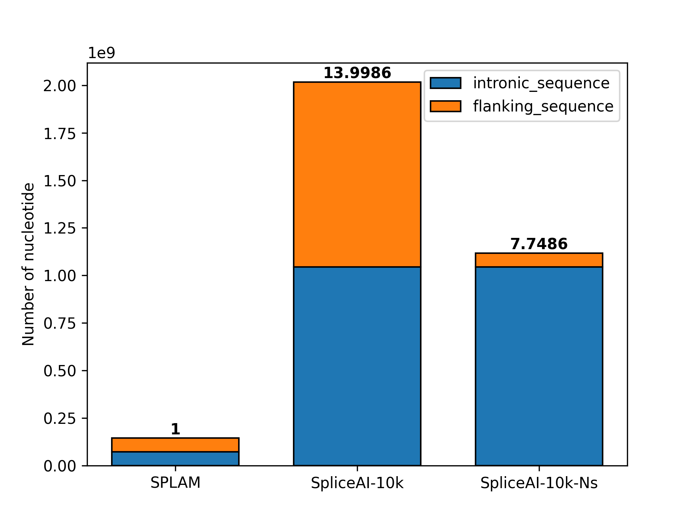
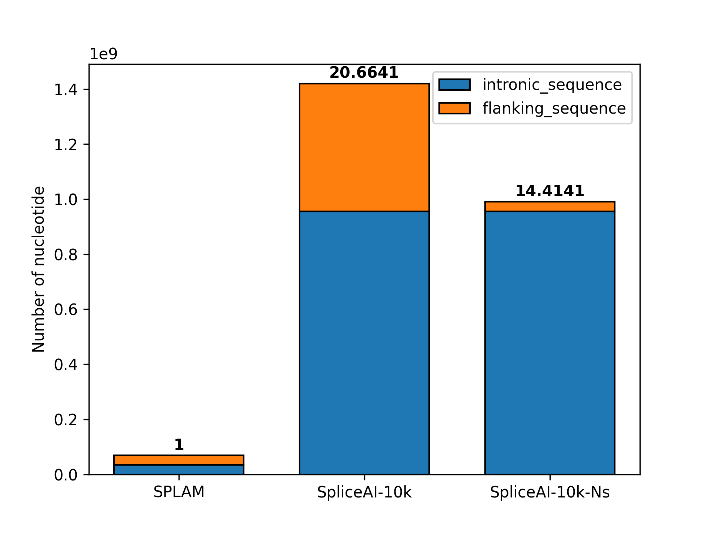
Donor: 400bp
Acceptor: 400bp
Input sequence (len: 800; + )
0
200
600
799
…
…
X
800 * 4
Y
800 * 3
Donor
Acceptor
A
T
A
T
G
….
A
A
T
A
T
SPLAM
C
T
T
N
G
C
G
200
200
200
200
1
0
0
…
…
0
1
0
0
0
….
1
0
1
0
0
1
0
0
0
Input sequence
0
0
0
…
0
…
1
0
0
0
0
….
0
0
0
0
1
0
0
0
0
0
1
…
0
…
0
0
0
0
0
….
0
1
0
0
0
0
0
1
output
…
…
0
1
0
….
0
0
1
1
1
0
0
0
0
1
0
0
1
0
SpliceAI-10k
0
0
0
…
…
0
0
….
0
0
0
0
0
0
0
0
0
0
0
0
N: intron length
200
5000
0
0
0
…
0
…
5000
200
0
0
0
1
0
….
0
0
0
0
0
0
0
0
0
0
0
0
0
…
0
…
Input sequence
0
0
0
….
0
0
1
0
0
0
0
0
output
SpliceAI-10k-Ns
5000
200
N: intron length
200
5000
Input sequence
NNNNN … NNNN
NNNNN … NNNN
output
GT-AG ratio
Base information ratio

