Slide 1
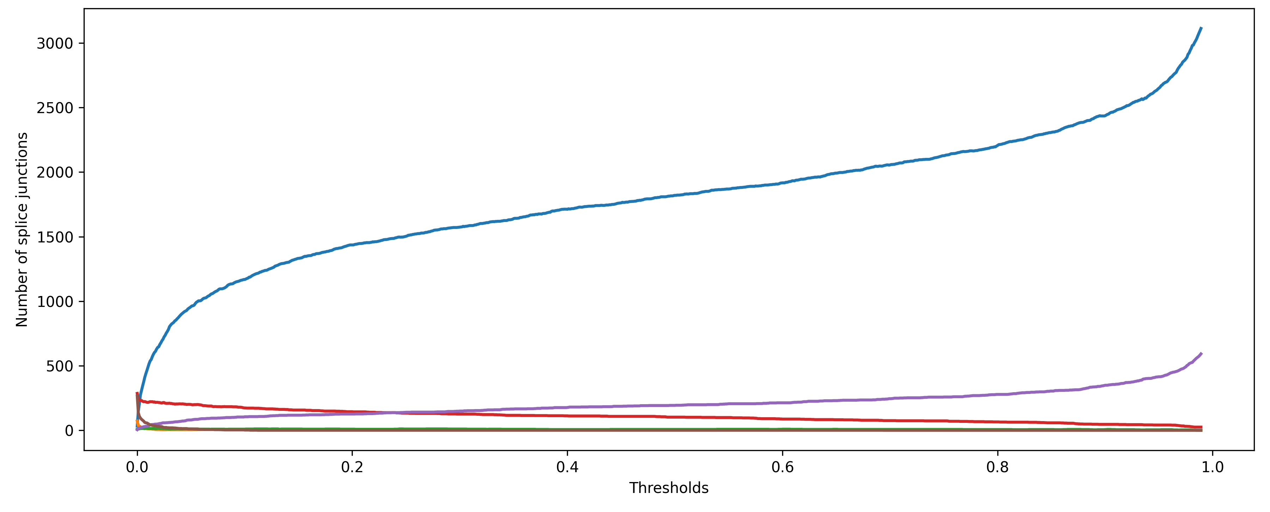
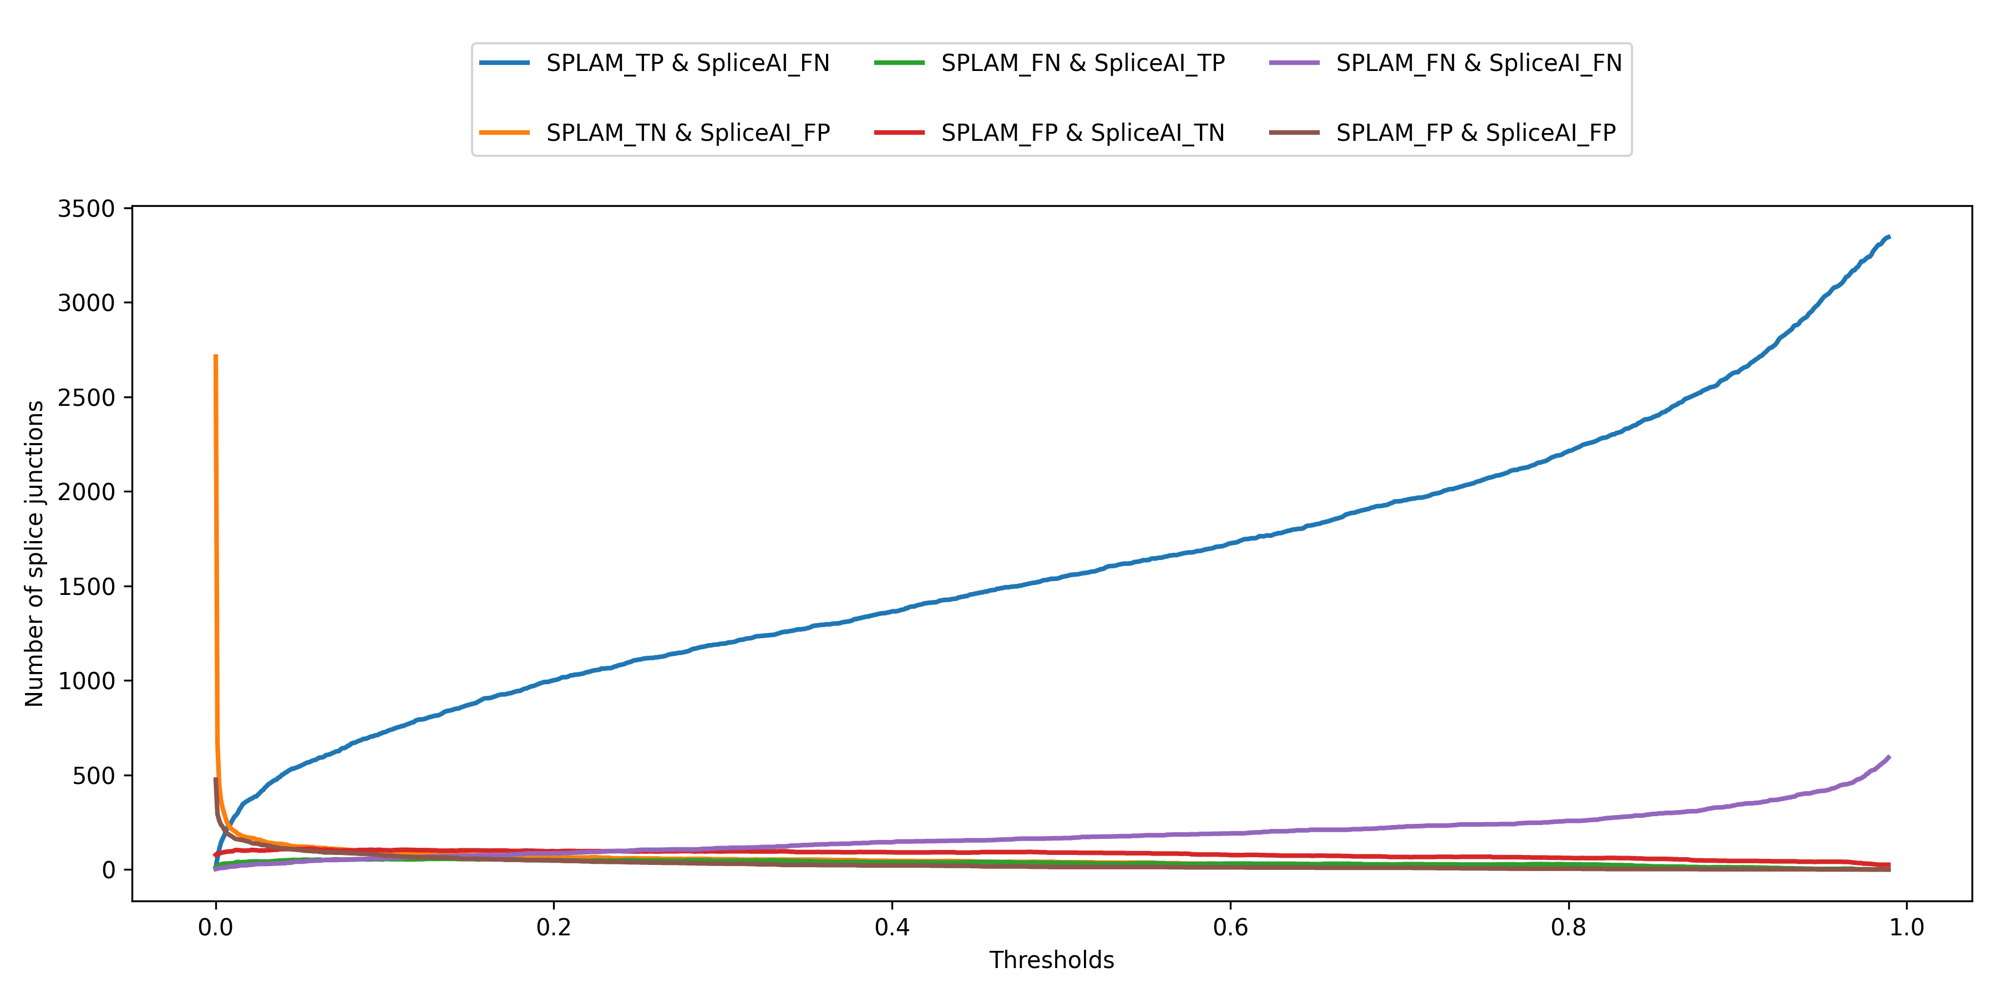
a
SpliceAI-10k
b
SpliceAI-10k-Ns

