Slide 1
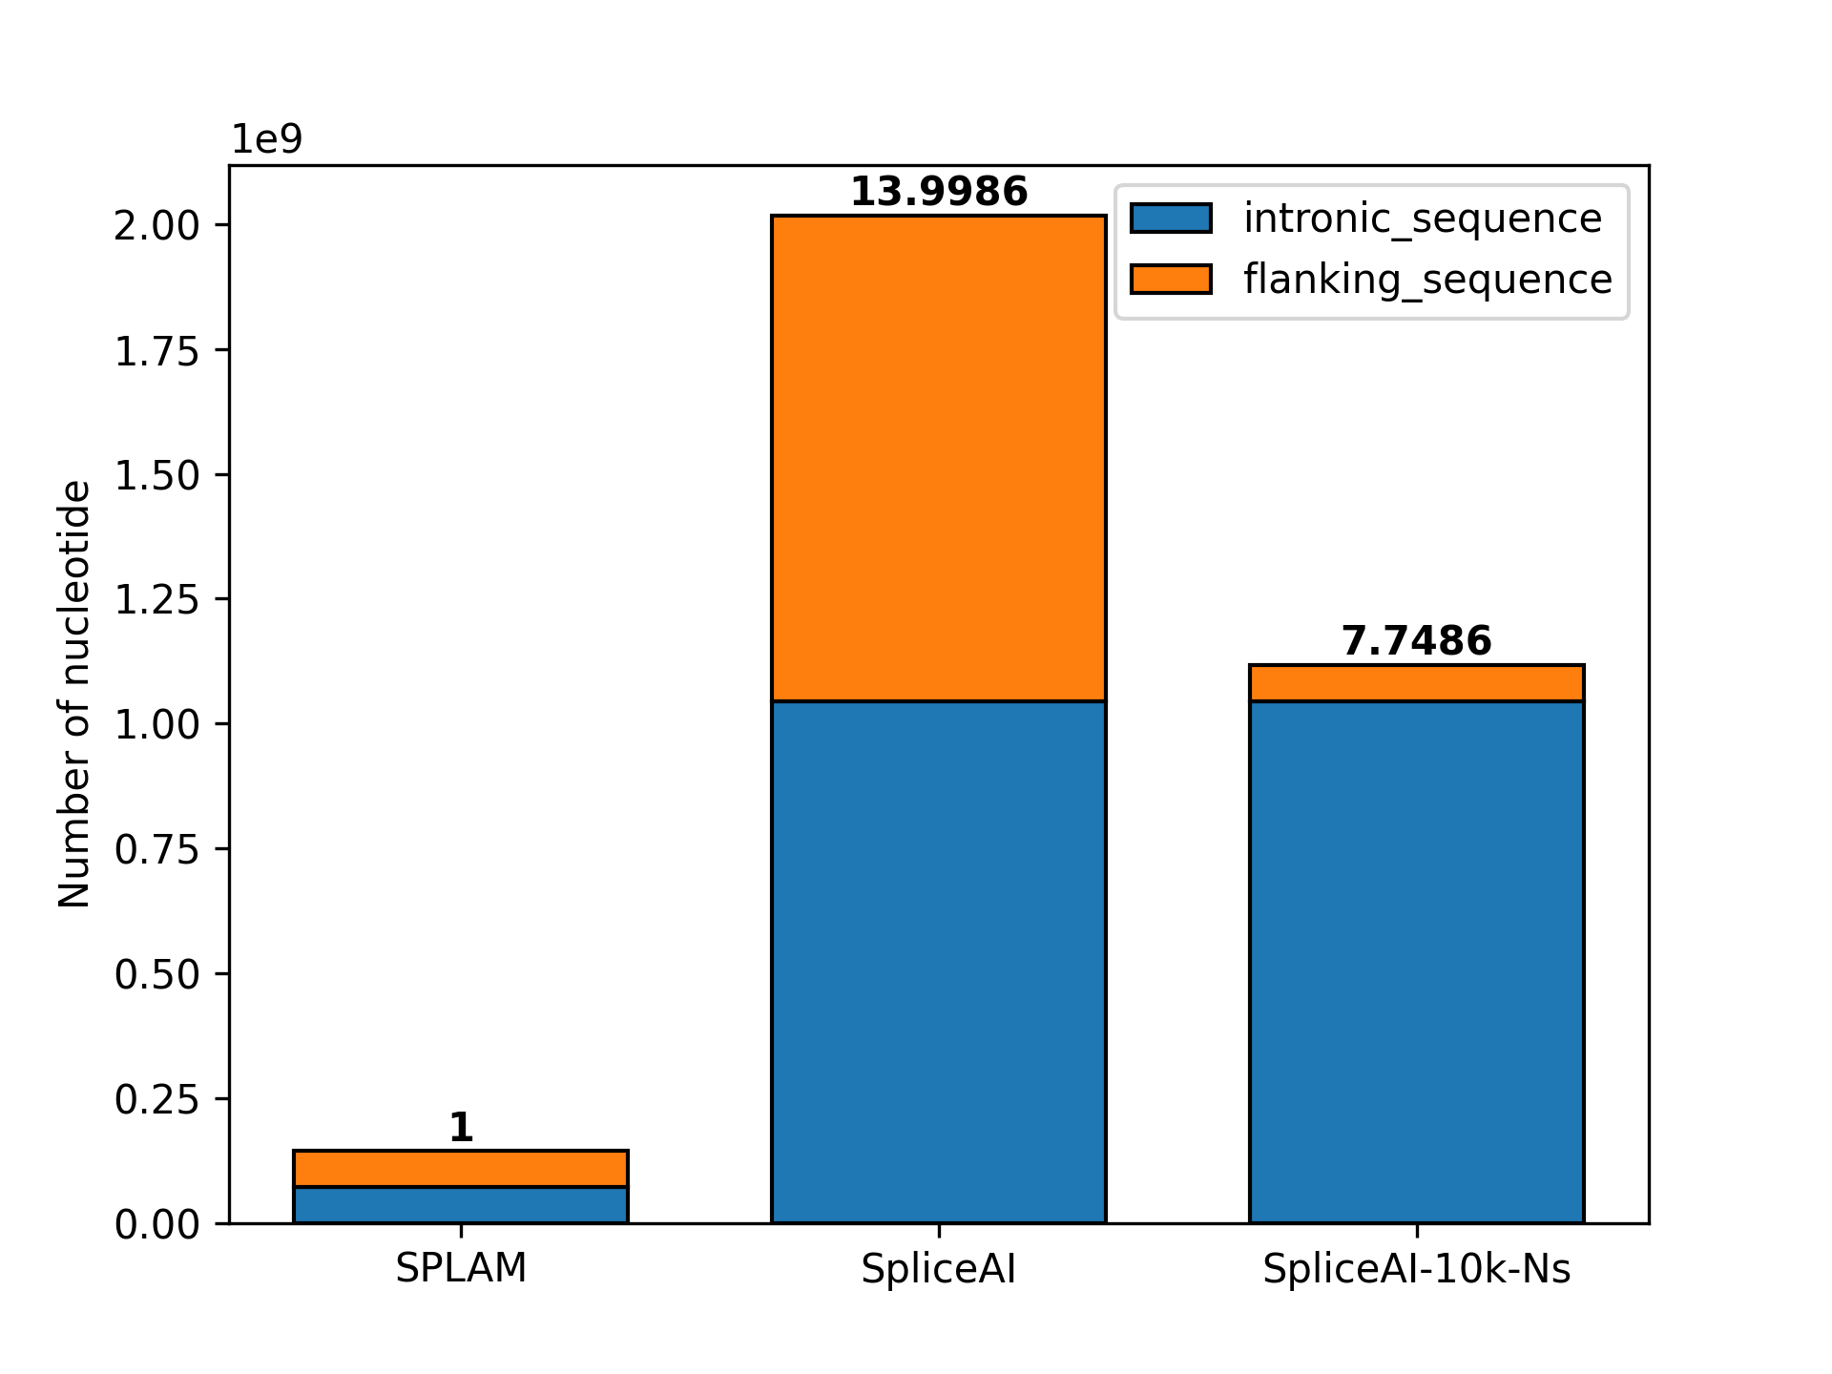
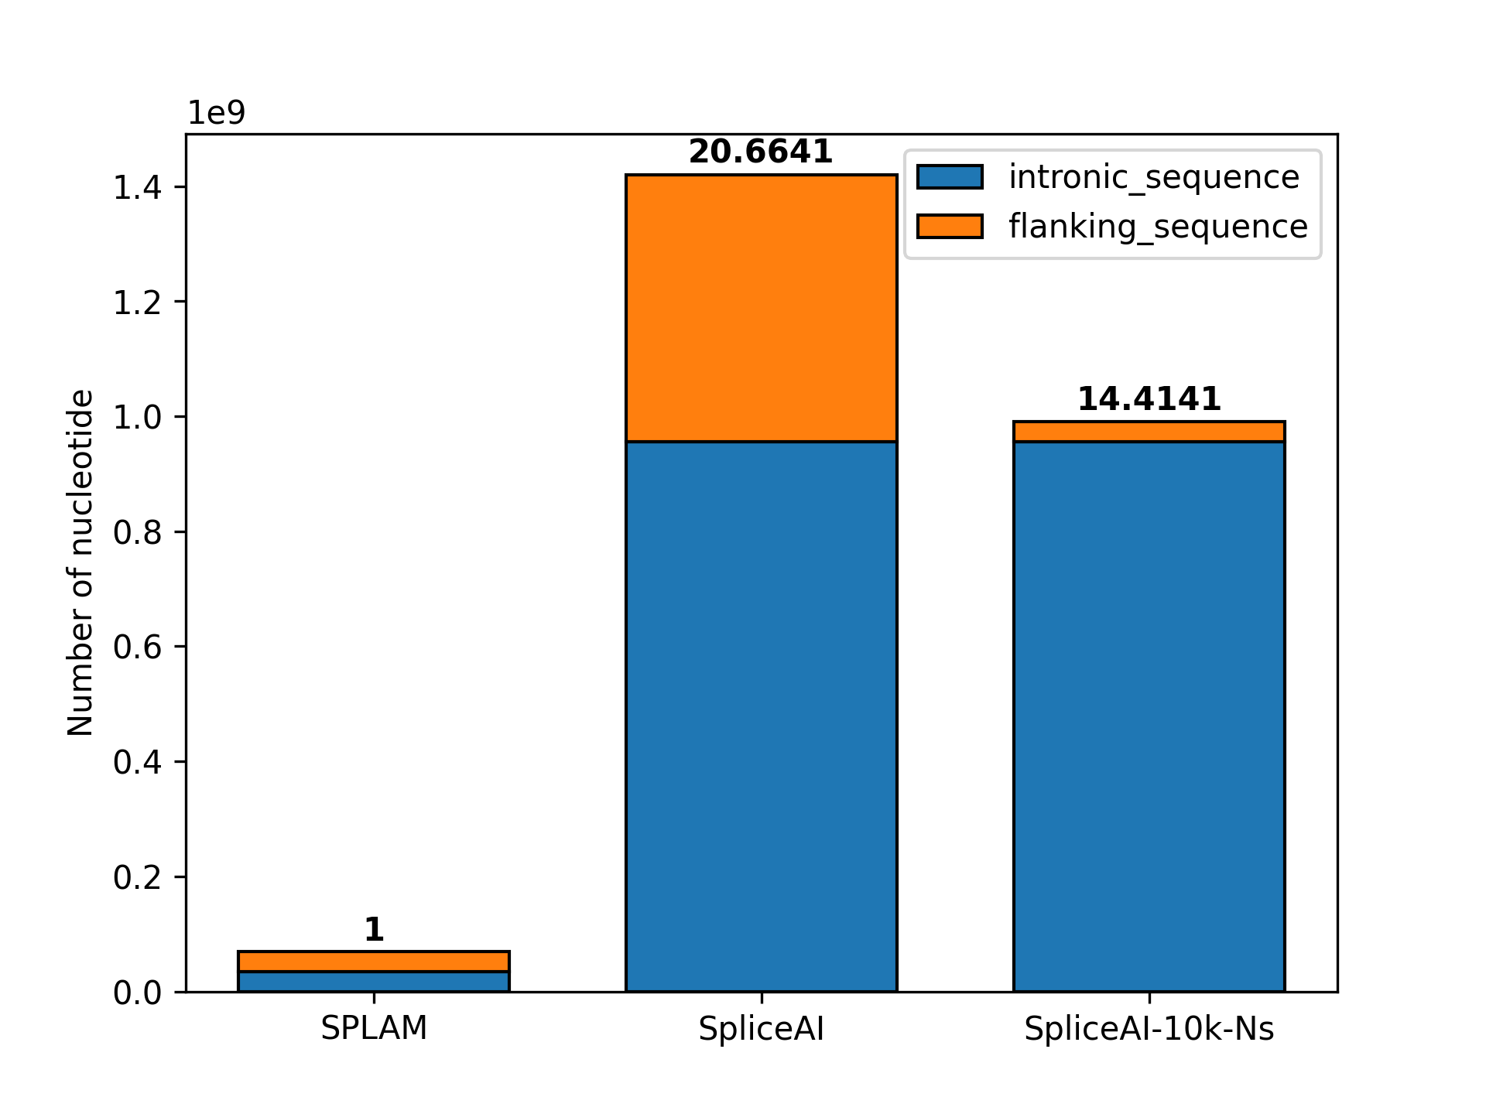
a
b
Donor
Acceptor
Positive_MANE
SPLAM
200
200
200
200
Input sequence
output
SpliceAI
5000
200
N: intron length
200
5000
Input sequence
Positive_ALT
output
SpliceAI-10k-Ns
5000
200
N: intron length
200
5000
Input sequence
NNNNN … NNNN
NNNNN … NNNN
output

