Slide 1
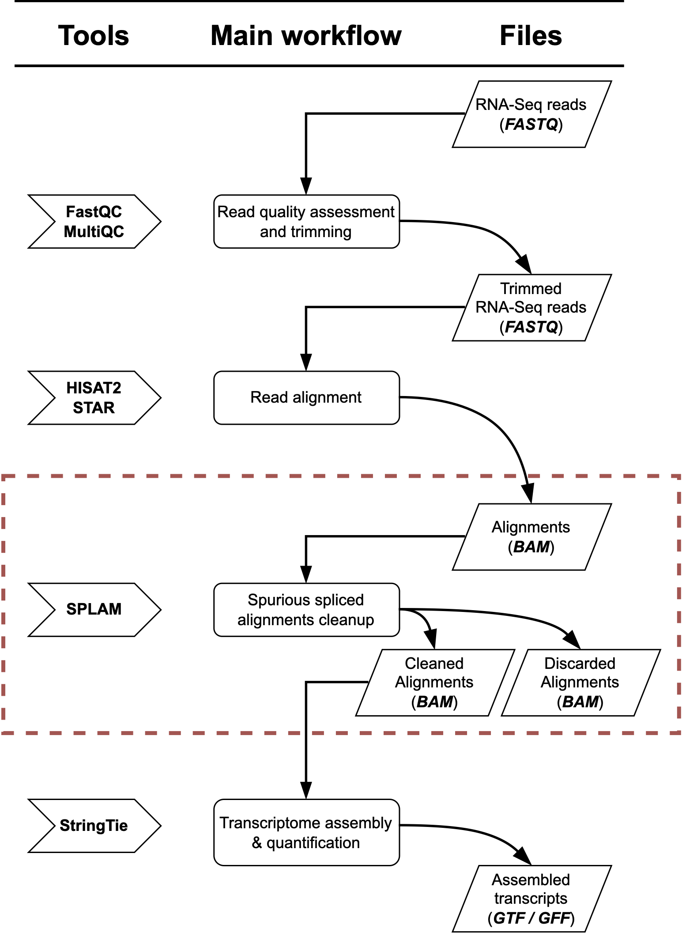
a
b
BAM
(Raw alignments)
SPLAM
spliced alignments
Non-spliced alignments
All junctions
SPLAM
Alignments contain any bad junctions?
No
Good junctions
Bad junctions
Yes
BAM
BAM
(Discarded alignments)
(Cleaned alignments)

