Slide 1
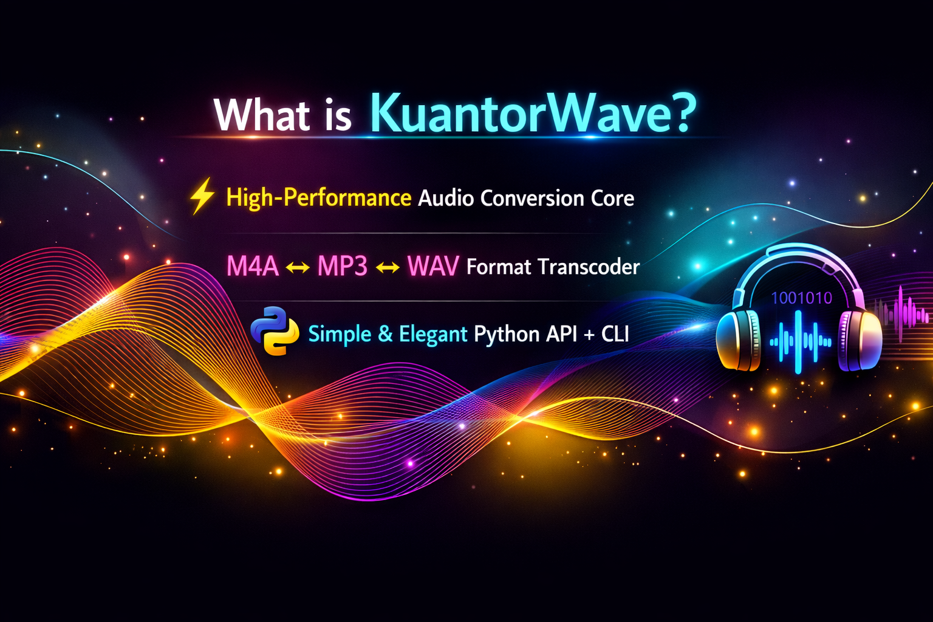

Slide 2
One Project, Three Repositories
kuantorwave_cli
kuantorwave
kw_tests
Python
C
pytest
The face. Pure-Python package:
core_api wrapper + the
kuantorwave CLI command.
The engine. Compiled shared
library: decode, encode, resample,
detect, metadata.
The proof. End-to-end regression
suite exercising CLI + wrapper +
binary together.
Everything difficult lives in the engine. Python never touches codec internals — it orchestrates eleven C functions behind one stable header.
All work is tracked as GitHub issues under the “Core Implementation Phase 1” milestone, linked as sub-issues of kuantorwave#1.

Slide 3
Why C for the Core — Not Pure Python?
44,100
samples per second, per channel,
in CD-quality audio
The codec ecosystem is C.
LAME (MP3), FDK-AAC, FFmpeg, libopus — every production codec is compiled code. Every Python audio library (pydub, librosa, soundfile) is a wrapper over someone's C.
“Audio in Python” always means Python steering C — the only question is whose C it is.
~16 million
samples in one three-minute song —
each crunched through MDCTs and
filter banks
The honest caveat.
Just converting files? 20 lines of Python around ffmpeg. KuantorWave exists to own the engine: full pipeline control, no external process, an embeddable C API.
50–100×
slower: interpreted Python in tight
numeric loops vs compiled C

Slide 4
Architecture: Everything Pivots on PCM
PCM
buffer
input
file
format
detection
decoder
resampler
(optional)
encoder
output
file
Every decoder produces a PCM buffer; every encoder consumes one. No codec ever talks to another codec.
N + M, not N × M.
Supporting a new format means one decoder or one encoder — never a converter per format pair.
One header, eleven functions.
include/kuantorwave.h is the whole contract; Python binds it at runtime with ctypes — no compiler in the install path.

Slide 5
Phase 1 Task Map
Issue | Delivers | Status
#5 | Core architecture: header, module map, ctypes decision | Done · PR #12
#6 | Format detection from magic bytes | Done · PR #13
#7 | PCM buffer subsystem — the pivot type | Next up
#8 | Decoder: AAC (M4A), MP3, WAV → PCM | To do
#9 | Encoder: PCM → MP3, AAC (M4A) | To do
#10 | Resampler: 44.1 kHz ↔ 48 kHz | To do
#11 | Metadata: duration, bitrate, rate, channels | To do
cli#1 | Python wrapper: core_api via ctypes | To do
cli#2 | CLI: kuantorwave convert / metadata | To do
kw_tests#1 | End-to-end regression suite | To do
#14 · #16 | Tutorial document · this deck | Done · Now

Slide 6
The Build Story: Contract First, Proof Last
1
2
3
4
5
The contract
Eyes & hands
Pipeline organs
Python face
The proof
#5 — merged
#6 ✓ · #7 next
#8 – #11
cli#1 · cli#2
kw_tests#1
Header + architecture
doc + ctypes ADR
Format detection;
PCM pivot type
Decoder, encoder,
resampler, metadata —
in parallel
ctypes wrapper,
then the CLI
Regression suite:
green = Phase 1 done
Why this order? Each stage fixes the contract the next implements against — the header lets the wrapper start before the core is finished, and PCM must exist before any codec can.

Slide 7
Where We Are, and What's Next
Merged
PR #12 — the eleven-function C API, architecture doc, ctypes ADR
PR #13 — format detection module + first CMake build
PR #15 — the project tutorial document
CI green on Linux, Windows, macOS — every push compiles and tests on all three
Next up
#7 PCM buffer — the pivot type with sanitizer-checked memory tests
then #8 decoder + #9 encoder — the first end-to-end kw_convert()
then the Python wrapper, the CLI, and the regression suite
$ kuantorwave convert input.m4a output.mp3
the Phase 1 finish line

