Slide 1
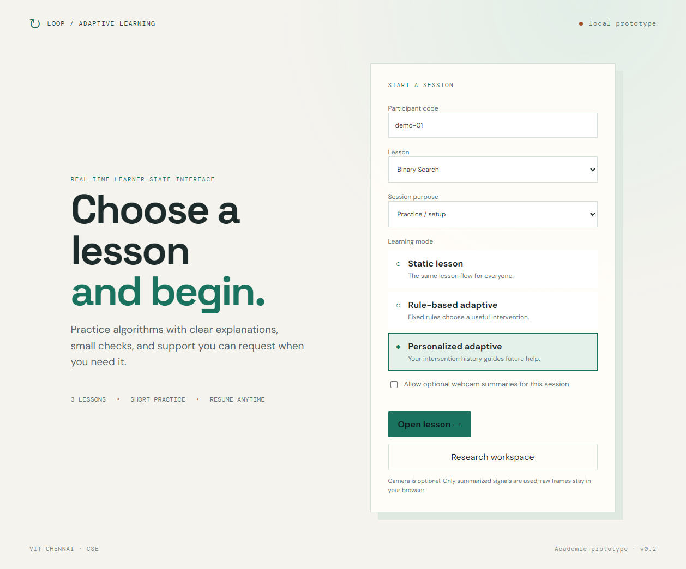
ADAPTIVE LEARNING LOOP
A working closed loop
for algorithm learning
Technical rebuild, browser evidence, and the remaining study handoff
observe
estimate
support
September 2026 · local academic prototype
Notes:
Source: verified local browser evidence in docs/verification.md. The screenshot is an observed application state, not a study result.

Slide 2
PROJECT SCOPE
A small learning study with a complete software loop
Three algorithms, three modes, and a policy that stays explainable.
The learner can
Guardrails
• choose linear search, binary search, or bubble sort
• complete pre-test, instruction, checkpoints, and post-test
• request, accept, dismiss, or skip support
• resume a saved session and inspect its trace
• camera signals describe observable context only
• raw frames and landmarks stay in the browser
• missing camera data remains unavailable
• synthetic and legacy rows stay labelled
• no claim of causal learning improvement
ADAPTIVE LEARNING LOOP · TECHNICAL REBUILD
02
Notes:
Source: original final.pptx scope, README.md, docs/decisions.md, and the interpretation note shown in the app. No emotion classification or comprehension claim is made.

Slide 3
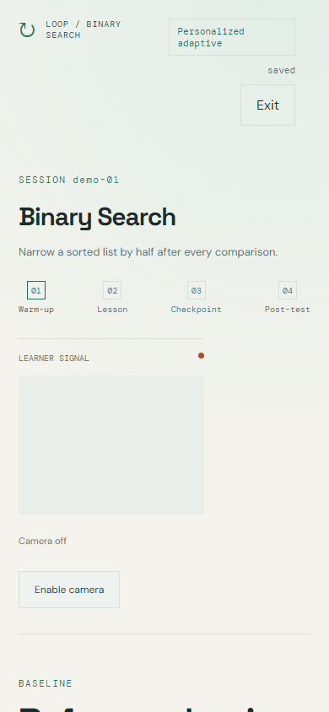
LEARNING WORKSPACE
The product is a lesson, not a landing page
The same instructional content supports static, rule-based, and personalized comparison modes.
Six usable surfaces
Lesson library
Session setup
Learning workspace
Support panel
Results and history
Research workspace
Every surface has explicit loading, saved, unavailable, error, and completed states. A learner can continue without a camera.
ADAPTIVE LEARNING LOOP · TECHNICAL REBUILD
03
Notes:
Screenshot: artifacts/screenshots/latest-lesson.png, captured from the live localhost application at 390×844. The app uses a camera-optional path and keeps the reading workspace usable on narrow screens.

Slide 4
DECISION POLICY
Each support offer has a reason and a measurable follow-up
The system separates learning difficulty, camera context, sensor availability, cooldown, and active support.
OBSERVE
ESTIMATE
OFFER
CHECK
PERSONALIZE
answer, timing, revisit, help request
streaks and configured friction thresholds
simplified, worked example, or practice
two concept-specific follow-ups
completed outcomes by learner and concept
Automatic prompts observe a 90-second cooldown. Explicit help remains available and reuses an active support item.
Selection rule: unseen concept → fixed exploration order → highest smoothed completed score
ADAPTIVE LEARNING LOOP · TECHNICAL REBUILD
04
Notes:
Source: backend/app/main.py decision policy and the acceptance criteria in the rebuild plan. The smoothed score is (sum of completed follow-up correctness + 1) / (completed follow-ups + 2).

Slide 5
ARCHITECTURE
Local sensing, server grading, persistent evidence
The application keeps raw camera material out of API traffic, storage, and exports.
Browser
API
Storage
React + TypeScript + Vite
MediaPipe Face Landmarker worker
Durable event outbox
Camera preview and calibration
FastAPI + typed validation
Server-side answer keys
Idempotent events
Intervention lifecycle
CSV export boundaries
PostgreSQL
(or documented SQLite convenience)
Sessions
Answers
Signals
Supports
Aggregates
Only approved summaries leave the browser. The research export carries provenance and completeness flags, never raw biometric material.
ADAPTIVE LEARNING LOOP · TECHNICAL REBUILD
05
Notes:
Source: README.md, backend/app/db.py, backend/app/main.py, and src/faceWorker.ts. MediaPipe reference: https://developers.google.com/edge/api/mediapipe/js/tasks-vision.facelandmarker

Slide 6
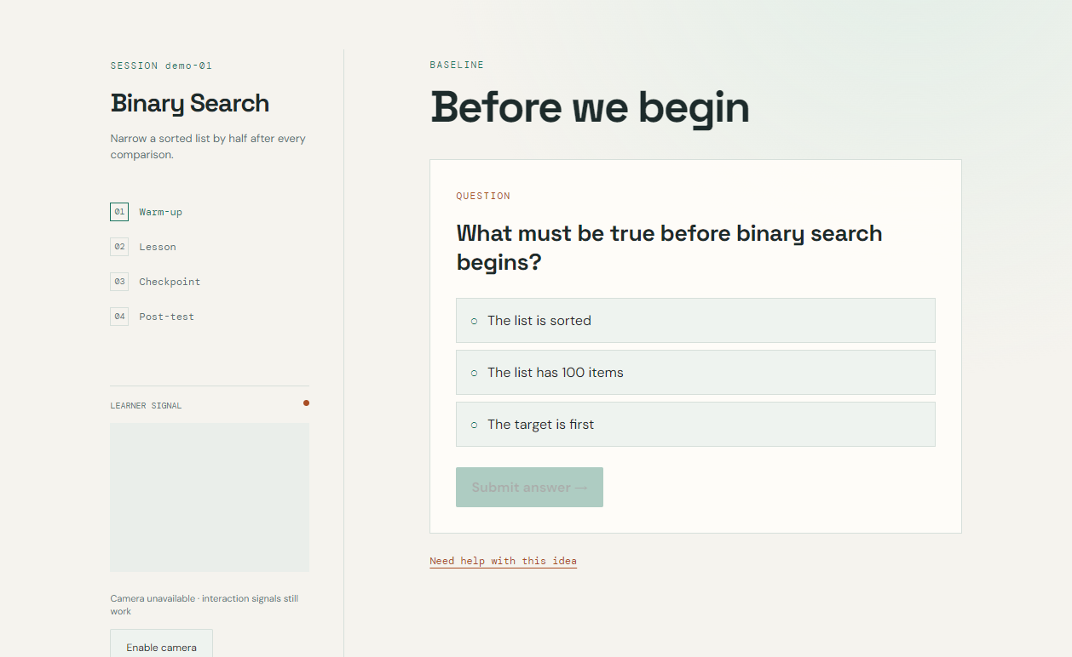
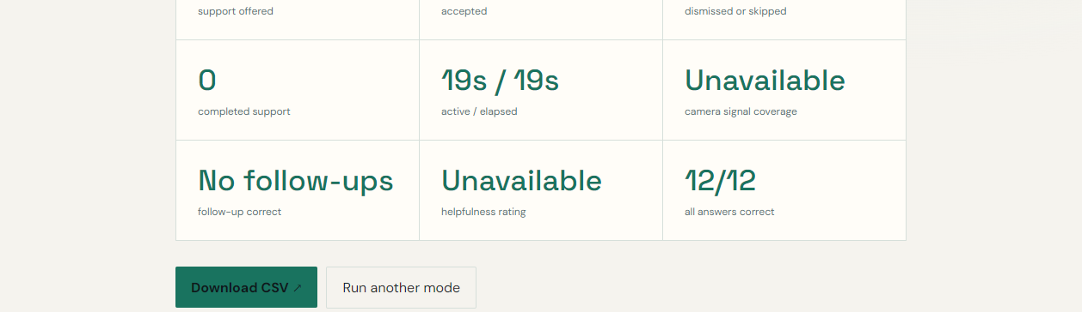
VERIFICATION EVIDENCE
The software loop is exercised end to end
These are technical validation results from the local application. They are not human-study findings.
18
9
0
200
backend tests
lesson/mode flows
axe violations
ready health status
ADAPTIVE LEARNING LOOP · TECHNICAL REBUILD
06
Notes:
Source: docs/verification.md. The nine flows covered linear search, binary search, and bubble sort in static, rule-based, and personalized modes. The camera screenshot shows the unavailable-device path; the results screenshot is a technical practice session and is not a volunteer result.

Slide 7
DEMONSTRATION TRACE
A later choice can use a learner’s completed history
The example below is labelled practice data so it cannot be confused with a measured study.
01
Two wrong checkpoints
The current concept enters the support policy.
02
Simplified support
The learner accepts the first unused support type.
03
Two follow-ups
The server grades both checks and stores the outcome.
04
Later session
Personalized mode can select the next eligible type using history.
Practice/demo provenance is visible in the results and research workspace.
ADAPTIVE LEARNING LOOP · TECHNICAL REBUILD
07
Notes:
Source: docs/demo-script.md and the personalized Linear Search browser trace recorded in docs/verification.md. The saved rows are practice/demo observations, not participant-study evidence.

Slide 8
STUDY HANDOFF
The software is ready for evidence collection
The remaining claims require people, hardware, and a reproducible PostgreSQL run.
Next human actions
External verification still open
1 Run the practice session and build history
2 Run the rotated 3–6-person pilot
3 Collect feedback and optional retention
4 Export observed study rows
5 Generate charts and finish the report
• PostgreSQL Compose restart test
• consenting webcam calibration and plausibility
• screen-reader review
• content and citation sign-off
• revised findings deck and backup recording
No human-study result is reported here until it exists in the exported dataset.
ADAPTIVE LEARNING LOOP · TECHNICAL REBUILD
08
Notes:
Source: EVALUATION.md, docs/implementation-status.md, docs/report-template.md, and docs/verification.md. This slide intentionally leaves human evidence pending.

