Slide 1
PP2 MIDTERM PROJECT
University Library
System
A Python program for books, members, and borrowing records
Team: Kuanysh Asker · Zhan Sharkhanov · Zhanibek Uzakbai
October 2026

Slide 2
LIBRARY MANAGEMENT SYSTEM
What the program stores
Python + SQLite
We made a small library program to add and manage books, members, and loans.
BOOKS
BORROWINGS
MEMBERS
book_id
title
author
genre
available
borrowing_id
book_id
member_id
returned
member_id
name
email
study program
Borrowings connect a member with a book.
The Book and Member classes format records for display. Email input is checked with a regular expression, and random is used for sample borrowing data.
Current sample database: 50 books, 40 members, 30 borrowing records.
PP2 MIDTERM PROJECT
2

Slide 3
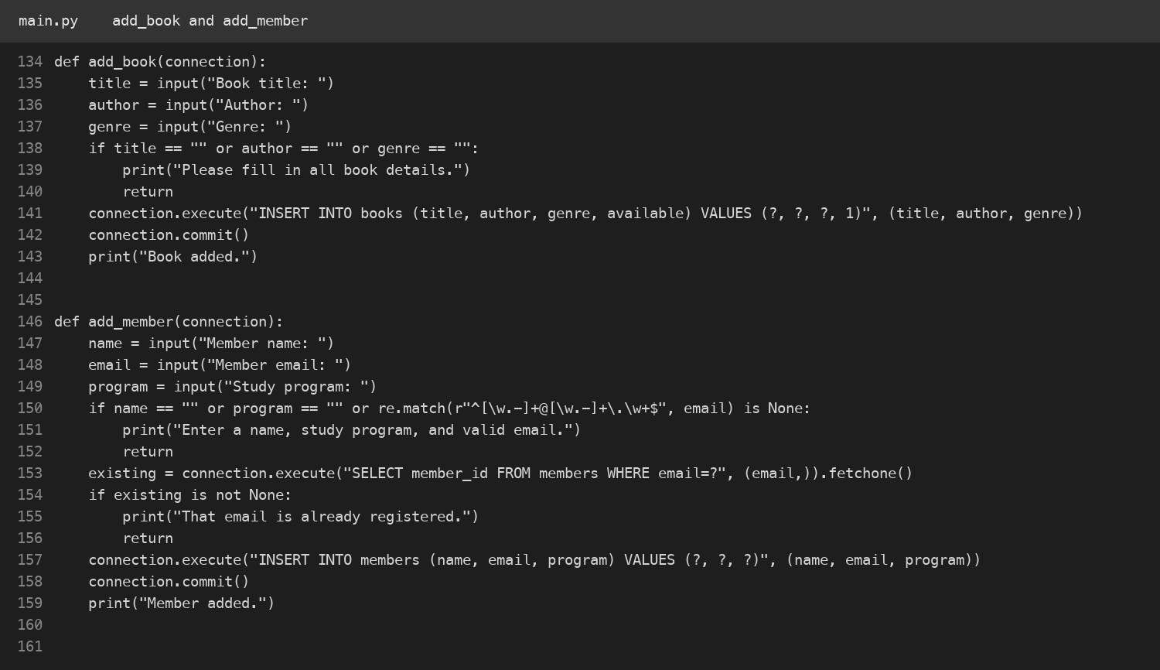
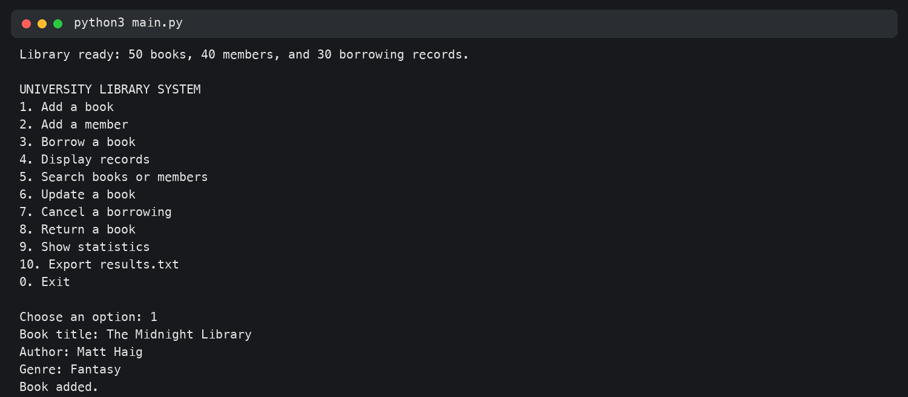
LIBRARY MANAGEMENT SYSTEM
Adding records
Kuanysh Asker · Task 1
The terminal shows a book added successfully.
The functions ask for book or member details, check required fields, then save to SQLite.
PP2 MIDTERM PROJECT
3

Slide 4
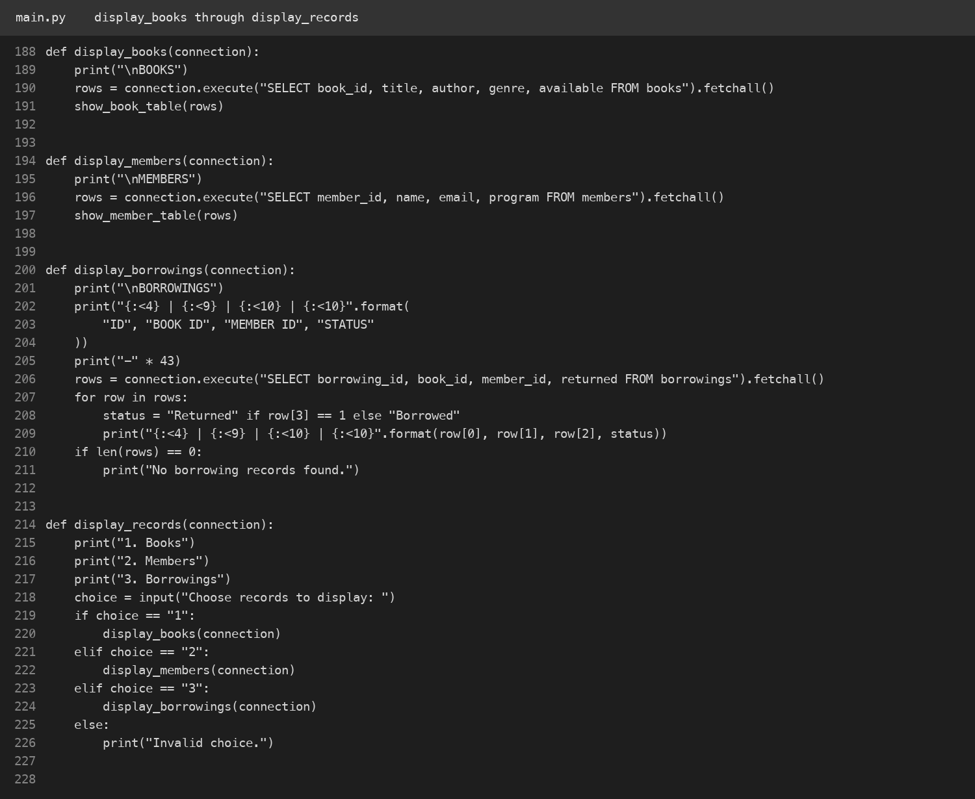
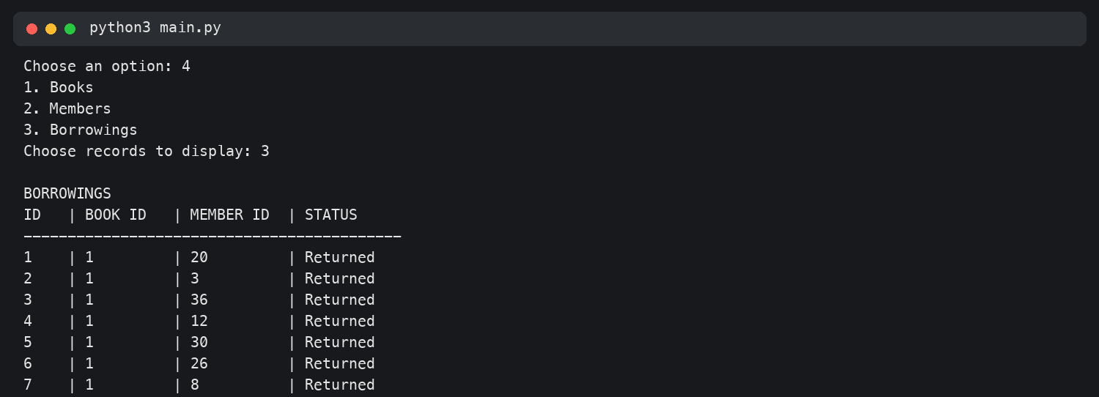
LIBRARY MANAGEMENT SYSTEM
Displaying records
Kuanysh Asker · Task 2
Example output: borrowing ID, book ID, member ID, and status.
The menu lets the user choose books, members, or borrowings. Each option reads saved rows from the database.
PP2 MIDTERM PROJECT
4

Slide 5
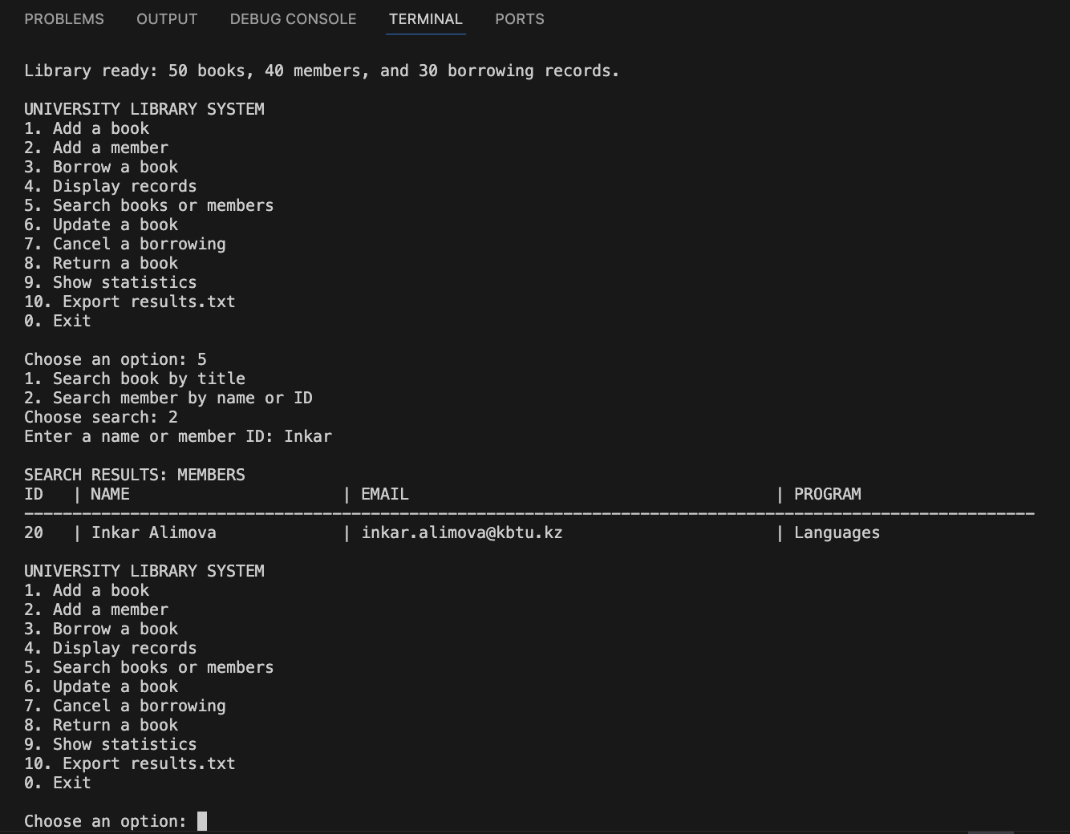
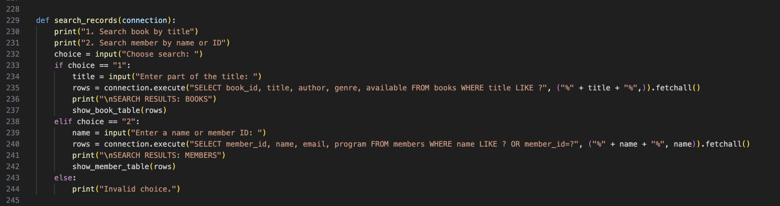
LIBRARY MANAGEMENT SYSTEM
Searching the records
Zhan Sharkhanov · Task 4
Example: “Inkar” finds member ID 20.
Search by part of a book title, or search members by name or ID.
PP2 MIDTERM PROJECT
5

Slide 6
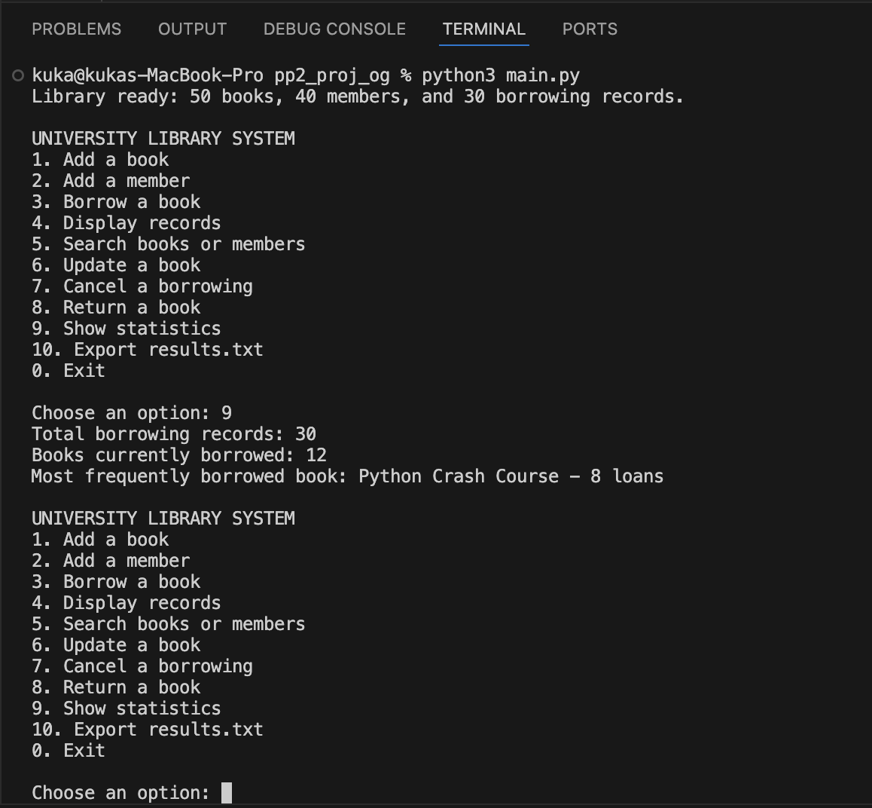
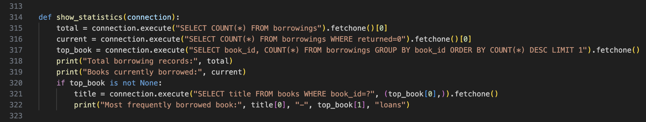
LIBRARY MANAGEMENT SYSTEM
Statistics from the database
Zhan Sharkhanov · Task 3
30 total · 12 current · Python Crash Course: 8 loans
The program counts all borrowing records and current loans, then finds the most borrowed title.
PP2 MIDTERM PROJECT
6

Slide 7
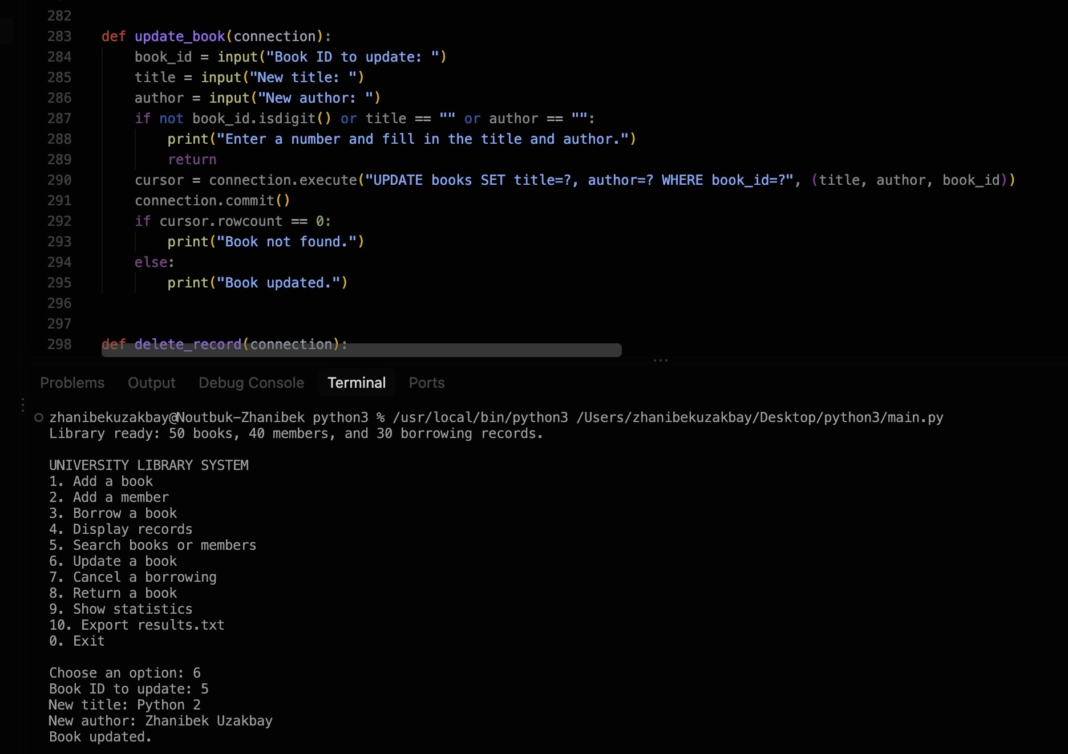
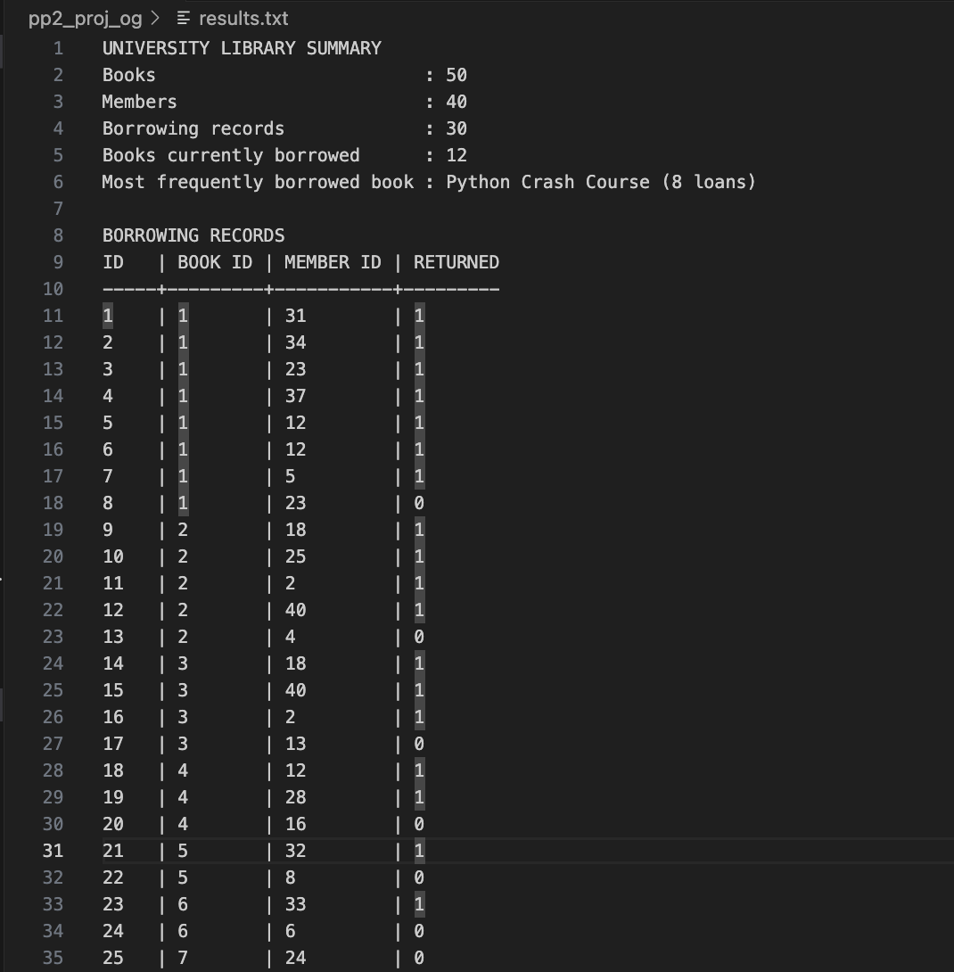
LIBRARY MANAGEMENT SYSTEM
Updating and exporting
Zhanibek Uzakbai · Tasks 5–6
Latest export summary and borrowing list
He added functions to update a book, cancel or return a borrowing, and export results.txt.
The current export shows 50 books, 40 members, 30 borrowing records, 12 active loans, and Python Crash Course as the most borrowed book.
PP2 MIDTERM PROJECT
7

