Slide 1
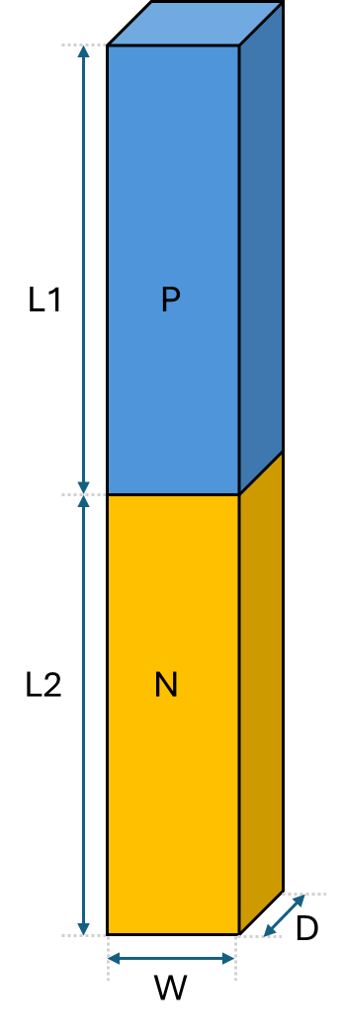
L1
P
L2
N
D
W

Slide 2
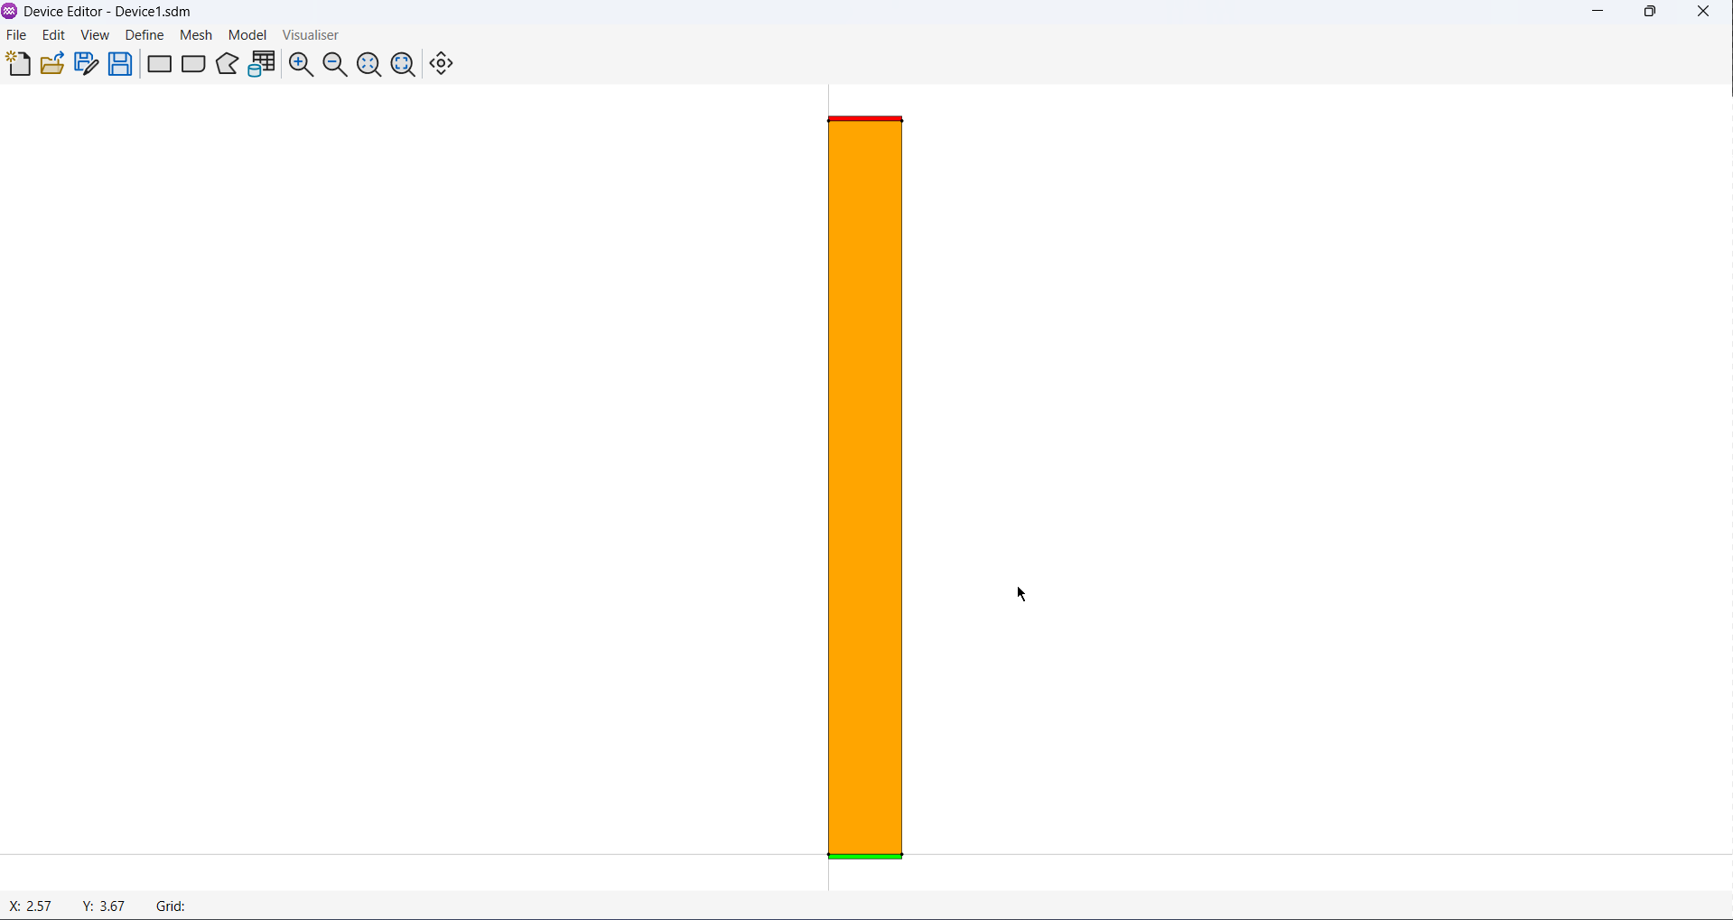
A
B

