Slide 1
AI-Powered Smart City
Making Barcelona's open data accessible through AI & Cloud
Jia Lyu · Jakub Dusza · José Arias Pérez · Mark Atzberger
CCBDA · May 2026

Slide 2
Overview
Agenda
01
Project idea & background
02
Project’s Evolution
03
Amazon Bedrock
04
MCP Server
05
Integrations & architecture
06
Live demo

Slide 3
01 · Project Idea
Barcelona Smart City
Problem
Data sources
Barcelona's open data is spread across many APIs — hard to access and use daily.
Weather (Open-Meteo, XVPCA from Barcelona city’s open data portal)
Solution
Transportation(TMB API, citybik.es, Transitous)
An AI layer that lets anyone ask questions in plain language and get instant city insights.
Air quality
Target users
UV index(currentuvindex.com)
Everyday residents and visitors in Barcelona

Slide 4
02 · Evolution
Project Evolution
1
Initial proposal
Data lake on AWS — S3, Glue, Athena, QuickSight dashboard, Bedrock chatbot
2
Discovered MCP
Model Context Protocol — a standard that lets any AI agent call our tools via a single server
3
Final build
MCP Server used by AWS Lambda + Bedrock Agents + Telegram Bot + Dashboard

Slide 5
03 · Amazon Bedrock
Amazon Bedrock
What it is
A managed AWS service that gives access to foundation models (Claude, Llama, Titan) via API — no model training, no infrastructure to manage.
Why we chose it
Simple to set up
Stays inside AWS
Bedrock Agents
No model hosting or scaling needed
Security, IAM, VPC — all handled
Orchestrates multi-step tool calls automatically

Slide 6
04 · MCP Server
Model Context Protocol - MCP Server
A standard protocol that lets any AI agent connect to any tool server
How it works
1
Handshake
Client connects → server replies with available tools and capabilities
2
Discovery
Client asks "tools/list" → server returns names, descriptions, input schemas
3
Execution
Client calls "tools/call" with arguments → server runs it and returns JSON

Slide 7
04 · MCP Server
Model Context Protocol
AI Host
e.g. Claude / Bedrock Agent
Client
1 client
per server
Client
GitHub connection
Smart City connection
MCP SERVER
MCP SERVER
e.g. GitHub
Smart City
list_repos()
get_weather()
create_issue()
get_traffic()
get_commits()
get_air_quality()

Slide 8
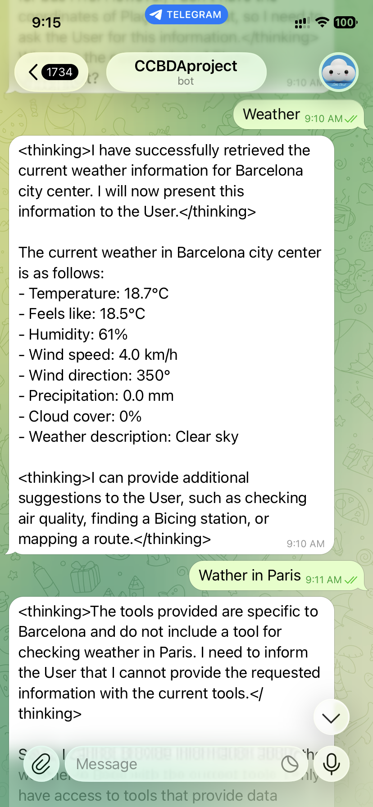

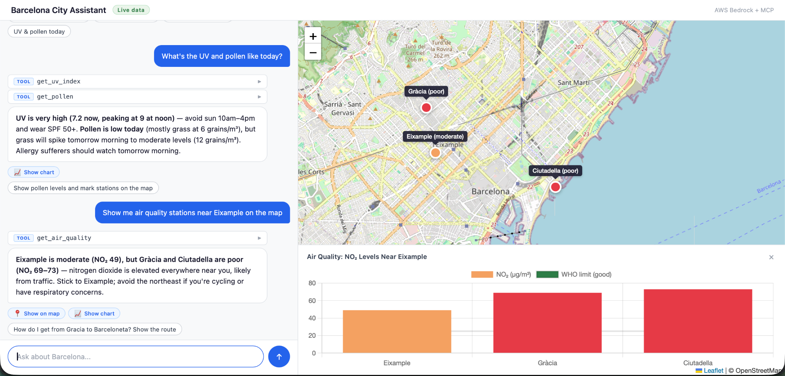
05 · Architecture & Integrations
How It All Connects
Data APIs
MCP Server
Bedrock Agent
User
Weather · Transport
Air quality · UV
→
AWS Lambda
Tool functions
→
Understands intent
Orchestrates calls
→
Telegram Bot
Dashboard
Telegram Bot
Dashboard

Slide 9
05 · Architecture & Integrations
AWS Resources Deployed
Resource | Name | Purpose
DynamoDB (×7) | BicingStations, TransitStops, … | City data storage
Lambda (×5 ingest) | smart-city-*-ingest | Data collectors
Lambda (×1 MCP) | smart-city-mcp | MCP server handler
Lambda (×1 chat) | smart-city-chat | Bedrock agentic loop
API Gateway (×2) | MCP + chat endpoints | HTTPS routing
EventBridge (×6) | *-ingest-schedule | Trigger schedules
S3 | barcelona-smart-city-site-* | Static frontend
CloudFront | E2LPOSVMFTXZ34 | CDN + HTTPS
AgentCore Gateway | barcelona-smart-city-xwyxovrhex | Managed MCP proxy
IAM roles | smart-city-lambda-*-role | Least-privilege per Lambda

Slide 10
05 · Architecture & Integrations
System Architecture
DATA SOURCES
Bicing GBFS · TMB GTFS · Open Data BCN · Open-Meteo · currentuvindex.com
▼
INGESTION LAYER (AWS)
EventBridge Schedules → Lambda ×5
• bicing_ingest (every 5 min) → BicingStations
• air_quality_ingest (every 1 hr) → AirQualityReadings
• weather_ingest (every 1 hr) → WeatherData
• uv_ingest (every 1 hr) → UVData
• pollen_ingest (every 1 hr) → PollenData
One-time: load_gtfs.py → TransitStops (3,453 stops)
▼
STORAGE LAYER
DynamoDB (eu-west-1, on-demand capacity, 30-day TTL)
• BicingStations • TransitStops • ScheduleCache • AirQualityReadings • WeatherData • UVData • PollenData
▼
SERVING LAYER (MCP Server)
API Gateway (HTTP API) → Lambda: mcp_server (Python, FastMCP)
• 11 tools exposed via JSON-RPC 2.0
• Reads from DynamoDB + calls live APIs (Transitous, UV, Pollen)
• Stateless — each request is independent Lambda invocation
▼
EXTERNAL MCP CLIENTS
BEDROCK CHAT APPLICATION
• claude.ai
• Claude Desktop
• VS Code
CloudFront → S3 (static HTML/JS)
API Gateway → Lambda: smart-city-chat
bedrock-runtime.invoke_model (Claude Haiku)
agentic loop (up to 8 rounds)
HTTP POST → MCP server (tool calls)

Slide 11

On mobile:
Demo
Website:
https://shorturl.at/x0aWW
Jia Lyu · Jakub Dusza · José Arias Pérez · Mark Atzberger

