Slide 1
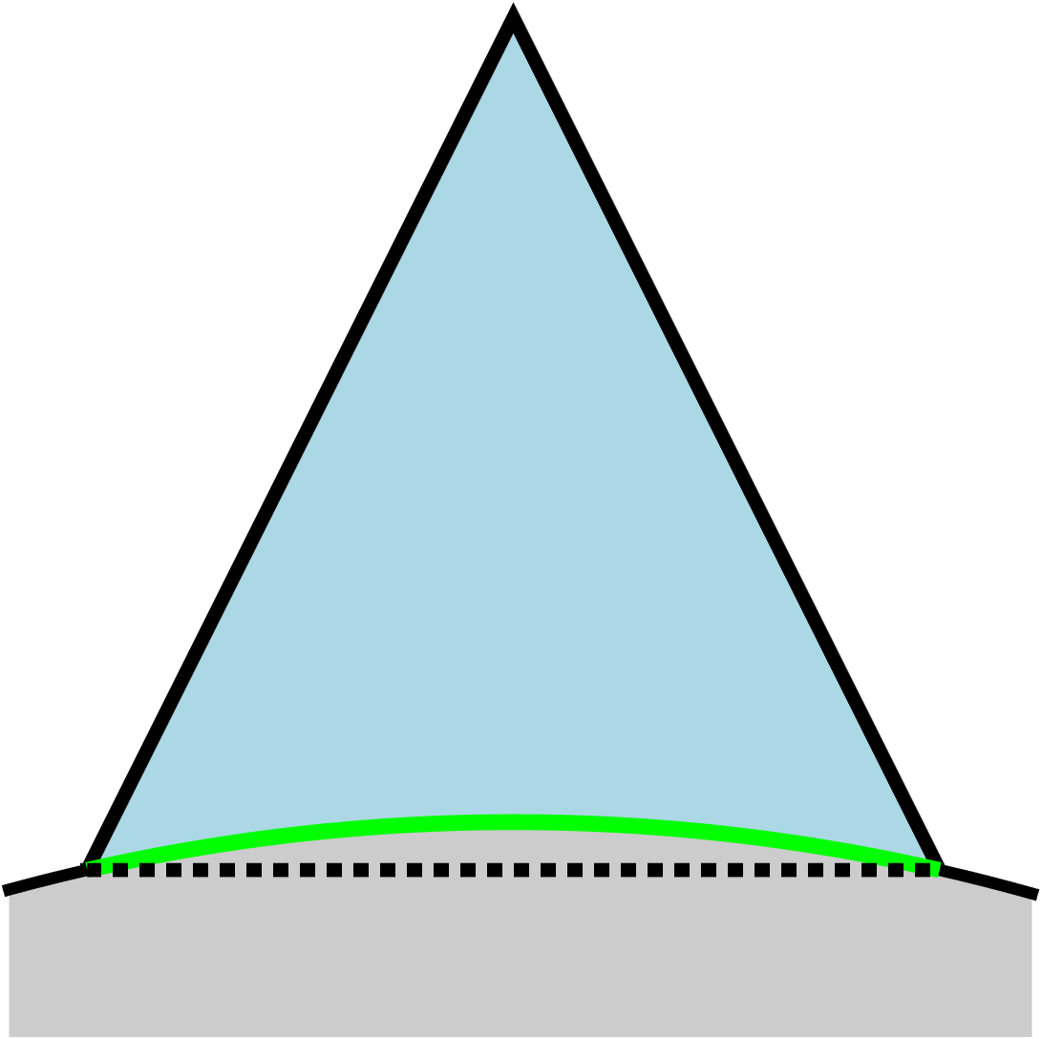
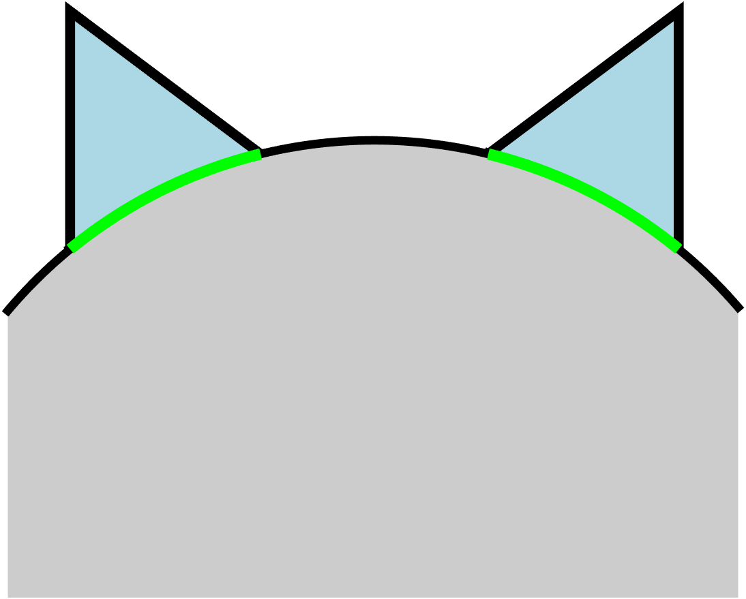
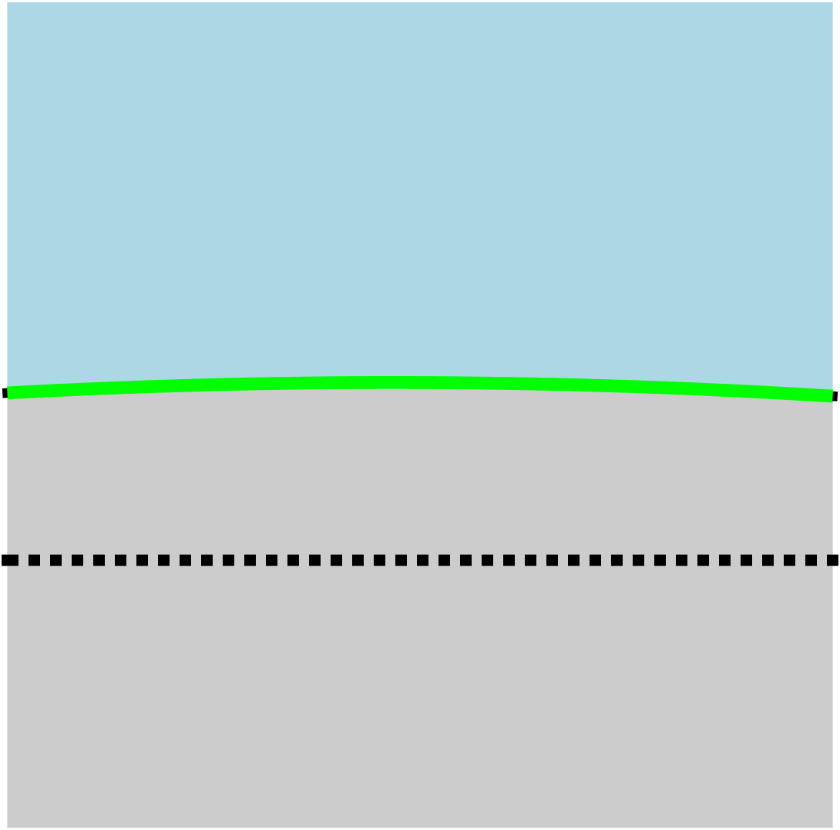
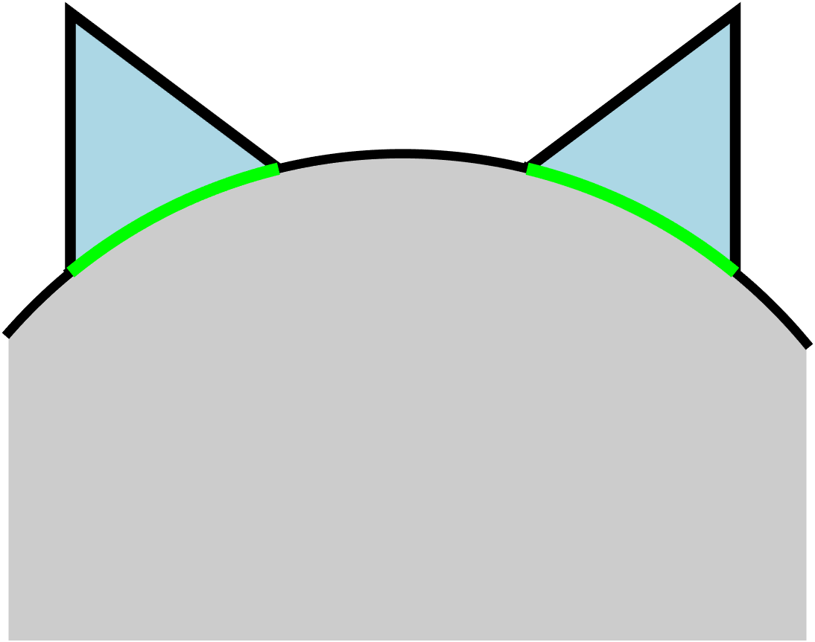
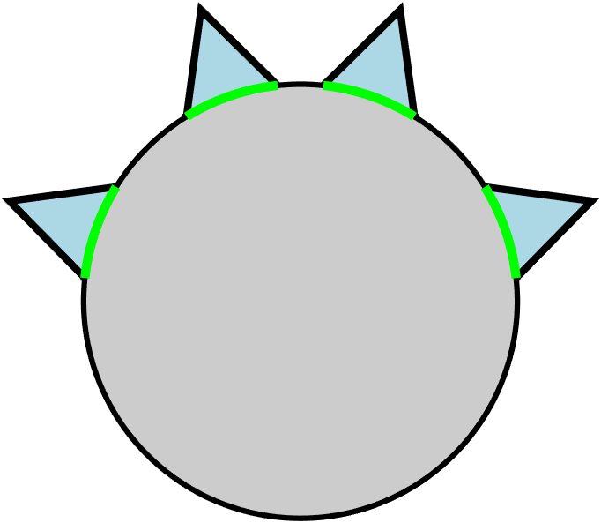
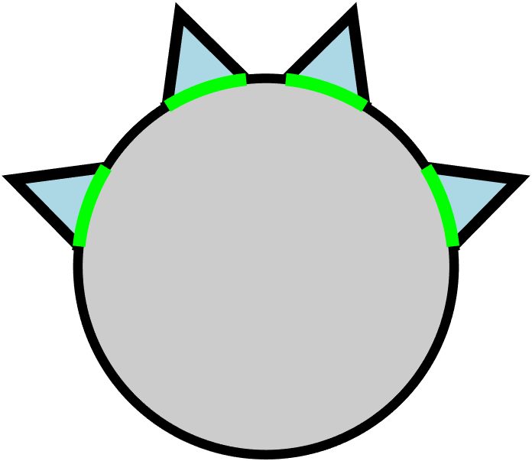
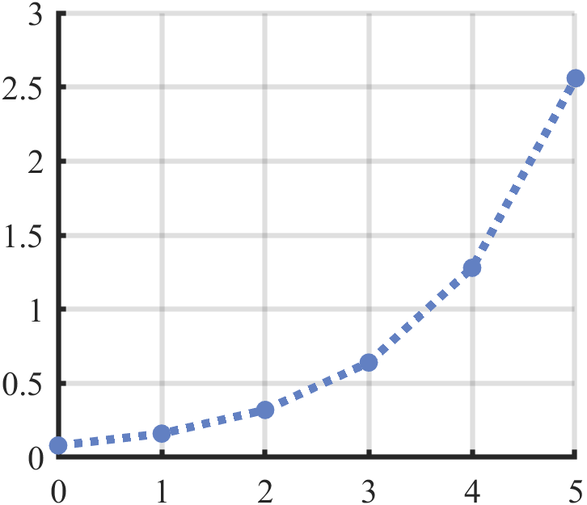





$$w_{0}$$
$$ε$$
$$w_{0}$$
$$w_{1}$$
$$w_{2}$$
$$w_{1}$$
$$R$$
$$w_{0}$$
$$n=1$$
$$n=0$$
$n=$2
Minimum grasp curvature vs fractal depth
Relative curvature ($w_{0}/R$)
Fractal depth $(n$)

Slide 2
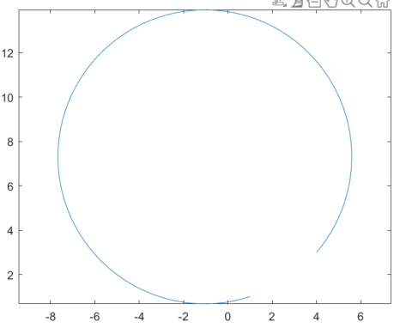
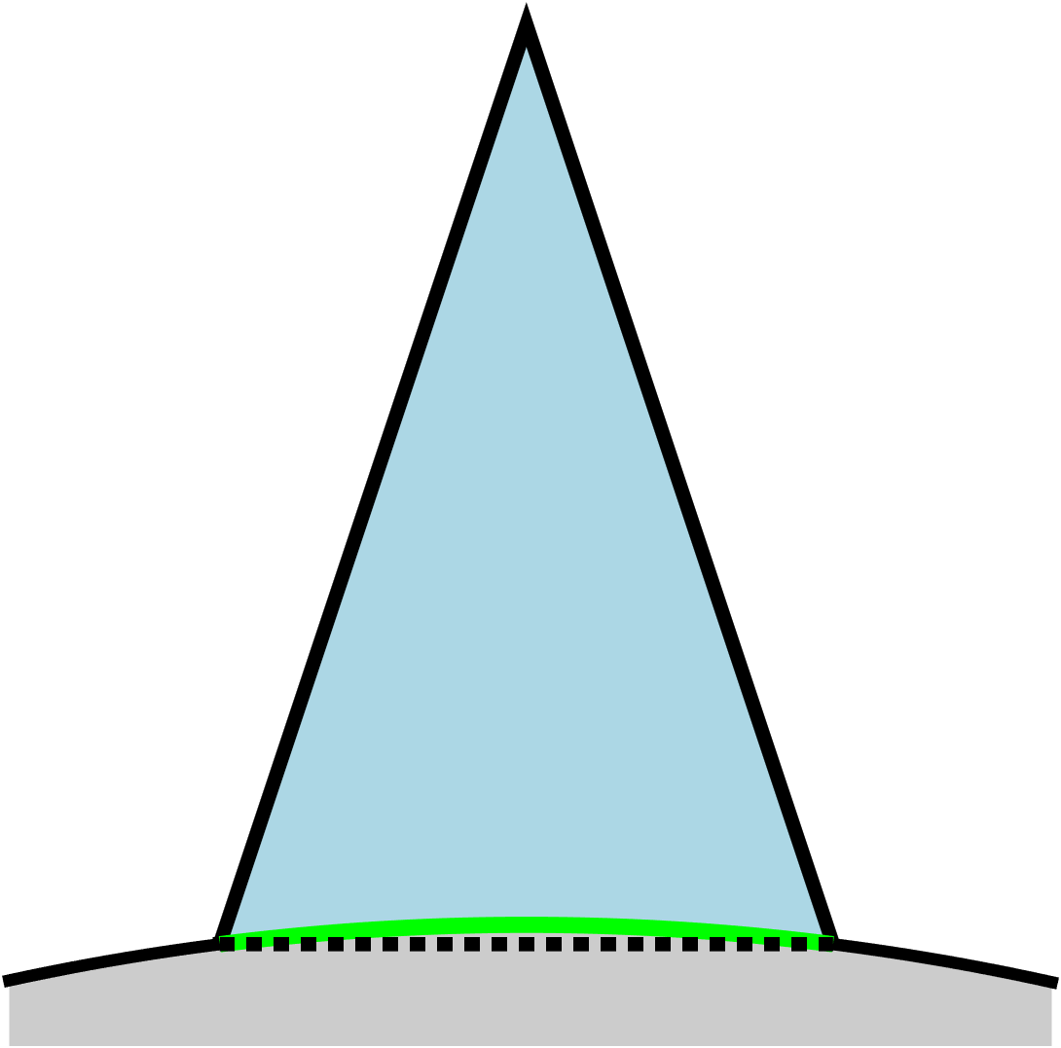
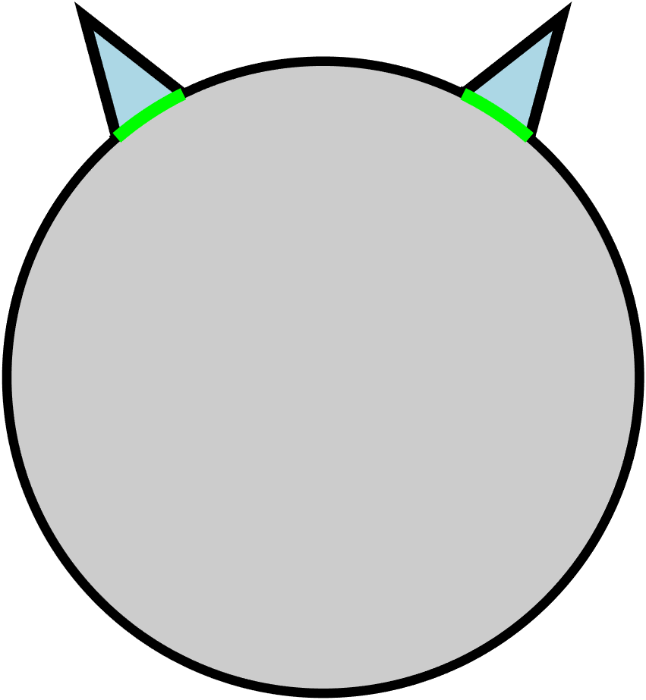
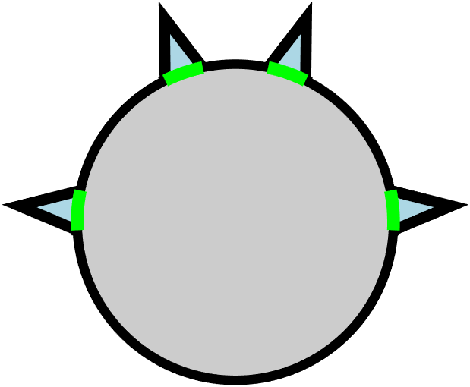


Slide 3
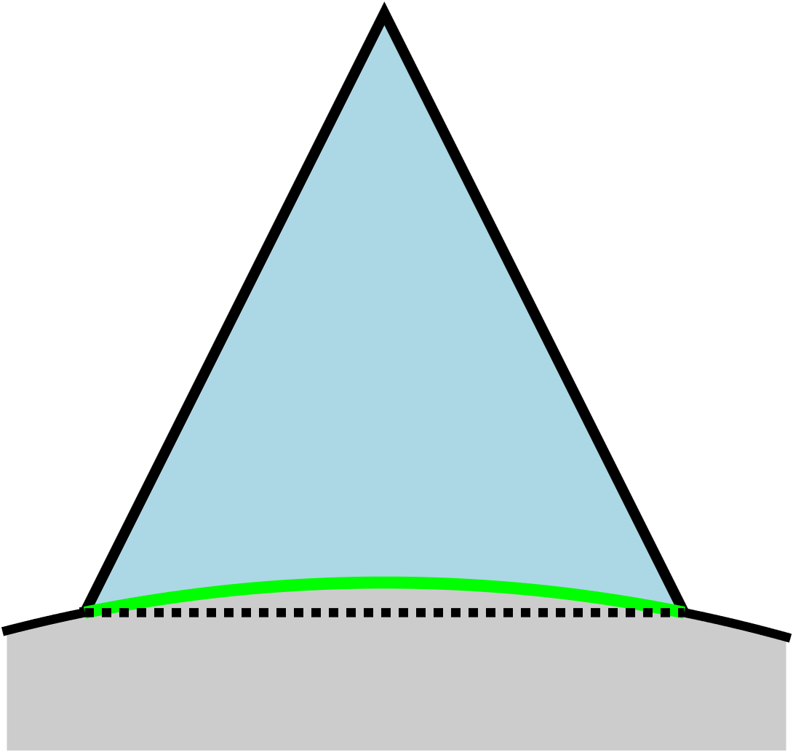
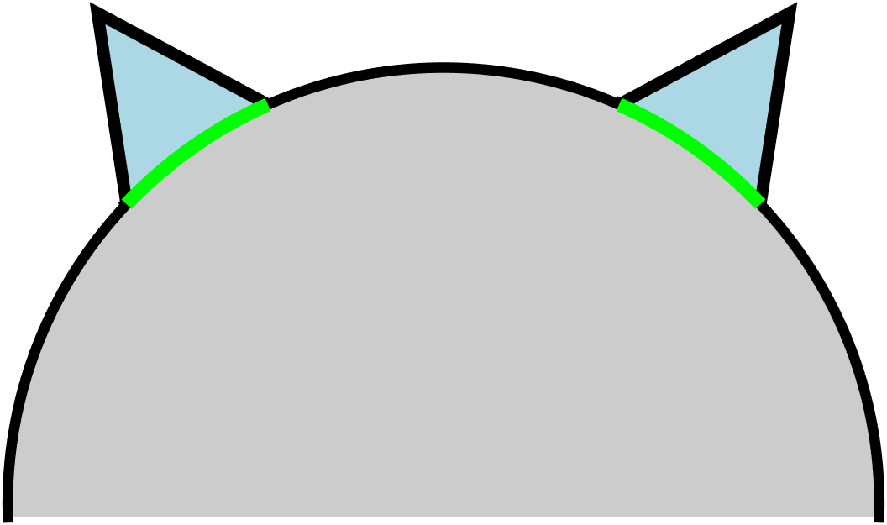
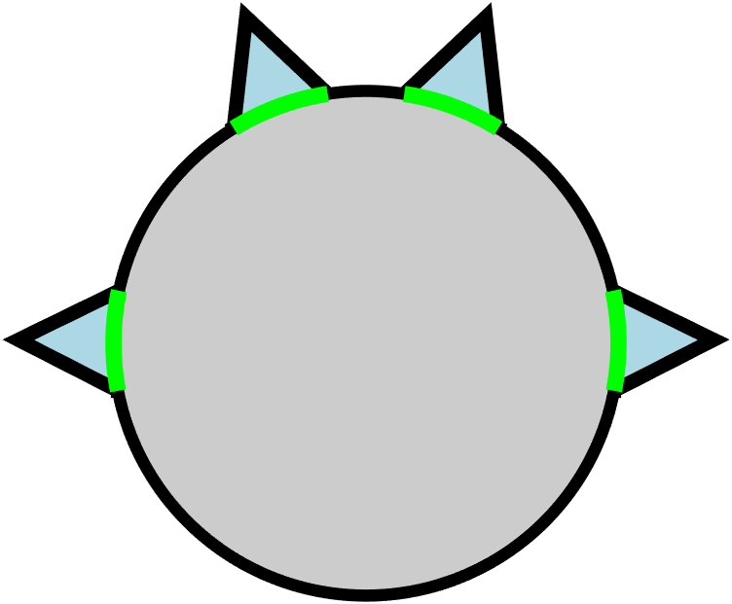





$$ε_{min}$$
$$w_{0}$$
$$w_{0}$$
$$w_{1}=s_{l}w_{0}$$
$$h_{n}$$
$$w_{n=}s_{c}h_{n}$$
$$R$$
$$w_{0}$$
$$w_{2}$$
$$n=0$$
$$n=1$$
$$n=2$$
Grasp curvature vs fractal depth $(ε={10}^{−2}, s_{C}=0.5)$
$$s_{l}=0.25$$
Relative curvature ($w_{0}/R$)
$$s_{l}=0.5$$
$$s_{l}=0.75$$
Fractal depth $(n$)

Slide 4
