Slide 1
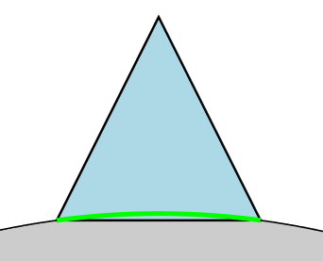
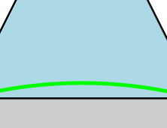
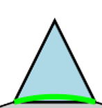
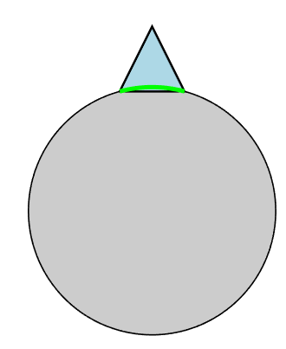
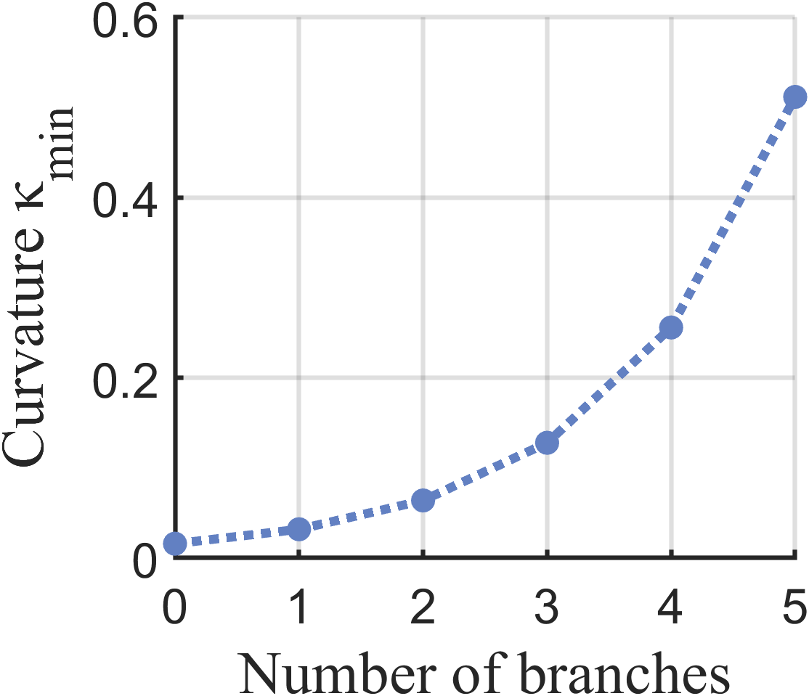




N = 0
N = 1
$$W_{0}$$
$$ε_{max}$$
$$W_{0}$$
N = 2
$$W_{0}$$
$$κ_{min}=1/R_{min}$$

Slide 2
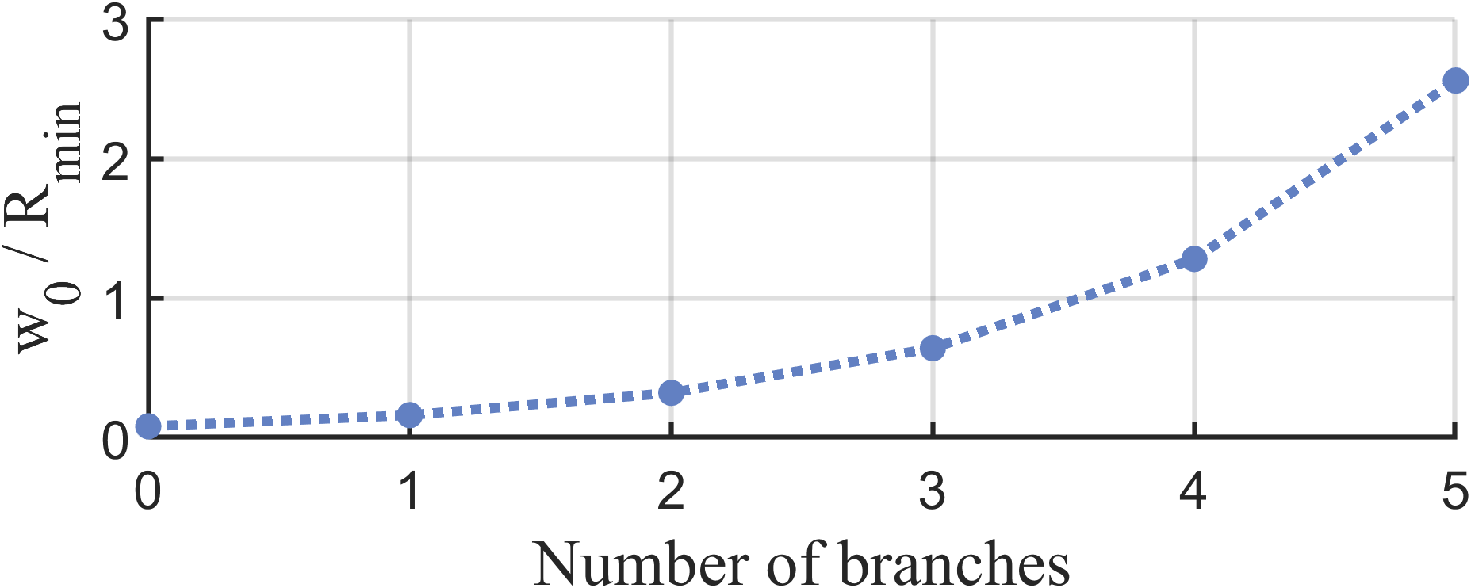

A
B
$$W_{0}$$
C
$$W_{0}$$
$$ε_{max}$$
$$R_{min}$$
$$W_{0}$$
N = 0
N = 1
N = 2
D

Slide 3







N = 1
N = 2
$$ε_{max}$$
$$W_{0}$$
$$W_{0}$$
$$W_{0}$$
$$R_{min}=$$
$$R_{min}=$$
$$R_{min}=$$

