Slide 1
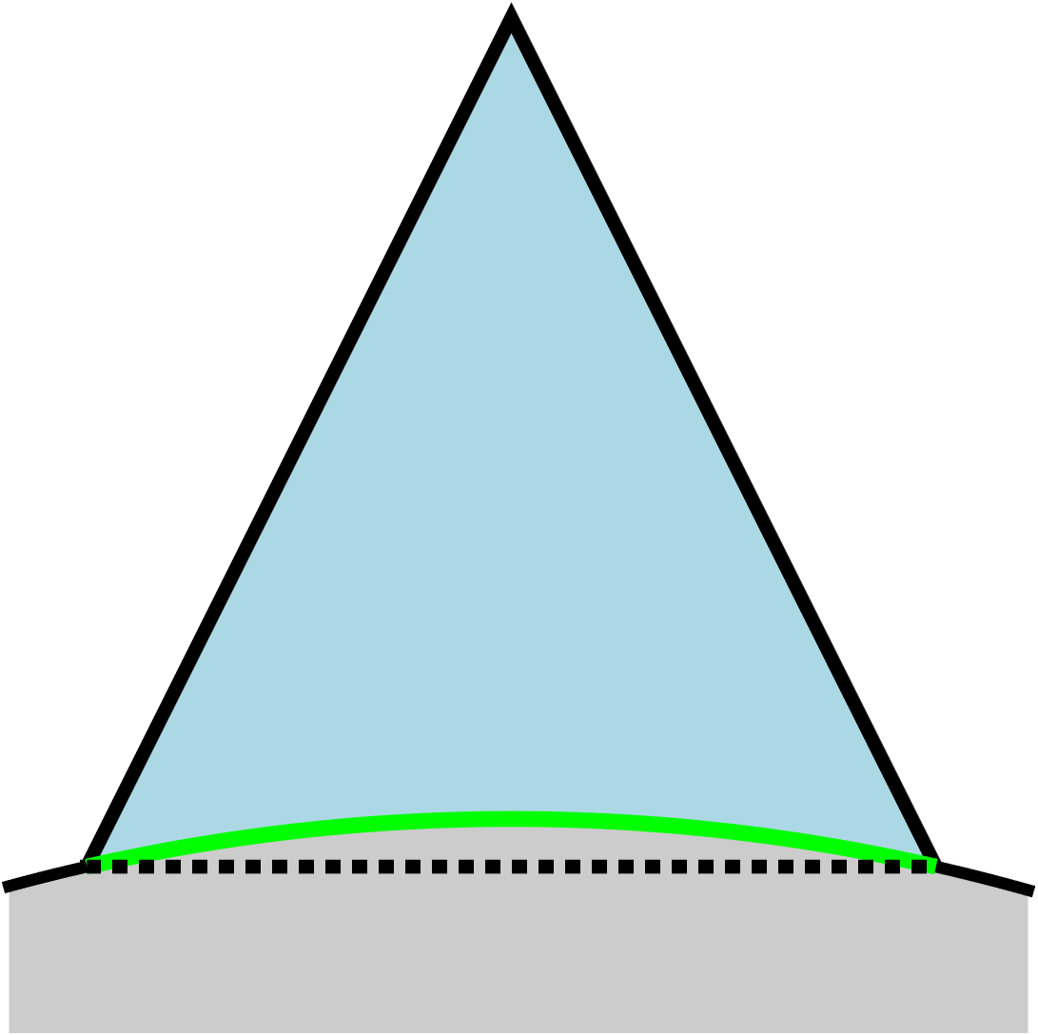
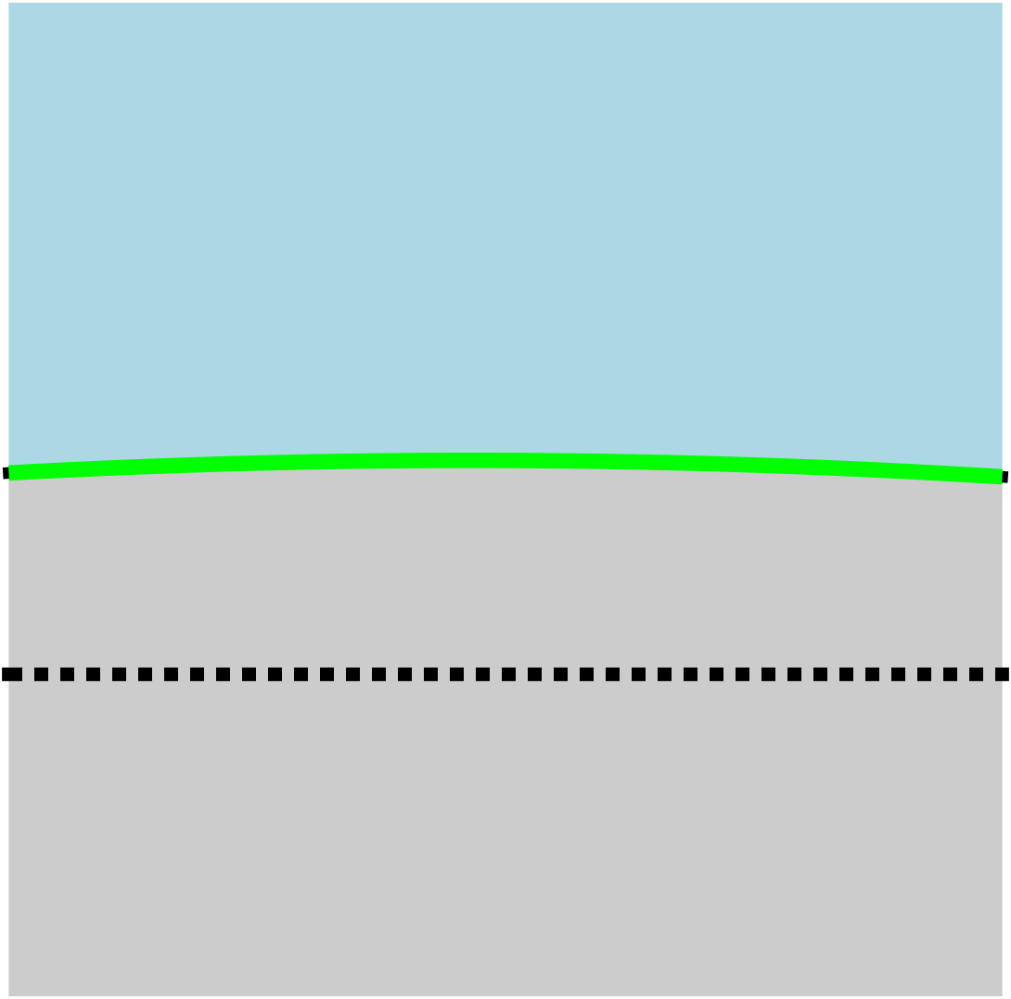
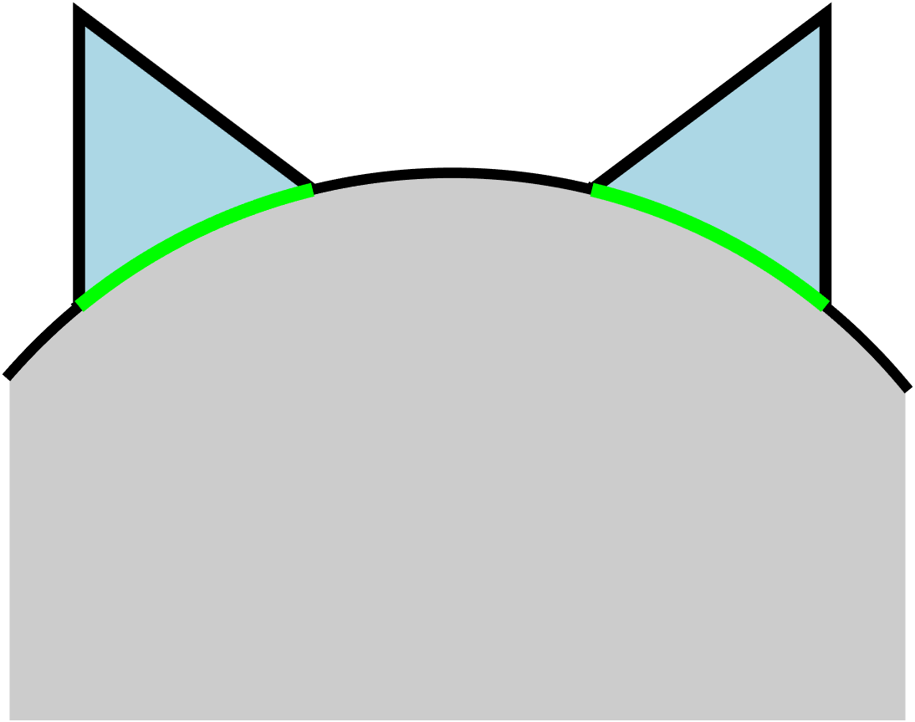
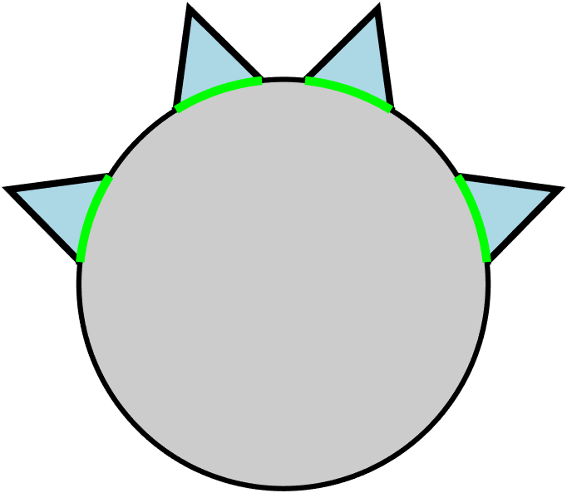
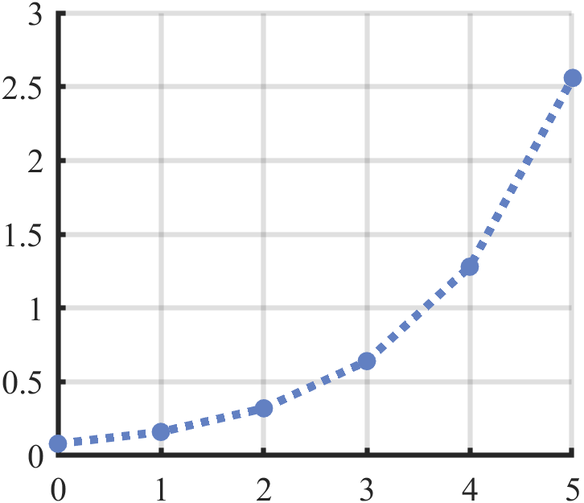

$$ε_{min}$$
$$W_{0}$$
$$W_{0}$$
$$R$$
$$W_{0}$$
N=1
N=2
N=0
Minimum grasp curvature vs fractal depth
$$W_{0}/R$$
Fractal depth

