Slide 1
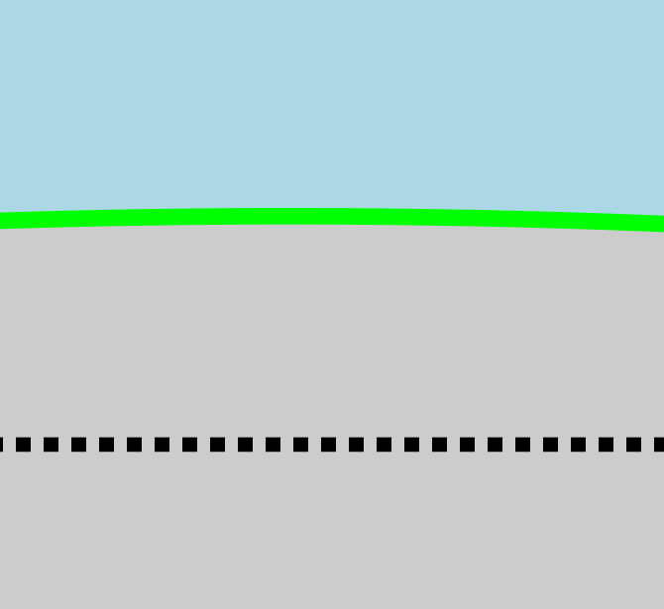
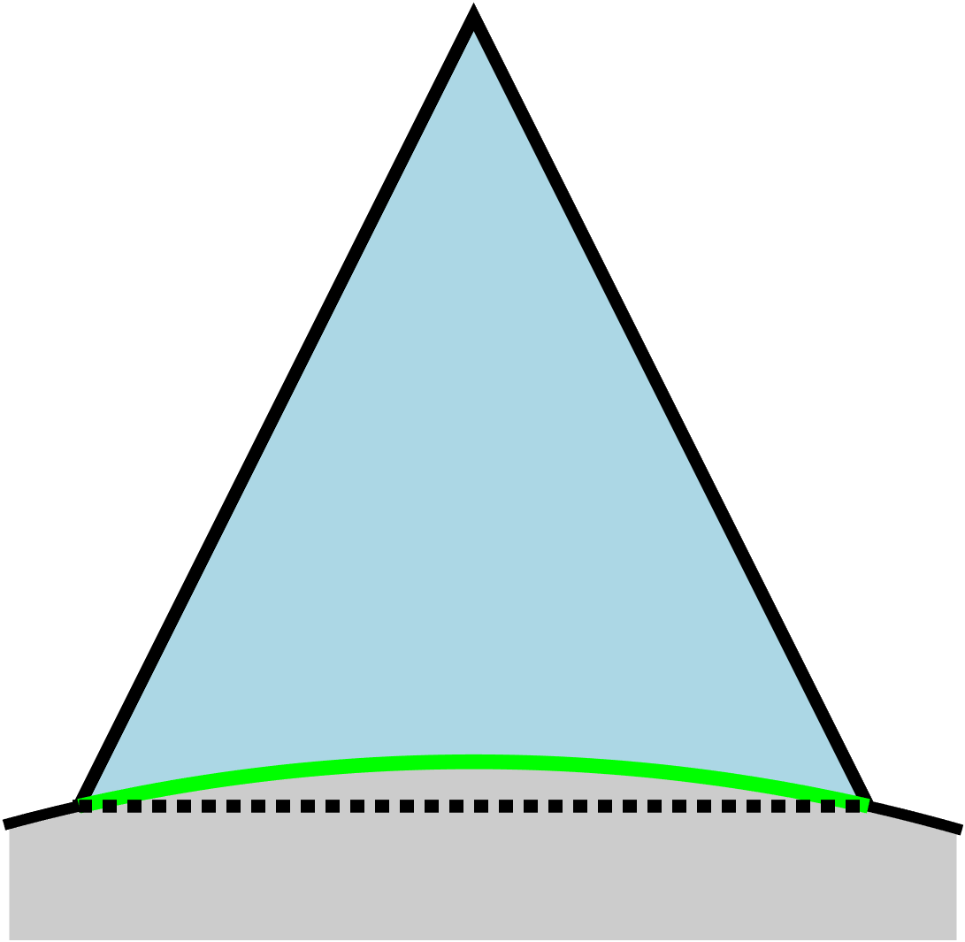
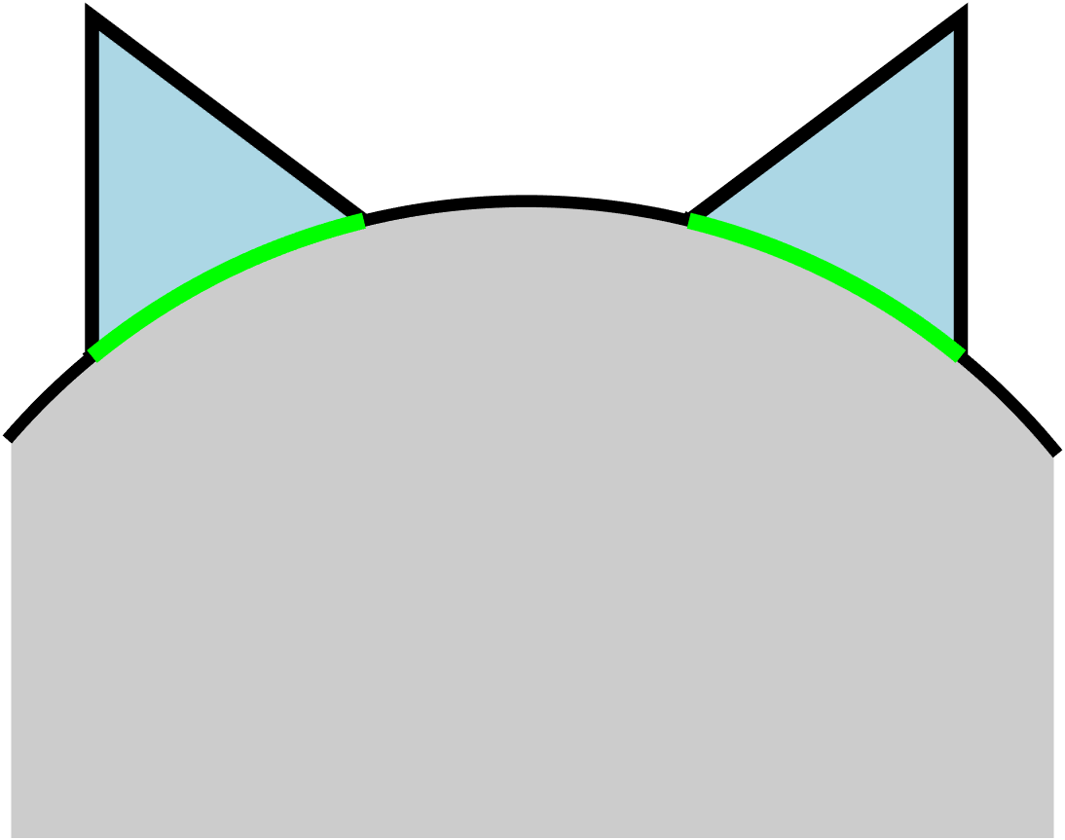
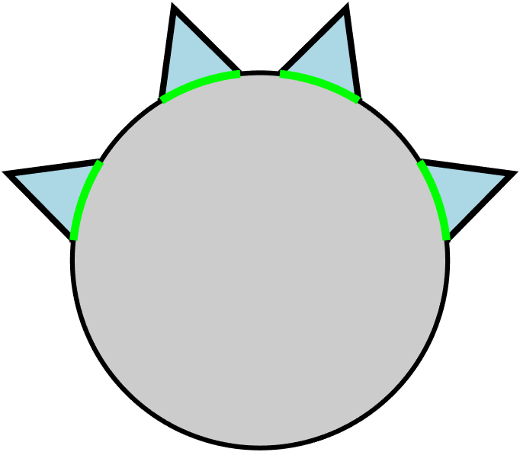
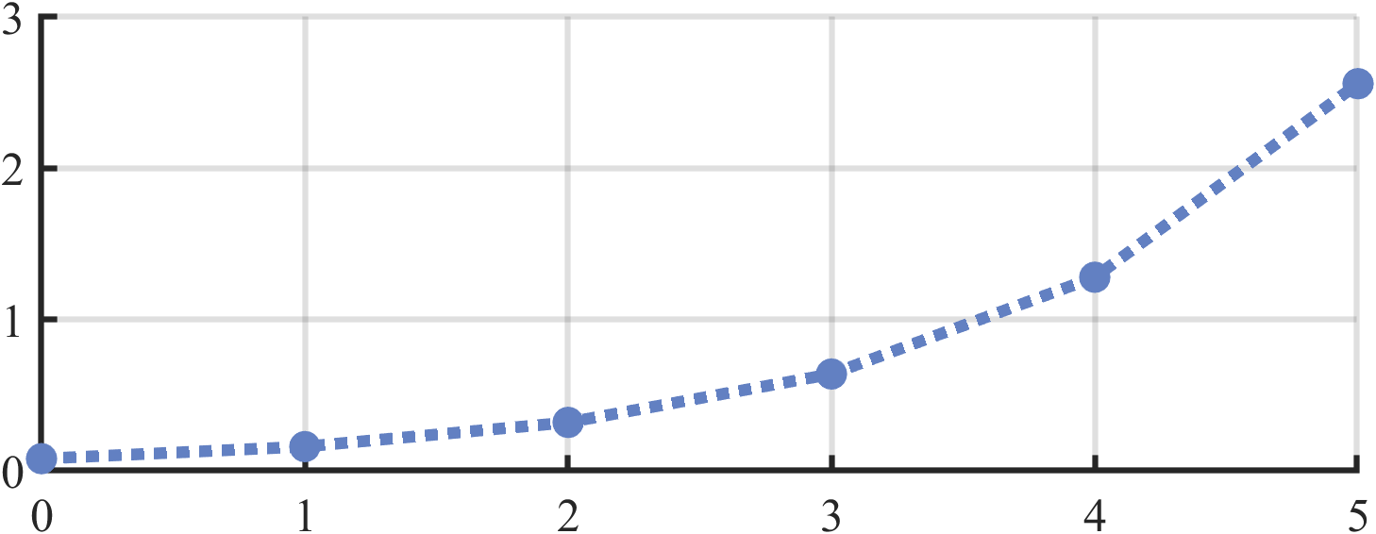

$$W_{0}$$
$$W_{0}$$
$$ε_{min}$$
$$R$$
$$W_{0}$$
$$\frac{W_{0}}{R}$$
Number of layers

