Slide 1
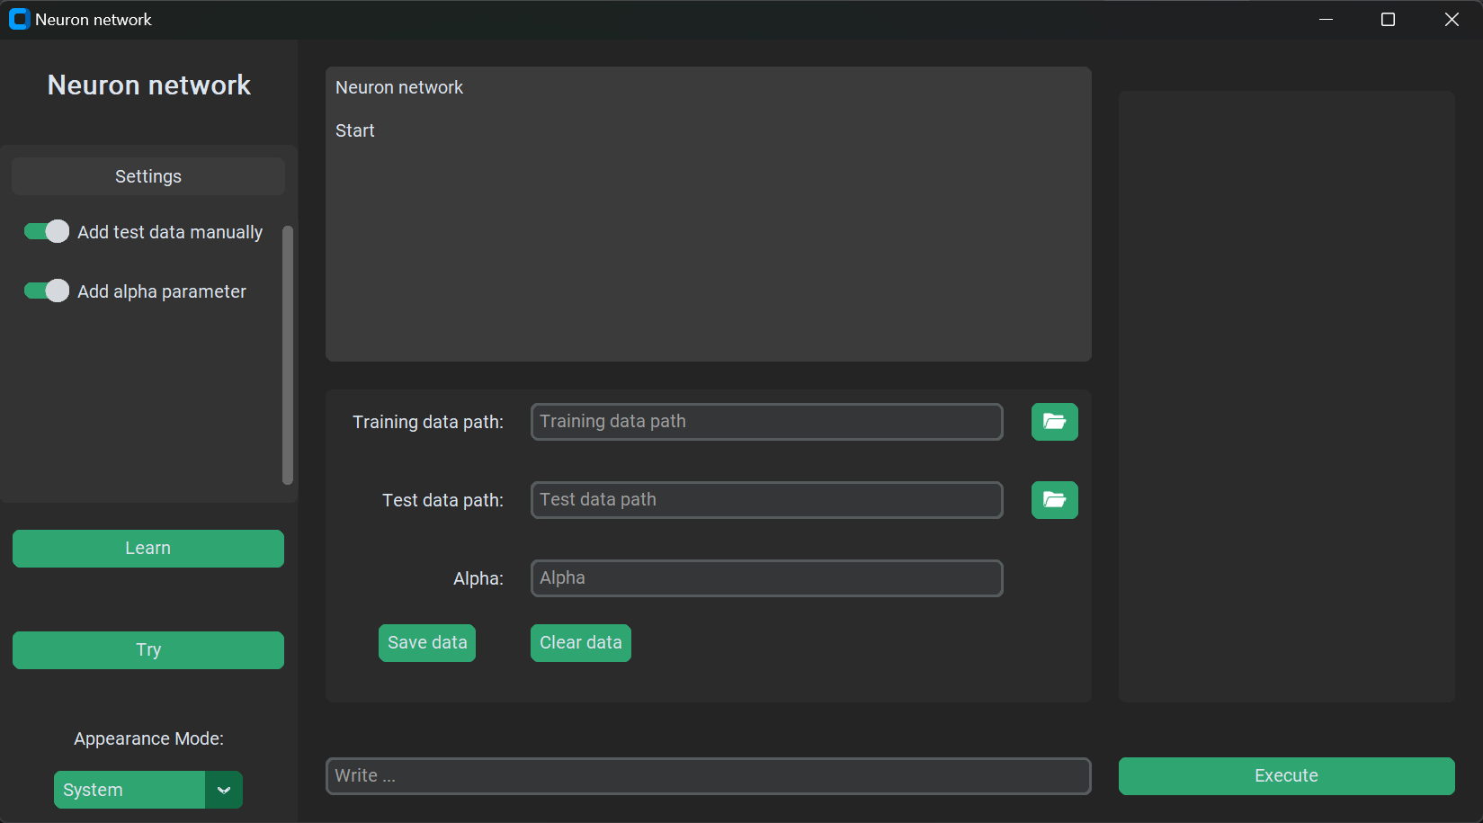

Slide 2
Start
You need to start by adding training data, test data and alpha parameter

Slide 3
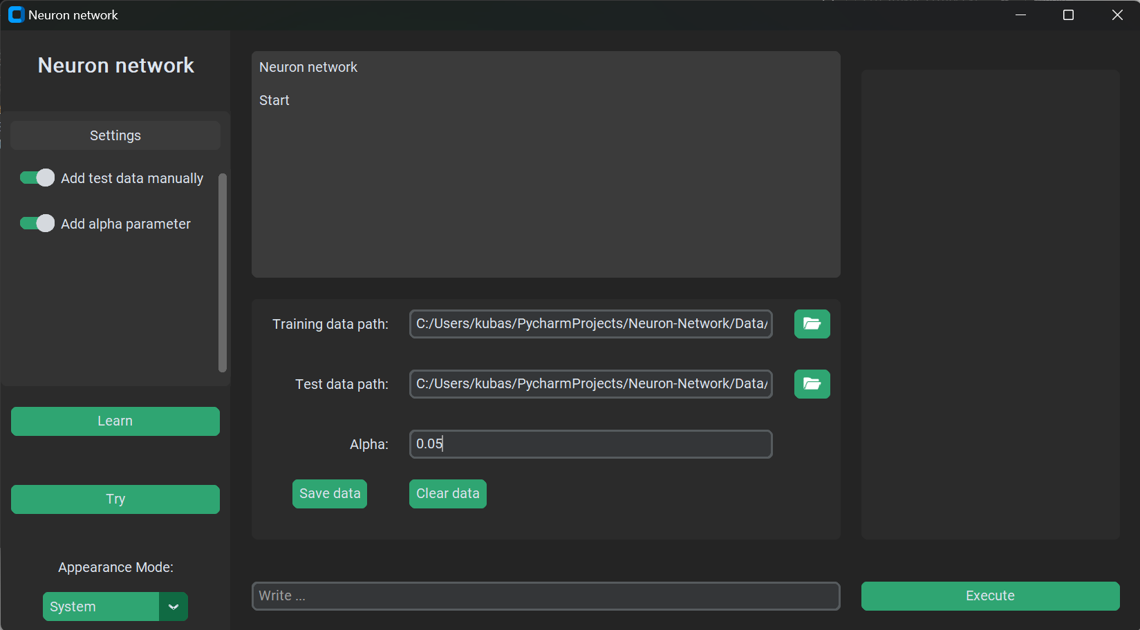
Start
Next you need to save given arguments by clicking save data button

Slide 4
Start
Next you need to save given arguments by clicking save data button

Slide 5
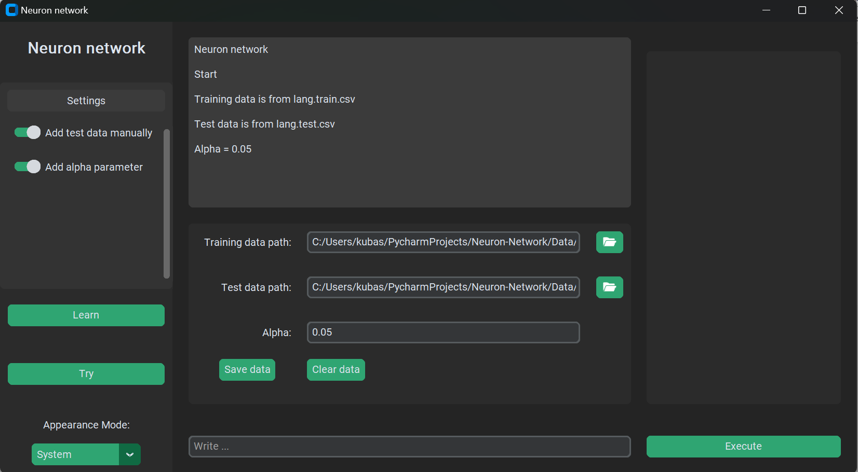

Slide 6
Console
As you can see, console shows information about your actions. Every action, message or notification will show up here.

Slide 7
Learn
Now you can click learn buton to let the network learn from your training data

Slide 9
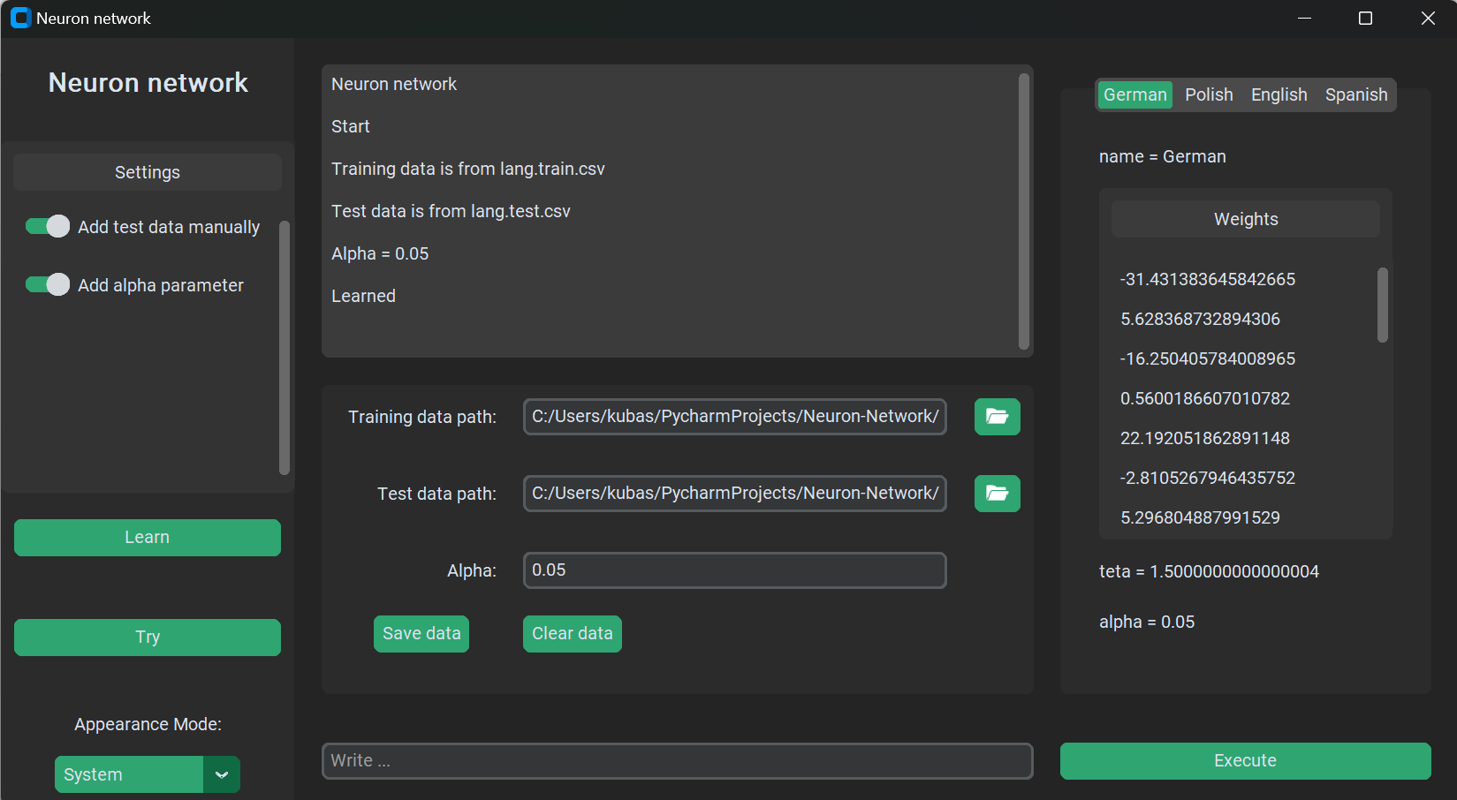
Learn
After that, you will see natification on console.

Slide 10
Learn
After that, you will see natification on console.

Slide 13
Learn
Each perceptron will apear on right site frame.
You can see the name of perceptron, weights vector, teta parameter and alpha parameter
Each perceptron if is activated, then it returns it’s name

Slide 14
Learn
Each perceptron will apear on right site frame.
You can see the name of perceptron, weights vector, teta parameter and alpha parameter
Each perceptron if is activated, then it returns it’s name

Slide 15
Learn
Each perceptron will apear on right site frame.
You can see the name of perceptron, weights vector, teta parameter and alpha parameter
Each perceptron if is activated, then it returns it’s name

Slide 16
Learn
Each perceptron will apear on right site frame.
You can see the name of perceptron, weights vector, teta parameter and alpha parameter
Each perceptron if is activated, then it returns it’s name

Slide 17
Learn
Each perceptron will apear on right site frame.
You can see the name of perceptron, weights vector, teta parameter and alpha parameter
Each perceptron if is activated, then it returns it’s name

Slide 18
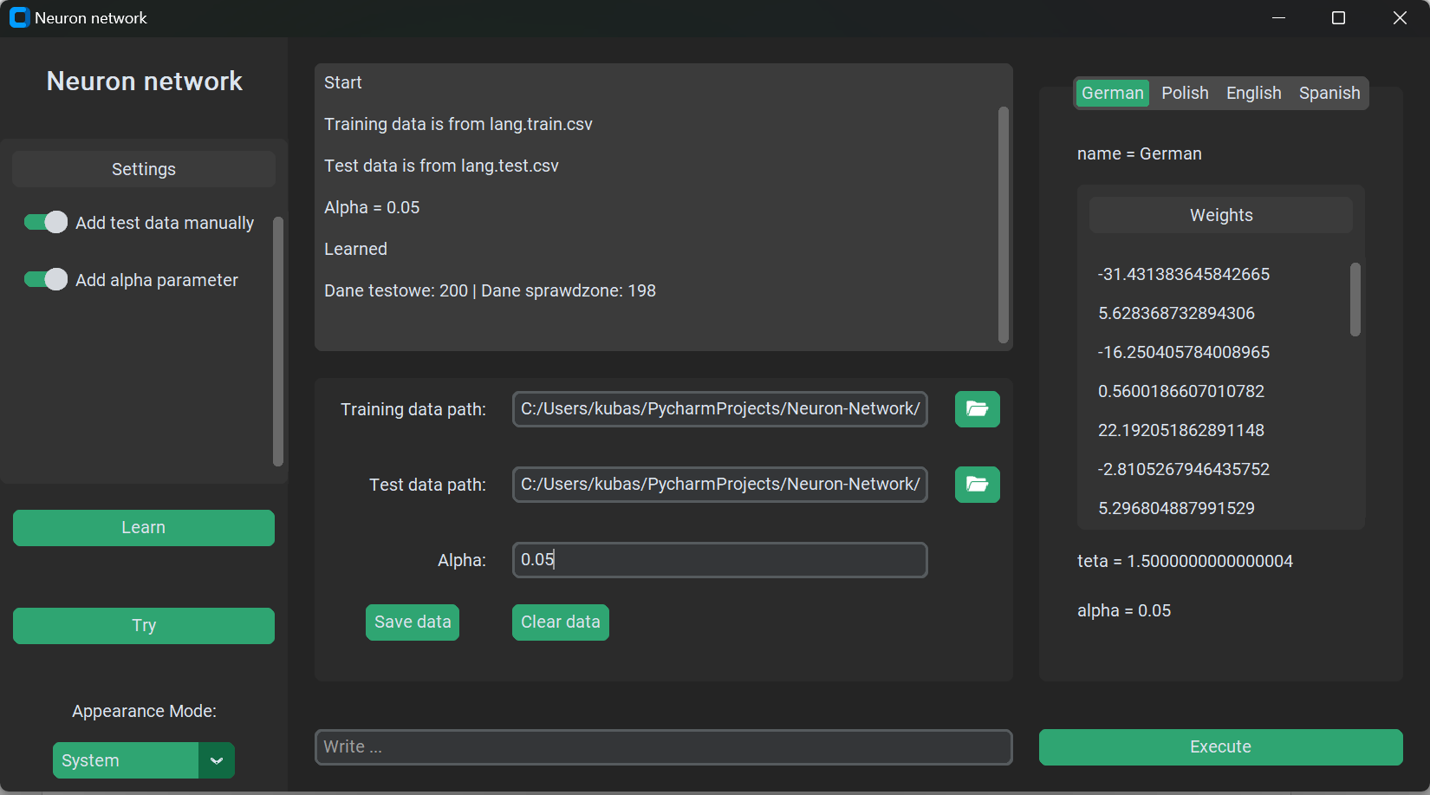
Try
Now, when perceptrons are set and network is learned you can try it out.
If test data was given, then you can press try button.

Slide 19
Try
Now, when perceptrons are set and network is learned you can try it out.
If test data was given, then you can press try button.

Slide 22
Try
As you can see, there are 200 data in the test data file, of which 198 were correctly classified.

Slide 24
If you want to try it manually and see what is the response of the network, then go to the bottom of the window and type something long and click execute button.
Try

Slide 25

If you want to try it manually and see what is the response of the network, then go to the bottom of the window and type something long and click execute buton.
Try

Slide 26
If you want to try it manually and see what is the response of the network, then go to the bottom of the window and type something long and click execute buton.
Try

