Slide 1
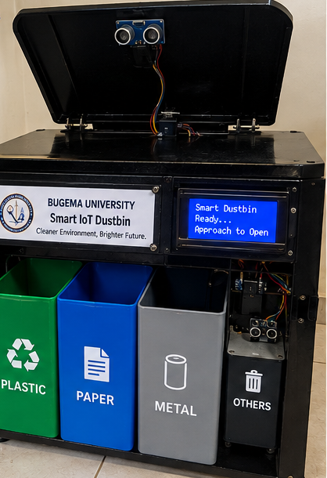
BUGEMA UNIVERSITY
Department of Computing and Informatics
Research Methods in Computing | Assignment 11
Design and Implementation of a
Smart IoT Dustbin
with Automatic Sorting
Touchless lid control, waste sorting
and IoT monitoring.
Demaga Lawrence
24/BSE/BU/R/0001
Individual proposal | September 2026
AI-generated assembly concept.
References: World Bank (2026) [1]; Bin-e (n.d.) [2]. Full supplied citations are in notes.
1 / 6
Notes:
LAYOUT-CORRECTED PRESENTATION | DEMAGA LAWRENCE | 24/BSE/BU/R/0001
Source: Demaga_Lawrence_Smart_IoT_Dustbin_6_Slides_Recreated.pptx, slide 1.
This pass corrects the slide layout. On-slide wording is shortened only where needed for projection; the complete supplied slide wording is preserved below. This is not a technical verification or a hardware redesign.
IMAGE PROVENANCE
The assembly, parts and context images are supplied AI-generated concept illustrations. They are not actual product photographs, a photographed Bugema installation, or proof of a completed or original physical prototype. They illustrate the proposed integration.
COMPLETE ORIGINAL SLIDE WORDING
BUGEMA UNIVERSITY
Department of Computing and Informatics | Research Methods in Computing | Assignment 11
Design and Implementation of a
Smart IoT Dustbin with
Automatic Sorting
An intelligent waste-management solution with touchless lid control, automatic sorting, and IoT monitoring.
Student: Demaga Lawrence
Registration No.: 24/BSE/BU/R/0001
Prepared: September 2026
Original assembled prototype views: front assembly and internal sorting mechanism.
References: World Bank (2026) [1]; Bin-e (n.d.) [2]. Images are original AI-assisted assembly visuals for this proposal.
1 / 6
SUPPLIED REFERENCE ENTRIES
[1] World Bank. (2026). What a Waste 3.0. https://www.worldbank.org/en/publication/what-a-waste
[2] Bin-e. (n.d.). Smart waste bin. https://bine.world/forwhom
[3] Espressif Systems. ESP32 product information. https://www.espressif.com/
[4] Arduino. UNO Rev3. https://store.arduino.cc/products/arduino-uno-rev3
[5] TensorFlow. Transfer learning and fine-tuning. https://www.tensorflow.org/tutorials/images/transfer_learning
[6] OASIS. MQTT Version 5.0. https://docs.oasis-open.org/mqtt/mqtt/v5.0/mqtt-v5.0.html
[7] HC-SR04 ultrasonic sensor module documentation.
[8] Micro servo motor product documentation.
[9] IR obstacle sensor product documentation.
[10] HX711 load cell amplifier documentation.

Slide 2
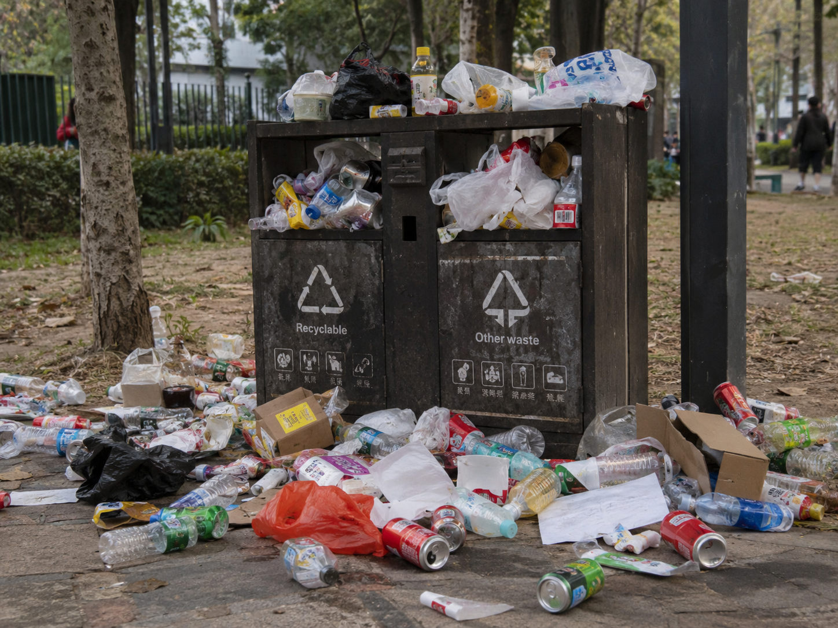
Problem statement
A proposed campus recycling point; local needs will be investigated.
Mixed bins cannot separate waste
or show when they are full.
Touch-operated lids require contact
and may be unhygienic.
At a proposed Bugema recycling point,
local needs must first be established.
This study will test a touchless bin that
sorts selected items, rejects unsupported
items, and reports fill levels safely.
AI-generated context image.
Not a photograph of Bugema University.
Research question: Can it open, sort and report bin status reliably?
References: World Bank (2026) [1]; Bin-e (n.d.) [2]. No local findings are claimed.
2 / 6
Notes:
LAYOUT-CORRECTED PRESENTATION | DEMAGA LAWRENCE | 24/BSE/BU/R/0001
Source: Demaga_Lawrence_Smart_IoT_Dustbin_6_Slides_Recreated.pptx, slide 2.
This pass corrects the slide layout. On-slide wording is shortened only where needed for projection; the complete supplied slide wording is preserved below. This is not a technical verification or a hardware redesign.
IMAGE PROVENANCE
The assembly, parts and context images are supplied AI-generated concept illustrations. They are not actual product photographs, a photographed Bugema installation, or proof of a completed or original physical prototype. They illustrate the proposed integration.
COMPLETE ORIGINAL SLIDE WORDING
Problem Statement
A realistic, researchable waste-management problem for a campus recycling point
Mixed bins cannot separate waste or show when they are full.
Touch-operated lids require physical contact and may be unhygienic.
At a proposed Bugema University recycling point, local needs must first be established.
This study will test a touchless smart dustbin that sorts selected waste items,
rejects unsupported items, and reports fill levels with safe local control.
Research question: How reliably can the proposed smart dustbin open automatically, sort selected items correctly, and report bin status under controlled conditions?
References: World Bank (2026) [1]; Bin-e (n.d.) [2]. Problem and local need are proposed for investigation.
2 / 6
SUPPLIED REFERENCE ENTRIES
[1] World Bank. (2026). What a Waste 3.0. https://www.worldbank.org/en/publication/what-a-waste
[2] Bin-e. (n.d.). Smart waste bin. https://bine.world/forwhom
[3] Espressif Systems. ESP32 product information. https://www.espressif.com/
[4] Arduino. UNO Rev3. https://store.arduino.cc/products/arduino-uno-rev3
[5] TensorFlow. Transfer learning and fine-tuning. https://www.tensorflow.org/tutorials/images/transfer_learning
[6] OASIS. MQTT Version 5.0. https://docs.oasis-open.org/mqtt/mqtt/v5.0/mqtt-v5.0.html
[7] HC-SR04 ultrasonic sensor module documentation.
[8] Micro servo motor product documentation.
[9] IR obstacle sensor product documentation.
[10] HX711 load cell amplifier documentation.

Slide 3
Four specific SMART objectives
Ten-week plan; starts after approval and resource confirmation.
01
BY WEEK
Interview 8 students + 2 cleaning staff; observe
disposal; define at least 10 prioritised requirements.
2
02
BY WEEK
Build 1 guarded, four-compartment prototype:
touchless lid, sensing and mechanical sorting.
5
03
BY WEEK
Train and validate a classifier on ≥1,200 images;
connect fill-level alerts to an IoT dashboard.
8
04
BY WEEK
Complete 120 sorting trials, 40 approach tests, 20
fault tests and a 10-person supervised pilot.
10
References: Espressif [3]; Arduino [4]; TensorFlow [5]; OASIS [6]; hardware [7–10].
3 / 6
Notes:
LAYOUT-CORRECTED PRESENTATION | DEMAGA LAWRENCE | 24/BSE/BU/R/0001
Source: Demaga_Lawrence_Smart_IoT_Dustbin_6_Slides_Recreated.pptx, slide 3.
This pass corrects the slide layout. On-slide wording is shortened only where needed for projection; the complete supplied slide wording is preserved below. This is not a technical verification or a hardware redesign.
IMAGE PROVENANCE
The assembly, parts and context images are supplied AI-generated concept illustrations. They are not actual product photographs, a photographed Bugema installation, or proof of a completed or original physical prototype. They illustrate the proposed integration.
COMPLETE ORIGINAL SLIDE WORDING
Four Specific SMART Objectives
A ten-week proposal beginning after approval and resource confirmation
1
By Week 2
Interview eight students and two cleaning personnel, observe disposal practice, and define at least ten prioritised requirements.
2
By Week 5
Build one guarded four-compartment prototype with touchless lid opening, sensing, and mechanical sorting.
3
By Week 8
Train and validate a classifier using at least 1,200 images and connect fill-level alerts to an IoT dashboard.
4
By Week 10
Complete 120 sorting trials, 40 approach tests, 20 fault tests, and a ten-person supervised pilot.
References: Espressif [3]; Arduino [4]; TensorFlow [5]; MQTT/OASIS [6]; sensor and actuator documentation [7–10].
3 / 6
SUPPLIED REFERENCE ENTRIES
[1] World Bank. (2026). What a Waste 3.0. https://www.worldbank.org/en/publication/what-a-waste
[2] Bin-e. (n.d.). Smart waste bin. https://bine.world/forwhom
[3] Espressif Systems. ESP32 product information. https://www.espressif.com/
[4] Arduino. UNO Rev3. https://store.arduino.cc/products/arduino-uno-rev3
[5] TensorFlow. Transfer learning and fine-tuning. https://www.tensorflow.org/tutorials/images/transfer_learning
[6] OASIS. MQTT Version 5.0. https://docs.oasis-open.org/mqtt/mqtt/v5.0/mqtt-v5.0.html
[7] HC-SR04 ultrasonic sensor module documentation.
[8] Micro servo motor product documentation.
[9] IR obstacle sensor product documentation.
[10] HX711 load cell amplifier documentation.

Slide 4






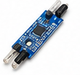

Components and their roles
Close-up views from the proposed assembled dustbin concept.
Arduino UNO
Load cell / HX711
Sensor and actuator control
Item-weight measurement
HC-SR04 sensor
ESP32
Approach detection
Wi-Fi / IoT updates
Servo motor
LCD display
Lid opening and waste routing
Local system-status messages
IR sensor
Power + four bins
Object-presence detection
Power supply and waste storage
Supplied AI-generated component illustrations; the written component list is retained.
References: Arduino [4]; HC-SR04 [7]; servo [8]; IR [9]; HX711 [10]; ESP32 [3].
4 / 6
Notes:
LAYOUT-CORRECTED PRESENTATION | DEMAGA LAWRENCE | 24/BSE/BU/R/0001
Source: Demaga_Lawrence_Smart_IoT_Dustbin_6_Slides_Recreated.pptx, slide 4.
This pass corrects the slide layout. On-slide wording is shortened only where needed for projection; the complete supplied slide wording is preserved below. This is not a technical verification or a hardware redesign.
IMAGE PROVENANCE
The assembly, parts and context images are supplied AI-generated concept illustrations. They are not actual product photographs, a photographed Bugema installation, or proof of a completed or original physical prototype. They illustrate the proposed integration.
COMPLETE ORIGINAL SLIDE WORDING
Assembled Components and Prototype Originality
The assembled views below show how the major components come together in one student-built concept
Front assembled view
with touchless lid and 4 compartments
Internal view
showing sorting chute, sensors, and servos
References: Arduino UNO [4]; HC-SR04 [7]; servo motor [8]; IR sensor [9]; load cell/HX711 [10]; ESP32 [3].
4 / 6
SUPPLIED REFERENCE ENTRIES
[1] World Bank. (2026). What a Waste 3.0. https://www.worldbank.org/en/publication/what-a-waste
[2] Bin-e. (n.d.). Smart waste bin. https://bine.world/forwhom
[3] Espressif Systems. ESP32 product information. https://www.espressif.com/
[4] Arduino. UNO Rev3. https://store.arduino.cc/products/arduino-uno-rev3
[5] TensorFlow. Transfer learning and fine-tuning. https://www.tensorflow.org/tutorials/images/transfer_learning
[6] OASIS. MQTT Version 5.0. https://docs.oasis-open.org/mqtt/mqtt/v5.0/mqtt-v5.0.html
[7] HC-SR04 ultrasonic sensor module documentation.
[8] Micro servo motor product documentation.
[9] IR obstacle sensor product documentation.
[10] HX711 load cell amplifier documentation.
The full component-panel text is now represented with readable editable labels and role descriptions. The source did not provide detailed publishers, exact model numbers or links for references [7–10]. Their supplied wording is retained without inventing citations.

Slide 5
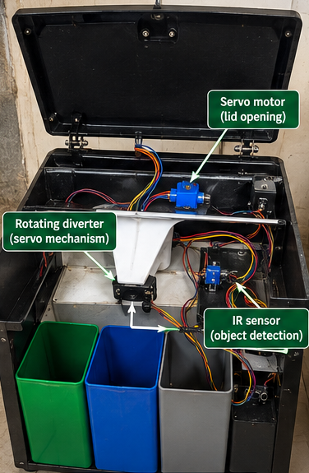
Intended technological solution
Presence detection, inspection, sorting and connected monitoring.
1
Sense presence and open
Ultrasonic detection requests lid opening.
2
Inspect the item
IR, load-cell and optical inspection.
3
Direct it to a compartment
Plastic, paper, metal or others.
4
Display and report status
LCD feedback; ESP32 sends IoT updates.
AI-generated assembly concept.
Local control stays active during network loss.
References: World Bank [1]; Bin-e [2]; TensorFlow [5]; OASIS [6]; hardware [3–10].
5 / 6
Notes:
LAYOUT-CORRECTED PRESENTATION | DEMAGA LAWRENCE | 24/BSE/BU/R/0001
Source: Demaga_Lawrence_Smart_IoT_Dustbin_6_Slides_Recreated.pptx, slide 5.
This pass corrects the slide layout. On-slide wording is shortened only where needed for projection; the complete supplied slide wording is preserved below. This is not a technical verification or a hardware redesign.
IMAGE PROVENANCE
The assembly, parts and context images are supplied AI-generated concept illustrations. They are not actual product photographs, a photographed Bugema installation, or proof of a completed or original physical prototype. They illustrate the proposed integration.
COMPLETE ORIGINAL SLIDE WORDING
Intended Technological Solution
How the smart dustbin works from detection to sorting and reporting
Presence detection: the ultrasonic sensor detects a user and opens the lid automatically.
Item inspection: an IR sensor, load cell, and optical inspection help identify the item placed inside.
Automatic sorting: a servo-driven mechanism directs the item to plastic, paper, metal, or others.
Monitoring: the LCD and ESP32 provide local status and IoT updates for fill level and system condition.
Safety: local control remains active even if the network is unavailable.
References: World Bank [1]; Bin-e [2]; TensorFlow [5]; MQTT/OASIS [6]; hardware references [3–10].
5 / 6
SUPPLIED REFERENCE ENTRIES
[1] World Bank. (2026). What a Waste 3.0. https://www.worldbank.org/en/publication/what-a-waste
[2] Bin-e. (n.d.). Smart waste bin. https://bine.world/forwhom
[3] Espressif Systems. ESP32 product information. https://www.espressif.com/
[4] Arduino. UNO Rev3. https://store.arduino.cc/products/arduino-uno-rev3
[5] TensorFlow. Transfer learning and fine-tuning. https://www.tensorflow.org/tutorials/images/transfer_learning
[6] OASIS. MQTT Version 5.0. https://docs.oasis-open.org/mqtt/mqtt/v5.0/mqtt-v5.0.html
[7] HC-SR04 ultrasonic sensor module documentation.
[8] Micro servo motor product documentation.
[9] IR obstacle sensor product documentation.
[10] HX711 load cell amplifier documentation.

Slide 6
References
Source entries retained from the supplied presentation.
[1] World Bank (2026)
[6] OASIS
What a Waste 3.0
MQTT Version 5.0
[2] Bin-e (n.d.)
[7] HC-SR04
Smart waste bin
Ultrasonic sensor module documentation
[3] Espressif Systems
[8] Micro servo motor
ESP32 product information
Product documentation
[4] Arduino
[9] IR obstacle sensor
UNO Rev3
Product documentation
[5] TensorFlow
[10] HX711
Transfer learning and fine-tuning
Load cell amplifier documentation
Entries [7–10] had no exact publisher or URL in the source deck.
References: [1–10]: complete supplied wording and available URLs are in the speaker notes.
6 / 6
Notes:
LAYOUT-CORRECTED PRESENTATION | DEMAGA LAWRENCE | 24/BSE/BU/R/0001
Source: Demaga_Lawrence_Smart_IoT_Dustbin_6_Slides_Recreated.pptx, slide 6.
This pass corrects the slide layout. On-slide wording is shortened only where needed for projection; the complete supplied slide wording is preserved below. This is not a technical verification or a hardware redesign.
IMAGE PROVENANCE
The assembly, parts and context images are supplied AI-generated concept illustrations. They are not actual product photographs, a photographed Bugema installation, or proof of a completed or original physical prototype. They illustrate the proposed integration.
COMPLETE ORIGINAL SLIDE WORDING
References
Primary sources consulted for the proposal and design choices
[1] World Bank. (2026). What a Waste 3.0. https://www.worldbank.org/en/publication/what-a-waste
[2] Bin-e. (n.d.). Smart waste bin. https://bine.world/forwhom
[3] Espressif Systems. ESP32 product information. https://www.espressif.com/
[4] Arduino. UNO Rev3. https://store.arduino.cc/products/arduino-uno-rev3
[5] TensorFlow. Transfer learning and fine-tuning. https://www.tensorflow.org/tutorials/images/transfer_learning
[6] OASIS. MQTT Version 5.0. https://docs.oasis-open.org/mqtt/mqtt/v5.0/mqtt-v5.0.html
[7] HC-SR04 ultrasonic sensor module documentation.
[8] Micro servo motor product documentation.
[9] IR obstacle sensor product documentation.
[10] HX711 load cell amplifier documentation.
References: All slides use proposal references and original assembled-concept images for illustration.
6 / 6
SUPPLIED REFERENCE ENTRIES
[1] World Bank. (2026). What a Waste 3.0. https://www.worldbank.org/en/publication/what-a-waste
[2] Bin-e. (n.d.). Smart waste bin. https://bine.world/forwhom
[3] Espressif Systems. ESP32 product information. https://www.espressif.com/
[4] Arduino. UNO Rev3. https://store.arduino.cc/products/arduino-uno-rev3
[5] TensorFlow. Transfer learning and fine-tuning. https://www.tensorflow.org/tutorials/images/transfer_learning
[6] OASIS. MQTT Version 5.0. https://docs.oasis-open.org/mqtt/mqtt/v5.0/mqtt-v5.0.html
[7] HC-SR04 ultrasonic sensor module documentation.
[8] Micro servo motor product documentation.
[9] IR obstacle sensor product documentation.
[10] HX711 load cell amplifier documentation.
References [7–10] are incomplete in the supplied source. No publisher, URL or exact model was inferred or added. This layout-only correction does not claim to have verified the source bibliography or the proposed hardware.

