Slide 1
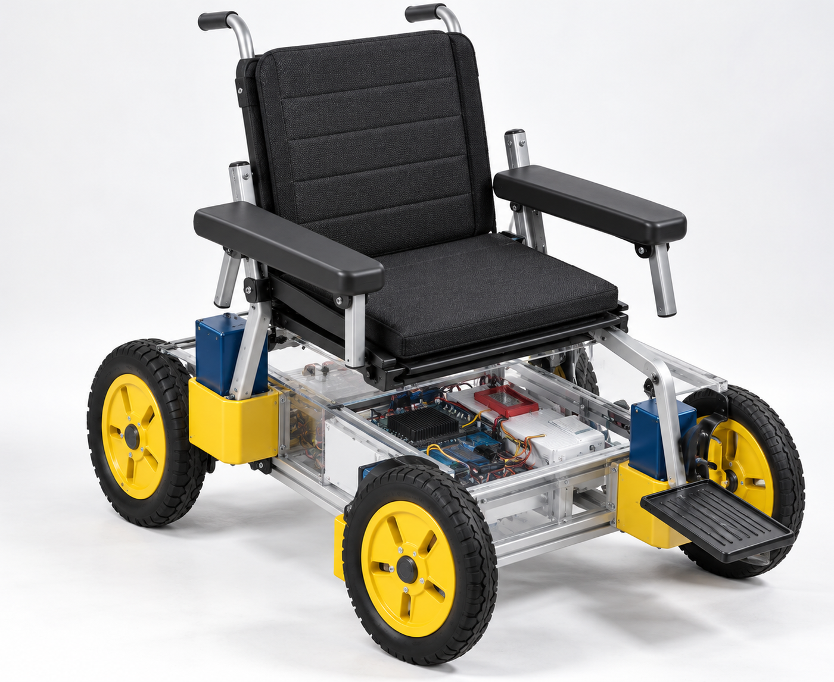
BUGEMA UNIVERSITY
Computing and Informatics
IoT Smart
Wheelchair
Arm-Gesture Control
and Fall Alerts
Kubanja Elijah Eldred
24/BSE/BU/R/0012
Research Methods in Computing
Concept illustration | September 2026
Sources: WHO [1]; Arduino [2]; InvenSense [3].
01
Notes:
Student: Kubanja Elijah Eldred, 24/BSE/BU/R/0012. This is an eight-week proposed tabletop model. The white cover uses the full-resolution 1400 by 1146 pixel version of the wheelchair image requested by the student. This asset was recovered directly from the original supplied PowerPoint (ppt/media/image2.png), replacing the 249 by 208 pixel screenshot. The original high-resolution PNG is embedded without resampling or regenerating its content, with its native aspect ratio preserved. The image remains a concept illustration and does not establish that a completed wheelchair has been built or safety-tested. The remaining five slides, all visible slide text, font sizes and references are unchanged. Original source date: 9 September 2026. Only the PowerPoint cover visual and its documentation are updated in this revision; the accompanying report has not been modified.
SOURCES
[1] World Health Organization. (2023). Wheelchair provision guidelines. Geneva: World Health Organization. ISBN 978-92-4-007452-1.
https://www.who.int/publications/i/item/9789240074521
[2] Arduino. (n.d.). UNO R3. Arduino Documentation.
https://docs.arduino.cc/hardware/uno-rev3/
[3] InvenSense Inc. (2013, August 19). MPU-6000 and MPU-6050 product specification (Revision 3.4; PS-MPU-6000A-00). Manufacturer-authored specification; distributor-hosted copy.
https://www.cdiweb.com/datasheets/invensense/mpu-6050_datasheet_v3%204.pdf
Source project: Kubanja Elijah Eldred, supplied six-slide proposal dated 9 September 2026. Images are retained from its embedded assets unless otherwise indicated. Accessed 15 September 2026.

Slide 2
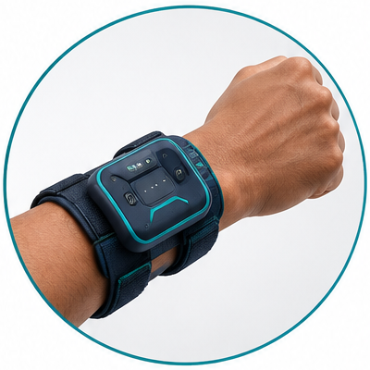
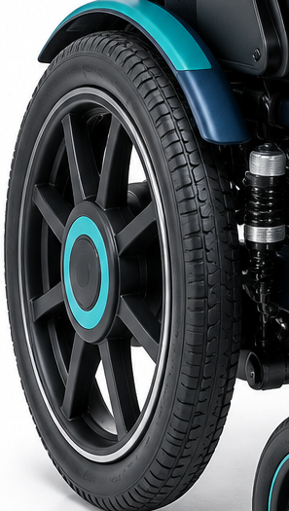
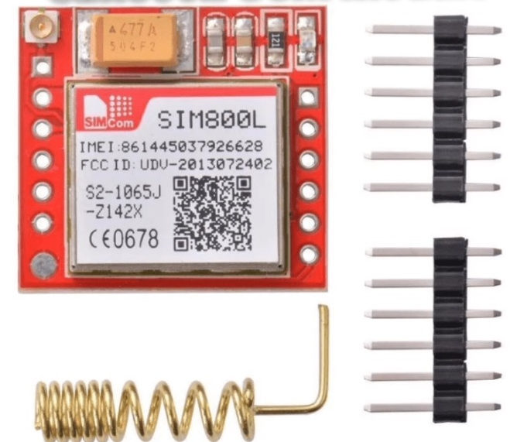
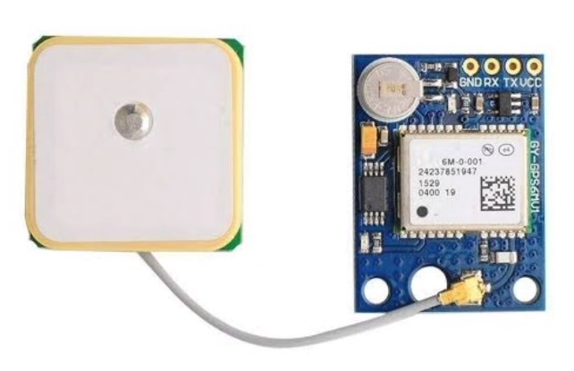
Mobility and safety gaps
Study concerns—not measured local findings.
1
Limited control
2
Physical effort
Limited hand strength
or dexterity can make
control difficult.
Manual propulsion can
be tiring and limit
independence.
3
Delayed help
4
Missing location
After a suspected fall,
help may not arrive
promptly.
Caregivers may not
know where support
is needed.
Need: intuitive movement control + prompt caregiver alerts.
Sources: WHO (2023) [1]; Bagalà et al. (2012) [6].
02
Notes:
These four concerns are preserved from the supplied project: limited control, physical effort, delayed assistance and missing location. They are not measured findings about Bugema University or Uganda. WHO supports individual needs assessment and appropriate wheelchair provision; the fall-detection study cautions against assuming that laboratory performance generalises to real life. It is not wheelchair-specific validation. Detail images are illustrative: the arm and wheel crops come from the supplied concept image, and GSM/GPS photos are supplied component examples.
SOURCES
[1] World Health Organization. (2023). Wheelchair provision guidelines. Geneva: World Health Organization. ISBN 978-92-4-007452-1.
https://www.who.int/publications/i/item/9789240074521
[6] Bagalà, F., Becker, C., Cappello, A., Chiari, L., Aminian, K., Hausdorff, J. M., Zijlstra, W., & Klenk, J. (2012). Evaluation of accelerometer-based fall detection algorithms on real-world falls. PLOS ONE, 7(5), e37062.
https://doi.org/10.1371/journal.pone.0037062
Source project: Kubanja Elijah Eldred, supplied six-slide proposal dated 9 September 2026. Images are retained from its embedded assets unless otherwise indicated. Accessed 15 September 2026.

Slide 3
Four measurable objectives
Eight-week study • Planned work, not completed results.
Document 10 user and caregiver requirements.
WEEK 1
Build the gesture-control model;
test 100 movement commands.
WEEK 3
Integrate caregiver alerts;
safely simulate 20 fall-candidate events.
WEEK 5
Evaluate accuracy, false alarms and
responses to 10 radio-link failures.
WEEK 8
Sources: supplied project plan; WHO [1]; Bagalà et al. [6].
03
Notes:
The original four objectives and the eight-week scope are retained. Week 1: document 10 user/caregiver requirements; this is not a claim that ten people will be interviewed. Week 3: build and test the gesture-control model using 100 commands. Week 5: integrate alerts and safely simulate 20 fall-candidate events with a fixture or dummy, never human falls. Week 8: evaluate accuracy, false alarms and ten controlled radio-link failures. The original notes propose balancing the commands across forward, reverse, left, right and stop. Non-fall trial counts and acceptance thresholds are not supplied and must be specified before evaluation.
SOURCES
[1] World Health Organization. (2023). Wheelchair provision guidelines. Geneva: World Health Organization. ISBN 978-92-4-007452-1.
https://www.who.int/publications/i/item/9789240074521
[6] Bagalà, F., Becker, C., Cappello, A., Chiari, L., Aminian, K., Hausdorff, J. M., Zijlstra, W., & Klenk, J. (2012). Evaluation of accelerometer-based fall detection algorithms on real-world falls. PLOS ONE, 7(5), e37062.
https://doi.org/10.1371/journal.pone.0037062
Source project: Kubanja Elijah Eldred, supplied six-slide proposal dated 9 September 2026. Images are retained from its embedded assets unless otherwise indicated. Accessed 15 September 2026.

Slide 4
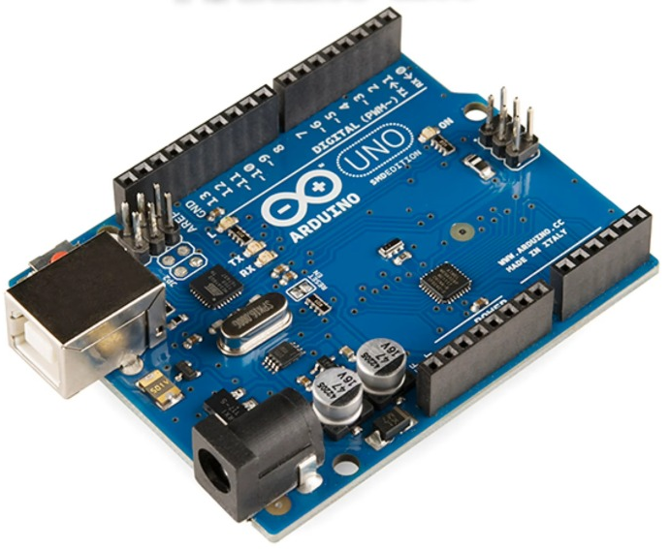
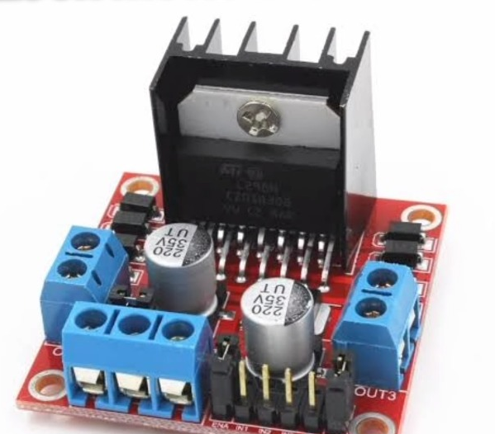
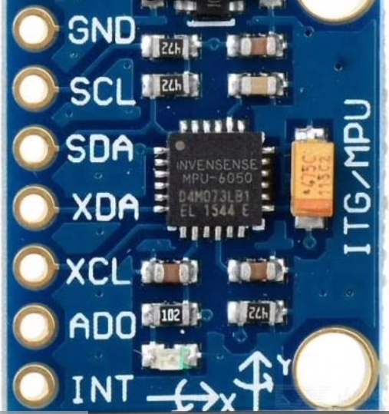
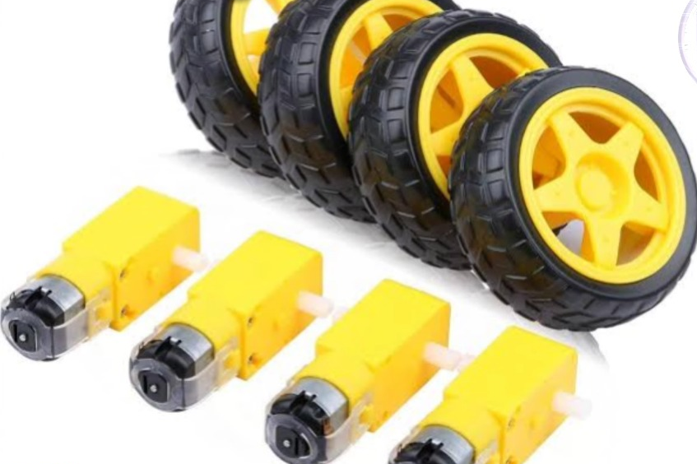
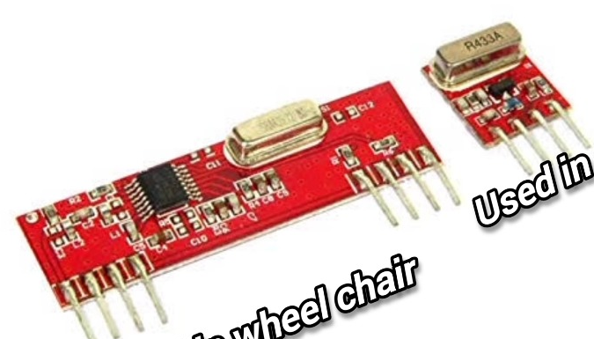
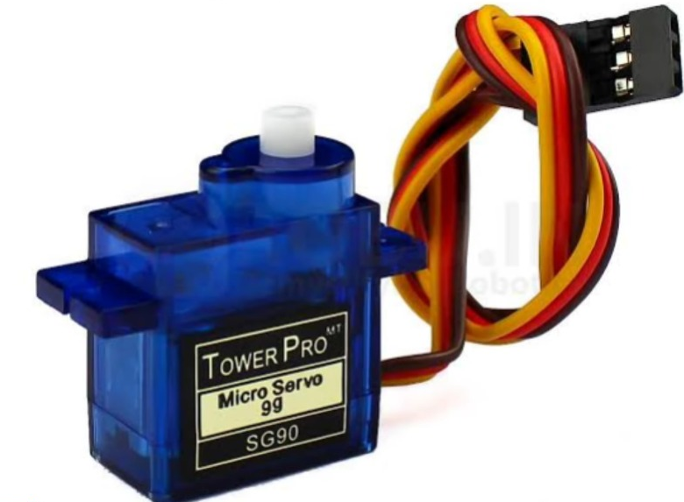
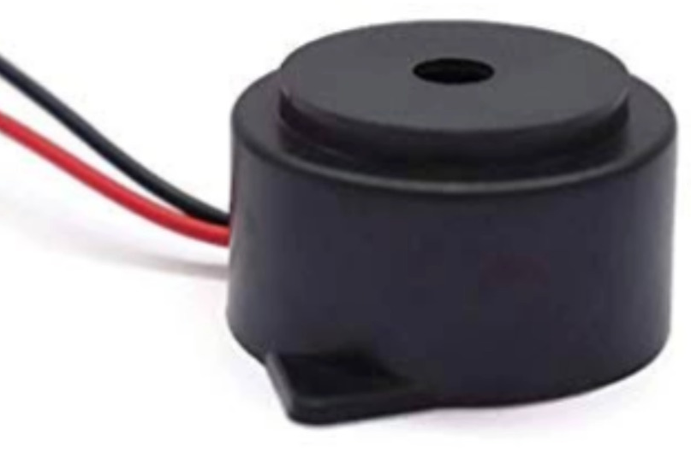
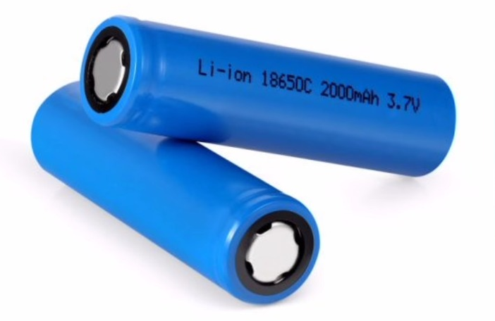
Prototype: components and roles
Tabletop model only—not passenger-ready.
Arduino Uno ×2
L298N / L293D
Control both units
Drive model motors
MPU6050
Motors + wheels
Sense arm motion
Move the model
433 MHz RF pair
SG90 servos*
Send commands
Optional steering
GPS module
Local buzzer
Get coordinates
Sound an alert
SIM800L GSM
Li-ion supply
Send caregiver SMS
Power the model
Sources: Arduino; InvenSense; SIMCom; ST; GPS/servo [2–5, 7–9].
04
Notes:
These are the original educational model components, not a full-size wheelchair bill of materials. The RF model is unspecified; confirm its exact frequency and interface before assembly. SG90 is optional and not required for differential steering. L298 is a STMicroelectronics device [5]; L293D is from Texas Instruments [8]. Their current limits and voltage losses must be checked for the selected small motors. SIM800L must not be powered from an Arduino GPIO. The UNO serial-port integration arrangement remains to be resolved and bench-tested. All photos were already embedded in the uploaded file; original photographer URLs are not provided. Datasheet citations document technical roles, not the provenance of these photographs.
SOURCES
[2] Arduino. (n.d.). UNO R3. Arduino Documentation.
https://docs.arduino.cc/hardware/uno-rev3/
[3] InvenSense Inc. (2013, August 19). MPU-6000 and MPU-6050 product specification (Revision 3.4; PS-MPU-6000A-00). Manufacturer-authored specification; distributor-hosted copy.
https://www.cdiweb.com/datasheets/invensense/mpu-6050_datasheet_v3%204.pdf
[4] SIMCom. (2013, August 20). SIM800L hardware design (Version 1.00). Manufacturer-authored hardware manual; MakerHero-hosted copy.
https://www.makerhero.com/img/files/download/Datasheet_SIM800L.pdf
[5] STMicroelectronics. (2023, October). L298: Dual full-bridge driver (DS0218, Revision 5).
https://www.st.com/resource/en/datasheet/l298.pdf
[7] u-blox AG. (2011, December 5). NEO-6: u-blox 6 GPS modules, data sheet (GPS.G6-HW-09005-E).
https://content.u-blox.com/sites/default/files/products/documents/NEO-6_DataSheet_(GPS.G6-HW-09005).pdf
[8] Texas Instruments. (2016, January). L293x quadruple half-H drivers (SLRS008D, Revision D).
https://www.ti.com/lit/ds/symlink/l293.pdf
[9] Tower Pro. (n.d.). SG90 Digital. Product documentation.
https://towerpro.com.tw/product/sg90-7/
Source project: Kubanja Elijah Eldred, supplied six-slide proposal dated 9 September 2026. Images are retained from its embedded assets unless otherwise indicated. Accessed 15 September 2026.

Slide 5
Key references
The same reference numbers are used in the report.
[1] WHO (2023)
[2] Arduino (n.d.)
Wheelchair provision
guidelines.
UNO R3 official
documentation.
[3] InvenSense (2013)
[4] SIMCom (2013)
MPU-6000 / MPU-6050
product specification.
SIM800L hardware
design, version 1.00.
[5] STMicroelectronics (2023)
[6] Bagalà et al. (2012)
L298 dual full-bridge
driver datasheet.
Fall-detection evaluation.
PLOS ONE, 7(5), e37062.
Full references [1]–[9], source links and image credits are in the report.
05
Notes:
The six principal references are retained with their original numbering. Click an author heading to open the source. Full bibliographic details and URLs for [1]–[9] appear in the report. InvenSense [3] and SIMCom [4] are manufacturer-authored documents accessed through distributor/public mirrors; they are not presented as websites hosting the original photographs. Additional sources: u-blox NEO-6 [7], TI L293D [8], Tower Pro SG90 [9]. The report does not claim to have independently authenticated the supplied component photos.
SOURCES
[1] World Health Organization. (2023). Wheelchair provision guidelines. Geneva: World Health Organization. ISBN 978-92-4-007452-1.
https://www.who.int/publications/i/item/9789240074521
[2] Arduino. (n.d.). UNO R3. Arduino Documentation.
https://docs.arduino.cc/hardware/uno-rev3/
[3] InvenSense Inc. (2013, August 19). MPU-6000 and MPU-6050 product specification (Revision 3.4; PS-MPU-6000A-00). Manufacturer-authored specification; distributor-hosted copy.
https://www.cdiweb.com/datasheets/invensense/mpu-6050_datasheet_v3%204.pdf
[4] SIMCom. (2013, August 20). SIM800L hardware design (Version 1.00). Manufacturer-authored hardware manual; MakerHero-hosted copy.
https://www.makerhero.com/img/files/download/Datasheet_SIM800L.pdf
[5] STMicroelectronics. (2023, October). L298: Dual full-bridge driver (DS0218, Revision 5).
https://www.st.com/resource/en/datasheet/l298.pdf
[6] Bagalà, F., Becker, C., Cappello, A., Chiari, L., Aminian, K., Hausdorff, J. M., Zijlstra, W., & Klenk, J. (2012). Evaluation of accelerometer-based fall detection algorithms on real-world falls. PLOS ONE, 7(5), e37062.
https://doi.org/10.1371/journal.pone.0037062
[7] u-blox AG. (2011, December 5). NEO-6: u-blox 6 GPS modules, data sheet (GPS.G6-HW-09005-E).
https://content.u-blox.com/sites/default/files/products/documents/NEO-6_DataSheet_(GPS.G6-HW-09005).pdf
[8] Texas Instruments. (2016, January). L293x quadruple half-H drivers (SLRS008D, Revision D).
https://www.ti.com/lit/ds/symlink/l293.pdf
[9] Tower Pro. (n.d.). SG90 Digital. Product documentation.
https://towerpro.com.tw/product/sg90-7/
Source project: Kubanja Elijah Eldred, supplied six-slide proposal dated 9 September 2026. Images are retained from its embedded assets unless otherwise indicated. Accessed 15 September 2026.

Slide 6
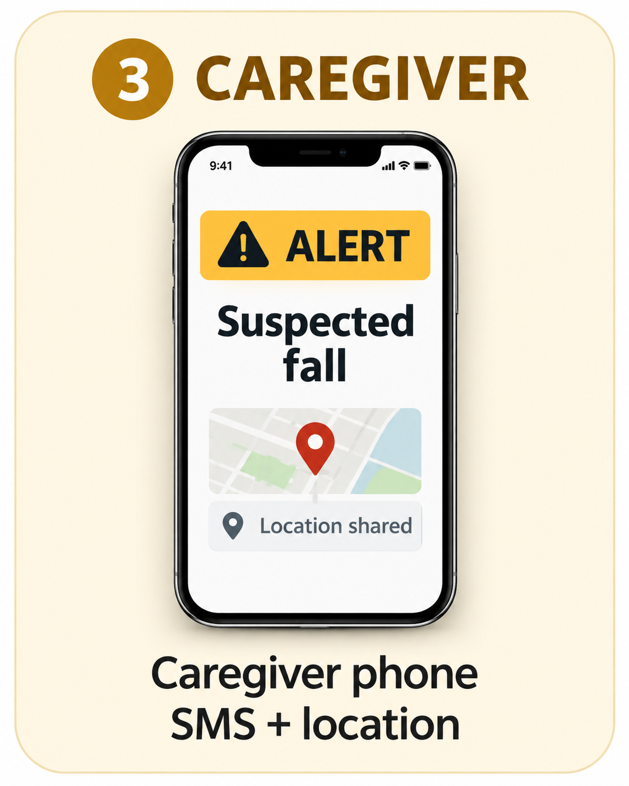
How the proposed system works
Arm controller → wheelchair model → caregiver
1 ARM UNIT
2 CHAIR MODEL
RF
GSM
MPU6050 + Uno
Arm gestures
Control + drive
+ protected power
Suspected fall → local alarm + SMS. *When location is available.
Sources: Arduino; InvenSense; SIMCom; ST; Bagalà; u-blox [2–7].
06
Notes:
Proposed sequence retained from the source notes: calibrate a neutral arm position; read MPU6050 motion; validate fresh radio commands; drive the small motors; monitor possible fall cues; stop motion and sound a buzzer; allow a cancellation window; then send caregiver SMS with location when available. Do not wait indefinitely for GPS before alerting. GSM/network conditions affect receipt; local radio movement control must not depend on a mobile network or Internet service. The one arm-mounted IMU does not establish reliable detection of every user fall or wheelchair tip-over; distinguish the target event before evaluation. The report labels implementation additions and open design decisions. The phone is a concept mockup, not evidence of a delivered SMS.
SOURCES
[2] Arduino. (n.d.). UNO R3. Arduino Documentation.
https://docs.arduino.cc/hardware/uno-rev3/
[3] InvenSense Inc. (2013, August 19). MPU-6000 and MPU-6050 product specification (Revision 3.4; PS-MPU-6000A-00). Manufacturer-authored specification; distributor-hosted copy.
https://www.cdiweb.com/datasheets/invensense/mpu-6050_datasheet_v3%204.pdf
[4] SIMCom. (2013, August 20). SIM800L hardware design (Version 1.00). Manufacturer-authored hardware manual; MakerHero-hosted copy.
https://www.makerhero.com/img/files/download/Datasheet_SIM800L.pdf
[5] STMicroelectronics. (2023, October). L298: Dual full-bridge driver (DS0218, Revision 5).
https://www.st.com/resource/en/datasheet/l298.pdf
[6] Bagalà, F., Becker, C., Cappello, A., Chiari, L., Aminian, K., Hausdorff, J. M., Zijlstra, W., & Klenk, J. (2012). Evaluation of accelerometer-based fall detection algorithms on real-world falls. PLOS ONE, 7(5), e37062.
https://doi.org/10.1371/journal.pone.0037062
[7] u-blox AG. (2011, December 5). NEO-6: u-blox 6 GPS modules, data sheet (GPS.G6-HW-09005-E).
https://content.u-blox.com/sites/default/files/products/documents/NEO-6_DataSheet_(GPS.G6-HW-09005).pdf
Source project: Kubanja Elijah Eldred, supplied six-slide proposal dated 9 September 2026. Images are retained from its embedded assets unless otherwise indicated. Accessed 15 September 2026.

