Slide 1
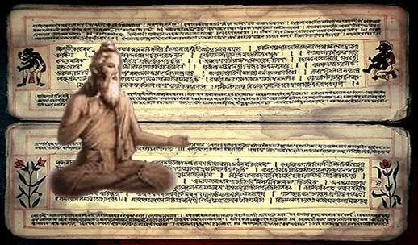
NYaya
Dr. Meenu Dudeja
Indian thought

Slide 2
Historical background
The Nyāya and the Vaiśeṣika systems are two orthodox (āstika) systems of Indian philosophy—meaning they admit the Vedas as eternal and infallible—that preexist the Common Era.
The Nyāya and the Vaiśeṣika were two independent systems with their own respective metaphysics, epistemology, logic, ethics, and soteriology. Over time, the Vaiśeṣika system became so entwined with the Nyāya to the extent that until recently, there was no independent history of the Vaiśeṣika as a basic system.
The Nyāya and the Vaiśeṣika are committed to common-sense realism and pluralism in their ontology; believe in the creation of the world from material atoms that conjoin to generate this world by the will of God and in accordance with the accumulated merits and demerits of individual agents; accept a theory of causation according to which a new effect is produced by its cause and is not a mere manifestation of the cause; and admit that liberation means absolute cessation of suffering, a state where the liberated self is without any consciousness.
Dr. Meenu Dudeja

Slide 3
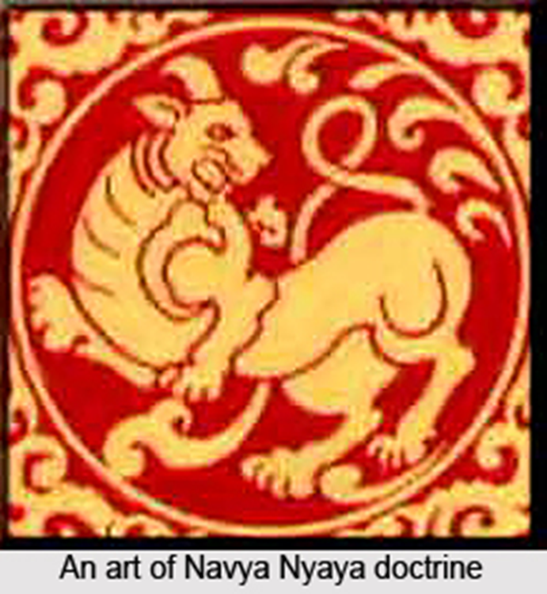
Nyaya in brief (1)
Dr. Meenu Dudeja
Nyaya, ( Sanskrit: “Rule” or “Method”) one of the six systems (darshans) of Indian philosophy, important for its analysis of logic and epistemology.
The major contribution of the Nyaya system is its working out in profound detail the means of knowledge known as inference.
Like the other systems, Nyaya is both philosophical and religious. Its ultimate concern is to bring an end to human suffering, which results from ignorance of reality. Liberation is brought about through right knowledge. Nyaya is thus concerned with the means of right knowledge.

Slide 4
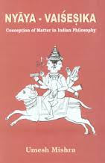
Nyaya in brief (2)
In its metaphysics, Nyaya is allied to the Vaisheshika system, and the two schools were often combined from about the 10th century.
Its principal text is the Nyaya-sutras, ascribed to Gautama (c. 2nd century bce).
Dr. Meenu Dudeja

Slide 5
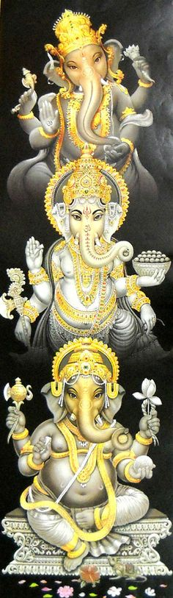
Nyaya in brief (3)
Dr. Meenu Dudeja
Old Nyaya: The Nyaya system—from Gautama through his important early commentator Vatsyayana (c. 450 ce) until Udayanacharya (10th century)—became qualified as the Old Nyaya (Prachina-Nyaya)
New Nyaya: The new school of Nyaya (Navya-Nyaya, or “New Nyaya”) arose in Bengal in the 11th century. The best-known philosopher of the Navya-Nyaya, and the founder of the modern school of Indian logic, was Gangesha (13th century).

Slide 6
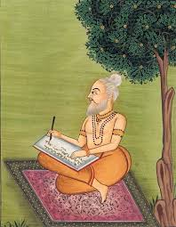
Nyaya in brief (4)
Valid means of knowledge: (1) Perception (pratyaksha), (2) Inference (anumana), (3) Comparison (upamana), and (4) Sound, or Testimony (shabda).
Invalid knowledge: Involves memory, doubt, error, and hypothetical argument.

Slide 7
Nyaya in Brief (5)
Theory of causation: Nyaya defines a cause as an unconditional and invariable antecedent of an effect. In its emphasis on sequence—an effect does not preexist in its cause—the Nyaya theory is at variance with the Samkhya-Yoga and Vedantist views, but it is not unlike modern Western inductive logic in this respect.
Three kinds of causes:
Inherent or material cause (the substance out of which an effect is produced)
Non-inherent cause (which helps in the production of a cause),
Efficient cause (the power that helps the material cause produce the effect).
God is not the material cause of the universe, since atoms and souls are also eternal, but is rather the efficient cause.

Slide 8
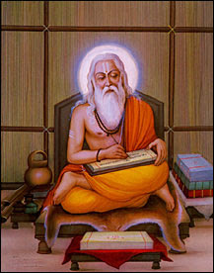
Epistemology (1)
Nyaya treated epistemology as theory of knowledge, and its scholars developed it as Pramana-sastras.
Pramana, a Sanskrit word, literally is "means of knowledge". It encompasses one or more reliable and valid means by which human beings gain accurate, true knowledge.
The focus of Pramana is how correct knowledge can be acquired, how one knows, how one doesn't, and to what extent knowledge pertinent about someone or something can be acquired.

Slide 9
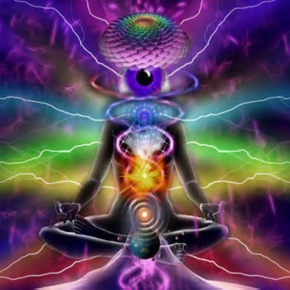
Epistemology (2)
The Nyaya scholars accepted four valid means of obtaining valid knowledge perception, inference, comparison and word/testimony of reliable sources.
The Nyaya scholars also developed a theory of error, to methodically establish means to identify errors and the process by which errors are made in human pursuit of knowledge. These include Saṁśaya (problems, inconsistencies, doubts) and Viparyaya (contrariness and errors) which can be corrected or resolved by a systematic process of Tarka (reasoning and technique).

Slide 10
Perception (1)
Perception occupies the foremost position in the Nyaya epistemology. It can be of two types: Ordinary and Extraordinary).
Ordinary perception is defined by Akṣapāda Gautama in his Nyaya Sutra as a 'non-erroneous cognition which is produced by the intercourse of sense-organs with the objects'. Ordinary perception to Nyaya scholars was based on direct experience of reality by eyes, ears, nose, touch and taste.
Extraordinary perception included: (1) intuition), (2) a form of induction from perceived specifics to a universal), and (3) a form of perception of prior processes and previous states of a 'topic of study' by observing its current state).

Slide 11
Perception (2)
Indian texts identify four requirements for correct perception:
Direct experience by one's sensory organ(s) with the object, (whatever is being studied)
Non-verbal; correct perception is not through hearsay where one's sensory organ relies on accepting or rejecting someone else's perception,
Does not wander; correct perception does not change, nor is it the result of deception because one's sensory organ or means of observation is drifting, defective, or suspect.
Definite; correct perception excludes judgments of doubt, either because of one's failure to observe all the details, or because one is mixing inference with observation and observing what one wants to observe, or not observing what one does not want to observe.

Slide 12
Indeterminate and Determinate Perception
Nyaya scholars maintains two modes or stages in perception:
Indeterminate, when one just perceives an object without being able to know its features,
Determinate, when one is able to clearly know an object.
if an object is perceived with its name we have determinate perception but if it is perceived without a name, we have indeterminate perception.
Indeterminate perception apprehends substance, qualities and actions and universals as separate and indistinct something and also it does not have any association with name, while determinate perception apprehends all these together with a name.
There is yet another stage called Pratyabhijñā, when one is able to re-recognize something on the basis of memory.

Slide 13
Inference
Inference is one of the most important contributions of the Nyaya.
Inference can be of two types: Inference for oneself where one does not need any formal procedure, and at the most the last three of their 5 steps, and Inference for others which requires a systematic methodology of 5 steps. [see next slide]
Inference can also be classified into 3 types: (1) inferring an unperceived effect from a perceived cause), (2) inferring an unperceived cause from a perceived effect and (3) when inference is not based on causation but on uniformity of co-existence).

Slide 14
Theory of inference (1)
The methodology of inference involves a combination of induction and deduction by moving from particular to particular via generality. It has five steps, as in the example shown:
There is fire on the hill (called Pratijñā, required to be proved) Because there is smoke there (called Hetu, reason)
Wherever there is smoke, there is fire, e.g. in a kitchen (called Udāhārana)
The hill has smoke that is pervaded by fire (called Upanaya, reaffirmation or application)
Therefore there is fire on the hill (called Nigamana, conclusion)

Slide 15
Theory of inference (2)
In Nyāya terminology for this example:
the hill=minor term
the fire=major term
the smoke=hetu (reason)
the relationship between the smoke and the fire=middle term
Hetu (reason) has five characteristics: (1) It must be present in the minor term (2) It must be present in all positive instances, (3) It must be absent in all negative instances, (4) It must not incompatible with the minor term (5) All other contradictions by other means of knowledge should be absent.

Slide 16
The Origin of fallacies (1)
1) Asiddha: It is the unproved hetu (reason) that results in this fallacy.
If Paksha [minor term] itself is unreal, then there cannot be locus of the hetu. e.g. The sky-lotus is fragrant, because it is a lotus like any other lotus.
Hetu cannot exist in minor term at all. E.g. Sound is a quality, because it is visible.
Conditional hetu. `Wherever there is fire, there is smoke'. The presence of smoke is due to wet fuel.
2) Savyabhichara: This is the fallacy of irregular hetu.
The hetu is too wide. It is present in both sapaksa and vipaksa (aspaksa) [similar and dissimilar to paksa]. `The hill has fire because it is knowable'.
The hetu is too narrow. It is only present in the minor term, it is not present in the Sapaksa and in the Vipaksha. `Sound is eternal because it is audible'.
Here the hetu is non-exclusive. The hetu is all-inclusive and leaves nothing by way of sapaksha or vipaksha. e.g. 'All things are non-eternal, because they are knowable'.

Slide 17
The Origin of fallacies (2)
3) Satpratipaksa: Here the hetu is contradicted by another hetu. If both have equal force, then nothing follows. 'Sound is eternal, because it is audible', and 'Sound is non-eternal, because it is produced'. Here 'audible' is counterbalanced by 'produced' and both are of equal force.
4) Badhita: When another proof (as by perception) definitely contradicts and disproves the middle term (hetu). 'Fire is cold because it is a substance'.
5) Viruddha: Instead of proving something it is proving the opposite. 'Sound is eternal because it is produced'.

Slide 18
Comparison, analogy
Upamāna means comparison and analogy may be explained with the example of a traveller who has never visited lands or islands with endemic population of wildlife. He or she is told, by someone who has been there, that in those lands you see an animal that sort of looks like a cow, grazes like cow but is different from a cow in such and such way. Such use of analogy and comparison is, state the Indian epistemologists, a valid means of conditional knowledge, as it helps the traveller identify the new animal later.

Slide 19
Word, Testimony (1)
Śabda means relying on word, testimony of past or present reliable experts.
Sabda is a concept which means testimony of a reliable and trustworthy person. The schools of Hinduism which consider it epistemically valid suggest that a human being needs to know numerous facts, and with the limited time and energy available, he can learn only a fraction of those facts and truths directly. He must rely on others, his parent, family, friends, teachers, ancestors and kindred members of society to rapidly acquire and share knowledge and thereby enrich each other's lives. This means of gaining proper knowledge is either spoken or written, but through Sabda (words). The reliability of the source is important, and legitimate knowledge can only come from the Sabda of reliable sources. The disagreement between the schools of Hinduism has been on how to establish reliability. Some schools, such as Carvaka, state that this is never possible. Other schools debate means to establish reliability.

Slide 20
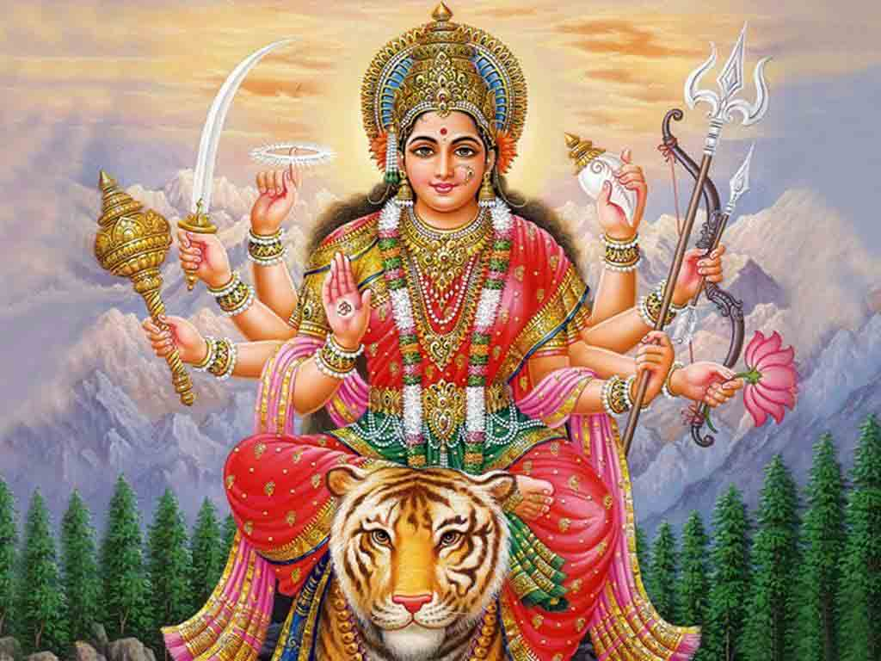
Word, Testimony (2)
Testimony can be of two types, Vaidika (Vedic), which are the words of the four sacred Vedas, and Laukika, or words and writings of trustworthy human beings. Vaidika testimony is preferred over Laukika testimony. Laukika-sourced knowledge must be questioned and revised as more trustworthy knowledge becomes available.

Slide 21
The Nyaya theory of causation (1)
A cause is defined as an unconditional and invariable antecedent of an effect and an effect as an unconditional and invariable consequent of a cause. The same cause produces the same effect; and the same effect is produced by the same cause. The cause is not present in any hidden form whatsoever in its effect.
The following conditions should be met:
The cause must be antecedent
Invariability
Unconditionality

Slide 22
The Nyaya theory of causation (2)
Nyaya recognizes five kinds of accidental antecedents:
Mere accidental antecedent. E.g., The color of the potter's cloth.
Remote cause is not a cause because it is not unconditional. E.g., The father of the potter.
The co-effects of a cause are not causally related.
Eternal substances, or eternal conditions are not unconditional antecedents, e.g. space.
Unnecessary things, e.g. the donkey of the potter.
Nyaya recognizes three kinds of cause:
Material cause, e.g. thread of a cloth.
Color of the thread which gives the color of the cloth.
Efficient cause, e.g. the weaver of the cloth.

Slide 23
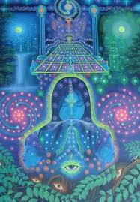
Nyaya on God
Early Nyaya scholars wrote very little about Ishvara (literally, the Supreme Soul).
Evidence available so far suggests that early Nyaya scholars were non-theistic or atheists.
Later, and over time, Nyaya scholars tried to apply some of their epistemological insights and methodology to the question: does God exist? Some offered arguments against and some in favor.

Slide 24
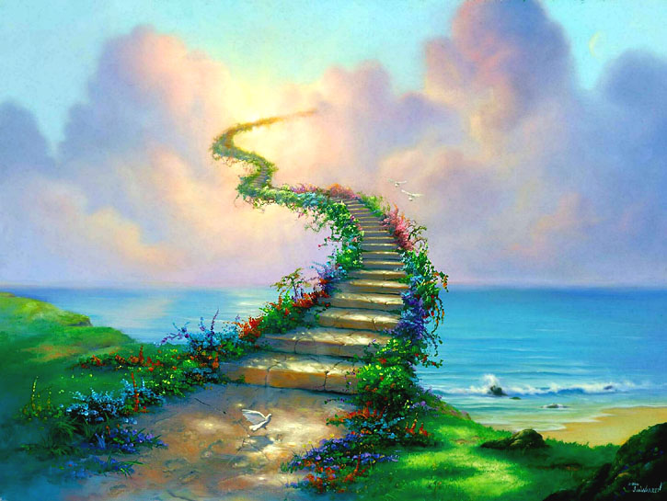
Nyaya on Salvation
The Nyaya scholars believe that the bondage of the world is due to false knowledge, which can be removed by constantly thinking of its opposite namely, the true knowledge. So the opening aphorism of the Nyāya Sūtra states that only the true knowledge lead to Salvation. But the Nyaya school also maintains that the God's grace is essential for obtaining true knowledge.
Salvation is a passive stage of self in its natural purity, unassociated with pleasure, pain, knowledge and willingness.

Slide 25
Summary
Nyaya is an orthodox school of philosophy. It was founded by a great sage called Gautama, not to be confused with the Lord Buddha.
Nyaya accepts the basic philosophy of Vaisheshika system. It can be said that the Vaisheshika system is theory, Nyaya is the practice.
Nyaya recognizes god but Gautama does not deal with the problem of existence of god in any detail.
Like the Vaisheshika, Nyaya holds that the self is an individual substance, eternal and all pervading. Consciousness is not an essential attribute of the self, but it is only an accidental one.
According to Nyaya, salvation is the state of absolute freedom. It is freedom from all pains and pleasures. Then there is freedom from the cycle of the birth and death also.

Slide 26

DISCUSSIONS

