Slide 1
Indian Knowledge System Number System and Unit of Measurement UNIT 2
By:
Mr. Hirdesh Sharma
JIMS, Greater Noida

Slide 2
Number System in India- Historical Evidence
The contribution of ancient Indians to the development of mathematical concepts is well known and acknowledged.
Several archaeological excavations provide evidence about maturity and supremacy of Indian mathematical foundations.
An inscription on a temple wall in Gwalior dating back to the ninth century CE is considered the oldest recorded example of a zero.

Slide 3
Number System in India- Historical Evidence
Still, surviving Sanskrit texts reveal a rich tradition of Indian mathematical discoveries lasting more than 2,500 years.
In the Early Vedic period (1200–600 bc), a decimal system of numbers was already established in India, together with rules for arithmetical operations (ganita) and geometry (rekha-ganita).

Slide 4
Salient Features of the Indian Numeral System
The indian numeral system has a long history; the origin and the evolution of the numbers could be traced from the time of the Vedic period.
Being an oral tradition, unique and unambiguous names were to be attributed to the numbers.
The Sanskrit language has unique names for numbers strating from one and going upto very large numbers; the first nine digits have unique names (ekam, dve, trini, catvari, panca, sat, sapta, asta, nava).

Slide 5
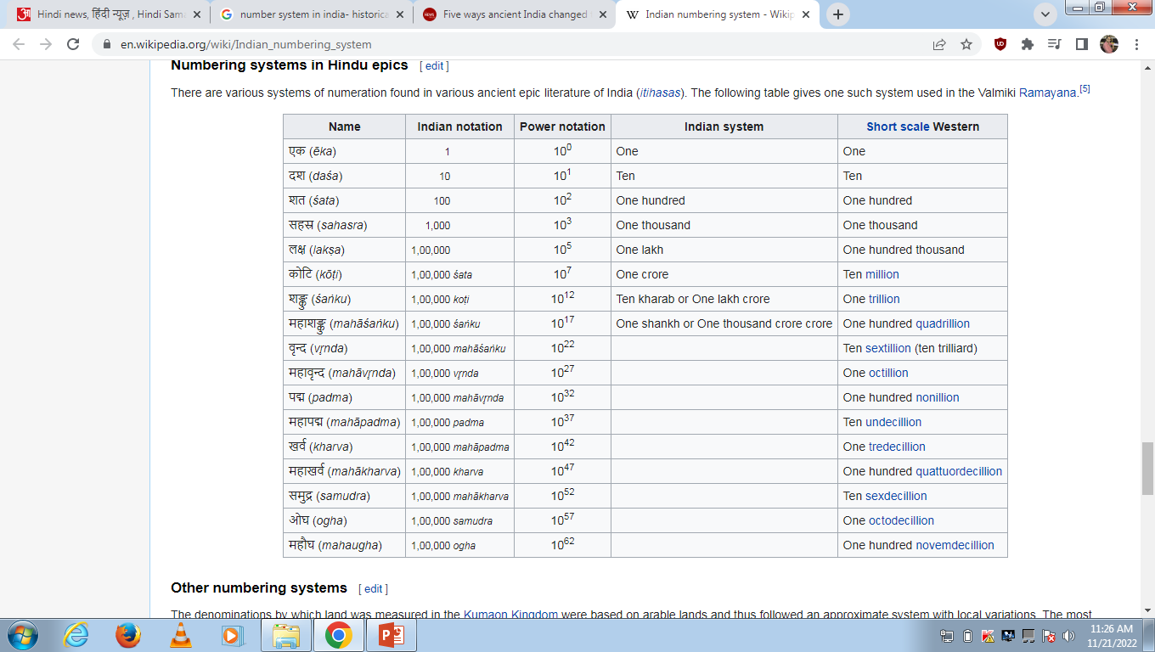
Salient Features of the Indian Numeral System

Slide 6
The Concept of Zero and Its Importance
The concept of zero was established during the period 500-300 BCE.
Ancient Indians used a decimal System that allowed them to develop a method for handling large numbers.
Brahmagupta developed a symbol for zero in 628 CE.
With this invention zero could be used as an independent numeral for computational purposes.

Slide 7
Large Numbers and their representation
Ancient Indians developed a systematic approach to the number- names that they used to describe large numbers.
Three categories of naming conventions were employed to develop the number names in Sanskrit:
All numbers in the digits from 0 to 9 had unique names (sunya, ekam, dve, trini, catvari, panca, sat, sapta, asta, nava).
All numbers in the range of 11 to 99 had an additive principle for naming.
All numbers of higher powers of 10 starting form 102 were named using multiplicative principle using the unit digits as a factor for multiplication.

Slide 8
Unique approaches to Represent Numbers
Ancient Indian mathematics seamlessly integrated mathematics with literature and poetry.
We find well developed systems to address this requirement and discuss two of them here:
Bhuta-Samkhya system is a system of expressing numbers by means of words representing certain entities.
Katapayadi system employs a technique to convert the numerals to alphabets using certain rules.

Slide 9
Bhūtasaṃkhyā (भूतसंख्या) system
Bhūtasaṃkhyā (भूतसंख्या) system is a method of recording numbers in Sanskrit using common nouns having connotations of numerical values.
The method was introduced already in astronomical texts in antiquity, but it was expanded and developed during the medieval period.
A kind of rebus system, bhūtasaṃkhyā has also been called the “concrete number notation”.

Slide 10
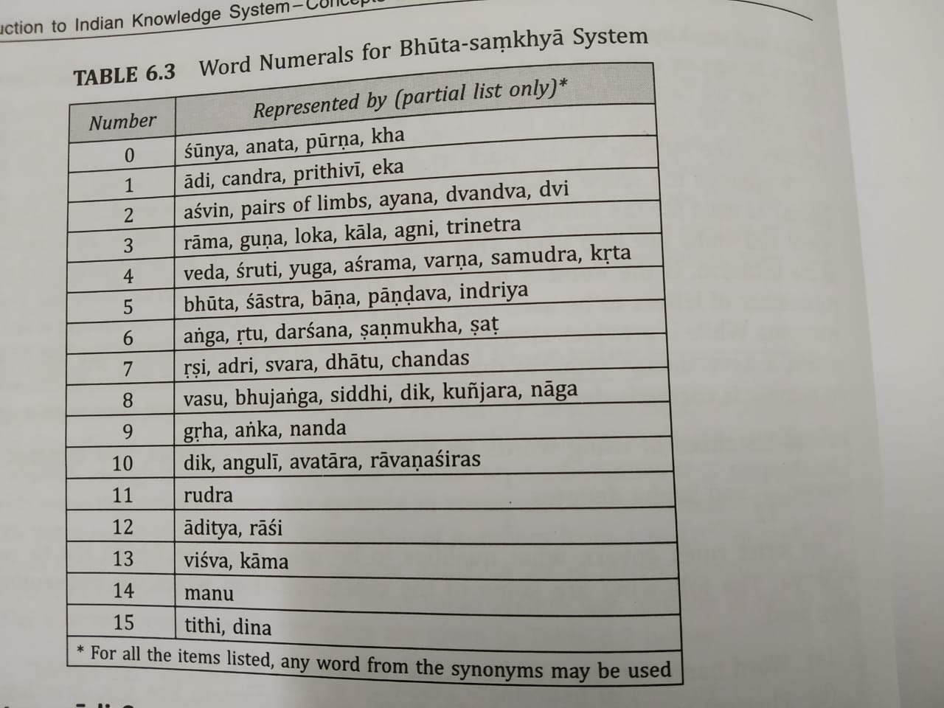
Bhūtasaṃkhyā (भूतसंख्या) system

Slide 11
Katapayadi System
Another System to convert the numerals to words is to associate a number to one or more alphabets.
Using the alphabets in place of numbers, one can construct words, which by deciphering one alphabet at a time will reveal the number expressed in the word.
The advantage of such a system lies in representing large numbers using a word, which can be easily remembered.
This provided a very efficient method of presenting results of complex calculations using number symbols.

Slide 12
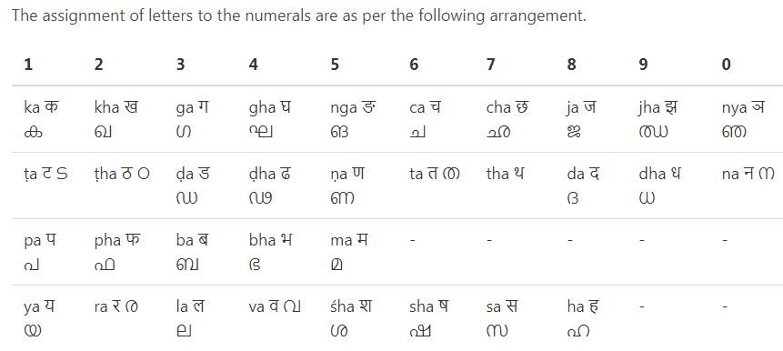
Katapayadi System

Slide 13
Measurement For Time, Distance and Weight
In the ancient Indian literature three fundamental physical measures for quantifying length, time and weight are found.
There are several sources in the literatue specifying units of measurement for these three physical quantities.
Three generic measures pertaining to length, weight and time could be used to measure physical entites.

Slide 14
Notion of Paramanu
At the smallest level, there is a fundamental measure called paramanu.
The measure of Paramanu are as follows:
Paramanu (length): 2.88 x 10⁻⁷ mm
Paramanu (weight): 5.79 x 10⁻⁵ g
Paramanu (time): 1.31 x 10⁻⁵ seconds

Slide 15
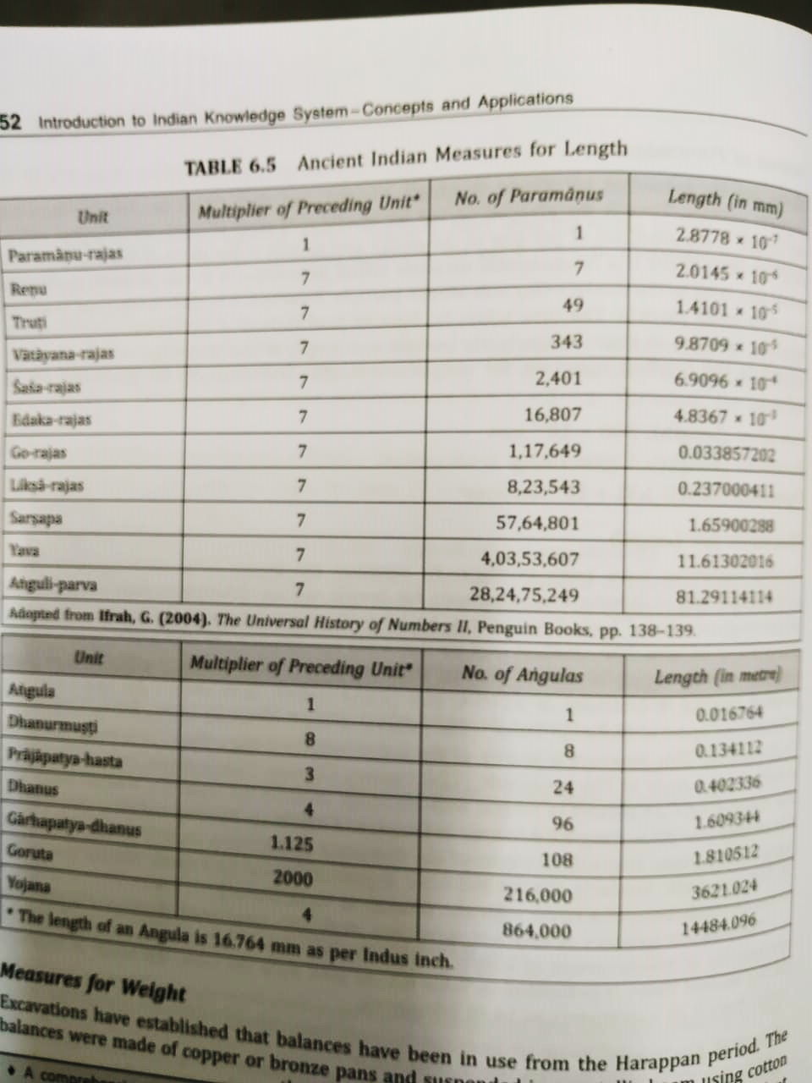
Measures for Length

Slide 16
THANKS

