Slide 1
ES – 107: ELECTRICAL SCIENCE
Dr. Pratul Arvind Ph. D (IIT Roorkee), M.Tech(NIT Jamshedpur), B. Tech( Amravati University)
LMISTE, MIEEE
Professor,
Department of Electronics & Communication Engineering,
Dr. Akhilesh Das Gupta Institute of Technology & Management
(Formerly: Northern India Engineering College)
(Affliated to Guru Gobind Singh Indraprastha University, New Delhi)
New Delhi - 110053.
pratul.arvind@gmail.com,pratularvindiitr@gmail.com,pratul.arvind@adgitmdelhi.ac.in,
9643160414, 7678471968, 9456132358

Slide 2
Topics to be Covered:
Transformers: Construction and principle of operation, equivalent circuit, losses in transformers, regulation and efficiency. Auto-transformer and three-phase transformer connections.
Measuring Instruments: Electromagnetism, Different Torques in Indicating instruments,
Moving Iron Instruments: Construction & Principle, Attraction and Repulsion type;
Moving Coil Instruments: Permanent Magnet type; Dynamometer type Instruments.

Slide 3
Indicating instruments are those which indicate the value of the quantity that is being measured at the time at which it is measured. Such instruments consist essentially of a pointer which moves over a calibrated scale and which is attached to a moving system pivoted in jeweled bearings. The moving system is subjected to the following three torques :
1.Deflecting Torque
2.Controlling Torque
3.Damping Torque
The deflecting torque or operating force is required for moving the pointer from its zero position. The system producing the deflecting force is called “Deflecting system or Moving System”. The deflecting torque can be produced by utilising any of the effects mentioned earlier.Thus the deflecting system of an instrument converts the electric current or potential into a mechanical force called deflecting torque.The deflecting system thus acts as the prime mover responsible for deflection of the pointer.

Slide 4
Constructional details of Deflecting or Moving system:
The requirements of a deflecting system are :
(i) The moving parts should be light
(ii) The frictional forces should be minimum.
These requirements should be fulfilled in order that power required by the instrument for its operation is small.(The power expenditure is proportional to the weight of the moving parts and the frictional forces opposing the movement).The deflecting system can be made light by using aluminium as far as possible.The frictional forces are reduced by using a spindle mounted between jewel bearings and by carefully balancing the system. Supporting the moving element.
The force or torque developed by the moving element of an electrical instrument is necessarily small in order that the power consumption of the instrument be kept low so that the introduction of the instrument into a circuit may cause a minimum change in the existing circuit conditions. Because of low power levels, the consideration of various methods of supporting moving element becomes of vital importance. With the operating forces being small, the frictional forces must be kept to a minimum in order that the instrument reads correctly and is not erratic in action and is reliable

Slide 5
Types of Supports:
Several types of supports are used, depending upon the sensitivity required and the operating conditions to be met. Supports may be of the following types :
♦ Suspension
♦ Taut Suspension
♦ Pivot and jewel bearings (double)
Suspension:
It consists of a fine, ribbon shaped metal filament for the upper suspension and coil of fine wire for the lower part.The ribbon is made of a spring material like beryllium copper or phosphor bronze.This coiling of the lower part of the suspension is done in order to give negligible restraint on the deflecting system.The type of suspension requires careful levelling of the instrument so that the moving system hangs in correct vertical position.
This construction is, therefore, not suited to field use and is employed only in those laboratory applications in which very great sensitivity is required. In order to prevent shocks to the suspension during transit etc. a clamping arrangement is employed for supporting the deflecting system.

Slide 6
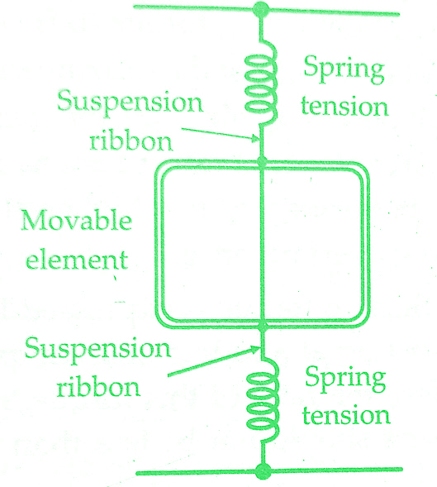

Slide 7
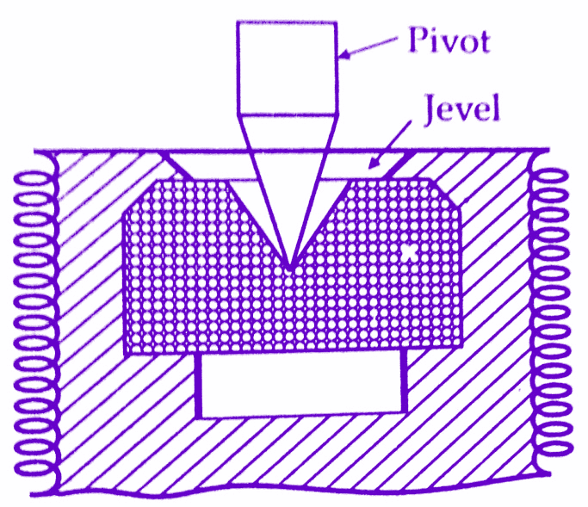
2.Taut suspension:
Suspension type of measuring instruments can only be used in a vertical position.The taut suspension has a flat ribbon suspension both above and below the moving element, with suspension kept under tension by a spring arrangement.The advantage of this suspension is that exact levelling is not required if the moving element is properly balanced.
3. Pivot and jewel bearings:
The deflecting system is mounted on a spindle made of hardened steel. The two ends of the spindle are made conical and then polished to form pivots.These ends fit conical holes in jewels located in the fixed parts of instruments as shown below.These jewels, which are preferably made of sapphire from the bearings.Originally natural sapphire was used but now synthetic sapphire is being used. The combination of gives lowest friction.
It has been found that the frictional torque, for jewel bearings, is proportional to the area of tact between the pivot and jewel.Thus the contact area between pivot and jewel should be small.The pivot is ground to a cone and its tip is rounded to a hemispherical surface of the small area.The jewel is ground to a cone of somewhat larger angle.

Slide 8
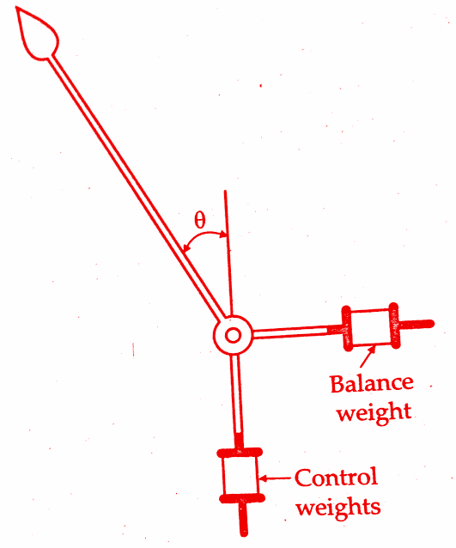
Balancing:
In order that the wear on the bearings becomes uniform and symmetrical, the centre of gravity of weight of moving parts should coincide with the axis of the spindle for all positions of the pointer and there are no out of balance forces.This also ensures that the deflection is unaffected by the position of the pointer and there are no reading errors.The balance can be achieved by using balance weights carried on arms attached to the deflecting system.
The use of balance weights is illustrated in the below figure “control weights“. The balance weight whose position is adjustable compensates for the weight of pointer and any other part attached to the deflecting system. A cheaper method is to replace balance weights by a wire wound round and soldered to the balance arm. Once fixed, the degree of balance is not adjustable in this case

Slide 9
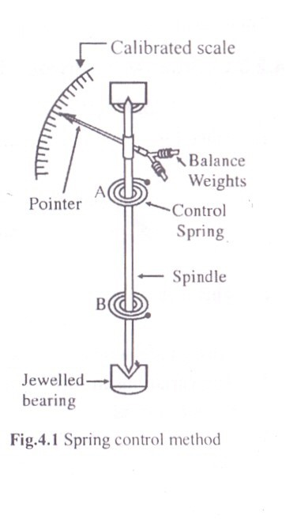
Controlling Torque • Controlling torque limits the movement of pointer and ensures that the magnitude of deflection is unique and is always same for the given value of electrical quantity to be measured.
Two methods of controlling Torque
• i. Spring Control method
• ii Gravity control method
Spring Control method
1. Two phosphor bronze hair
springs of spiral shapes
are attached to the spindle
of the moving system of
the instrument.
2. They are wound in
opposite direction
3. Pointer is attached to the
spindle of the moving
system

Slide 10
Working of Spring Control Method
When the moving system deflected, one spring gets wounded and the other one gets unwounded. This results in controlling torque whose magnitude is directly proportional to angle of deflection
Td is directly proportional to current I and Tc is directly proportional to deflection angle, at final steady state Td = Tc, deflection is directly proportional to current, hence scale is linear

Slide 11
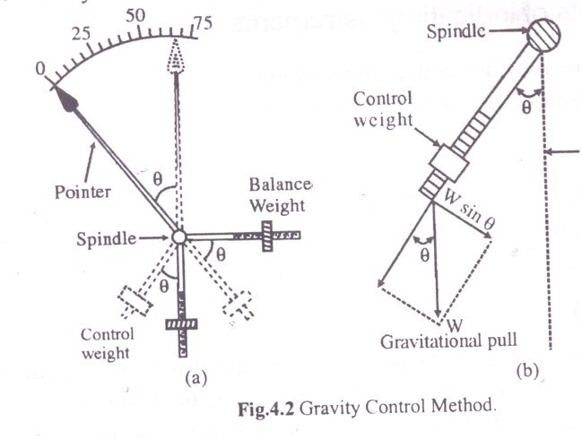
Gravity Control Method
In gravity control method, a small weight is attached to the spindle of the moving system. Due to the gravitational pull, a control torque (acting in opposite direction to the deflecting torque) is produced whenever the pointer tends to move away from its initial position
In this case, Td is directly proportional to current I and Tc is directly proportional to sine of the deflection angle, since Td = Tc, sine of the deflection is directly proportional to current, hence scale is non linear i.e. cramped scale.

Slide 12
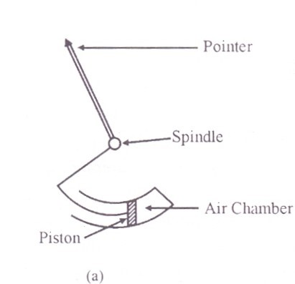
Damping torque
• Damping torque minimizes the oscillations of the pointer about the final steady state deflection and makes it steady.. In the absence of this torque, pointer continues oscillating to its final position after reaching to its final position.
• Depending on the magnitude of damping, it can be classified as underdamped, overdamped and critcal damp
A light aluminum frame is attached to the moving system. This piston moves in an air chamber (cylinder) closed at one end. At the time of oscillation of the moving system or pointer about its final steady state, if the piston is moving into the chamber, the trapped air gets compressed and the pressure opposes the motion of the piston (and therefore the moving system or pointer). Similarly, if the piston is moving out of the chamber, the pressure in the closed chamber falls and becomes less than air pressure on the outer part of the piston. Motion is thus again opposed. Oscillations are damped

Slide 13
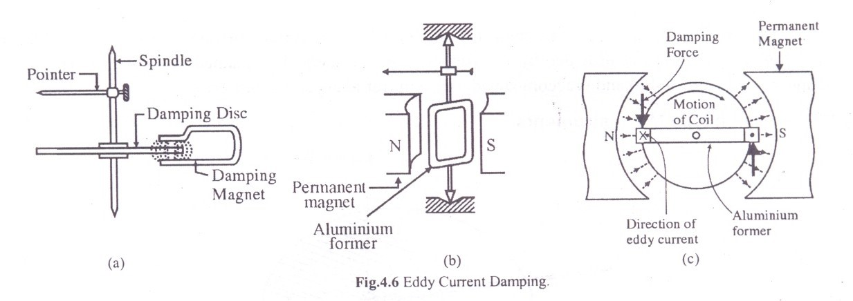
Eddy current damping
An aluminum frame or damping disc is mounted on the spindle and free to rotate in the magnetic field provided by damping magnets. Since damping disc is rotating with spindle, emf is induced in the disc according to faradays law of electromagnetic induction. Since disc is a closed circuit, eddy current in the form of concentric circles will be induced in the damping disc. Interaction between this eddy current and magnetic field develops a force on the damping disc which opposes the movement of sheet. And thus provides damping of the oscillations of the pointer

Slide 14
Moving Iron Instruments
Construction
Instrument consists of a stationary coil in which the current to be measured is passed.
A piece of un-magnetized soft iron which is of oval shape is mounted rigidly on the spindle. This soft iron piece is free to move about the spindle and along with the spindle.
Working
1. The current to be measured is flowing in the coil, produces a magnetic field. Iron piece gets attracted towards center of the magnetic field and pointer deflects on the scale.
2. Control torque is provided either by control springs or by gravity control
method
3. Damping is provided by air friction damping
4. The scale is non-linear. Mirror is provided to avoid parallax error.

Slide 15
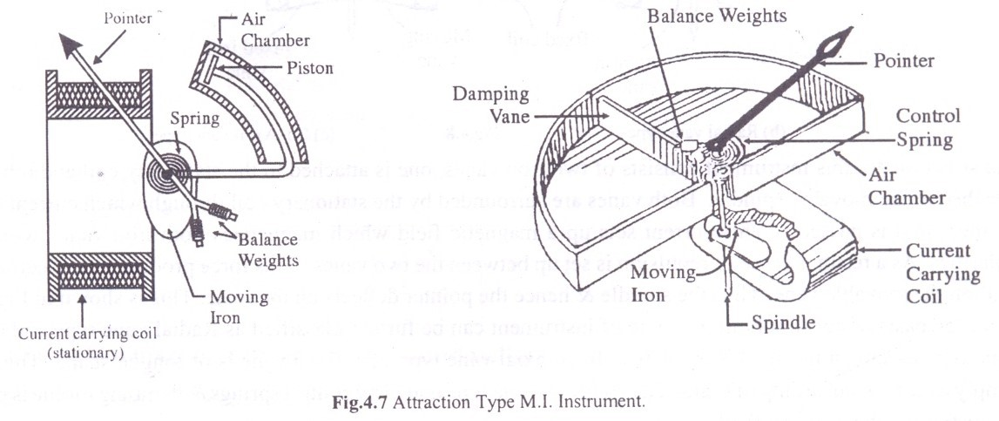
Attraction type M. I. Instruments
This instrument consists of stationary coil in which current I that is to be measured is passed
A piece of un-magnetised soft iron which is oval in shape is mounted rigidly on the spindle. This soft iron piece is free to move about the spindle and along with the spindle. It is placed closer to the stationary coil as shown in fig.
A pointer is fixed on the spindle.

Slide 16
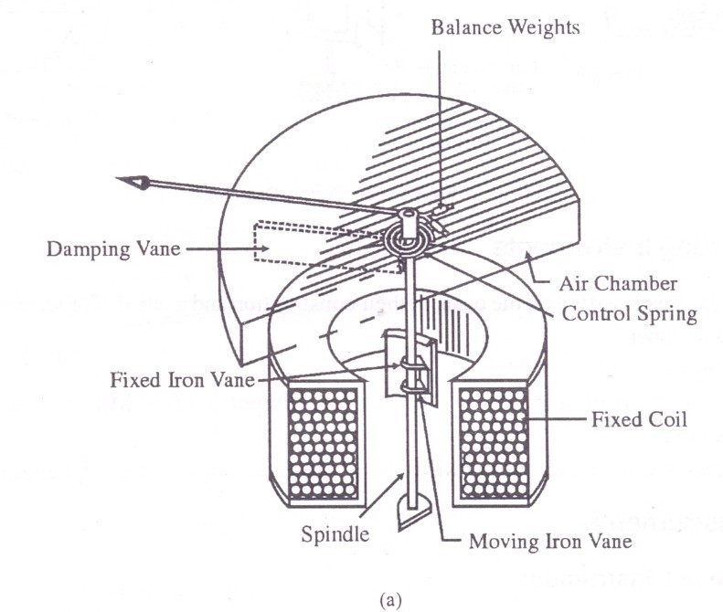
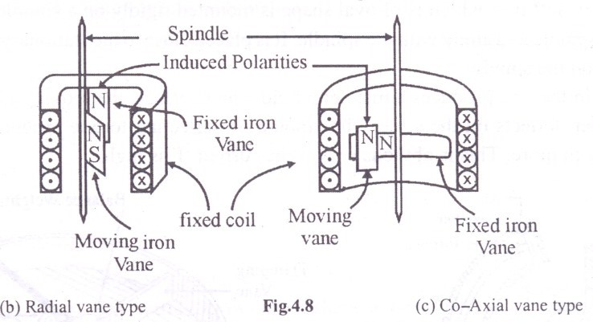
Repulsion type M. I. Instruments
Construction
This instrument consists of two iron vanes, one is attached to the stationary coil and other one is attached to the movable spindle.
Both vanes are surrounded by the stationary coil, current to be measured is passing thorough this coil.

Slide 17
Working
Current to be measured is passing thorough stationary coil produces magnetic field. Both the vanes magnetizes with similar polarities.
As a result a force of repulsion is set up between two vanes.
This force produces a deflecting torque on the movable vanes, gives deflection on the scale.

Slide 18
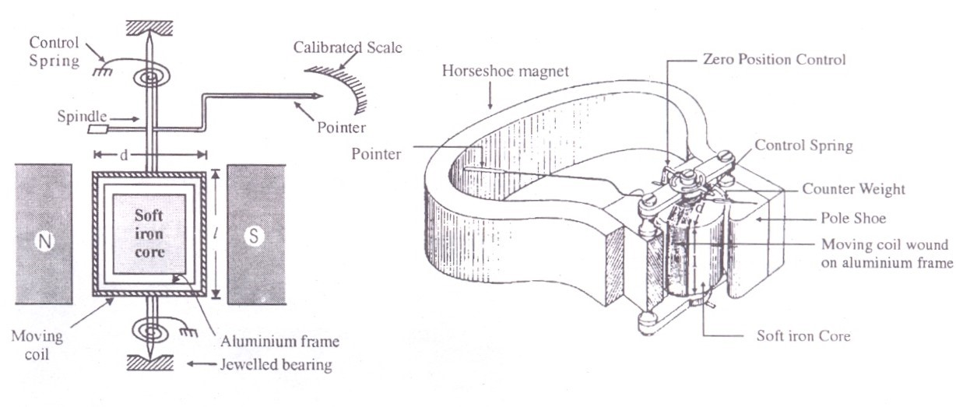
Permanent Magnet Moving Coil Instruments
It consists of permanent magnet which is stationary.
Moving system consists of a spindle attached to a rectangular aluminium frame. A coil made up of thin copper wire is wound over the frame. The current to be measured is passed through this coil.
A soft iron core is placed in the in the space within the aluminium frame.
Two spiral springs are mounted on the spindle to produce control torque. Control spring also serves an additional purpose & acts as control lead.
Pointer is mounted on spindle. Mirror is provided below the scale to avoid parallax error. The spindle is supported by jeweled bearings.

Slide 19
Construction
It consists of permanent magnet which is stationary.
Moving system consists of a spindle attached to a rectangular aluminum frame. A coil made up of thin copper wire is wound over the frame. The current to be measured is passed through this coil.
A soft iron core is placed in the in the space within the alluminium frame. This core is stationary and is provided to reduce the reluctance of the magnetic path between two poles of the permanent magnet.
Two spiral springs are mounted on the spindle to produce control torque. The control spring also serves an additional purpose and acts as control lead. Pointer is mounted on spindle. Mirror is provided below the scale to avoid parallax error. The spindle is supported by jeweled bearings

Slide 20
Working
1. The current to be measured is passed through moving coil via control springs.
2. A current carrying moving coil is now in a magnetic field. According to Flemings left hand rule, torque is produced on the coil and coil moves, pointer deflects.
3. Damping torque is provided by eddy current damping method.
• Torque equation- Deflection is proportional to current
Errors in PMMC Instruments
• Weakening of permanent magnet due to ageing and temperature effects
• Weakening of springs due to ageing and temperature effects
• Change of resistance of moving coil with temperature.
Merits
• Uniform scale for the instrument
• Power consumption is very low
• A single instrument can be used for different current and voltage ranges
• The toque-weight ratio is high gives higher accuracy.
Demerits
• This instrument can be used only on DC supply
• The cost of the instrument is more than M.I. Instruments

Slide 21
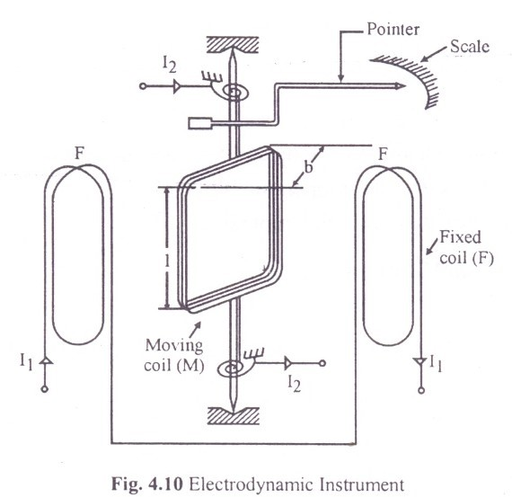
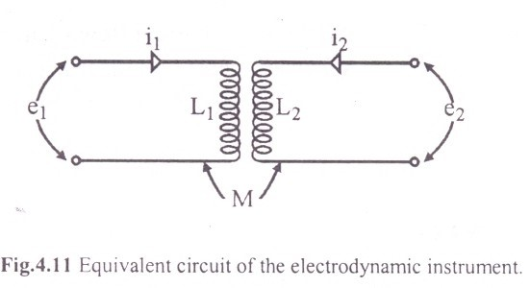
Electrodynamic Instruments
Construction
• Stationary part consists of two fixed coils connected in series as shown in fig. so that they carry same current.
• The moving system consists of a coil mounted on the spindle which is free to rotate in the space between the two fixed coils. The coil is made up of thin copper wire and is air cored to avoid hysterisis.
• Control torque provided by two spiral springs. They also act as connecting leads for the moving coil. Pointer is mounted on the spindle.
• Mirror is provided to avoid parallax error.
• Damping is provided by air friction damping.

Slide 22
Current to be measured is passed through two stationary coils which are connected in series, forms magnetic field.
Current to be measured is also passed through moving coil via control springs. Now current carrying moving coil is placed in magnetic field. According to Flemings left hand rule, force is experienced on the moving coil, gives deflection of the pointer
Merits
It can be used on a.c as well as d.c.
It can be used as ammeter voltmeter and wattmeter
it is also called as dynamometer instruments
Demerits
• Low torque to weight ratio
• More expensive
• Weak magnetic field
• Scale is non-uniform

