Slide 1

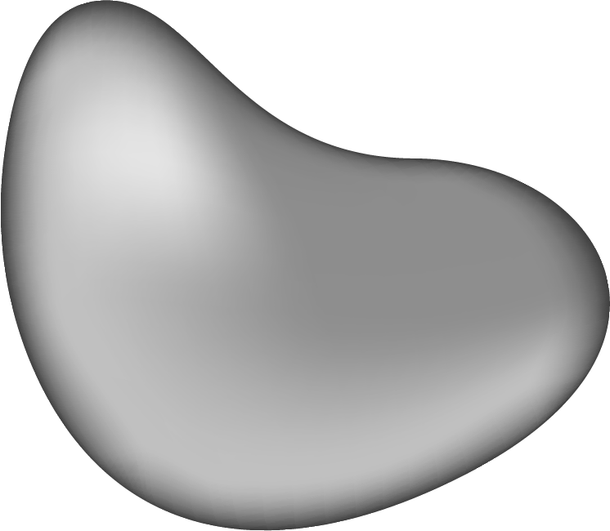
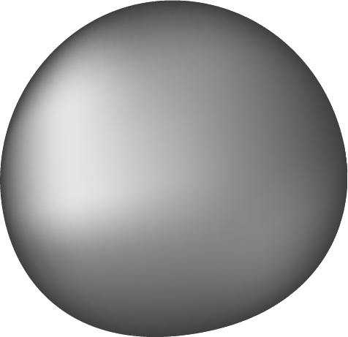
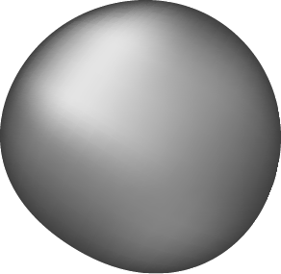
AI's Impact on Radiologists' Efficiency and Speed in Radiograph Interpretation
Presented by Aman, Joash, Kubra & Manikar

Slide 2
INTRODUCTION
01
Chest X-rays (CXR) are essential for diagnosing diseases like lung cancer, brain tumors, tuberculosis and others.
02
Traditional radiology is time-consuming and error-prone.
03
AI-based diagnostic tools aim to automate and enhance interpretation.

Slide 3
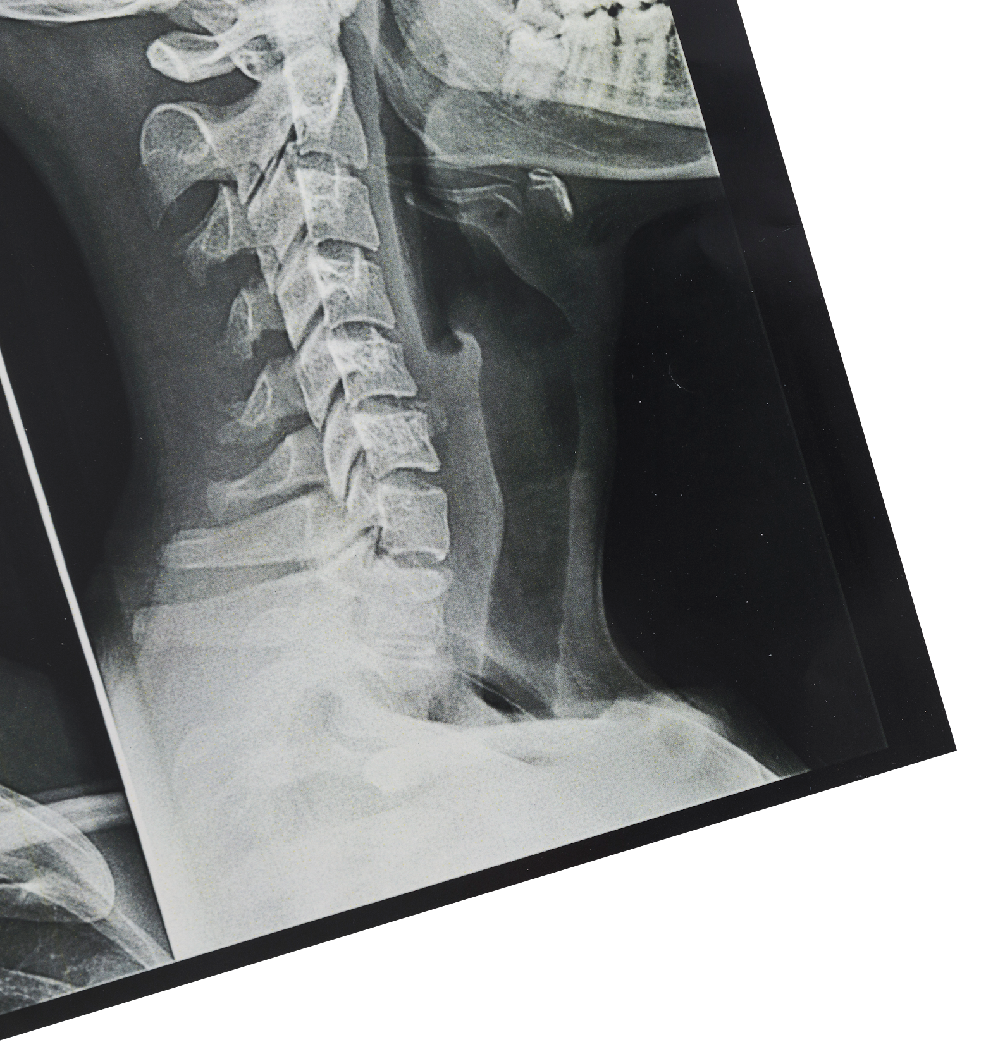
Why AI in Radiology Reports?
• Fast triaging of high-risk patients.
• Detect missed patterns in bulky text.
• Generate second opinions for doctors.
• Helps radiologists prioritize complex cases.
“Not a replacement, but an intelligent assistant!”

Slide 4
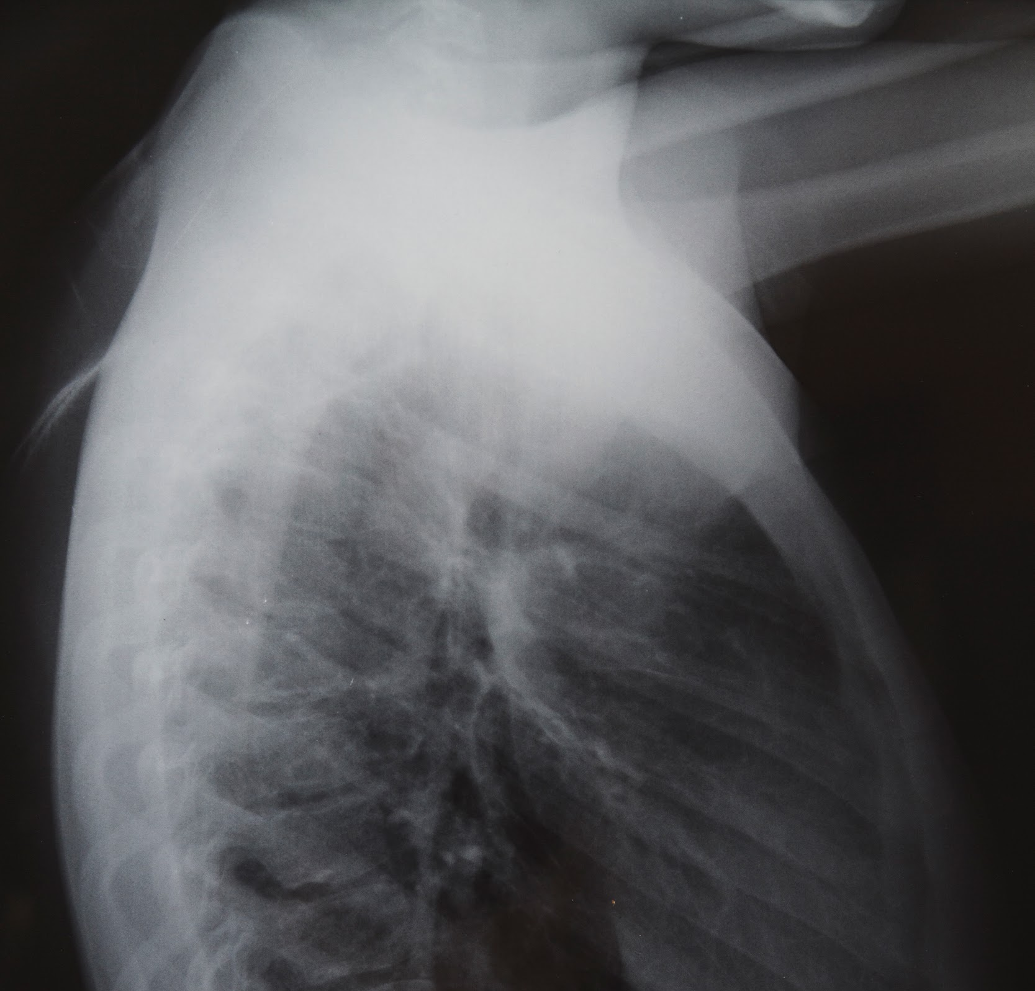
01
Problem Statement

Slide 5
Manual interpretation is slow, prone to error, and non-scalable.
1
2
3
4
Classify reports using ML
Automate clinical sentiment analysis
Doctors ask: "Is the report critical?"
Improve speed and accuracy for radiologists

Slide 6
ABOUT THE DATASET
Database
Compliance
Research
MIMIC-CXR v2.0.0:
377K chest X-rays with reports.
Dataset de-identified per HIPAA rules.
Enables Medical Imaging and NLP Research

Slide 7
Methodology
Text Preprocessing: Cleaning, tokenizing, stop word removal
01
Feature Extraction:
Bag of Words / TF-IDF
02
03
Modeling:
Logistic Regression, KNN, Random Forest and XGBoost
04
Evaluation:
ROC Curves, Confusion Matrix, Accuracy

Slide 8
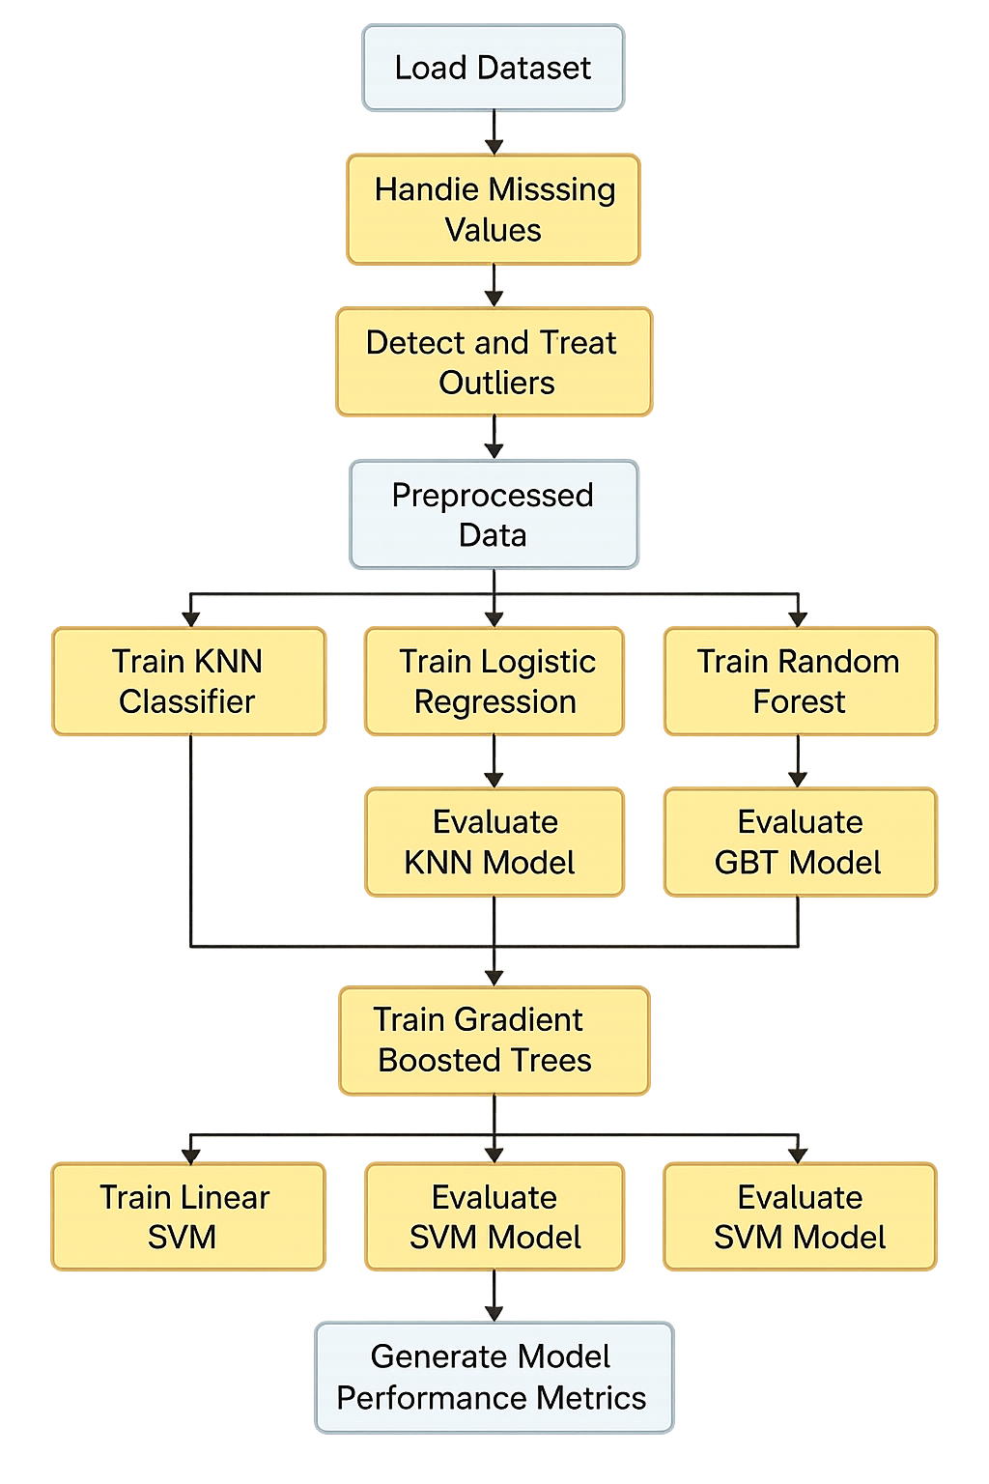

A Diagram of our KNIME Workflow

Slide 9
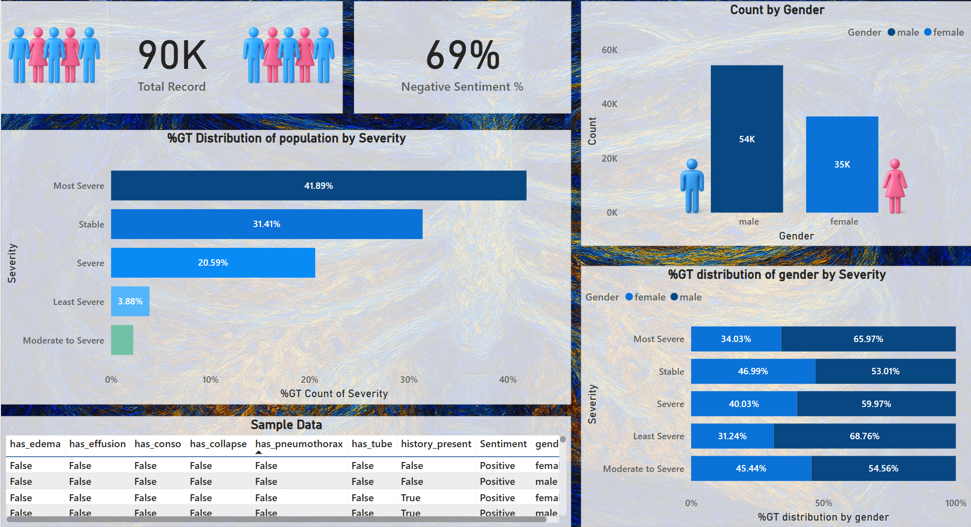
DASHBOARD

Slide 10
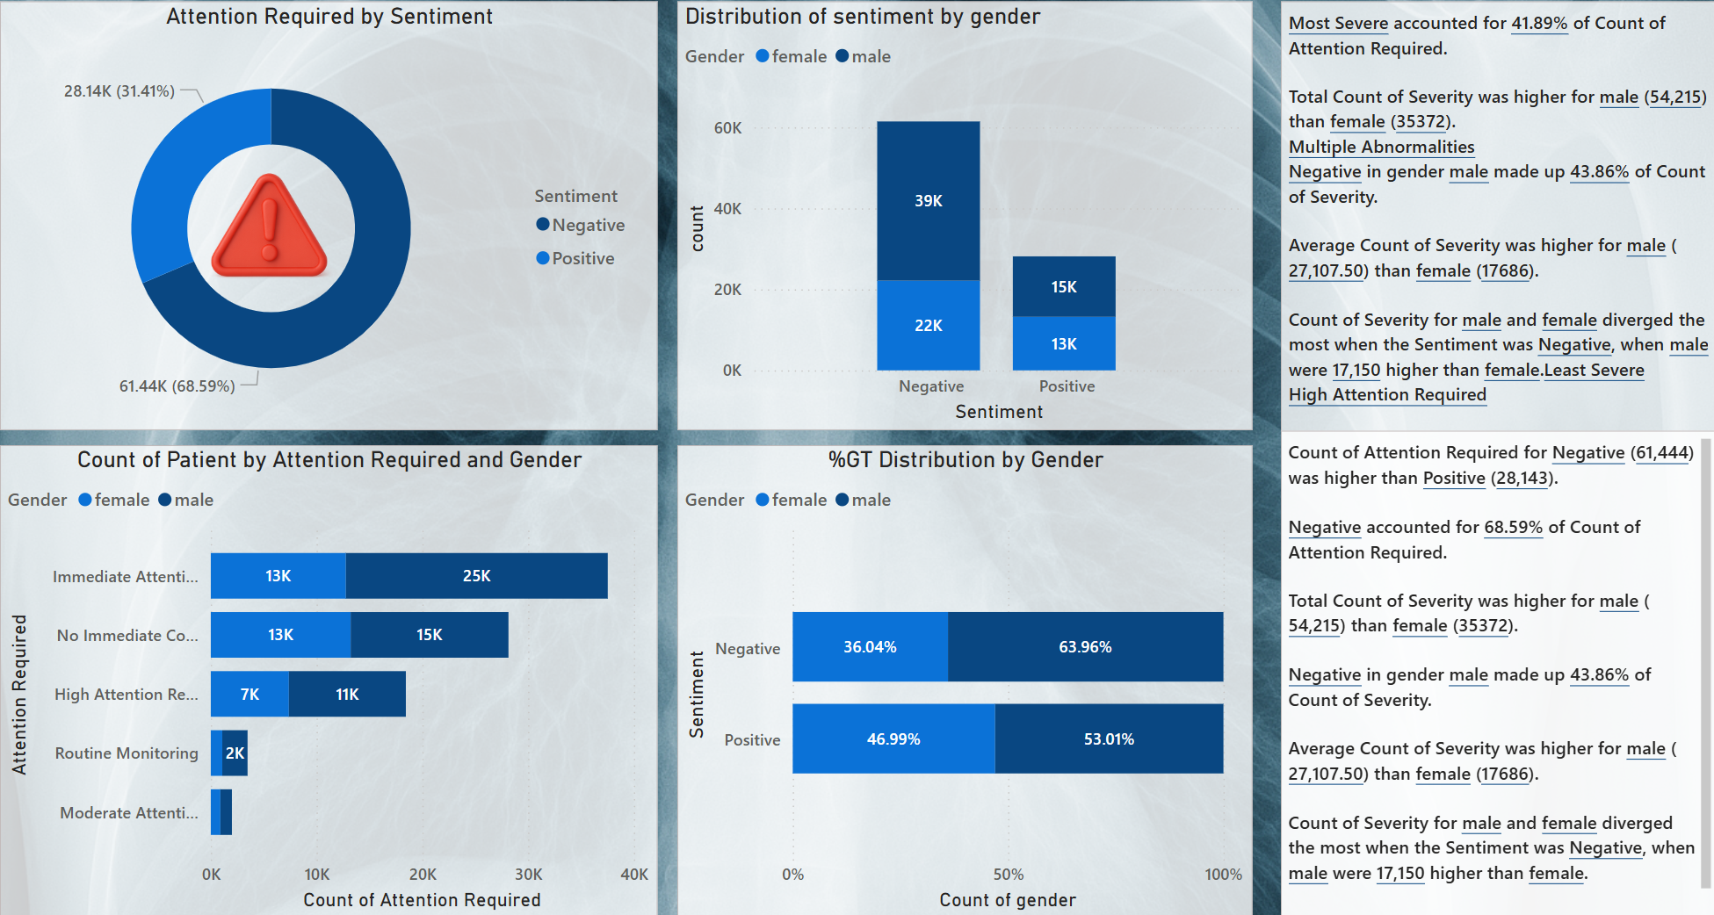
DASHBOARD

Slide 11

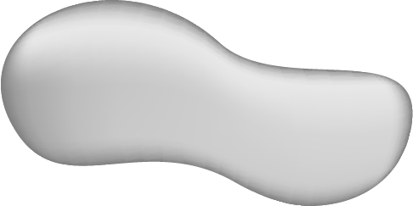
KEY NUMBERS
0.848
0.847
Logistic Regression:
Random Forest: ROC AUC
XGBoost: ROC AUC
Simpler, good baseline, but lower precision.

Slide 12
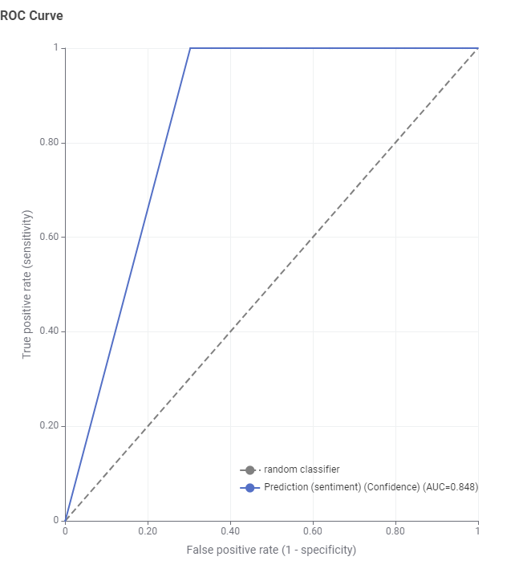

ROC CURVE – RANDOM FOREST

Slide 13

ROC CURVE – XGBOOST

Slide 14
Contribution to Radiologists
Automates report classification
Flags reports with high infection probability
Highlights reports requiring urgent attention
Provides a sentiment overview of all reports in a day
Scalable & replicable model for hospitals

Slide 15
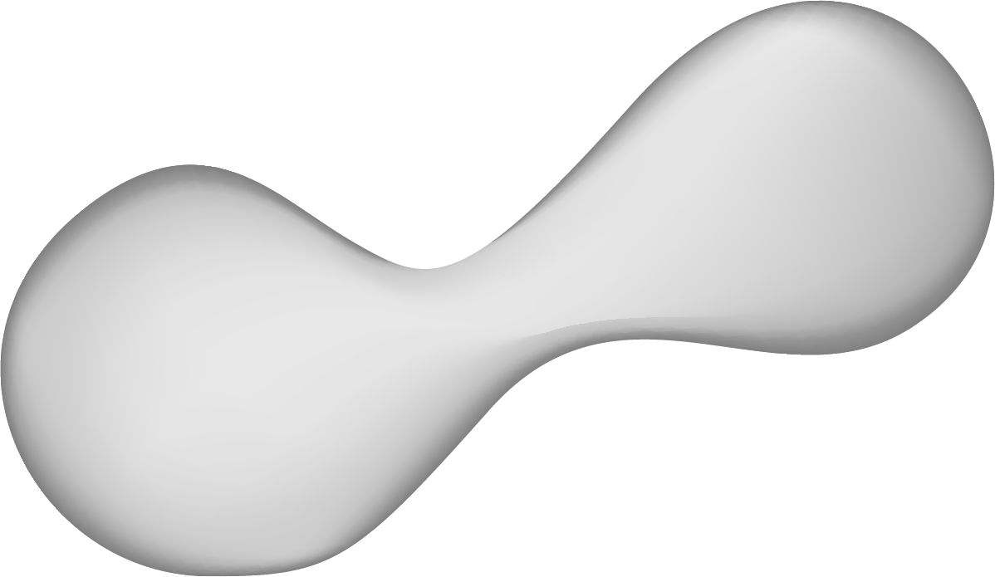
Challenges Faced
Medical language complexity (abbreviations, mixed tone)
Small dataset → Limited generalizability
KNIME + Python integration required workflow tuning
Labeling text with thresholds required manual rule-making

Slide 16

CONCLUSIONS
We successfully built a pipeline to classify radiology reports
Achieved high accuracy with Random Forest and XGBoost
Added value by integrating clinical sentiment
AI can accelerate radiologist decision-making
FUTURE OUTLOOK
Integrate BERT-based NLP models
Use a larger dataset with real-time EMR data
Build a web interface for doctors to input new reports

Slide 17
REFRENCES
01
KNIME Documentation
I
01
02
Physio.net
02
03
03
CITI Data

Slide 18
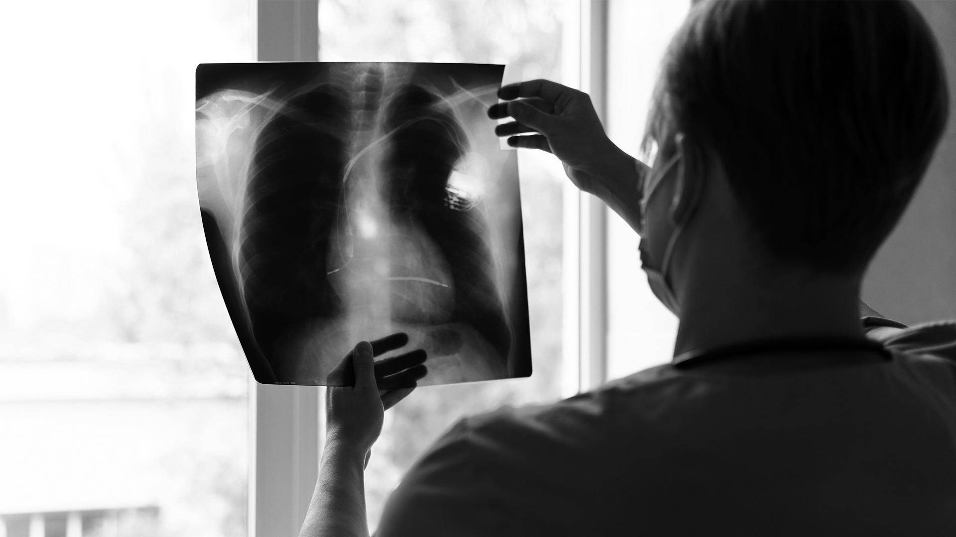
A PICTURE IS WORTH A THOUSAND WORDS
THANKS!

