Slide 1
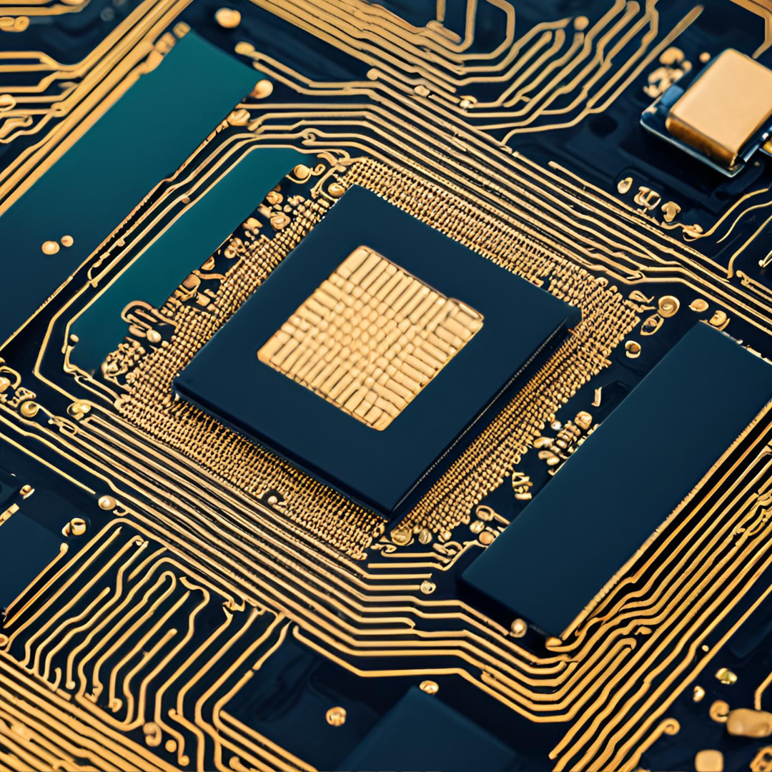
The Chips Act
Kubra Banu & Joash Kawal
Representing Clark & Co

Slide 2
A Research Question with Our Evidence
The Chips and Science Act is positively impacting the US Semiconductor and Related Devices industry.
Incentives and funding support for companies that prioritize U.S.-based production.
The current administration funded Intel with $8.5 billion.
It is perceived that the Chips and Science Act will reshape the semiconductor landscape.

Slide 3
Overview of our Industry & the Event
Event | The Chips Act
Date | August 9th, 2022
Industry | The Semiconductor Industry
Company | Intel
Significance of Event | Domestic semiconductor manufacturing
Key Stakeholders | Semiconductor Companies such as Intel, NVIDIA and others

Slide 4
Data Description
01
02
03
Industry : Semiconductors
It is a material essential in creating chips
SIC : 3674
Sample size after merging our data: 5667

Slide 5
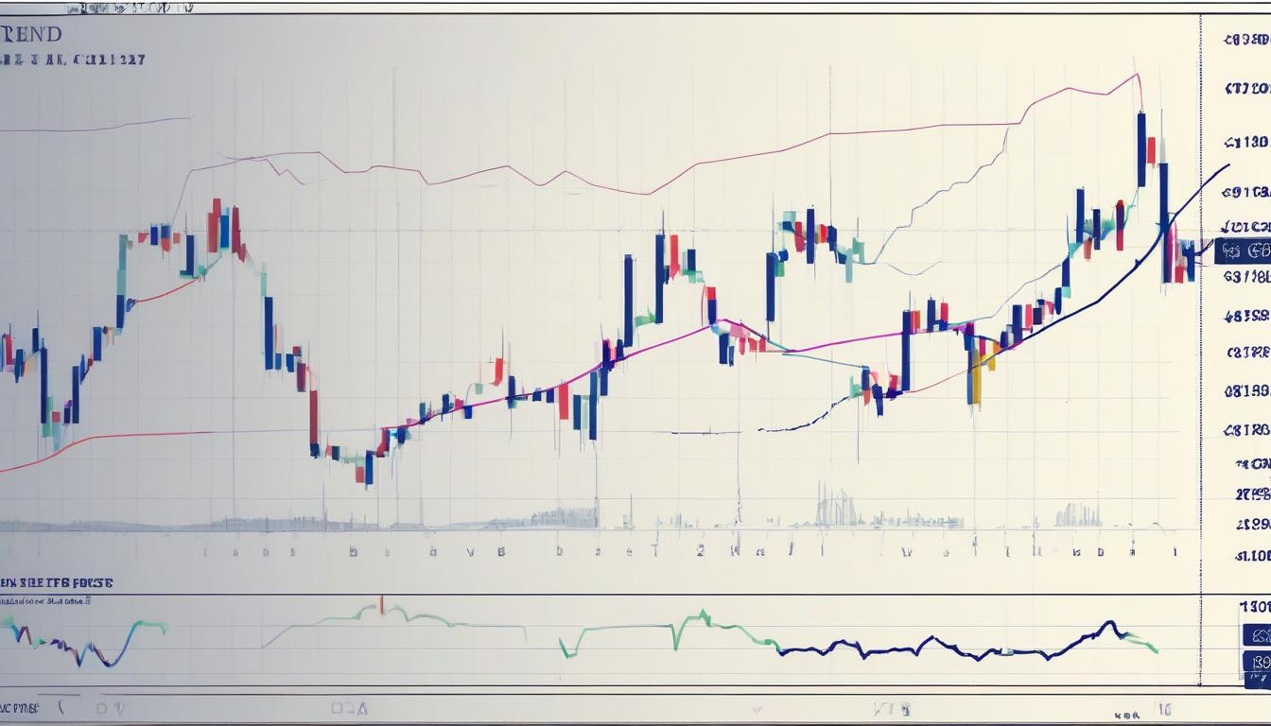
The trend of the Semiconductor industry vs others
The semiconductor industry is performing well in both the CAR(cumulative abnormal return) as well as the revenue.
Indicates that the hypothesis is accurate
Industry is performing well
Industry has good potential as we advance

Slide 6
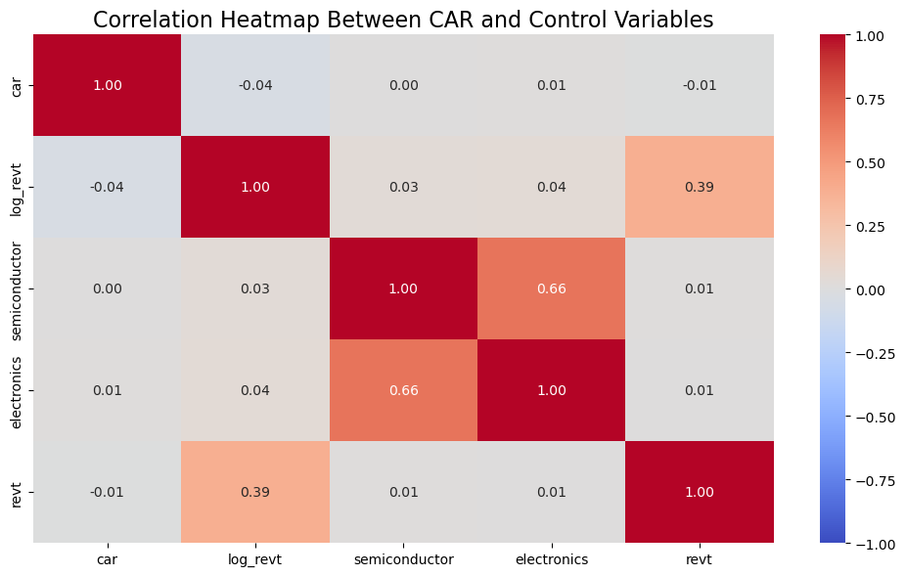
Correlation :
R value ranges between -1 and 1
1 : Perfect positive correlation
-1 : Perfect negative correlation
0: No correlation
-1 and 1 : varying degree of correlation

Slide 7
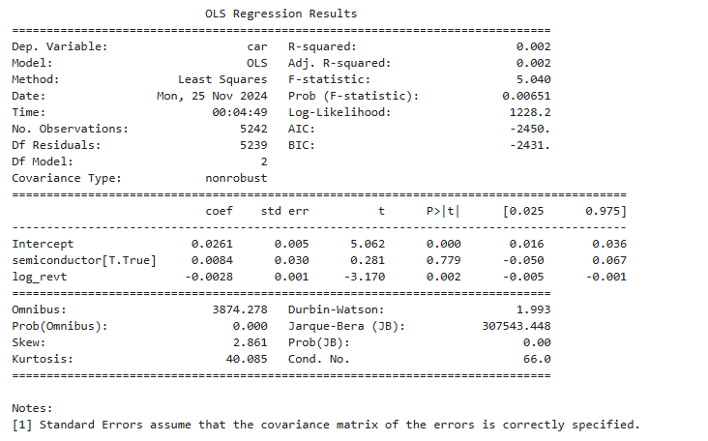
Regression Analysis

Slide 8
Regression Analysis Findings
P value is less than 0.1
Our model is significant
R-squared value is 0.2 percent
The coefficient of the semiconductor suggests that there 0.0084 increase in the cumulative abnormal return.

Slide 9
Business Implications
What is business implication ?
Significance :
- It is an Investment opportunity
It has Statistical significance
Market and Industry Impact

Slide 10
Limitations
1
The dataset can't be comprehensive, as many external elements are bound to affect outside the scope of the Chips Act.
2
A potential bias could occur in the situation where, for example, the industry had already been performing effectively before the Chips Act was enacted.

Slide 11
Potential Projects
Predictive
Prescriptive
STEP 1
STEP 2
How will the CHIPS and Science Act affect the semiconductor industry?
What strategies should the semiconductor companies adopt to maximize the benefits of the CHIPS and Science Act?

Slide 12
Q&A: 1
Question
Does the Chips Act have a positive impact on the
Semiconductor industry?
True
False

Slide 13
Q&A: 2
Question
Which year was the chips act signed into law?
2019
2020
2021
2022

Slide 14
THANKYOU!

