Slide 1

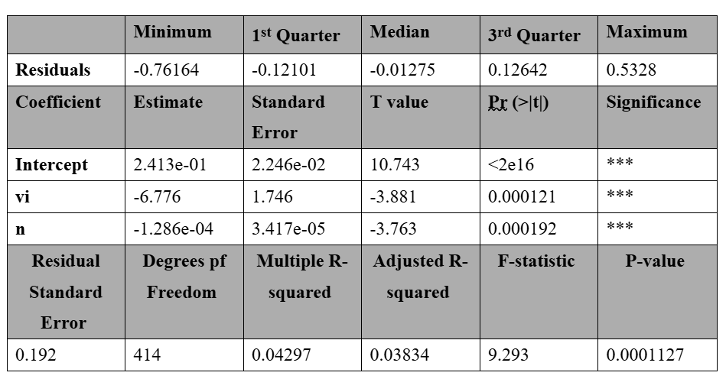
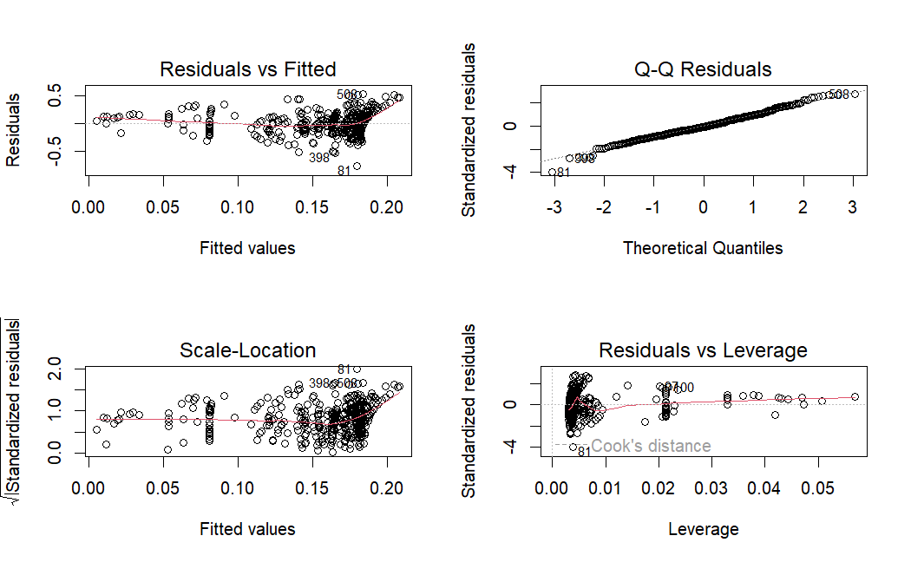
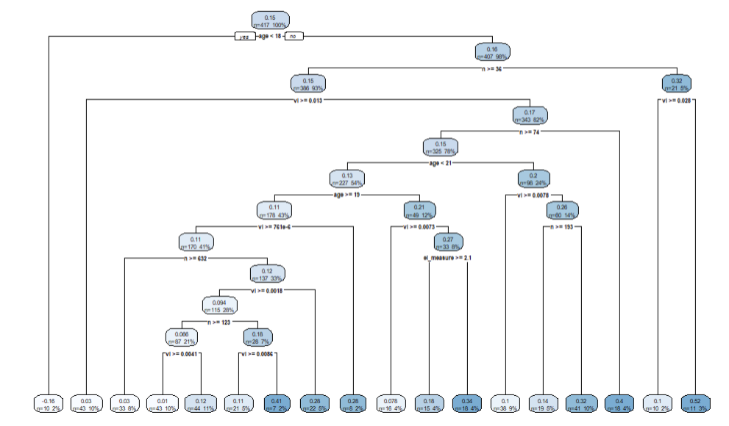
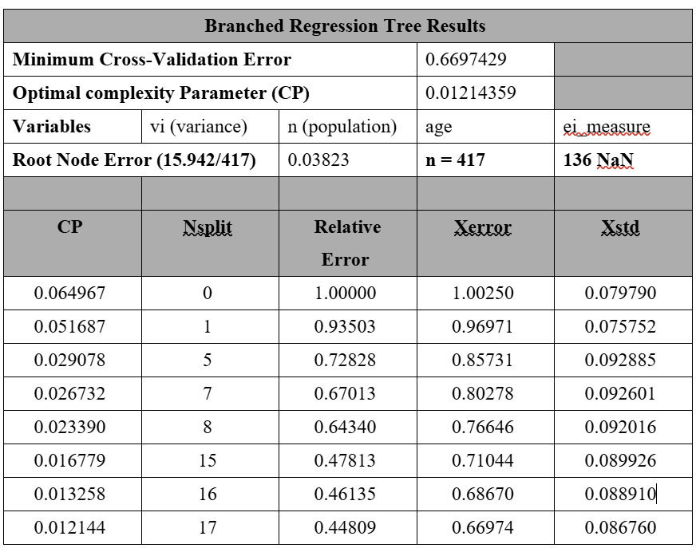
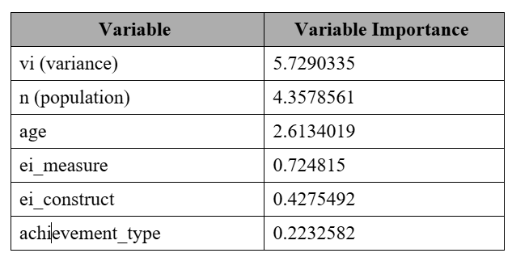
Emotional Intelligence as A Measure of Potential Academic Success
Authors: Kubra Bani, Joash Kawal, Kabhilan Shanmugasundaram , and Angelina Zuger | Clark University | MSBA
(Mentor: Professor Jin Fang)
Introduction
Academic performance is traditionally measured using standardized criteria such as test scores, IQ, grade point average (GPA), SATs, and GREs, which measure cognitive ability. Recent studies have shown that these measures are not accurate when evaluating academic performance (Haynes, 2023; MacCann, 2019). A 2008 study evaluating the SAT scores for 50,000 students found a correlation of 0.41, accounting for 16% of the variance reported in college GPAs (Haynes, 2023; Kobrin et al., 2008). Such scores provide a limited scope of a student’s aptitude, excluding a student’s socio-economic circumstances, inequalities in access to educational opportunities, or the behavioral/emotional aspects of the student’s personality (Haynes, 2023; Sepehrian, 2012). New research indicates that these socio-emotional attributes are important and can be assessed using Emotional Intelligence (EI) as far as the effects on long term academic achievement are concerned.
GRE and GMAT tests traditionally evaluate general cognitive ability, including verbal, quantitative, and writing skills (Moneta-Koehler et.al., 2017). These exams are admission requirements for many graduate programs. The Education Testing Service (ETS), which creates and proctors the GRE examination, cautions against using the test as a valid predictor of academic success, as it overlooks other skills vital to succeeding in a rigorous academic program (Haynes, 2023; Moneta-Koehler et al., 2017). EI encompasses constructs such as perseverance, emotional resilience, and adaptability, which are essential to navigating the challenges of an academic environment (Haynes, 2023; Moneta-Koehler et al., 2017; Romanelli et al., 2006). The importance placed on standardized testing scores and GPA has been questioned in many studies and institutions, resulting in approximately 50% of science-based graduate programs dropping their GRE admissions requirement by 2020 (Langin, 2019). Considering this statistic, EI measurements could be a more accurate replacement for the GRE. Based on this preliminary evidence, can emotional intelligence be an accurate metric for academic performance compared to standardized tests? By asking this question, this study hopes to inform future graduate enrollment policies, paving the way for the use of more comprehensive measures of potential student success in higher education, rather than a focus on mere measures of cognitive ability.
Table 1: Output of Regression Analysis, Model # 7
Fig 1: Model 7: Comparing yi (effect size) with vi (variance) an n (age).
Results
The focus of this study was to investigate whether EI can accurately predict academic outcomes for graduate students, compared to standardized tests. The dataset that was used included pre-calculated values for the correlation coefficients comparing EI to the academic measures of success (MacCann, 2020). These values were transformed into Pearson’s R Correlations in the form of an effect size, represented by the variable yi (MacCann, 2020, Using Effect Size, 2024). To test the proposed hypothesis a regression analysis was performed.
For this study, the effect size (yi) was used as the dependent variable and compared to several independent variables including the following: vi (variance), n (population size), age, ei_measure, ei_construct, and ei_stream. Seven models were performed with one variable alone or in different combinations. Model 7, is representative of the results of our models and compares the dependent variable yi (effect size) to independent variables (vi: variance and n: population). The residuals have a fairly even distribution around zero but then create a funnel pattern towards the right of the plot (Figure 1). This pattern of the residuals are non-linear, and mostly normally distributed, with some deviation from a normally distributed pattern in the left tail (Figure 1). Clustering of the data points in this plot shows that some data points are influencing the outcome of the model more than others and warrant further investigation. The residuals have a range of -0.76164 to -0.12101 (Table 1). The coefficients were all significant and are as follows: intercept (0.2413), vi ( -6.776), and n ( -0.0001286) (Table 1). The F-statistics were large (F-statistic = 9.293), with a significant p-value however, the adjusted R-squared value was equal to 0.03834, only explaining ~3.8% of the variance in the model (Table 1). Despite large and significant F statistics present in several of the models, the adjusted R-squared values demonstrate little to no explanatory power. This suggests that further testing needs to be completed to better understand any confounding variables that could be influencing the data.
To further investigate the relationship between the variables of interest, a drill down study weas performed using a Branched Decision Tree Model (Figure 2). The summary for the branched Decision Tree is as follows. Variables ei_construct and achievement_type were excluded due to low representation. The optimal tree was selected with a complexity parameter = 0.01214359 (Table 2). The tree had an n = 417, as 136 observations were deleted due to NaN values (Table 2). The mean squared error (root node error) = 0.03823. The cross-validation error (xerror) = 0.6697 (Table 2). Variance (vi) was the top split, indicating that it is the most important variable (vi >= 2.6089) (Table 2). The cross-validation error (xerror) = 0.6697 (Table 2). The optimal tree was constructed using a cross-validation model to decrease cross-validation error. In Table 3 the variables included in the model are ranked by importance, most important at the top to least important at the bottom (Table 3). Variance (vi) and population (n) were calculated as being the most important variables in the construction of the tree, with importance values of 5.73 and 4.36, respectively (Table X).
Methods
Type/Source/Content of the Data
In 2019, MacCann et al. of the University of New South Wales wrote the first comprehensive meta-analysis addressing the correlation between EI and academic performance (MacCann, 2019).
The original study included:
Results from 1,276 studies. Published between 1997 and 2019. Representing 27 different countries.
Trimmed dataset includes:
553 graduate-level students. Collected between 2000 and 2019.
Sources: journal articles (52.04%), dissertations (40.77%), unpublished data (6.95%), and other sources (0.24%).
Two EI streams: ability EI (48.68%), measured by MSCEIT, which evaluates cognitive abilities related to emotion-based information and mixed EI (51.32%), measured by EQI, assessing emotional and social functioning in workplace-related outcomes.
Cognitive success metrics (GPA: 83.21%, standardized tests: 16.79%).
Modeling approaches:
Descriptive statistics. Single linear regression. Multiple linear regression.
Machine Learning Approach:
Branched Decision Tree. Cross-validation.
Software:
R. R Studio.
Fig 2: Results of the Branched Tree Model.
Table 2: Results of the Branched Tree Model.
Conclusion
Data Summary/ Key Findings
The results from the study did not provide us any sufficient statistical or practical evidence to confirm our hypothesis.
The results of the multiple linear regression models demonstrate that none of our models fit well within the given dataset.
The drill down study, using a Branched Decision Tree, variance (vi) and population (n) were the most important variables in the construction of the tree, with importance values of 5.73 and 4.36, respectively. This is contrary to the assumptions at the beginning of this study, that the EI-stream and EI_measures would be the most significant variables.
Limitations
Restricted flexibility in analysing relationships within the raw data, reducing potential insights into unexplored associations.
Varying ppopulation sizes within the dataset constrained statistical power, and contributed to the variance of the residuals, skewing the outcome of the calculated models.
High variance means that there is low heterogeneity in the data, making generalization difficult.
Business Recommendations/ Future Directions
Perform a longitudinal study: A longitudinal design could be used to monitor changes in EI and academic success over time, which would have much stronger implications for causality.
Future Directions: Future applications and projects involving EI could investigate how high levels of EI further benefit human-AI collaboration using advanced machine learning models.
Table 3: Results of the Cross-Validation Model.
References
A wave of graduate programs drops the GRE application requirement. (n.d.). Retrieved October 22, 2024, from https://www.science.org/content/article/wave-graduate-programs-drop-gre-application-requirement
Allen, H. K., Barrall, A. L., Vincent, K. B., & Arria, A. M. (2021). Stress and burnout among graduate students: Moderation by sleep duration and quality. International Journal of Behavioral Medicine, 28(1), 21. https://doi.org/10.1007/s12529-020-09867-8
Almog, U. (2022, June 2). Decision Trees, Explained. Medium. https://towardsdatascience.com/decision-trees-explained-d7678c43a59e
Ashkanasy, N. M., & Daus, C. S. (2005). Rumors of the death of emotional intelligence in organizational behavior are vastly exaggerated. Journal of Organizational Behavior, 26(4), 441–452. https://doi.org/10.1002/job.320
Cross-Validation in R programming. (2020, August 1). GeeksforGeeks. https://www.geeksforgeeks.org/cross-validation-in-r-programming/
Decision Tree for Regression in R Programming. (2020, July 26). GeeksforGeeks. https://www.geeksforgeeks.org/decision-tree-for-regression-in-r-programming/
Discovering Statistics Using IBM SPSS Statistics. (n.d.). Retrieved October 22, 2024, from https://collegepublishing.sagepub.com/products/discovering-statistics-using-ibm-spss-statistics-5-260423
EQI. (n.d.). Retrieved November 18, 2024, from https://ap.themyersbriggs.com/overview/EQ-i-20-8
Gareth James, D. W., Trevor Hastie, Robert Tibshirani. (2013). An introduction to statistical learning: With applications in R. New York : Springer, [2013] ©2013. https://search.library.wisc.edu/catalog/9910207152902121
Gelman, A., & Hill, J. (2006, December 17). Data Analysis Using Regression and Multilevel/Hierarchical Models. Higher Education from Cambridge University Press; Cambridge University Press. https://doi.org/10.1017/CBO9780511790942
Graduation and Retention Rates—What is the full-time retention rate in postsecondary institutions? (n.d.). Retrieved October 22, 2024, from https://nces.ed.gov/ipeds/TrendGenerator/app/answer/7/32
Greenwell, B., M. (2017). pdp: An R Package for Constructing Partial Dependence Plots. The R Journal, 9(1), 421. https://doi.org/10.32614/RJ-2017-016
Grolemund, H. W. and G. (n.d.). Welcome | R for Data Science. Retrieved December 10, 2024, from https://r4ds.had.co.nz/
Higgins, J. P. T., & Thompson, S. G. (2002). Quantifying heterogeneity in a meta-analysis. Statistics in Medicine, 21(11), 1539–1558. https://doi.org/10.1002/sim.1186
Introducing ChatGPT. (n.d.). Retrieved December 10, 2024, from https://openai.com/index/chatgpt/
Introductory Econometrics, 6th Edition—9781305270107—Cengage. (n.d.). Retrieved October 22, 2024, from https://www.cengage.com/c/introductory-econometrics-a-modern-approach-6e-wooldridge/9781305270107/
Julie. (2017, May 10). Predict using trained model on dataset [Forum post]. Cross Validated. https://stats.stackexchange.com/q/278800
Kobrin, J. L., Patterson, B. F., Shaw, E. J., Mattern, K. D., & Barbuti, S. M. (2008). Validity of the SAT® for Predicting First-Year College Grade Point Average. Research Report No. 2008-5. College Board. https://eric.ed.gov/?id=ED563202
Kuhn, M. (n.d.). 15 Variable Importance | The caret Package. Retrieved December 10, 2024, from https://topepo.github.io/caret/variable-importance.html
Lab 14—Decision Trees in R v2. (n.d.). Retrieved December 10, 2024, from https://www.science.smith.edu/~jcrouser/SDS293/labs/lab14-r.html
Linear Regression in Machine learning. (2018, September 13). GeeksforGeeks. https://www.geeksforgeeks.org/ml-linear-regression/
Long, J. (JD), & Teetor, P. (n.d.). R Cookbook, 2nd Edition. Retrieved December 10, 2024, from https://rc2e.com/
MacCann, C., Jiang, Y., Brown, L. E. R., Double, K. S., Bucich, M., & Minbashian, A. (2020). Emotional intelligence predicts academic performance: A meta-analysis. Psychological Bulletin, 146(2), 150–186. https://doi.org/10.1037/bul0000219
Mayer-Salovey-Caruso Emotional Intelligence Test (MSCEIT). (n.d.). Retrieved November 18, 2024, from https://www.eiconsortium.org/measures/msceit.html
Molnar, C. (n.d.). 8.1 Partial Dependence Plot (PDP) | Interpretable Machine Learning. Retrieved December 10, 2024, from https://christophm.github.io/interpretable-ml-book/pdp.html
Moneta-Koehler, L., Brown, A. M., Petrie, K. A., Evans, B. J., & Chalkley, R. (2017). The Limitations of the GRE in Predicting Success in Biomedical Graduate School. PLoS ONE, 12(1), e0166742. https://doi.org/10.1371/journal.pone.0166742
Nair, S., Dev, S., & Dwivedi, A. (2016). Emotional intelligence and work performance of leaders—A study done with corporates and higher academic institutions in Abu Dhabi Emirate. International Journal of Work Organisation and Emotion, 7(3), 168. https://doi.org/10.1504/IJWOE.2016.081454
O’Connor, P. J., Hill, A., Kaya, M., & Martin, B. (2019). The Measurement of Emotional Intelligence: A Critical Review of the Literature and Recommendations for Researchers and Practitioners. Frontiers in Psychology, 10. https://doi.org/10.3389/fpsyg.2019.01116
R cookbook | BibSonomy. (n.d.). Retrieved November 18, 2024, from https://www.bibsonomy.org/bibtex/387e5a55f80acbcfd8d6851d9343fa42?postOwner=vivion&intraHash=a06edbcafdbb837e6799a69acc9843ba
R Decision Trees Tutorial: Examples & Code in R for Regression & Classification. (n.d.). Retrieved December 10, 2024, from https://www.datacamp.com/tutorial/decision-trees-R
Rodriguez, J. (2023). Josue-rodriguez/psymetadata [R]. https://github.com/josue-rodriguez/psymetadata (Original work published 2021)
Romanelli, F., Cain, J., & Smith, K. M. (2006). Emotional Intelligence as a Predictor of Academic and/or Professional Success. American Journal of Pharmaceutical Education, 70(3), 69. https://doi.org/10.5688/aj700369
Sepehrian, F. (2012, December 1). Emotional Intelligence as a predictor of academic performance in university. | EBSCOhost. https://openurl.ebsco.com/contentitem/gcd:113858112?sid=ebsco:plink:crawler&id=ebsco:gcd:113858112
Soriano-Vázquez, I., Castro, M. C., & Morales-García, W. C. (2023). Emotional intelligence as a predictor of job satisfaction: The mediating role of conflict management in nurses. Frontiers in Public Health, 11, 1249020. https://doi.org/10.3389/fpubh.2023.1249020
Statistical notes for clinical researchers: Effect size—PMC. (n.d.). Retrieved October 21, 2024, from https://pmc.ncbi.nlm.nih.gov/articles/PMC4650530/
The Limitations of Test Scores and GPAs in College Admissions. (2023, July 13). ACADEME BLOG. https://academeblog.org/2023/07/13/the-limitations-of-test-scores-and-gpas-in-college-admissions/
T.Joe. (2016, October 6). How to check interaction effects for a lot of predictors in R [Forum post]. Stack Overflow. https://stackoverflow.com/q/39886562/28242858
T-Test, Chi-Square, ANOVA, Regression, Correlation... (n.d.). Retrieved December 9, 2024, from https://datatab.net/tutorial/linear-regression
Using Effect Size—Or Why the P Value Is Not Enough—PMC. (n.d.). Retrieved October 21, 2024, from https://pmc.ncbi.nlm.nih.gov/articles/PMC3444174/
What Is a Residual in Stats? | Outlier. (2022, March 2). https://articles.outlier.org/what-is-a-residual-in-stats
What is the EQ-i 2.0 and emotional intelligence? (n.d.). The Emotional Intelligence Training Company. Retrieved November 18, 2024, from https://www.eitrainingcompany.com/eq-i/
Zins, J. E., & Elias, M. J. (2006). Social and Emotional Learning. In Children’s needs III: Development, prevention, and intervention (pp. 1–13). National Association of School Psychologists.

