Slide 1
Vistelligence
Advisor
Ms Hira Asim

Slide 2
Group Members
Mh Sherharyar L1F21BSSE0025
Hina Ijaz L1F21BSSE0037
Kubra Noor L1F21BSSE0211

Slide 3
Background
With the increasing demand for international travel, education, and work opportunities, visa application
processes have become a crucial aspect of global mobility. As we know that the current tools lack
personalization and rely heavily on static information. Integrating artificial intelligence into this
domain can transform the experience, reducing uncertainty and improving approval rates.

Slide 4
Related Work
Common App Portal https://apply.commonapp.org
Visabot https://visabot.eu
myVisa.io (no more available)
VisaHQ https://www.visahq.pk/en/

Slide 5
How We Are Different from Others
Common App Portal (apply.commonapp.org) The Common App primarily collects documents and creates profiles for college and university applications. However, it does not provide personalized recommendations on which country, university, or visa type would best suit an applicant’s needs.
VisaBot (visabot.eu) VisaBot focuses on Schengen visa appointments. It sends instant notifications when appointments become available at Schengen Visa Centres and even auto-books them. However, it does not assist users in choosing the best visa options based on their profiles.
VisaHQ (visahq.pk/en) VisaHQ allows users to apply for visas by selecting their preferred country and visa type. However, it does not offer AI-driven suggestions or personalized recommendations to help users determine the best option for their situation.
myVisa.io (No longer available) The platform is no longer active, and its domain is currently available for purchase.

Slide 6
What Makes Us Unique?
Unlike these platforms, our AI-powered solution goes beyond just collecting documents or offering basic visa services. We analyze users’ profiles and provide tailored recommendations on:
✅ The best country based on their background and preferences
✅ The most suitable visa type for their needs
✅ Real-time updates on their visa application status
✅ Insights from other applicants' experiences

Slide 7
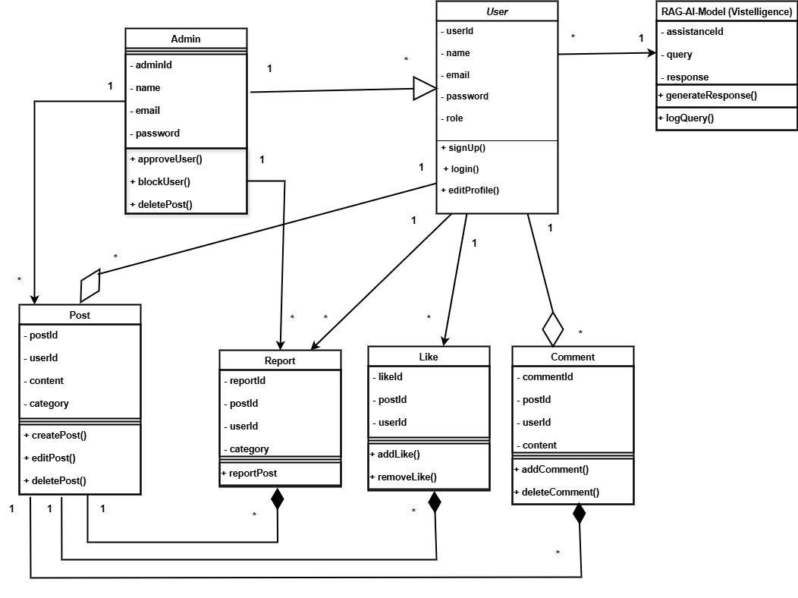
Class diagram

Slide 8
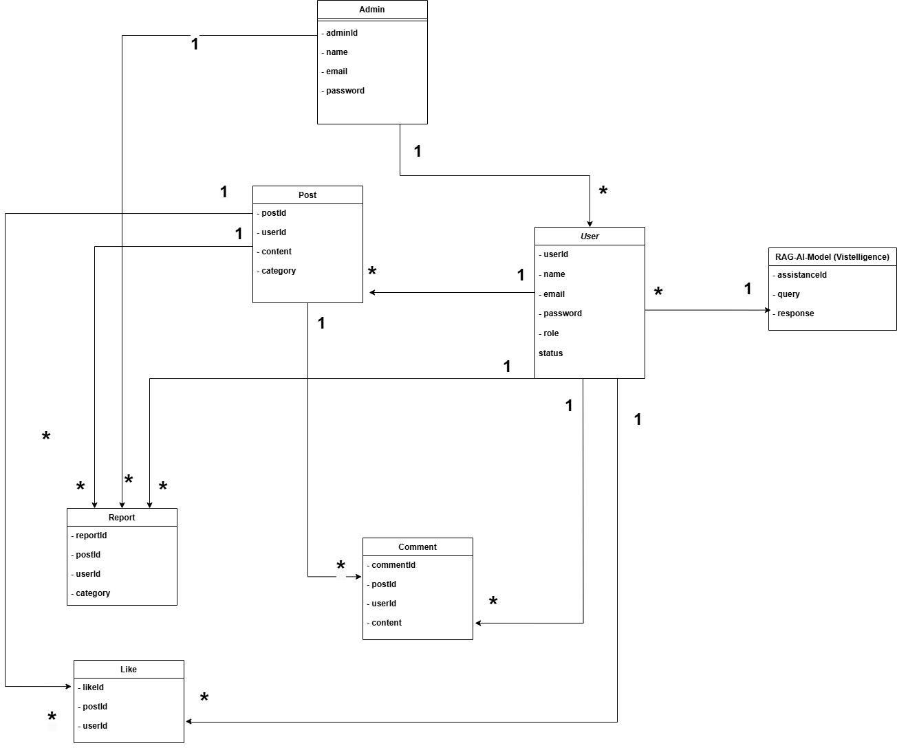
ER Diagram

Slide 9
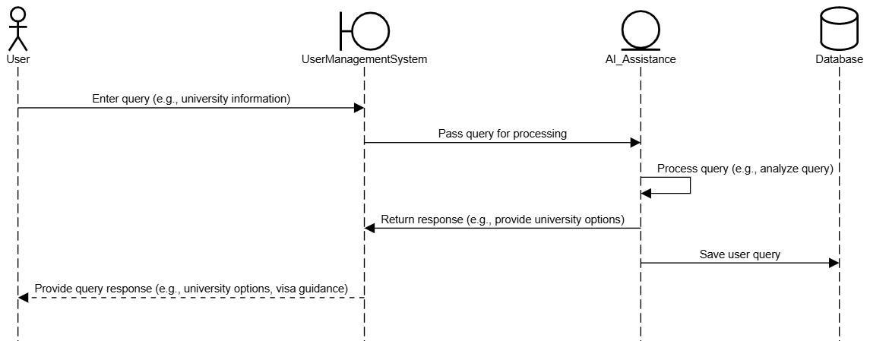
AI interaction Model

Slide 10
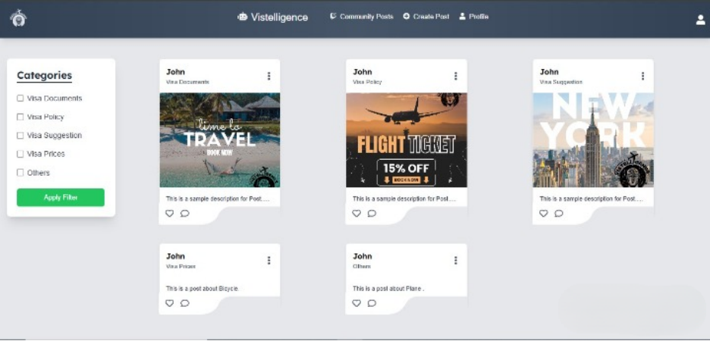
Community Posts

Slide 11

Footer

Slide 12
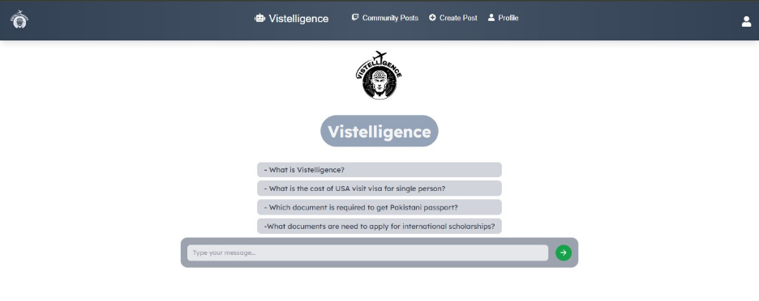
Vistelligence Community

Slide 13
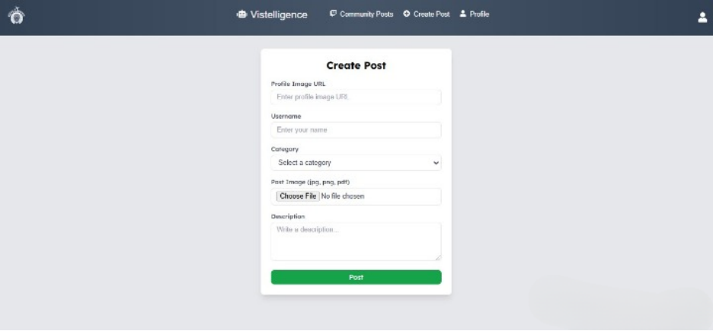
Create Post Page

Slide 14
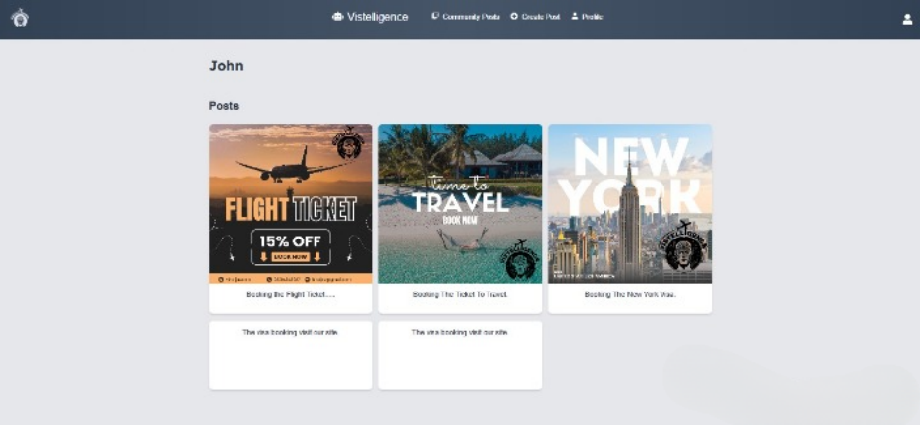
User Posts

Slide 15
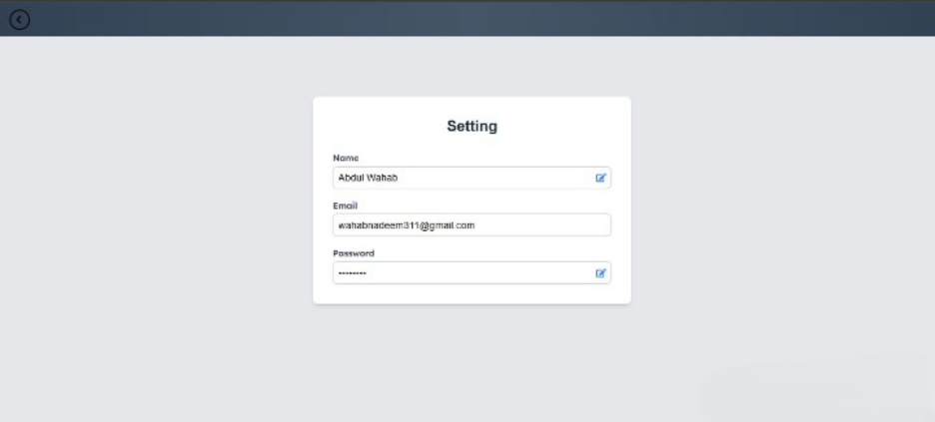
Setting Page

Slide 16
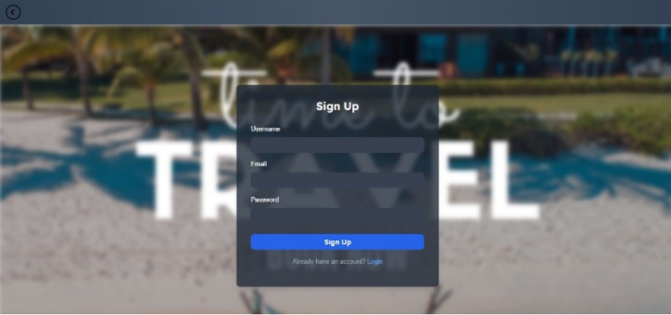
Signup Page

Slide 17
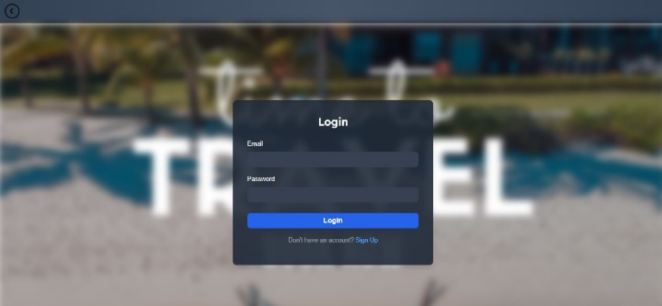
Login Page

Slide 18
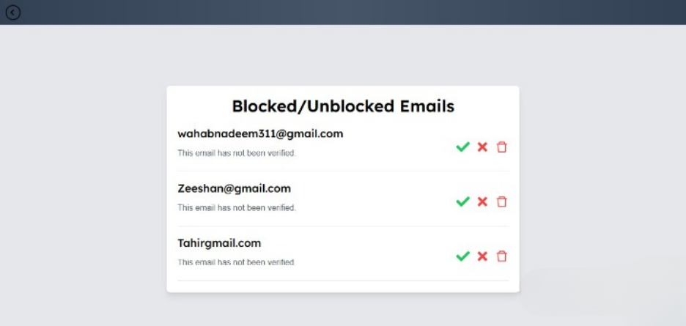
Block/UNBlock Emails

Slide 19
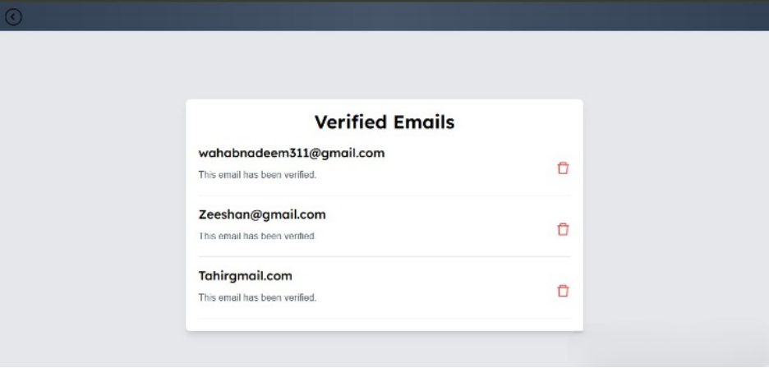
Verifying Emails

Slide 20
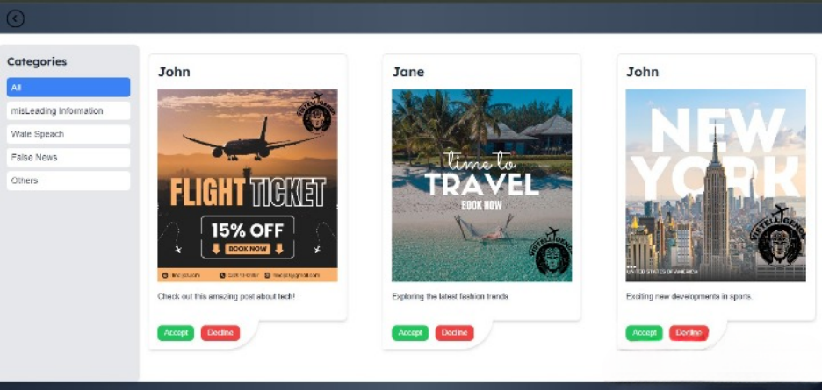
Reported Post

Slide 21
Data set
Paste link here

Slide 22
Front-end Hosted Link
https://vistelligence.netlify.app/

Slide 23
Bug Report
Paste link here

Slide 24
Any Question?
Thank You!

