Slide 1
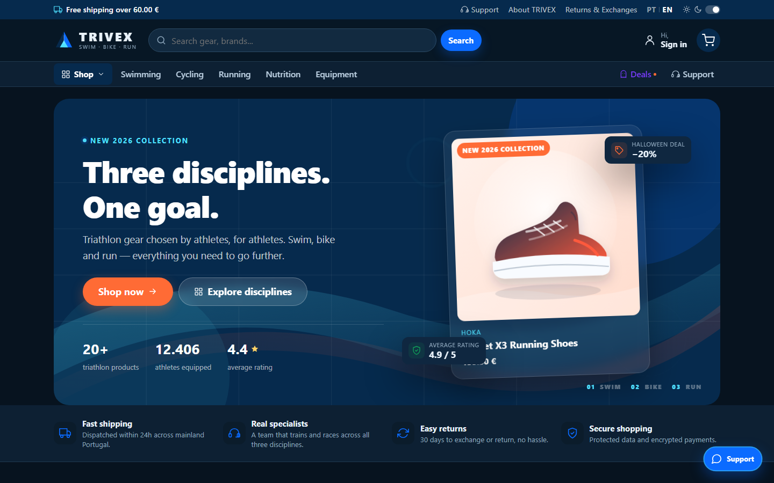
TRIVEX
TRIATHLON STORE
A complete, self-contained e-commerce platform for swim, bike and run.
Project overview · objectives · core mechanics
PHP 8
MySQL 8
Vanilla JS
PT / EN
STOREFRONT PREVIEW
Catalogue · product variants · promotions · PT/EN · light/dark
November 2026
Notes:
TRIVEX is a self-contained triathlon e-commerce platform built with PHP 8, MySQL and vanilla JavaScript. The deck covers the objectives, architecture, data model and the core business mechanics.

Slide 2
01 / OBJECTIVES
What the project sets out to prove
01
A realistic storefront
02
A multi-role operating model
Catalogue, search, filters, variants, stock, promotions, cart and checkout in one coherent journey.
Customers, companies, moderators and administrators each get a focused, permission-aware experience.
03
Controlled product publishing
04
A maintainable codebase
Companies submit and edit products; administrators approve them before they reach the storefront.
Custom MVC, local assets, PT/EN dictionaries and light/dark themes with no build step.
Goal: a complete triathlon commerce platform that can be demonstrated end-to-end.
TRIVEX · Triathlon Store
02
Notes:
The project has four objectives: a realistic storefront, a multi-role operating model, controlled product publishing and a maintainable, dependency-free codebase.

Slide 3
02 / PLATFORM
One codebase, four roles, five experiences
01
02
03
04
05
Storefront
Customer account
Company portal
Backoffice
Support chat
Catalogue, search, product variants, promotions, cart and checkout.
Orders, addresses, profile, reviews and support history.
Product submission, editing, media, stock and proposal status.
Orders, stock, companies, proposals, users and approvals.
Queue, assignment, heartbeat, conclusion and archive.
Zero build step · local assets · PT / EN · light / dark · responsive
TRIVEX · Triathlon Store
03
Notes:
The same codebase serves five experiences. Every area shares the same authentication, database and design system.

Slide 4
03 / STACK
Built to run anywhere PHP runs
Language
PHP 8.3 · OOP · strict types
No dependency chain
• No Composer packages
• No npm or bundler
• No CDN or external images
• No framework runtime
Database
MySQL 8 · PDO prepared statements
Frontend
Vanilla JS · CSS variables · no bundler
Assets
Local SVG · uploaded product images only
Localisation
PT / EN dictionaries
Project shape
public/ front controller
src/ MVC + services
lang/ PT / EN
database/ schema + seed
public/assets CSS / JS / SVG
Themes
Light / dark · system preference
TRIVEX · Triathlon Store
04
Notes:
The project deliberately avoids Composer, npm, CDNs and frameworks. That keeps the deployment simple and the codebase inspectable.

Slide 5
04 / ARCHITECTURE
A request through the MVC layers
Presentation
Views · Layouts · Partials · CSS / JS
Application
Router · Middleware · Controllers
Domain
Models · ModificationService · MailService
Infrastructure
PDO / MySQL · Mailer / SMTP · storage/mail · email_log
Thin controllers, SQL in models, cross-cutting rules in services.
TRIVEX · Triathlon Store
05
Notes:
The request enters through the front controller and bootstrap, passes through routing and middleware, reaches a controller, and then uses models and services to render a view or return JSON.

Slide 6
05 / DATA MODEL
17 tables, five clear domains
Identity & access
NEW
Catalogue
Commerce
roles
companies
users
categories
products
product_variants
product_color_images
addresses
orders
order_items
Who can sign in and what they can do.
What is sold and how it is presented.
Checkout, delivery and historical snapshots.
Engagement
Content & operations
Key relationships
reviews
chats
chat_messages
notifications
pages
pending_modifications
email_log
products 1 → * variants
products 1 → * colour images
orders 1 → * order_items
chats 1 → * messages
Feedback, support and system events.
CMS, approvals and email audit.
order_items stores the product name, variant label and unit price at purchase time.
TRIVEX · Triathlon Store
06
Notes:
The 17 tables are grouped into identity, catalogue, commerce, engagement and operations. product_color_images is the new table for colour-specific product photography.

Slide 7
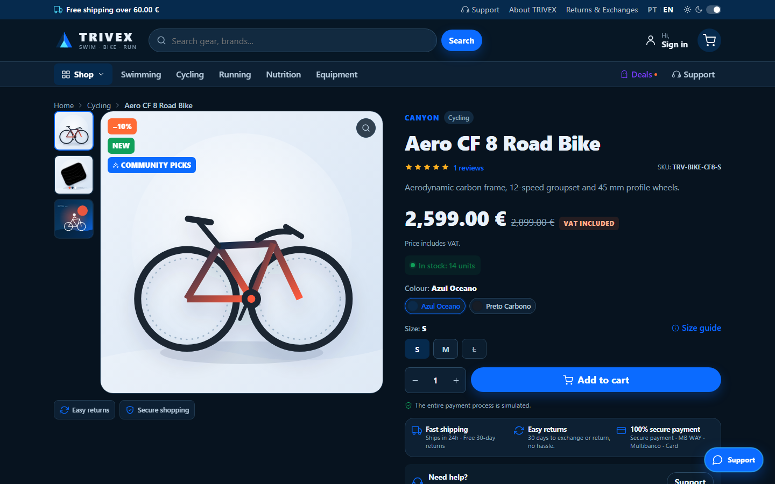
06 / STOREFRONT
Discovery, variants and trust
A storefront that behaves like a real shop
• Server-side catalogue filters: category, price, brand, size, stock and promotion.
• Instant search endpoint at /api/pesquisa.
• Product page with colour/size variants, live price, stock and SKU.
• Reviews, related products and CMS pages.
• PT/EN and light/dark without a full page reload.
Search API
Stock-aware
Reviews
PT / EN
Server-rendered for speed; JavaScript enhances the gallery and variant controls.
PRODUCT PAGE — VARIANT SELECTION AND GALLERY
TRIVEX · Triathlon Store
07
Notes:
The storefront uses server-side filtering and pagination. The product page supports variants, live stock, reviews and colour-specific galleries.

Slide 8
07 / CHECKOUT
Transactional by design
01
02
03
04
05
06
Add to cart
Validate
Transaction
Lock stock
Create order
Decrement
Session-based cart
Input and stock
Atomic order
FOR UPDATE
Order + items
Stock + email
Why it matters
Inside the transaction
• No overselling: stock is re-read under a row lock.
• No partial orders: the transaction rolls back on failure.
• Historical snapshots keep old orders accurate.
START TRANSACTION
SELECT ... FOR UPDATE
UPDATE stock = stock - qty
INSERT order_items (...)
COMMIT
Confirmation email is sent after commit; a mail failure does not remove the order.
TRIVEX · Triathlon Store
08
Notes:
Checkout is transactional. The variant row is locked with FOR UPDATE, stock is decremented, and order items store historical snapshots. Any failure rolls back the whole order.

Slide 9
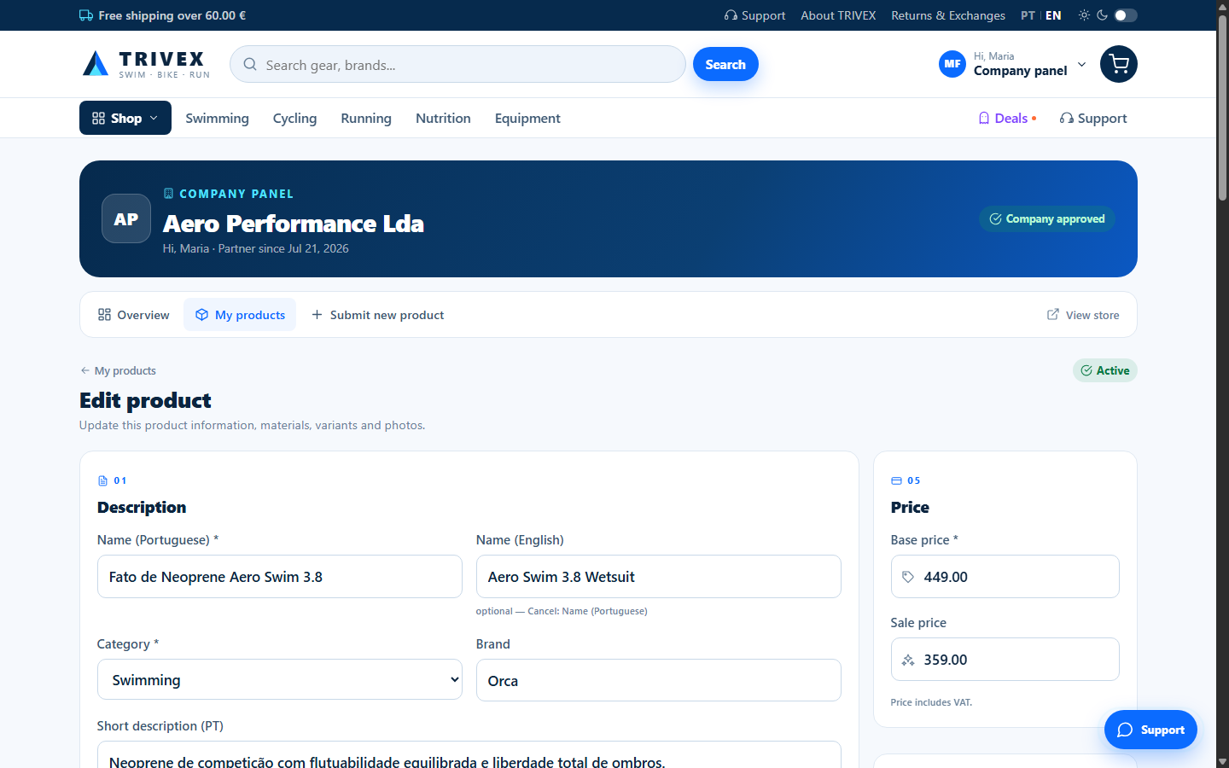
08 / COMPANY PORTAL
From submission to storefront
01
Create product
Names, category, price, variants, media
02
Pending review
Visible to the company; not in the store
03
Admin decision
Approve or reject with a note
04
Active / Rejected
Storefront or resubmission
05
Edit & resubmit
Active stays active; rejected → pending
COMPANY PRODUCT FORM — EDIT MODE
Add variant
Add spec
Image preview
Colour photos
Edit existing
TRIVEX · Triathlon Store
09
Notes:
Companies create products, which start as pending. Admins approve or reject them. Companies can then edit active or rejected products; active stays active and rejected returns to pending.

Slide 10

09 / MEDIA
One product, many ways to show it
Main image
Gallery
Colour photos
products.image
products.gallery
product_color_images
One default hero image.
JSON array of additional photos.
Many photos per exact colour.
Colour selected
product.js
Rebuild gallery
Default fallback
How the storefront switches
• Variant images are injected into the page data.
• The exact colour string is the matching key.
• The default gallery remains the fallback.
• Thumbnails stay clickable after a switch.
Colour: Ocean Blue
TRIVEX · Triathlon Store
10
Notes:
Media has three storage locations: the main image, the JSON gallery and colour-specific photos. When a colour is selected, product.js rebuilds the main image and thumbnails from the variant's images.

Slide 11
10 / GOVERNANCE
Roles and approval
Customer
Company
Moderator
Admin
Shop, order, review, chat
Submit and edit products
Operate; changes need approval
Full control; immediate changes
Moderator change
pending_modifications
Admin review
Apply / Reject
Rules of the queue
• Admin changes apply immediately; moderator changes wait for approval.
• Approval or rejection notifies the requesting moderator.
• Support chat actions are applied immediately and are exempt.
TRIVEX · Triathlon Store
11
Notes:
Admins act immediately. Moderators submit changes to pending_modifications, and an admin approves or rejects them. The support chat is the exception.

Slide 12
11 / SUPPORT
Chat lifecycle
open
in_progress
concluded
archived
Waiting for staff
Assigned to staff
Resolved
After 10 minutes
join
close
10m
Assignment rules
Timeline
• One moderator owns an open chat.
• A heartbeat keeps the assignment alive.
• Two minutes without a heartbeat returns it to open.
• Concluded chats archive after ten minutes.
• Polling keeps the stack dependency-free.
0 min open
2 min heartbeat check
10 min archive
The customer sees only their own conversations.
TRIVEX · Triathlon Store
12
Notes:
Chat states are open, in progress, concluded and archived. A heartbeat keeps ownership; two minutes without it returns the chat to the queue, and concluded chats archive after ten minutes.

Slide 13
12 / EMAIL
From event to inbox
App event
Order, verification, newsletter
Gmail SMTP
MAIL_DRIVER=smtp
MAIL_HOST=smtp.gmail.com
MAIL_PORT=587
MAIL_ENCRYPTION=tls
MAIL_USERNAME=you@gmail.com
MAIL_PASSWORD=app-password
MailService
Message composition
Mailer
Driver selection
Driver
log / smtp / mail
Delivery status
email_log
Audit + storage/mail
TLS handshake verified
STARTTLS + certificate validation
Gmail inbox delivery — pending app password
The current demo uses MAIL_DRIVER=log; switch to smtp when credentials are available.
TRIVEX · Triathlon Store
13
Notes:
MailService composes messages and Mailer selects the driver. SMTP supports AUTH LOGIN, STARTTLS and SSL. The TLS handshake has been verified; Gmail inbox delivery still needs an app password.

Slide 14
13 / SECURITY
Controls that matter
Application controls
Data & media controls
• CSRF tokens on POST forms
• PDO prepared statements
• password_hash / password_verify
• Session regeneration on login
• Role and company middleware
• Throttling on sensitive actions
• Upload type/size + getimagesize()
• Random upload filenames
• Server-side price and stock recalculation
• Output escaping
• Protected homepage
• Security headers
JavaScript is enhancement only; critical checks are enforced on the server.
TRIVEX · Triathlon Store
14
Notes:
Security is enforced server-side: CSRF, prepared statements, password hashing, session regeneration, middleware, throttling and upload validation.

Slide 15
14 / VALIDATION
What was tested
Check | Result | Evidence
PHP syntax | PASS | Changed PHP files linted with php -l
JavaScript syntax | PASS | company.js and product.js checked with node --check
HTTP health | PASS | Homepage returns 200
Responsive layout | PASS | 1440 / 1024 / 768 / 390 px; no document overflow
Product edit rules | PASS | Active stays active; rejected returns to pending
SMTP TLS | PASS | smtp.gmail.com:587; STARTTLS and certificate validation
Gmail inbox delivery | PENDING | App password not configured
6 PASS · 1 PENDING
Only Gmail inbox delivery is pending; SMTP TLS and authentication code are in place.
TRIVEX · Triathlon Store
15
Notes:
Syntax, HTTP, responsive and product-edit checks pass. SMTP TLS passes. Gmail inbox delivery remains pending until an app password is configured.

Slide 16
15 / STATUS
Demonstration-ready, production-hardening next
Completed
Next
• Storefront and catalogue
• Cart and transactional checkout
• Customer accounts and reviews
• Company create/edit product flow
• Main image, gallery and colour photos
• Admin/moderator approval queue
• Support chat
• PT/EN, light/dark and responsive
• Configure a Gmail app password and verify inbox delivery
• Add automated end-to-end tests
• Add image resizing and compression
• Harden the production deployment
Known limitations: simulated payments, simulated shipping, no automated E2E suite.
TRIVEX · Triathlon Store
16
Notes:
The core platform is complete and demonstration-ready. The remaining work is operational: real email credentials, automated tests, image optimisation and production hardening.

Slide 17
16 / DEMO
Accounts and key routes
Role | Email | Password
Admin | admin@trivex.pt | Admin123!
Moderator | moderador@trivex.pt | Mod12345!
Customer | cliente@trivex.pt | Cliente123!
Company | empresa@trivex.pt | Empresa123!
Pending company | tiago@oceanonorte.pt | Empresa123!
Key routes
/
/loja
/produto/{slug}
/empresa/produtos
/admin
/suporte
Suggested demo
Sign in as admin → approve Oceano Norte Sports → sign in as company → create or edit a product.
TRIVEX · Triathlon Store
17
Notes:
Use the admin account to approve the pending company, then sign in as the company to demonstrate product creation and editing. The customer account is useful for orders, reviews and chat.

Slide 18
TRIVEX
Built from scratch.
A complete triathlon commerce platform
No framework.
No bundler.
No external runtime.
Storefront · customer account · company portal · backoffice · support chat
17
4
0
tables
roles
build steps
Questions?
PHP 8 · MySQL 8 · PDO · vanilla JS · local SVG
swim · bike · run
Notes:
TRIVEX is a complete, self-contained triathlon commerce platform. It demonstrates the full journey from product discovery to checkout, company product management and backoffice governance.

