Slide 1
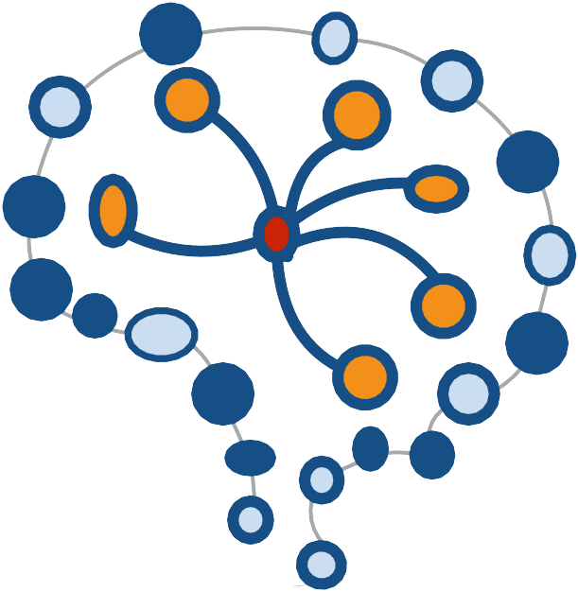
Viettel Network Internship 2023: Data Science and AI
Duc Nguyen Huu
Deep Learning and AI #2
Instruction Fine-tuning LLMs
Dec 13, 2023
Duc Nguyen Huu
Viettel Network Internship 2023
1

Slide 2
Contents
Supervised Instruction Fine-tuning
The Finetuning Pipeline and Dataset Origins
Instruction fine-tuning code showcase
2

Slide 3
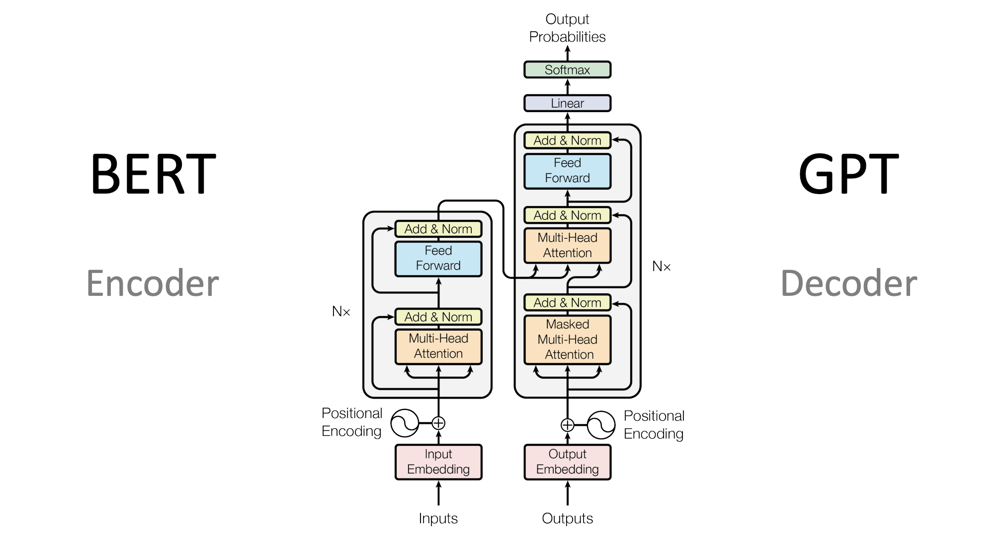
3

Slide 4
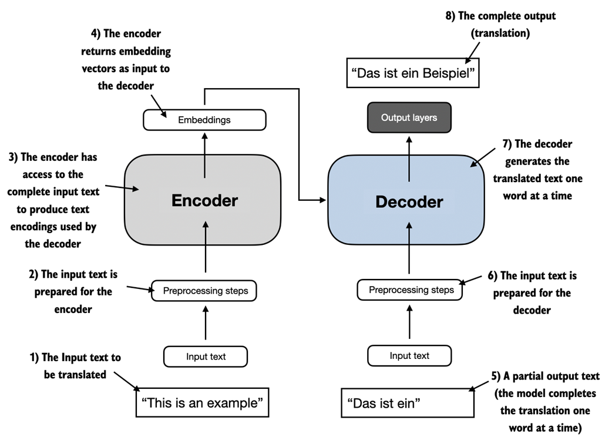
4

Slide 5
LLMs
Encoder-only architecture
(BERT, RoBERTa, DeBERTa ..)
Decoder-only architecture
(GPT-3, LLaMA, Mistral...)
5

Slide 6
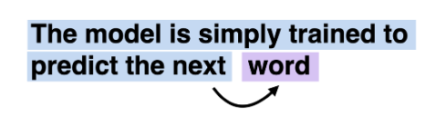
In the next-word pretraining task for GPT models, the system learns to predict the upcoming word in a sentence by looking at the words that have come before it. This approach helps the model understand how words and phrases typically fit together in language, forming a foundation that can be applied to various other tasks.
6

Slide 7
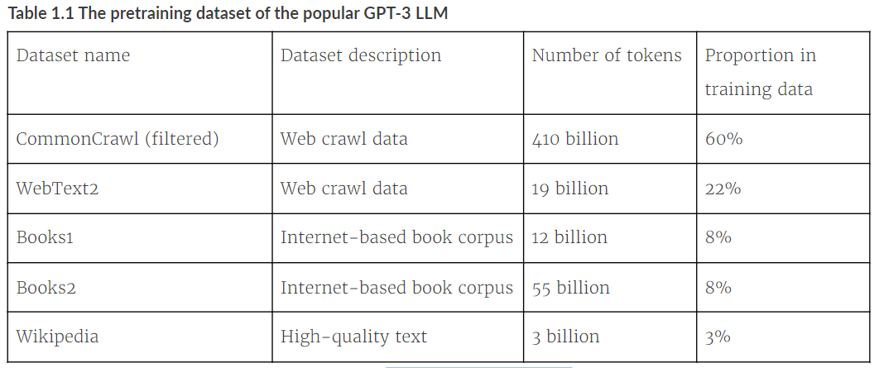
Datasets to pre-train GPT- 3
7

Slide 8
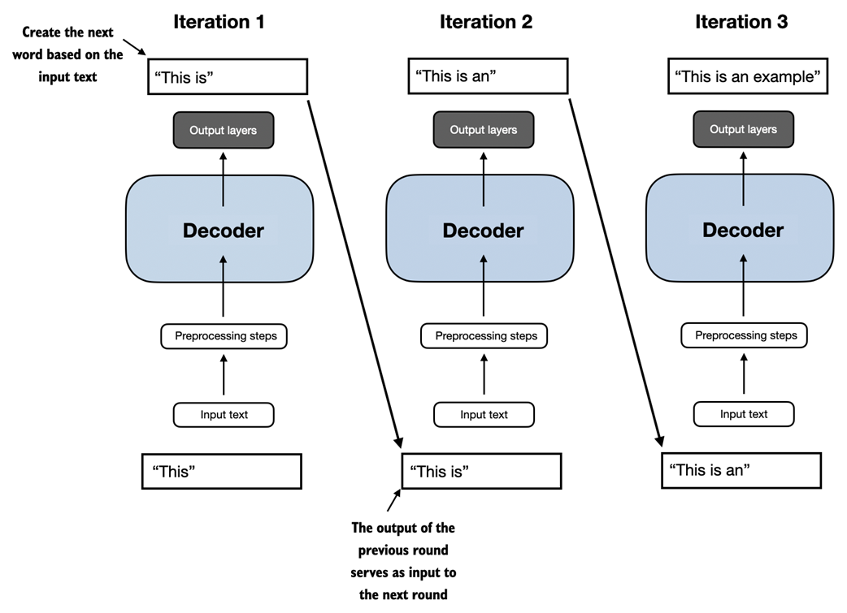
8

Slide 9
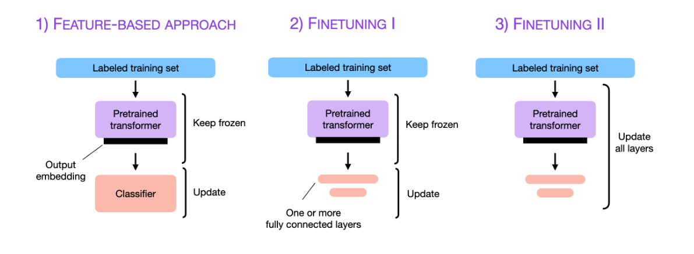
Fine-tuning approaches
9

Slide 10
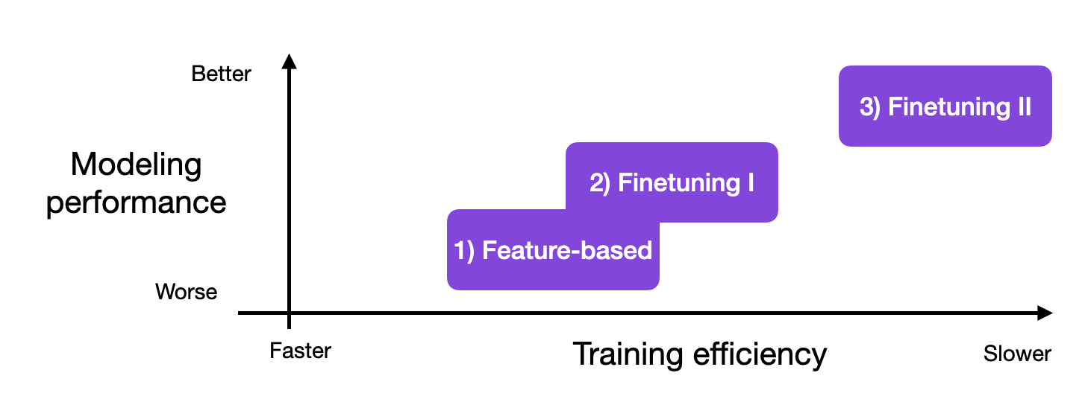
Fine-tuning all layers is often better
93 %
90 %
75 %
10

Slide 11
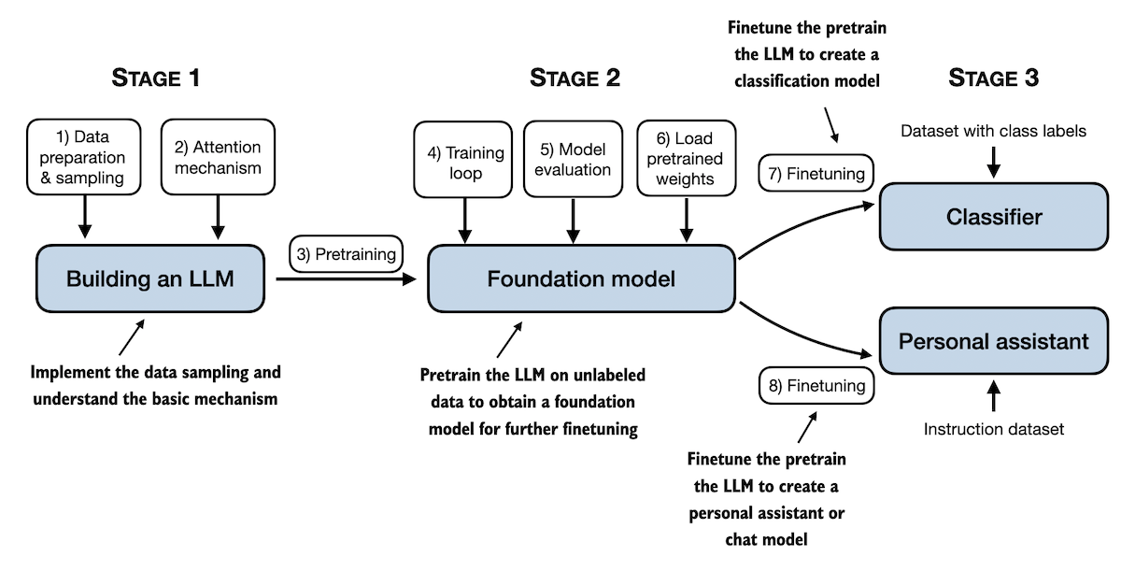
Instruction fine-tuning
https://github.com/rasbt/LLMs-from-scratch
11

Slide 12
What is instruction-finetuning, and why should we care?
- Train LLMs on specific input-output examples, allowing for more controlled and desired outputs.
- Enhance model behavior, reliability, and safety in various applications.
12

Slide 13
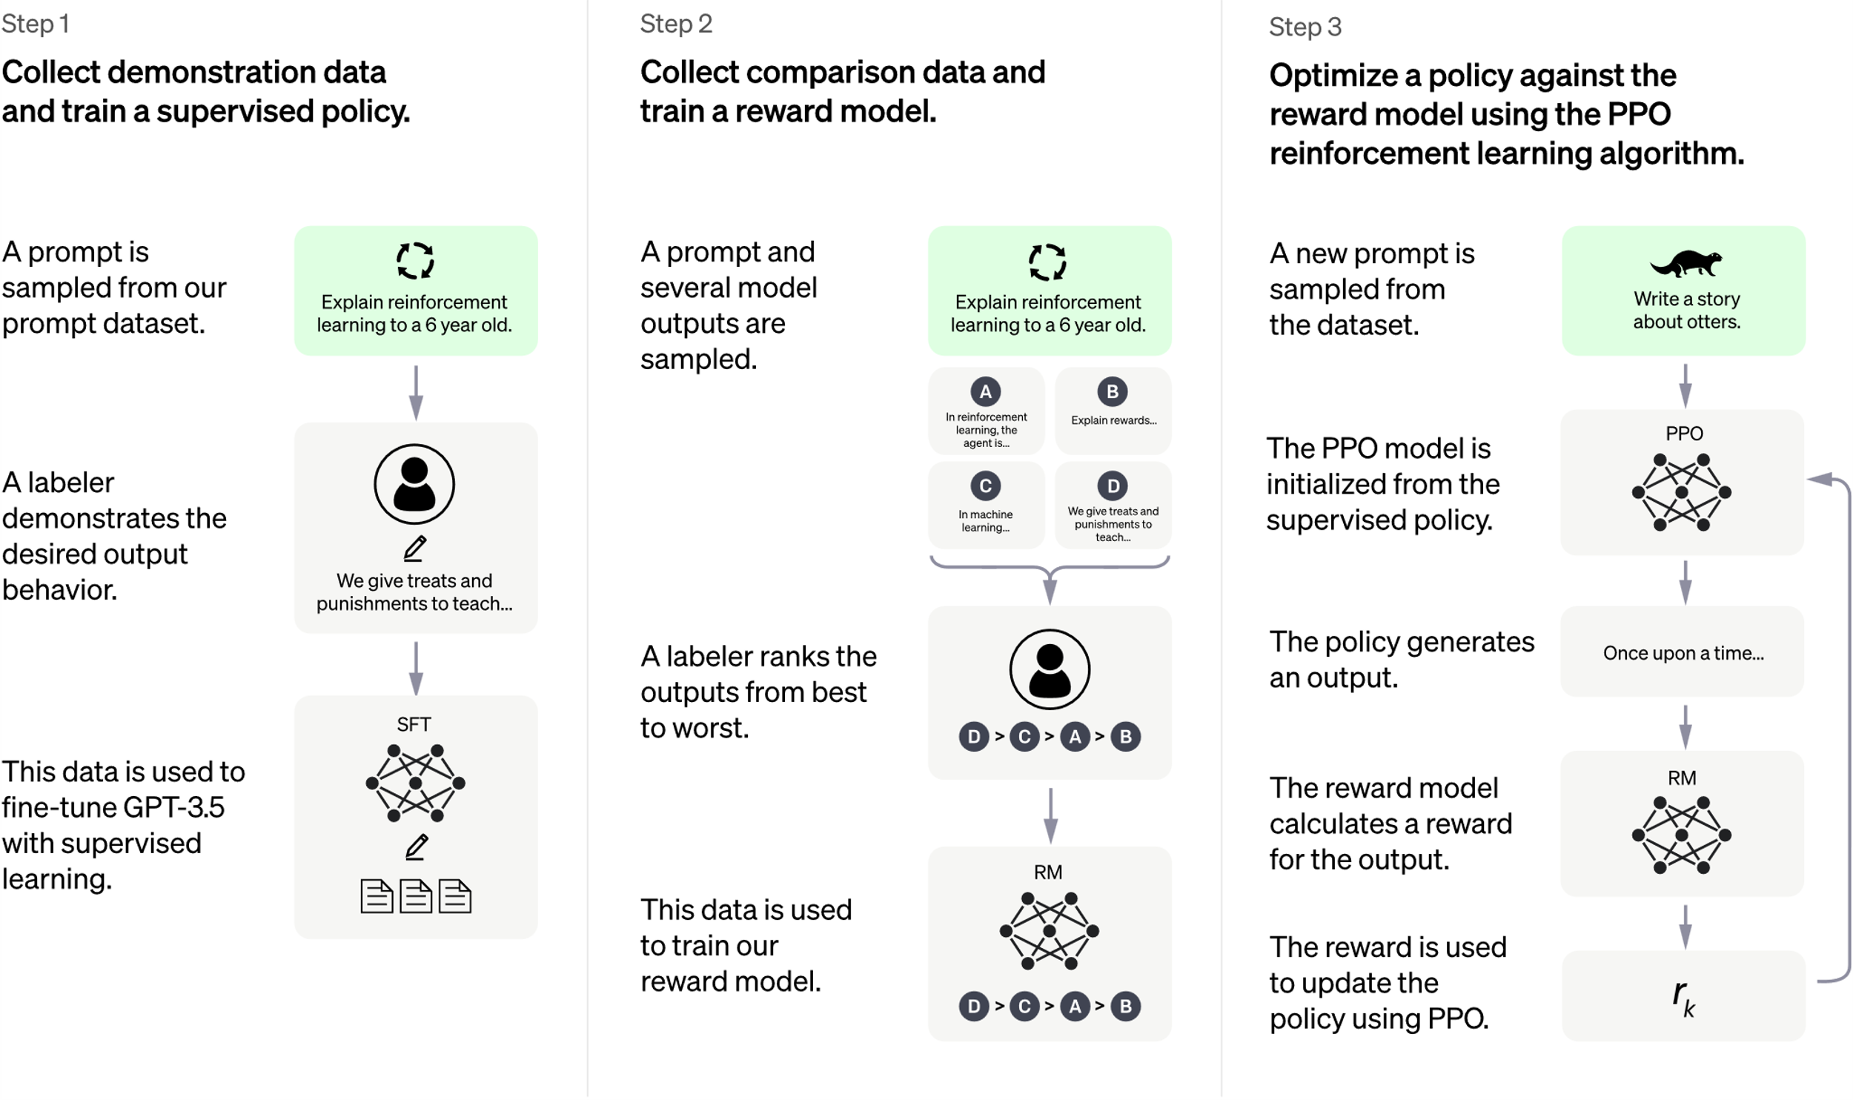
ChatGPT training steps after pre-training
https://arxiv.org/abs/2303.08774
https://openai.com/blog/chatgpt
13

Slide 14
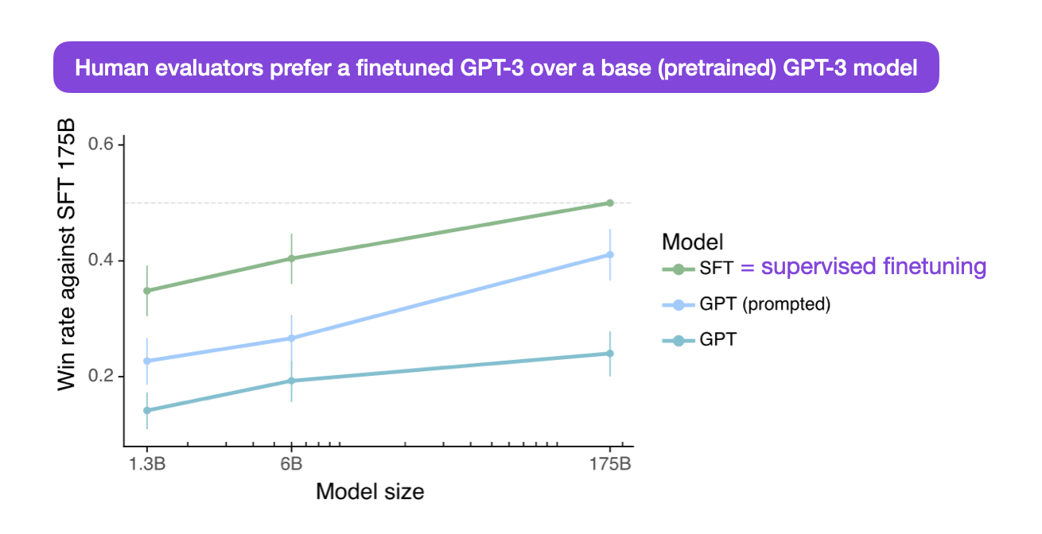
https://arxiv.org/pdf/2303.08774.pdf
14

Slide 15
How does a dataset for instruction fine-tuning look like?
- Instruction-response pairs
- A dataset for Instruction ST typically consists of 3 components
Instruction text
Input text (optional)
Output text
15

Slide 16
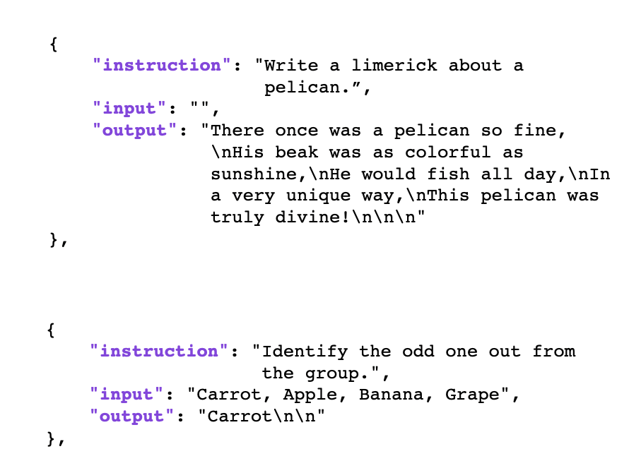
The example below lists two training examples, one without and one with an optional input text:
Input is optional here
16

Slide 17
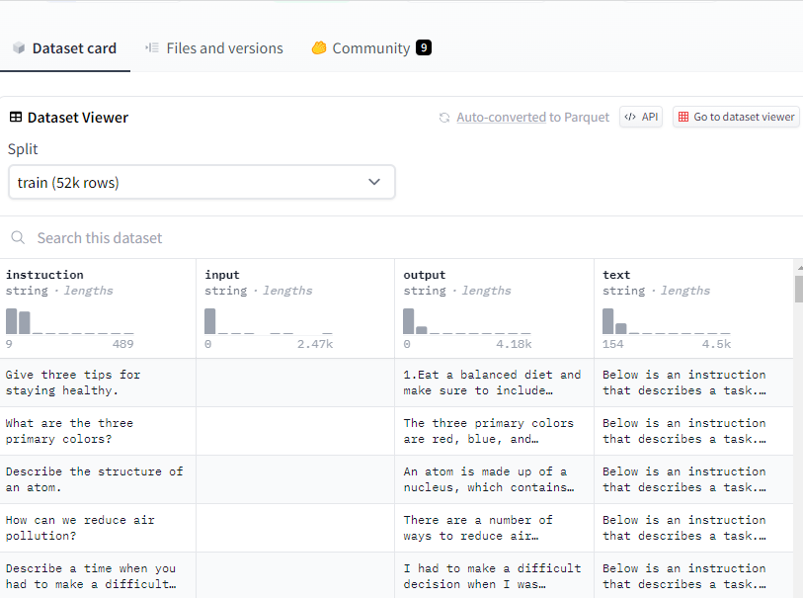
17

Slide 18
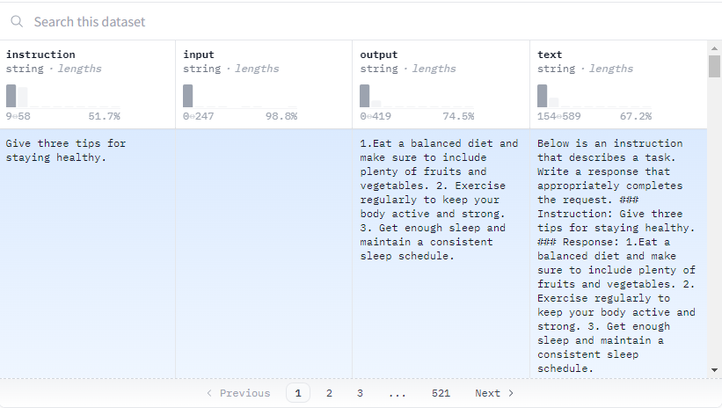
Input for instruction
fine-tuning
18

Slide 19
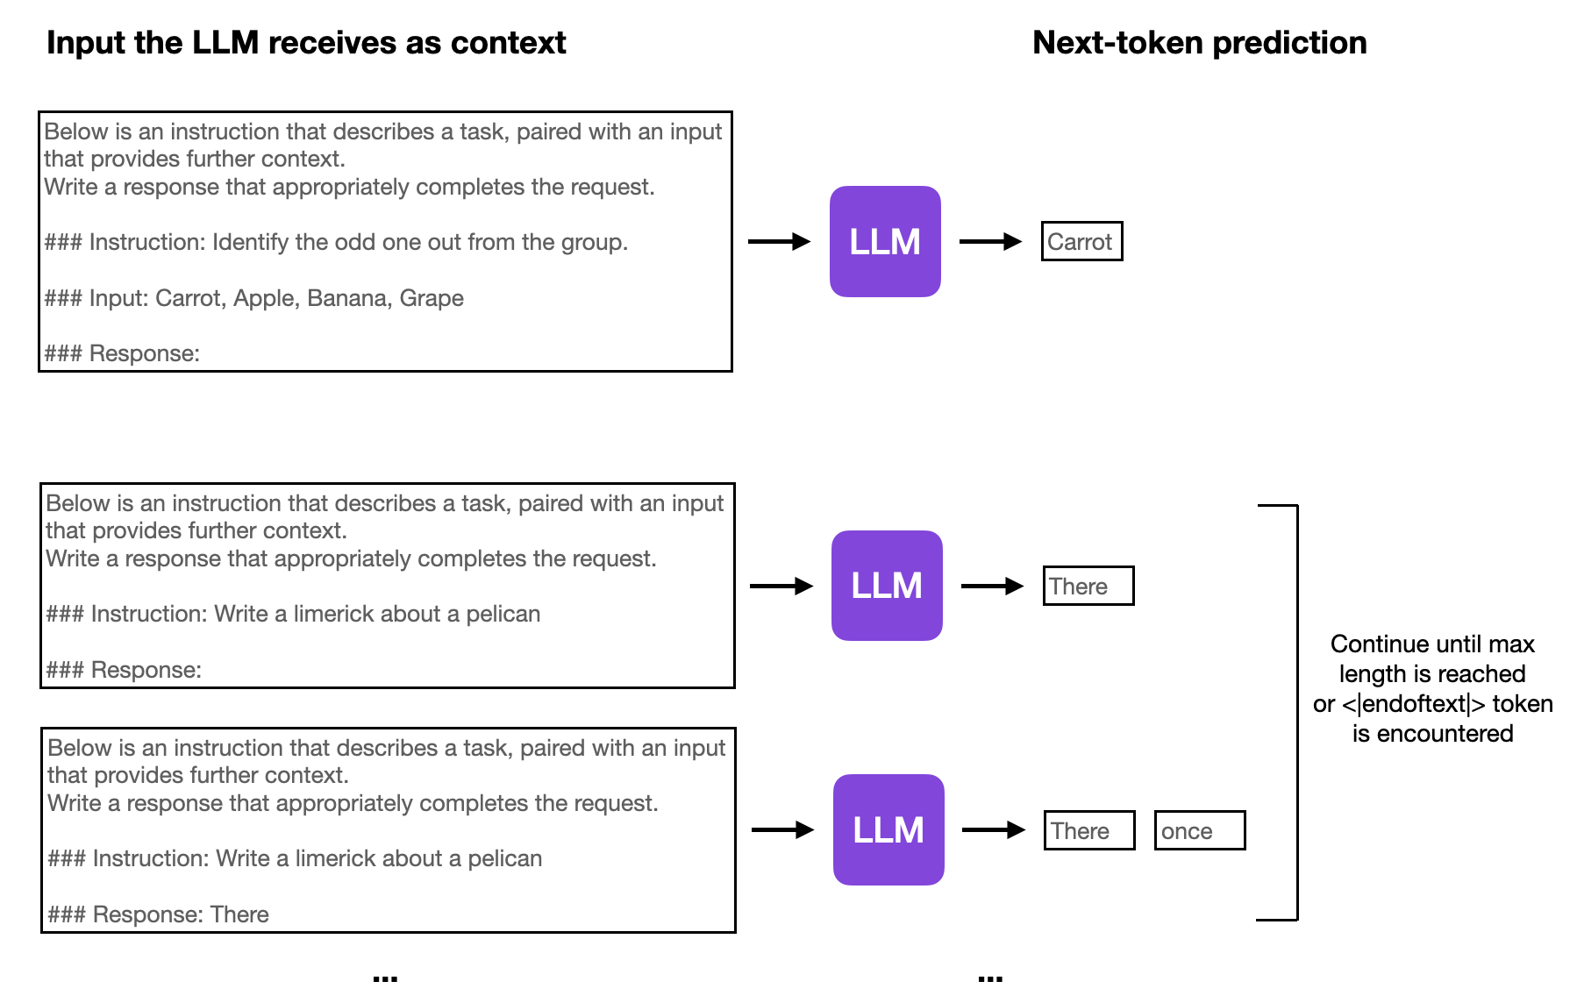
Instruction Fine-tuning
19

Slide 20
The Finetuning Pipeline and Dataset Origins
Supervised Instruction Finetuning
The Finetuning Pipeline and Dataset Origins
Instruction fine-tuning showcase using dolly’s training data
20

Slide 21
Sources of instruction datasets
1. Human-created: Expert annotators offer explicit instructions for instruction finetuning, aiding in domain-specific tasks and mitigating biases.
2. LLM-generated: Utilizing an existing LLM, like GPT-4 (if allowed by terms), produces abundant input-output pairs for efficient finetuning, with human refinement for quality.
21

Slide 22
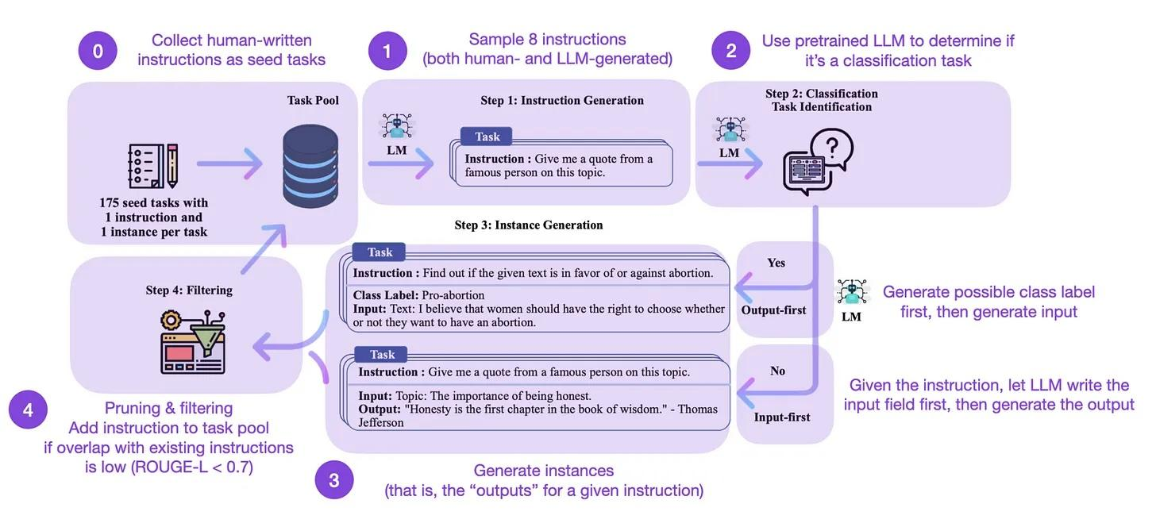
One of the most prominent and widely used methods for LLM-generated datasets is Self-Instruct
Annotated figure from: https://arxiv.org/pdf/2212.10560.pdf
22

Slide 23
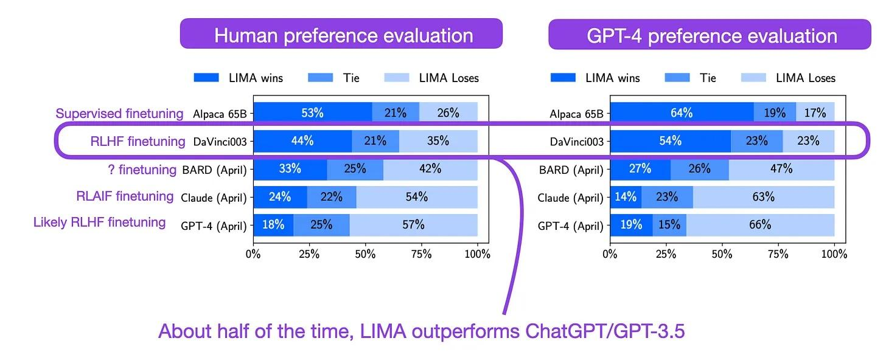
High-quality Datasets: Less May Be More
The LIMA: Less Is More for Alignment paper shows that quality trumps quantity when instruction finetuning datasets.
Annotated figure from: https://arxiv.org/pdf/2305.11206.pdf
23

Slide 24
Code example
Supervised Instruction Finetuning
The Finetuning Pipeline and Dataset Origins
Instruction fine-tuning code showcase
24

Slide 25
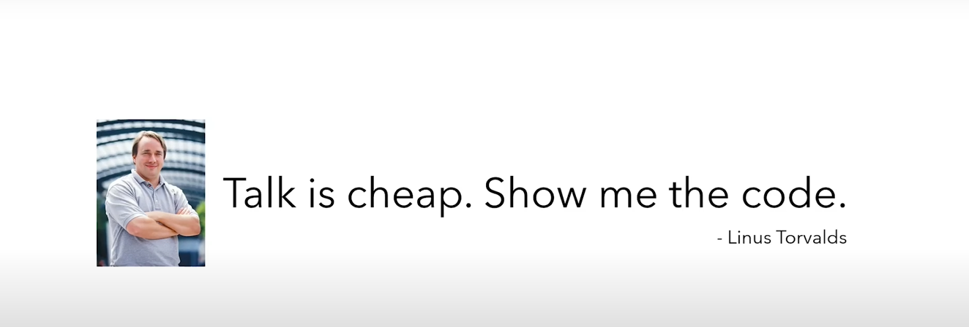

Slide 26
Instruction fine-tuning showcase
- Model: Mistral 7B
- Instruction Dataset: Dolly-15k (Human-created)
- Motivation:
+ Lack of clear spelled-out tutorials
+ Don’t want to count on available GUIs for fine- tuning LLMs
+ Check understanding and assumptions
+ Gain more hands-on experience in coding and LLM implementation
+ Grow in the field
26

Slide 27

27

