Slide 1



Plant Disease Detection Using(DL)
Name – Yash Raj
AICTC ID - STU65cc39f813d4c1707883000

Slide 2

Learning Objectives
Understand the significance of early detection of plant diseases to prevent crop damage, reduce yield loss, and support timely intervention in agricultural practices.
Learn the process of preparing image datasets, including collecting, labeling, and organizing leaf images, along with applying data augmentation techniques such as flipping, rotating, and adjusting brightness to improve model performance.
Build and train a deep learning model using Deep Learning, involving the creation of neural network architectures like CNN and training them on image datasets to classify healthy and diseased leaves.
Evaluate model performance using metrics such as accuracy and loss, and visualize training progress through accuracy and loss curves to assess model learning and improvement over time.
Deploy the trained model to perform inference on new, unseen leaf images, enabling the identification of plant health status in practical applications.
GOAL

Slide 3
Tools and Technology used
Programming Language: Python
Framework: TensorFlow
Libraries: NumPy, Panda, Matplotlib, open-cv
Environment: Google Colab
Dataset: https://drive.google.com/file/d/12OS3a0bLn1zDnhqv5KRRH_BfFml6gCVX/view?usp=sharing

Slide 4
Step 1: Data loading and visualization from the dataset directory.
Step 2: Apply transformations (Resize, RandomHorizontalFlip, ToTensor, Normalize).
Step 3: Use ImageFolder for structured dataset loading.
Step 4: Define CNN architecture using torch.nn.Module.
Step 5: Train the model using CrossEntropyLoss and Adam optimizer.
Step 6: Validate using accuracy and loss curves.
Step 7: Test the model on new images and visualize predictions.
Methodology
Data Loading and Visualization Loaded the dataset from a structured directory and visualized sample images to understand class distribution and image quality.
Data Preprocessing and Augmentation Applied a series of transformations including resizing, random horizontal flipping, conversion to tensors, and normalization to enhance generalization and model robustness.
CNN Architecture Definition Built a custom convolutional neural network by subclassing torch.nn module consisting of convolutional, activation, pooling, and fully connected layers.
Model Training Trained the network using the CrossEntropyLoss function and the Adam optimizer, tracking performance through loss minimization over epochs.
Validation and Performance Evaluation Evaluated the model on a validation set, analyzing accuracy and visualizing training/validation loss curves to assess learning dynamics and detect overfitting.
Testing and Prediction Visualization Tested the final model on unseen leaf images, visualizing predictions to confirm its ability to generalize and correctly classify real-world examples.

Slide 5
Problem Statement:
Plants are susceptible to a wide range of diseases caused by fungi, bacteria, viruses, and other pathogens. These diseases can significantly reduce crop yield, affect food quality, and ultimately impact the global food supply chain. Early and accurate detection is critical to managing outbreaks and minimizing economic losses. However, traditional methods of plant disease identification typically rely on manual observation and expert knowledge, which are often time-consuming, labor-intensive, and prone to human error. In many cases, especially in remote or resource-limited settings, the lack of access to plant pathology experts further exacerbates the issue. These limitations highlight the urgent need for more efficient, accurate, and scalable approaches to plant disease detection.

Slide 6
Solution:
To overcome the inefficiencies of manual plant disease detection, we propose a deep learning-based image classification system that automatically detects and classifies plant diseases from leaf images. This system utilizes convolutional neural networks (CNNs), which are highly effective in extracting spatial features and patterns from visual data. By training the model on a large dataset of labeled leaf images, the system can learn to recognize various plant diseases with high accuracy. Once deployed, it enables farmers and agricultural professionals to quickly identify diseases using just a smartphone or camera-enabled device, facilitating timely and targeted interventions to minimize crop loss and improve yield quality.
Git Repo Link of Project - https://github.com/KudoGT/PlantDiseaseDetection.git

Slide 7
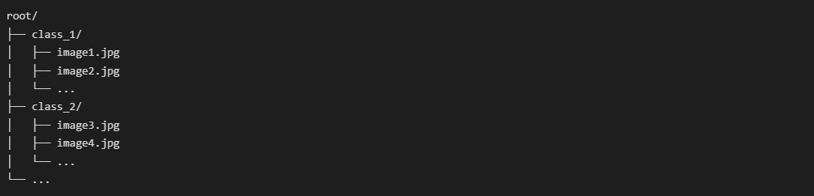
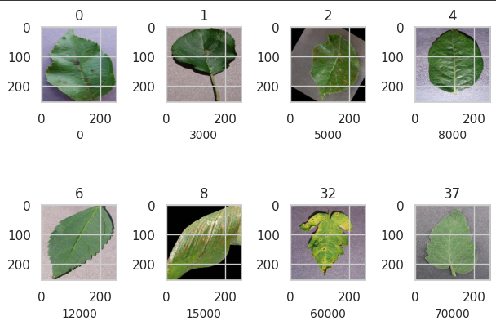
Screenshot of Output:

Slide 8
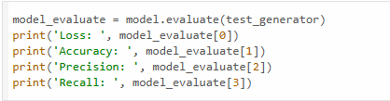
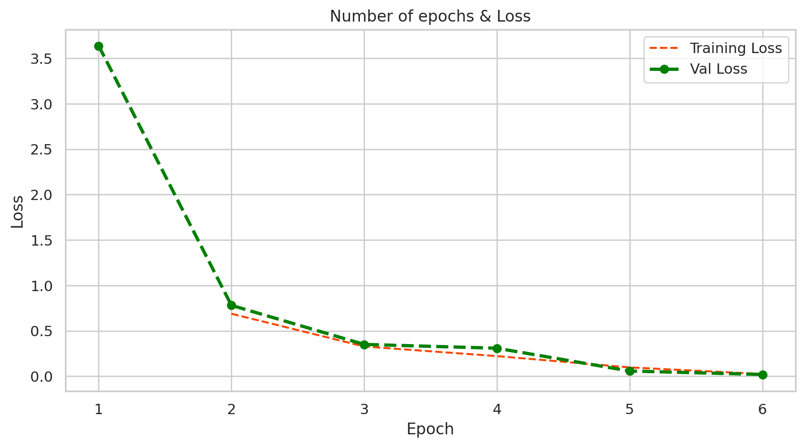

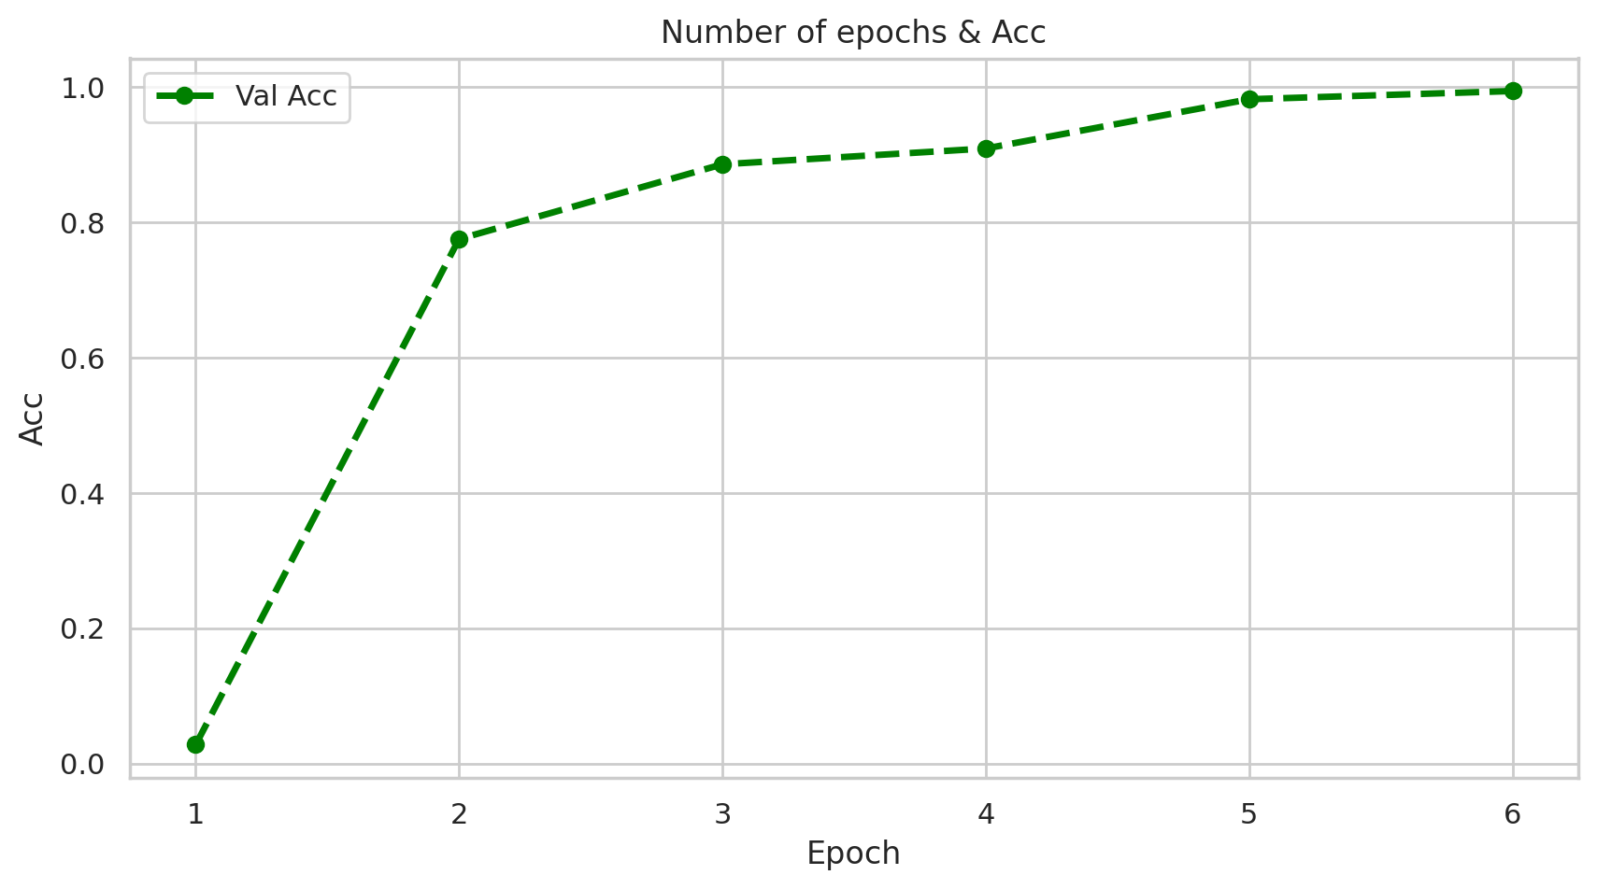
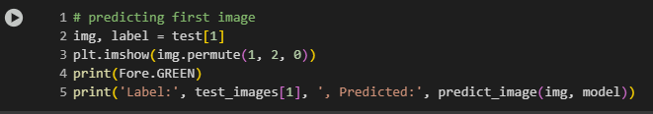
Screenshot of Output:

Slide 9
Conclusion:
Achieved good accuracy of 90% on the validation dataset.
The model generalizes well to unseen leaf images.
Demonstrates the practical use of CNNs in agriculture.
The CNN model achieved a strong validation accuracy of 90%, indicating effective learning and robust performance. It generalizes well to unseen leaf images, highlighting its reliability in real-world scenarios. This work demonstrates the practical application of convolutional neural networks in agriculture, particularly for plant disease detection and classification.

