Slide 1
Design of a 32 bit MIPS CPU
COMPUTER ENGINEERING GROUP 3
COE 381: MICROPROCESSORS – DESIGN PROJECT
DECEMBER 2018

Slide 2
Presentation Outline
General Introduction to processor Design
Overview of MIPS ISA
Register File Design
ALU Design
Datapath Design
Control Unit Design
Final CPU
Running test programs on the CPU

Slide 3
The steps in processor design
Step 1: Analyze instruction set to determine datapath requirements.
Step 2: Select set of datapath components & establish clock methodology
Step 3: Assemble datapath components that meet the requirements
Step 4: Analyze implementation of each instruction to determine setting of control points that realizes the register transfer.
Step 5: Assemble the control logic

Slide 4
THE MIPS ISA
Classical reduced instruction set architecture.
MIPS does not stand for Million instructions per second ☺.
We mean Microprocessor without interlocked pipeline stages.
Classical load/store architecture.
Very few instructions in total compared to IA-32

Slide 5
THE MIPS ISA
3 Instruction formats R (register),I (immediate), J (jump)
Every instruction can be represented in MIPS assembly language.
The assembly language representation has an equivalent machine level encoding.
MIPS-32 is a 32 bit ISA. What does this mean?

Slide 6
R-Type Instructions
MIPS assembly language representation
Register transfer language notation
Machine language encoding
op rd,rs,rt
R[rd] R[rs] op R[rt]
31 26
25 21
20 16
15 11
10 6
5 0
op
rs
rt
rd
shamt
funct
6 bits
5 bits
5 bits
5 bits
5 bits
6 bits

Slide 7
R-Type Instructions
All R-Type instructions have 000000 as opcode.
Which operation is performed depends on the value of the funct field.
shamt is the number of shifts and is used by shift operations.
A simple R-Type instruction is:
add $s1, $s2, $s3

Slide 8
I-Type Instructions
MIPS assembly language representation
Register transfer language notation
Machine language encoding
op rt, rs, imm
R[rt] R[rs] op imm
31 26
25 21
20 16
15 0
op
rs
rt
imm
6 bits
5 bits
5 bits
16 bits

Slide 9
I-Type Instructions
There are several ‘groups’ of immediate instructions.
The arithmetic and logical immediate:
addi, ori, xori
Memory operations: lw , sw
Conditional branch instructions: bne, beq
More on these instructions during their datapath design.

Slide 10
J – Type instructions
All J-Type instructions are jump instructions
There are a variety of j-type instructions.
MIPS assembly language representation:
Machine Language encoding
j target
31 26
25 0
op
imm
6 bits
26 bits

Slide 11
Our ISA (A ‘tiny’ ☺ MIPS Subset )
In total our processor can execute 16 MIPS ISAs
6 R-Type, 9 I-Type , 1 is J-Type
16 isn’t a bad number after all. Our processor can do ‘incredible’ stuff including branching and looping. ☺

Slide 12
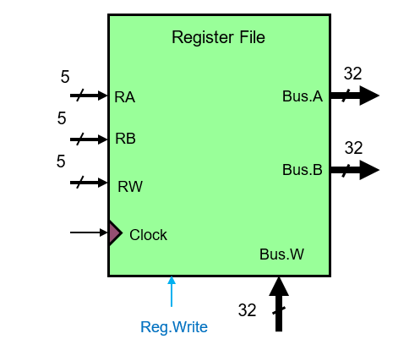
Register File Design

Slide 13
Register File Design
Logisim Demonstration

Slide 14
ALU Design
Logisim Demonstration

Slide 15
Datapath Design
The datapath determines how data and addresses flow around for processing.
For each instruction we convert to RTL and then consider the machine encoding to design it’s datapath.
The PC always points to the next instruction.
PC is incremented by 4 after ever instruction. Why?

Slide 16
Instruction Fetch Unit
4
+
PC
Read
address
Instruction
[31 – 0]
Instruction
memory

Slide 17
Datapath for R-Type Instructions
RegWr
ALUCtr
Ins[25 – 21] rs
Read
Reg 1
Ins
Ins[20 – 16]rt
Read
Data 1
Bus A
Read
Reg 2
32
Result
ALU
Ins[15– 11] rd
Registers
32
Write Reg
Bus B
Read
Data 2
32
Write data

Slide 18
Datapath for simple I-Type Instructions
RegWr
ALUCtr
Ins[25 – 21] rs
Read
Reg 1
Ins
Read
Data 1
Bus A
Read
Reg 2
32
Result
Registers
ALU
Ins[15– 11] rt
Write Reg
32
Read
Data 2
Write data
Ins[15– 0]
sign
16
extend
32

Slide 19
Combined Datapath for R and I-Type Instructions
RegWr
ALUCtr
Ins[25 – 21] rs
Read
Reg 1
Ins
Ins[20 – 16] rt
Read
Data 1
Bus A
Read
Reg 2
32
Result
0MUX1
ALU
Registers
32
Write Reg
Bus B
Ins[15– 11]
Read
Data 2
0MUX1
32
Write data
Ins[15– 0]
sign
16
32
ALUSrc
extend
RegDst

Slide 20
Datapath for the load instruction
RegWr
ALUCtr
memToReg
Ins[25–21] rs
Read
Reg 1
Bus A
Ins
Ins[20 – 16] rt
Read
Data 1
0MUX1
32
Result
Read data
32
Read
Reg 2
ALU
Address
0MUX1
32
Registers
Bus B
Data Memory
Write Reg
0MUX1
Ins[15-11]
Read
Data 2
32
Write data
Write data
Ins[15– 0]
sign
ALUSrc
memRd
16
extend
32
RegDst

Slide 21
Datapath for the store instruction
RegWr
ALUCtr
memWrite
memToReg
Ins[25–21] rs
Read
Reg 1
Bus A
Ins
Ins[20 – 16] rt
Read
Data 1
0MUX1
32
Result
Read data
32
Read
Reg 2
ALU
Address
0MUX1
32
Registers
Bus B
Data Memory
Write Reg
0MUX1
Ins[15-11]
Read
Data 2
32
Write data
Write data
Ins[15– 0]
sign
ALUSrc
memRd
16
extend
32
RegDst

Slide 22
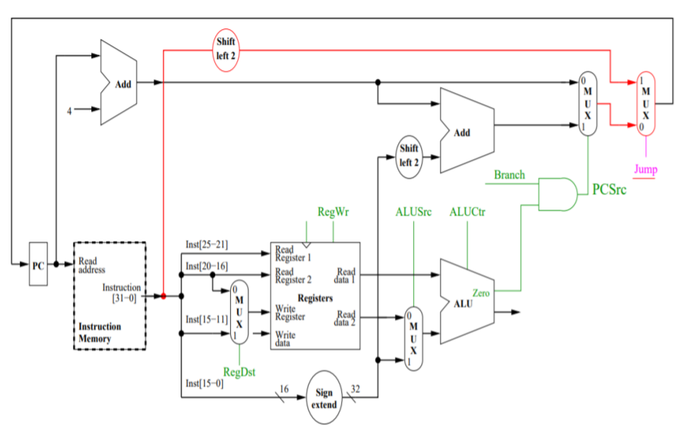
Datapath for branch and jump instructions

Slide 23
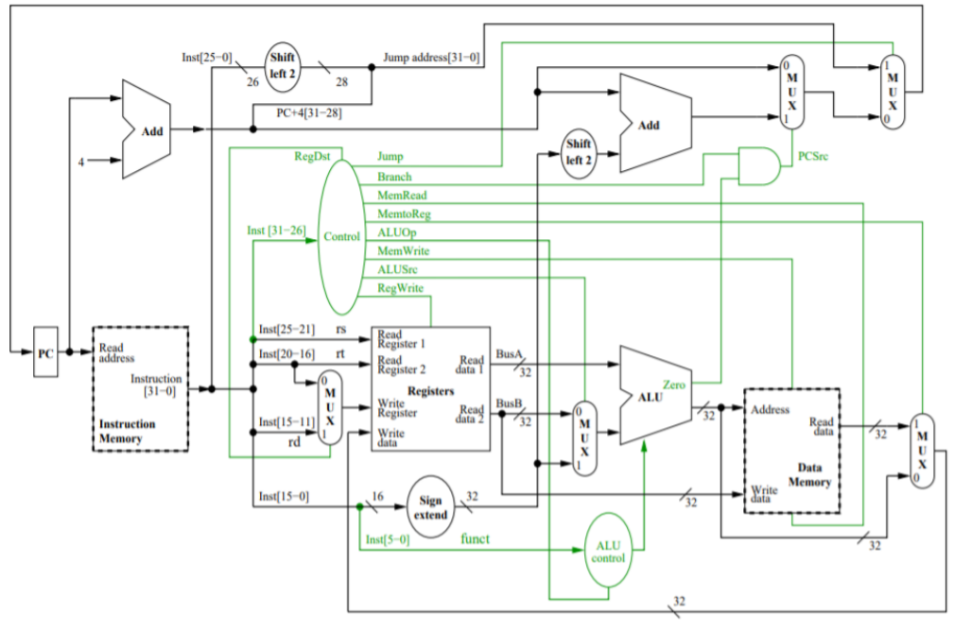
Final Datapath

