Slide 1
Neurorobotics in the Human Brain Project
Abschlusspräsentation
Sebastian „Captain“ Rebmann, Tobias Kalb, Yannick Schrempp

Slide 2
Outline
Task and Challenges
Solutions
Choice of Input
Learning Methods
Results
Future Work

Slide 3
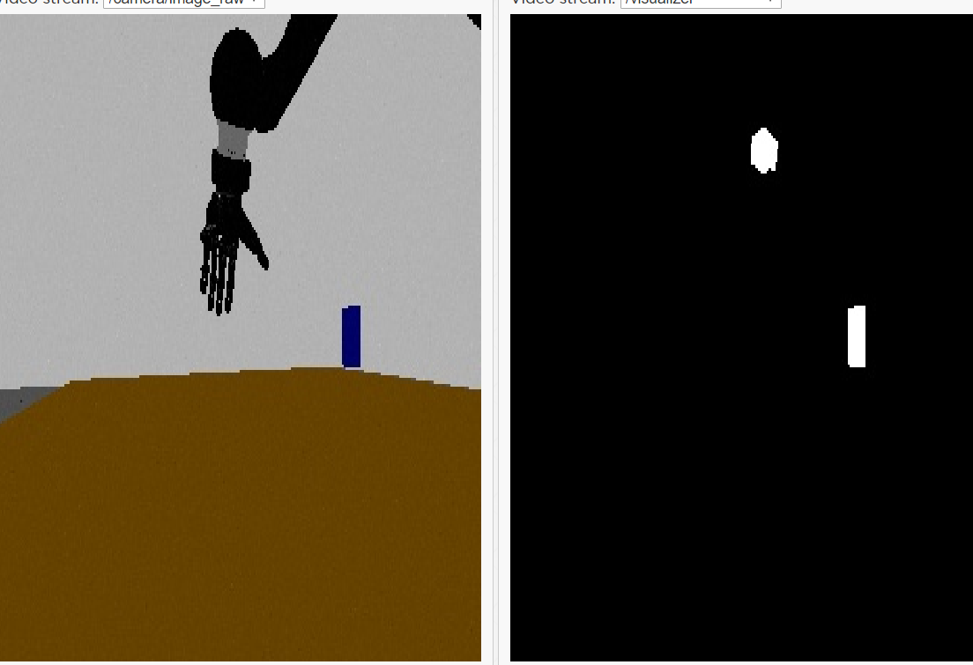
Choice of Input
Extract box position from camera input
Problems:
Hand out of camera scope most of the time
Occlusions
Unstable values
Take box position from state machine
Problems:
Values are changing extremely fast
Cast position to integer
(More stable and reproducible) ????

Slide 4
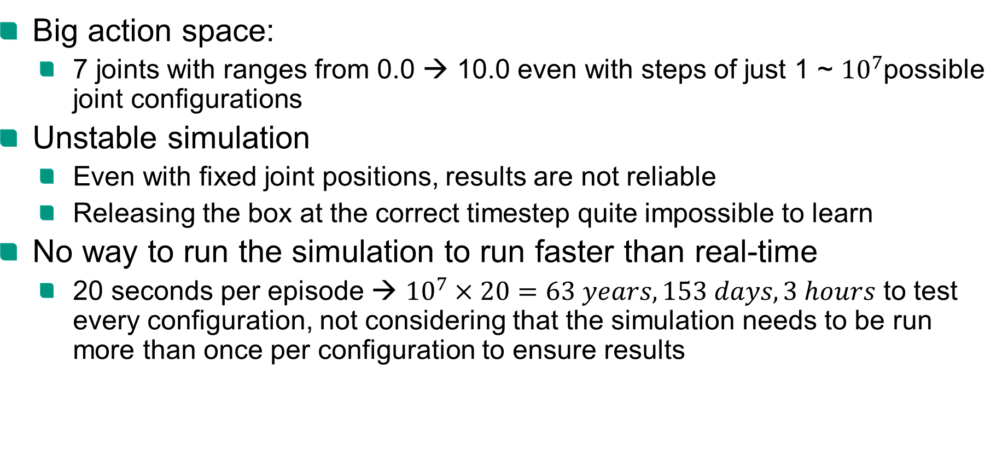
Challenges
Big action space:
7 joints with ranges from 0.0 → 10.0 even with steps of just 1 ~ ${10}^{7}$possible joint configurations
Unstable simulation
Even with fixed joint positions, results are not reliable
Releasing the box at the correct timestep quite impossible to learn
No way to run the simulation to run faster than real-time
20 seconds per episode → ${10}^{7}×20=63 years, 153 days, 3 hours$ to test every configuration, not considering that the simulation needs to be run more than once per configuration to ensure results

Slide 5
Solutions
Fixed routine to grasp cylinder to simplify task
Simplify input to reduce feature extraction from image
Assume that first try is enough to measure fitness

Slide 6


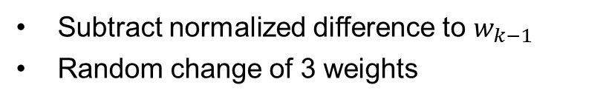
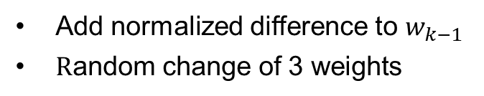
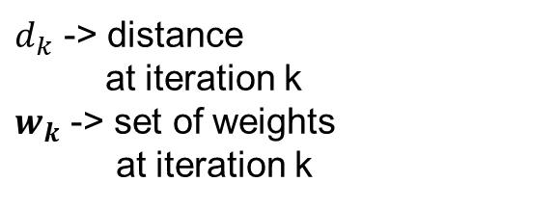
Evolutionary approach I - Implementation
Set of weights
$$w_{0}$$
𝒘_𝟎
$$w_{k}$$
𝒘_𝒌
$$w_{k+10}$$
𝒘_(𝒌+𝟏𝟎)
Action
$d_{k}$ -> distance
at iteration k
$w_{k}$ -> set of weights
at iteration k
Randomly initialize weights
$$d_{k}>d_{k −1}$$
$$d_{k}<d_{k−1}$$
Add normalized difference to $w_{k−1 }$
$\text{R}\text{andom} \text{change} \text{of}\text{ 3 }\text{weights}$
Subtract normalized difference to $w_{k−1}$
Random change of 3 weights
Merge best 25 individuals
Merge 25 random individuals

Slide 7
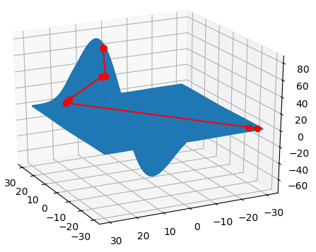
Evolutionary approach I – Testing
Built test function which verifies that maximum theoretically will be found
Weight dimensions for
testing purposes reduced to 2
Random distance function
Distance search scope
Best return value of every generation
distance
weight I
weight II

Slide 8
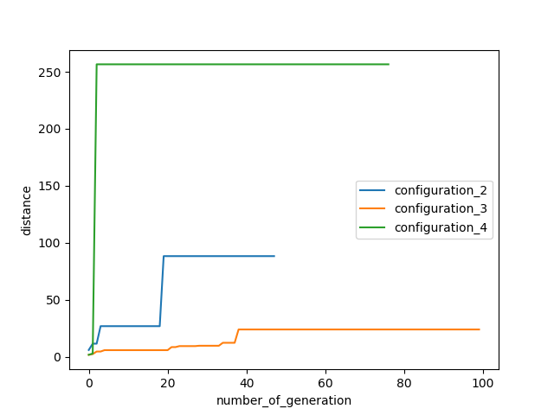
Results
Configuration 1
4 Joints
Input: fixed value (1)
Configuration 2
7 Joints
Input: Position of Box (x, y, z)
Configuration 3
7 Joints
Input: Position of Box casted to second decimal place
Configuration 4
7 Joints
Scaled output weights
No plot, best distance: 25m

Slide 9
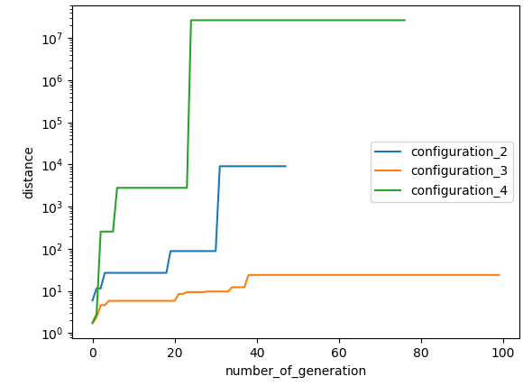

Results II
Same approaches but not
cut for values above 250 m
Logarithmic scale
Distances caused
by “exploding” hand during
throwing
Reason why “normal”
results could not improve

Slide 10
Q-Learning
Idea: train classic neural network, with Q-Learning and Backpropagation
Need to reduce action space: 63 years to long
Reduce number of used joints: only 1,3,5 and grasp
Pre-train Network reproducing fixed routine

Slide 11
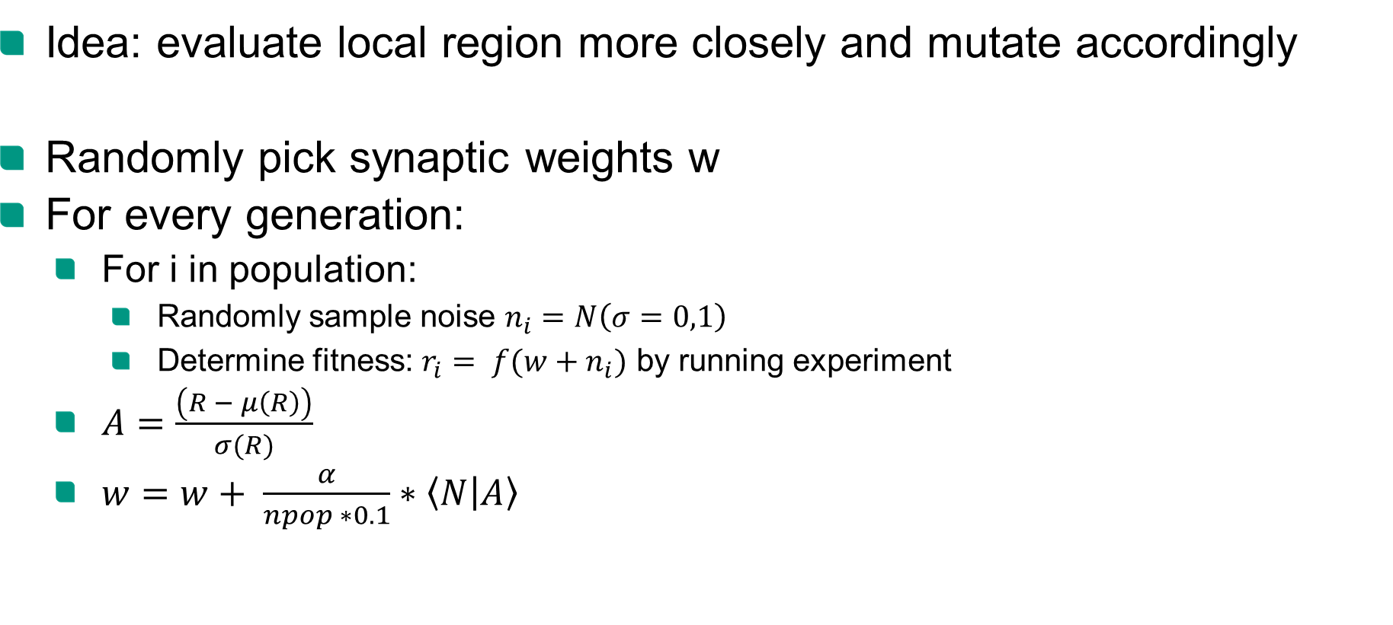
Evolutionary Algorithm
Idea: evaluate local region more closely and mutate accordingly
Randomly pick synaptic weights w
For every generation:
For i in population:
Randomly sample noise $n_{i}=N\left(σ=0,1\right)$
Determine fitness: $r_{i}= f(w+n_{i})$ by running experiment
$A=\frac{\left(R − μ\left(R\right)\right)}{σ(R)}$
$w=w+ \frac{α}{npop ∗0.1}∗\left\langle N | A\right\rangle$
Notes:
initial guess for the synaptic weights is random
N samples from a normal distribution N(0,1)
jitter w using gaussian of sigma 0.1
A standardize the rewards to have a gaussian distribution
perform the parameter update. The matrix multiply below # is just an efficient way to sum up all the rows of the noise matrix N, where each row N[j] is weighted by A[j]

