Slide 1
Neurorobotics in the Human Brain Project
Abschlusspräsentation
Sebastian „Captain“ …, Tobias Kalb, Yannick Schrempp

Slide 2
Outline
Task and Challenges
Solutions
Choice of Input
Learning Methods
Results
Future Work

Slide 3
Task

Slide 4
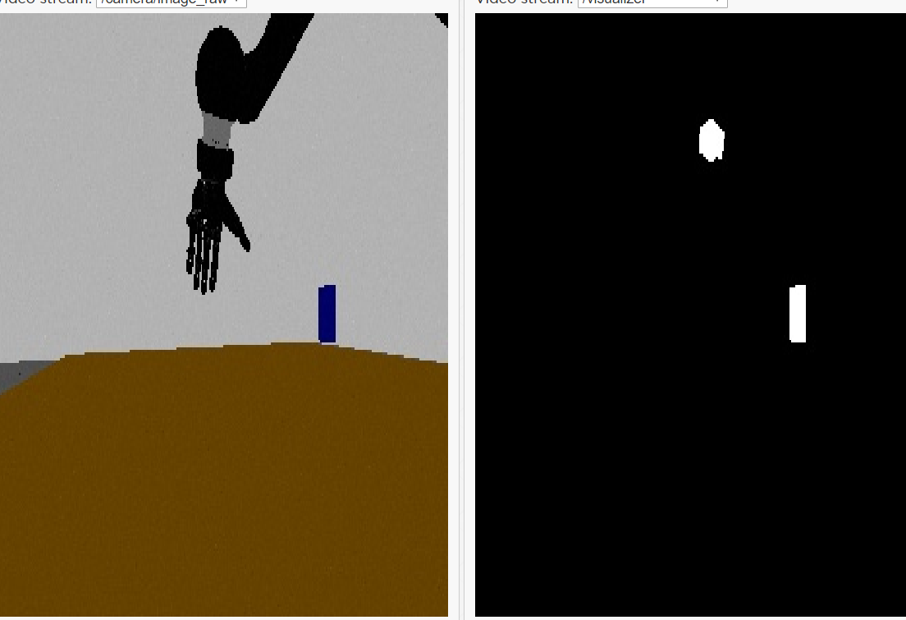
Choice of Input
Extract box position from camera input
Problems:
Hand out of camera scope most of the time
Occlusions
Unstable values
Take box position from state machine
Problems:
Values are changing extremely fast
Cast position to integer
More stable and reproducible

Slide 5
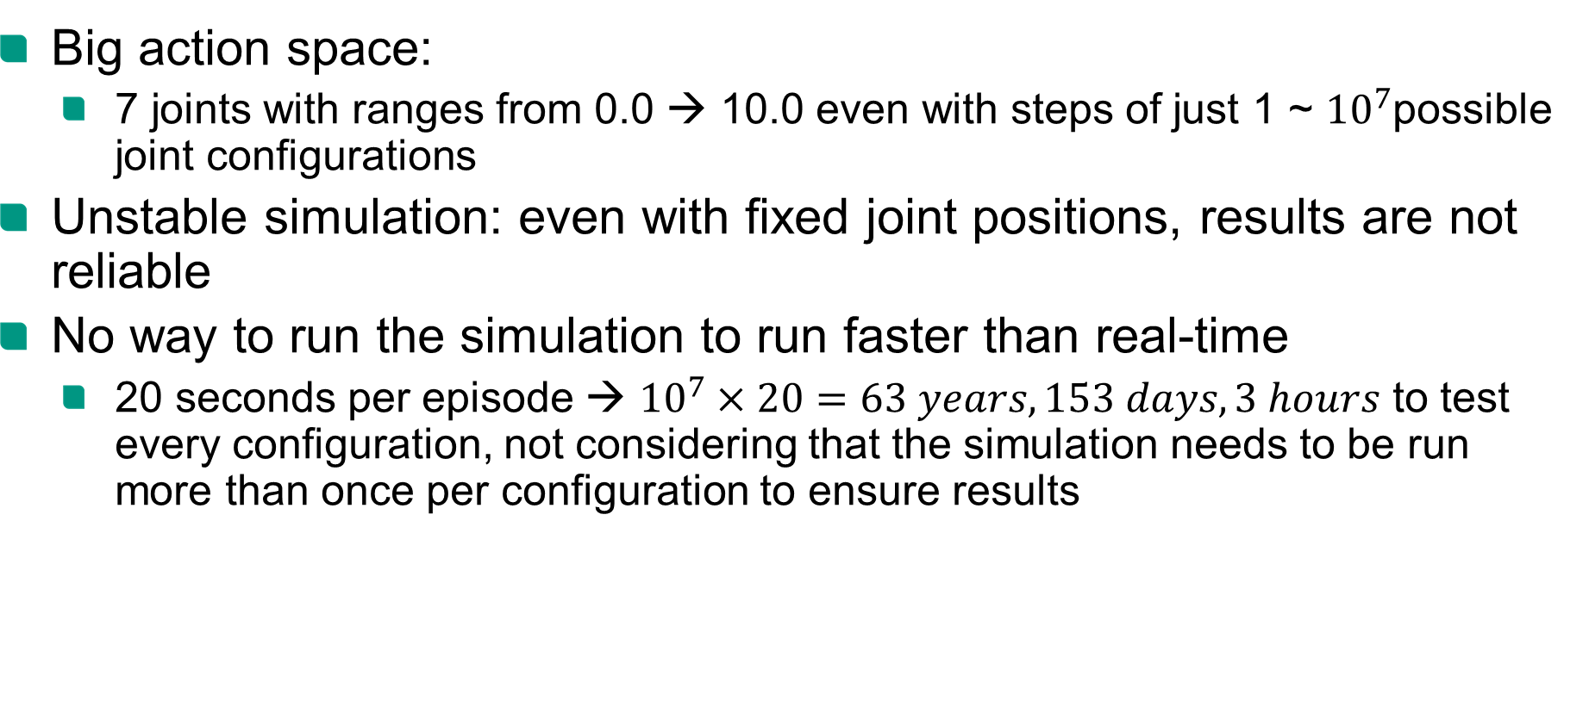
Challenges
Big action space:
7 joints with ranges from 0.0 → 10.0 even with steps of just 1 ~ ${10}^{7}$possible joint configurations
Unstable simulation: even with fixed joint positions, results are not reliable
No way to run the simulation to run faster than real-time
20 seconds per episode → ${10}^{7}×20=63 years, 153 days, 3 hours$ to test every configuration, not considering that the simulation needs to be run more than once per configuration to ensure results

Slide 6
Solutions
Fixed routine to grasp cylinder to simplify task
Simplify input to reduce feature extraction from image
assume that first try is enough to measure fitness

Slide 7


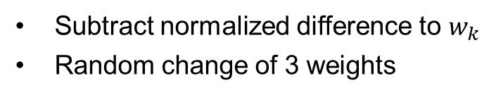
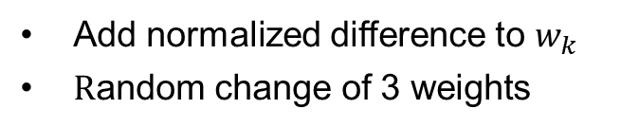
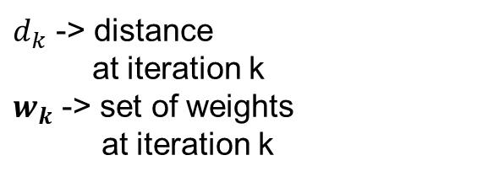
Evolutionary approach I - Implementation
Set of weights
$$w_{0}$$
𝒘_𝟎
$$w_{k}$$
𝒘_𝒌
$$w_{k+10}$$
𝒘_(𝒌+𝟏𝟎)
Action
$d_{k}$ -> distance
at iteration k
$w_{k}$ -> set of weights
at iteration k
Randomly initialize weights
$$d_{k}>d_{k −1}$$
$$d_{k}<d_{k−1}$$
Add normalized difference to $w_{k }$
$\text{R}\text{andom} \text{change} \text{of}\text{ 3 }\text{weights}$
Subtract normalized difference to $w_{k}$
Random change of 3 weights
Merge best 25 individuals
Merge 25 random individuals

Slide 8
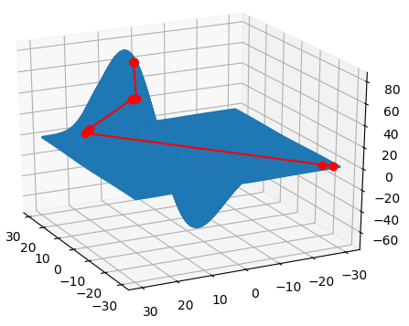
Evolutionary approach I – Testing
Built test function which verifies that maximum theoretically will be found
Weight dimensions for
testing purposes reduced to 2
Random distance function
Distance search scope
Best return value of every generation
distance
weight I
weight II

Slide 9
Results
Configuration 1
4 Joints
Input: fixed value (1)
Configuration 2
7 Joints
Input: Position of Box (x, y, z)
Configuration 3
7 Joints
Input: Position of Box casted to second decimal place

Slide 10
Q-Learning
Idea: train classic neural network, with Q-Learning and Backpropagation
Need to reduce action space: 63 years to long
Reduce number of used joints: only 1,3,5 and grasp
Pre-train Network reproducing fixed routine

Slide 11
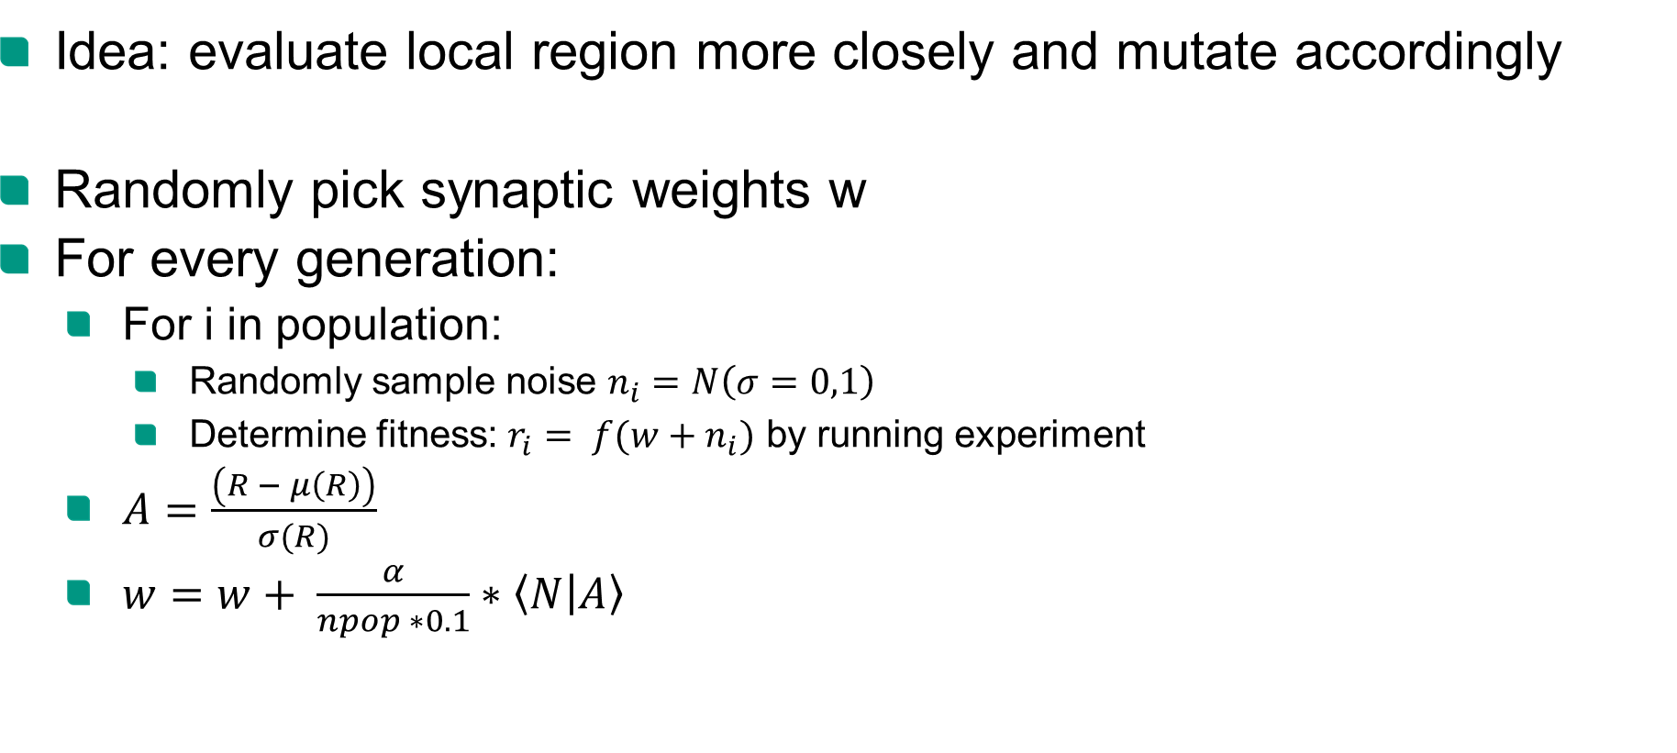
Evolutionary Algorithm
Idea: evaluate local region more closely and mutate accordingly
Randomly pick synaptic weights w
For every generation:
For i in population:
Randomly sample noise $n_{i}=N\left(σ=0,1\right)$
Determine fitness: $r_{i}= f(w+n_{i})$ by running experiment
$A=\frac{\left(R − μ\left(R\right)\right)}{σ(R)}$
$w=w+ \frac{α}{npop ∗0.1}∗\left\langle N | A\right\rangle$
Notes:
initial guess for the synaptic weights is random
N samples from a normal distribution N(0,1)
jitter w using gaussian of sigma 0.1
A standardize the rewards to have a gaussian distribution
perform the parameter update. The matrix multiply below # is just an efficient way to sum up all the rows of the noise matrix N, where each row N[j] is weighted by A[j]

