Slide 1
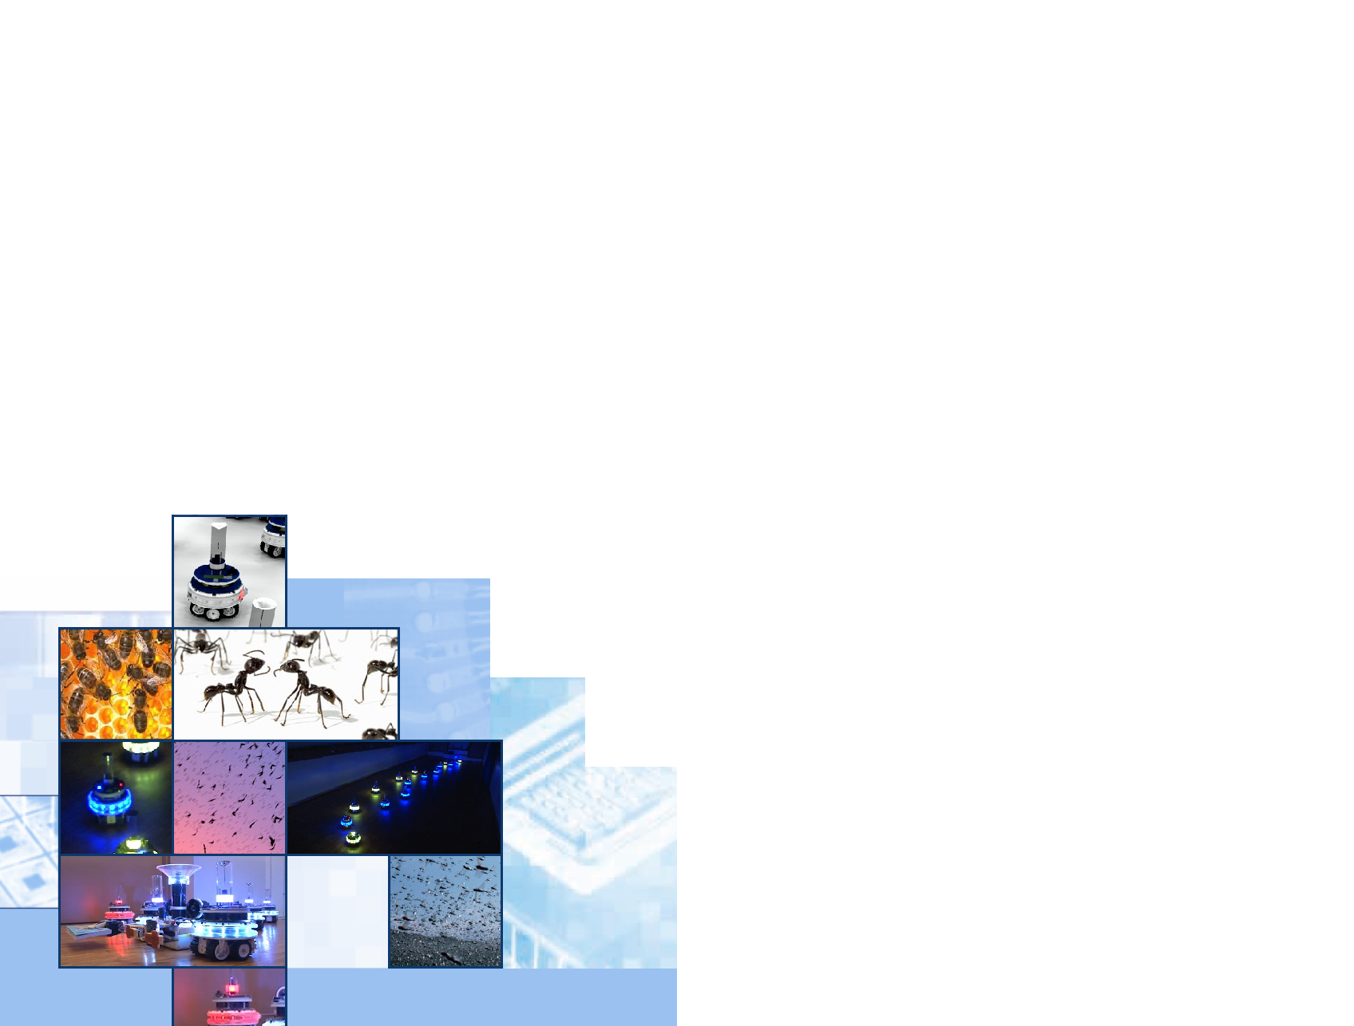
Automatic Generation of Model-to-Model Transformations using Evolutionary and Swarm-Intelligent Algorithms
Thomas Kühne
Master’s Thesis
Thesis Supervisor:
Jun.-Prof. Dr. Heiko Hamann and
Prof. Dr. Gregor Engels

Slide 2
Outline
Problem & Requirements
Solution
Evaluation
Future Work

Slide 3
Requirements
Notes:
Domain Expert provides the Meta Models => input for the algorithm
Algorithm is guided through MTBE
different definitions - chose one which provides few information (demonstration of transformations difficult in complex transformations, existing transformations which have to be assembled only niche scenario)
Domain Expert provides examples of Ma/Mb models
input for the algorithm:
Algorithm executes a transformation and compares results
Explain MTBE: fitness results out of comparison of expected vs. actual output
This defines what the algorithm uses, but what is the desired output?

Slide 4
Example Model-to-Model Transformation: Hierarchical State Machine to Flat State Machine
Notes:
A well known problem in software engineering
Hierarchical to flat state machines
Compilers are designed based on state machines
Can become complex
Hierarchy introduced for easier design
Must be removed
…

Slide 5
Example Model-to-Model Transformation: Hierarchical State Machine to Flat State Machine
Transformations can become complex
Infinite different solutions exist for a transformation problem
Transformation languages provide a rough guidance
➔ The problem cannot be defined precisely enough: A complete solution of the problem is considered impossible
Notes:
Explain example
General transfromation must be derived, not based on the example
This example is derived from a course of Prof. Engels. DHC is a warehouse management system, while this is only a simplified version.

Slide 6
Requirements
Notes:
Algorithm solutions will be incomplete => a human must be able to extend / maintain those

Slide 7
Algorithm Type Decision
Model-to-Model Transformations
Extendible problem definition & Input for the algorithm
Problem reduction
Naturally inspired Meta-Heuristic Optimization Algorithms
Swarm-intelligent Algorithms
Evolutionary Algorithms
Genetic Programming
Creates tree-representations of programs
Most Types
Focused on combinatorial problems
and/or require a finite set of dimensions
Often “Array based”, i.e. TSP
Notes:
Difficult part with many concepts that have been discarded
Use a meta-heuristic which are
- designed to cover large search spaces
- make few assumptions about the problem being solved
- Do not guarantee an optimal solution or a solution at all
Analysed algorithms of two types:
SI based on agents, no centralized control (ant colonies)
EA uses candidte solutions which are evolved towards a solution
Most Types: i.e. Particle Swarm Optimization; Genetic Algorithm based on discrete genotypes (i.e. binary strings => mutation is a bit-flip)
Difficult to define an extensible reduction of an incomplete problem
Reduction not possible considering the required systematic extensibility
Used Genetic Programming - based on tree-representation of programs which does not require a reduction when using an existing transformation language
[Approach not based on logical deduction / induction to derive transformation rules]

Slide 8
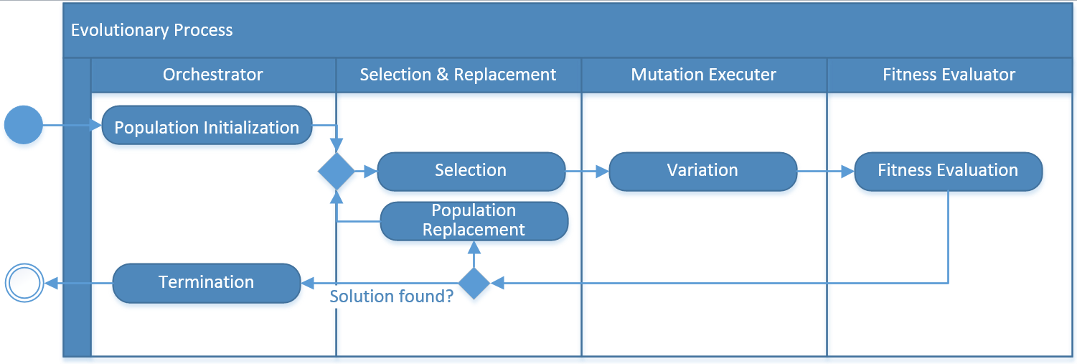
Evolutionary Algorithm
Variate transformation without causing a change in the output
No change in the fitness of the transformation
Algorithm cannot distinguish transformations
Algorithm has no guidance: is a random search
Notes:
Explain steps…
Variation: how to create a model-to-model transformation?
Example: add a loop
No change in fitness, because only output is evaluated
Algorithm cannot distinguish transformations
Algorithm has no guidance: Is a random search
Based on abstract synthax -> creates programs that are not transforming anything, no output change!
More guidance is required: transformation pattern are used = generic transformation concepts which are then used to define mutations

Slide 9
Solution: Divide & Conquer Approach
Notes:
Simplified Mof which allows only the definition of basic structures
- No enumerations
No operations
Simplified Associations (only 0..1, 0..n, not mandatory properties (default values required?)), not unique, not ordered
No opposite property relationship
No generalization

Slide 10
Transformation Pattern Example
Patten result in at least one add- and remove-mutation
Mutations are model-to-model transformations themselves
➔ maintainable & extendible
Notes:
Explain pattern
Require to transform one-to-many
Mutation are always add / remove but could also be modify
Important are application restrictions - i.e. do not follow self references etc.
➔ Pattern ➔ Mutations -> ARE transformations itself
===============
Show Example Models on second screen!

Slide 11
Solution

Slide 12

Evaluation
Implemented a modular algorithm framework (based on EMF & Java 8) including
a relational evaluation database
with a graphical evaluation frontend
Evaluated about 1.000 different algorithm configurations, each executed 50 times
Created 50.000 populations with 300m individuals
Resulted in a recommended configuration
Provides a solution or at least a result close to a solution for the evaluated scenarios within an acceptable time (<2 hours)
➔Algorithm and prototype are functional
Notes:
60% of the individuals were above 80% fitness, 5% above 90%

Slide 13

Future Work
Enable algorithm to solve common transformation problems itself
Define reference transformation scenarios
Increase reliability / prevent a random search
Add more input information into the fitness evaluation i.e. analyze the transformation itself, not only the output
Improve software quality of created transformations
Refine fitness function with a focus on software quality, i.e. take LOC into account
Add pattern which create re-useable transformation modules
Extend the algorithm based on those
Notes:
Generic transformation language => maybe domain specific?

Slide 14

Questions & Answers
Notes:
Demonstration of reporting frontend possible

Slide 15
Demo
Reporting Frontend

Slide 16
Demo
Prototype Extensibility

Slide 17
Problem: Generate Model-to-Model Transformations
Notes:
Generate Transformation

Slide 18
Requirements
Notes:
Domain Expert provides the Meta Models => input for the algorithm
Algorithm is guided through MTBE
different definitions - chose one which provides few information (demonstration of transformations difficult in complex transformations, existing transformations which have to be assembled only niche scenario)
Domain Expert provides examples of Ma/Mb models
input for the algorithm:
Algorithm executes a transformation and compares results
Explain MTBE: fitness results out of comparison of expected vs. actual output
This defines what the algorithm uses, but what is the desired output?

Slide 19
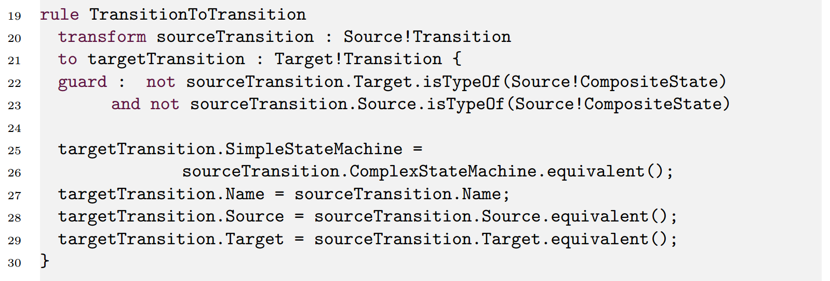
Example Model-to-Model Transformation in Epsilon Transformation Language (from Eclipse Foundation)
Infinite different solutions exist for a transformation problem.
Transformation languages provide a rough guidance
➔ The problem cannot be defined precisely enough: A complete solution of the problem is considered impossible
Notes:
What is the desired result of the algorithm?
Example of chosen language ETL from Eclipse Foundation => transforms a transition which is not related to a composite state into an equivalent transition (1:1)
Associations are transformed within the transformation of a type => many different possible solutions
MtM a problem that exists for decades - many existing transformation languages. No common definition. Use language is Eclipse Transformation Language:
…
=> provides only rough guidance, no precise definition
=> it is not possible in this thesis to provide a complete solution

Slide 20
Algorithm Type Decision
Naturally inspired Meta-Heuristic Optimization Algorithms
Swarm-intelligent Algorithms
Evolutionary Algorithms
Most Types
Focused on combinatorial problems
Require a finite set of dimensions
Often “Array based”, i.e. TSP
Genetic Programming
Creates tree-representations of programs
Notes:
Difficult part with many concepts that have been discarded
Use a meta-heuristic which are
- designed to cover large search spaces
- make few assumptions about the problem being solved
- Do not guarantee an optimal solution or a solution at all
Analysed algorithms of two types:
SI based on agents, no centralized control (ant colonies)
EA uses candidte solutions which are evolved towards a solution
Most Types: i.e. Particle Swarm Optimization; Genetic Algorithm based on discrete genotypes (i.e. binary strings => mutation is a bit-flip)
Difficult to define an extensible reduction of an incomplete problem
Reduction not possible considering the required systematic extensibility
Used Genetic Programming - based on tree-representation of programs which does not require a reduction when using an existing transformation language
[Approach not based on logical deduction / induction to derive transformation rules]

Slide 21
Design & Development Process

Slide 22
Design Method

Slide 23
Simplified Mof

Slide 24
Mutation Selection Strategy

Slide 25
Mutation

Slide 26
Fitness Function

Slide 27
Selection & Replacement Strategy: “Naive”
Notes:
Due to parallel execution per generation (8 processors) => faster than the others
=> Might reduce genetic diversity, but since “bad” is considered as below 2% fitness this is unlikely

Slide 28
Selection & Replacement Strategy: “Roulette”

Slide 29
Selection & Replacement Strategy: “Tournament”
Notes:
Size=10 very interatial => low selection pressure
Size=2 not that inertial, but still much slower

Slide 30
Architecture

Slide 31
Architecture

Slide 32
Mutation and Fitness Evaluation Realization

Slide 33
Evaluation Results
S&R Strategy: Naive approach with high selection pressure and elitism
Fitness Function: Class focused using heuristic
Mutataion Sel. Strategy: Operator -> Option
Population Size: 100
Generations: 100
Population Size: 50
Generations: 100
Population Size: 50
Generations: 200

Slide 34
Focus Distribution

Slide 35
Future Work
Software Engineering
Define reference transformation scenarios incl. examples
Create generic model-to-model transformation language
Meta-Heuristic Optimization
Define a generic domain model for all algorithms
Provide design guidelines (avoid trial-and-error)
Provide reference applications for each algorithm type
Notes:
Generic transformation language => maybe domain specific?

Slide 36
Example Issue: Unexpected shortcut

