Slide 1
Deploying OUD on OKD/OpenShift on Oracle Cloud Infrastructure
by Kuena Mahase

Slide 2
Table of Contents
Introduction
What is Oracle Unified Directory (OUD)?
What is Oracle Unified Directory Services Manager (OUDSM)?
What is OKD?
Objectives: What Are We Trying to Achieve?
Key Features of OpenShift on OCI
OpenShift Cluster Architecture in OCI
Benefits of Running OpenShift on OCI
Summary
Q&A / Thank You

Slide 3
What is OUD ?
Lightweight, high-performance LDAPv3 directory server
Supports LDAP, REST, DSML, SCIM protocols
Scalable, reliable with built-in multi-master replication
Manages identity data securely for enterprise environments

Slide 4
What is OUDSM?
Web-based administration console for OUD
Visual tools for managing directory data and schema
Real-time monitoring of servers
Simplifies configuration of replication, security, and users

Slide 5
What is OKD?
OKD = Origin Community Distribution of Kubernetes
The upstream open-source version of Red Hat OpenShift
Used to run containerized applications with:
Kubernetes
Built-in CI/CD (Jenkins pipelines, etc.)
Web console and CLI interfaces
In this case, deployed on Oracle Cloud Infrastructure (OCI)

Slide 6
What are we trying to achive?
Deploy OUD and OUDSM on OKD running in OC
Modernize directory services using containers
Provide scalable, HA-ready, and automated IAM services
Integrate with cloud-native DevSecOps practices

Slide 7
Key Features of OpenShift on OCI
Customer Managed OpenShift
Support for Terraform Automation
Flexible Infrastructure Options
Unified Platform for all the workloads
Best in class Performance
Cost Efficiency

Slide 8
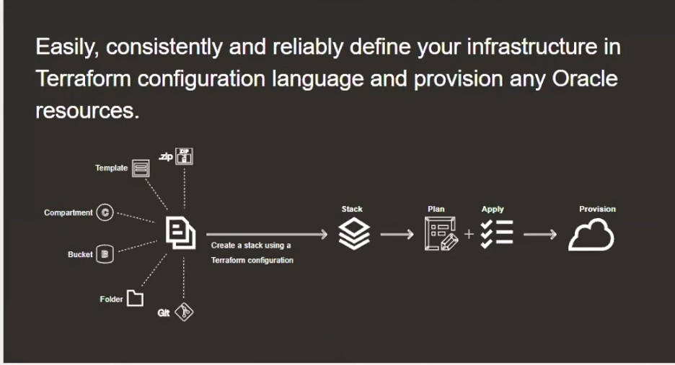
Oracle Resource Manager

Slide 9
Cluster Architecture in OCI
OpenShift Container Platform clusters use OCI's DNS Resolution, Virtual Cloud Network (VCN), load balancers, and compute nodes as follows:
Network traffic is resolved with OCI DNS.
Traffic is routed to the VCN assigned to the cluster compute nodes.
Within the VCN's public subnet, an external Load Balancer routes traffic to the control plane (master) nodes in a private subnet.
The control plane nodes use an internal Load Balancer to communicate with the cluster's compute nodes.

Slide 10
Cluster Architecture Design

Slide 11
Benefits of Running OpenShift on OCI Key benefits
Automation - Automated provisioning of the OpenShift infrastructure in OCI using Resource Manager stack.
Platform Integration - Can leverage core OCI services with OpenShift containers. For example, OCI FSS and Object Storage.
Storage - Container Storage Interface (CSI) plugin for OCI Block Storage - Container Storage Interface (CSI) integration with the OCI File Storage.
Elasticity - Autoscaling to maintain the number of control nodes and master nodes. Instance Pool and Instance Configuration.
Performance - Best possible network performance by leveraging the Gen-2 OCI off-box virtualization. - OCI Block Storage with Virtual Performance Unit (VPU). Flexible performance 120 VPU.

Slide 12
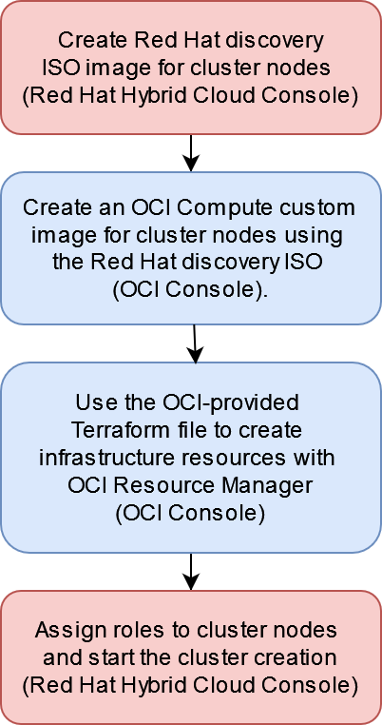
Implementation flow using assisted installer of OKD on OCI

Slide 13
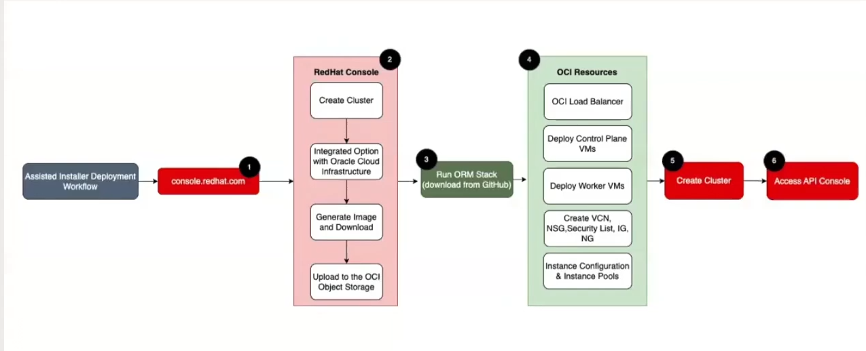
Implementation flow using Assisted Installer OKD on OCI (detailed)

Slide 14
Machine’s Path to the Console
oc login https://api.oud-okd-oci.example.internal:6443
DNS resolves to LB public IP (/etc/hosts)
Traffic hits Public LB Listener on port 6443
LB routes to healthy control plane node via backend set
kube-apiserver receives and processes login
Access Web Console (https://console-openshift-console.apps....)
DNS resolves to LB public IP (/etc/hosts)
Traffic hits Public LB Listener on port 443
LB routes to a worker node running the ingress pod
Pod forwards to the openshift-console route
Console UI is served back to your browse

Slide 15
Terraform Stacks: Inputs, Processing, and Outputs
Inputs:
Terraform configuration files (.tf) define desired OCI resources (VCNs, compute instances, storage, etc.)
Input variables specify environment-specific parameters (e.g., CIDR blocks, instance shapes, number of nodes)
Variables can be set via CLI, environment, or Terraform Cloud/OCI Resource Manager UI
Processing:
Terraform parses the configurations and variables
Connects to OCI API to create, update, or delete resources in the correct order
Uses a state file to track current resource status
Applies dependency graph to handle resource interrelations safely
Outputs:
After successful deployment, Terraform returns output variables such as:
Public IPs
Load balancer URLs
Resource OCIDs (Oracle Cloud IDs)
Cluster endpoint addresses (e.g., API server URL)
These outputs are used for further automation steps or human reference

Slide 16
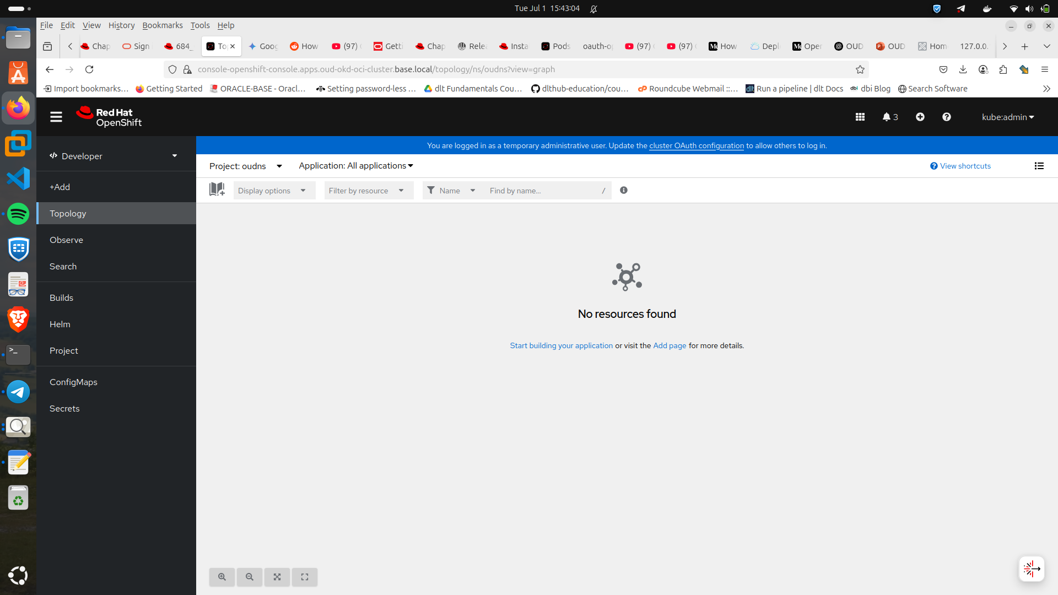
What's Next? Accessing the Web Console to deploy our Application(OUD/OUDSM)

Slide 17
Q&A
Thank you.

