Slide 1
0
5

Slide 2
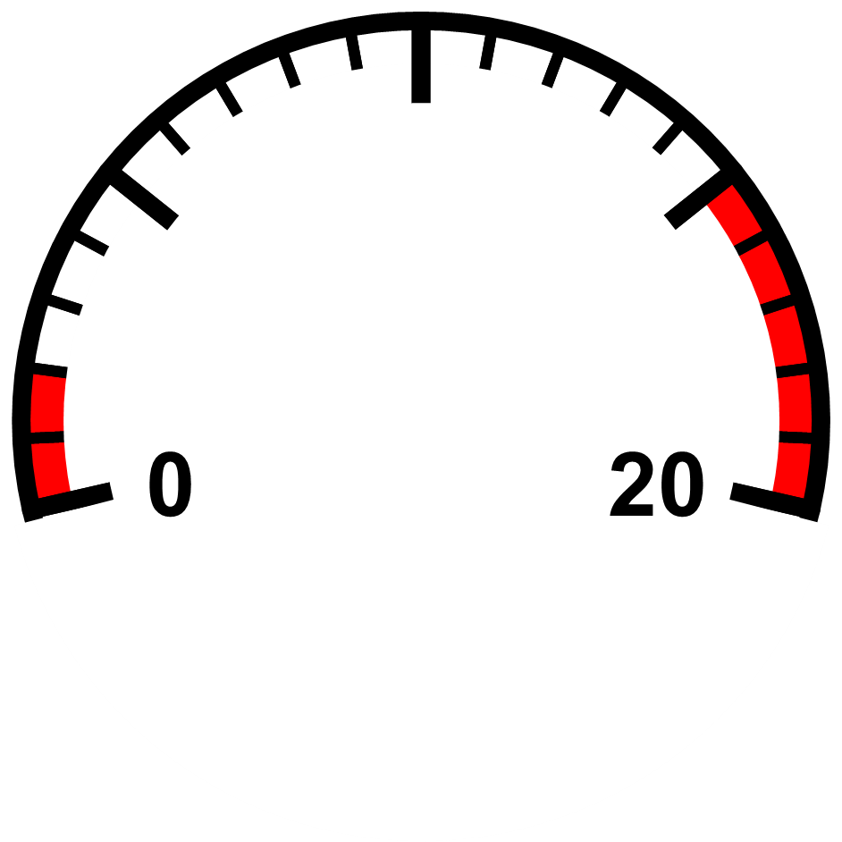

Slide 3
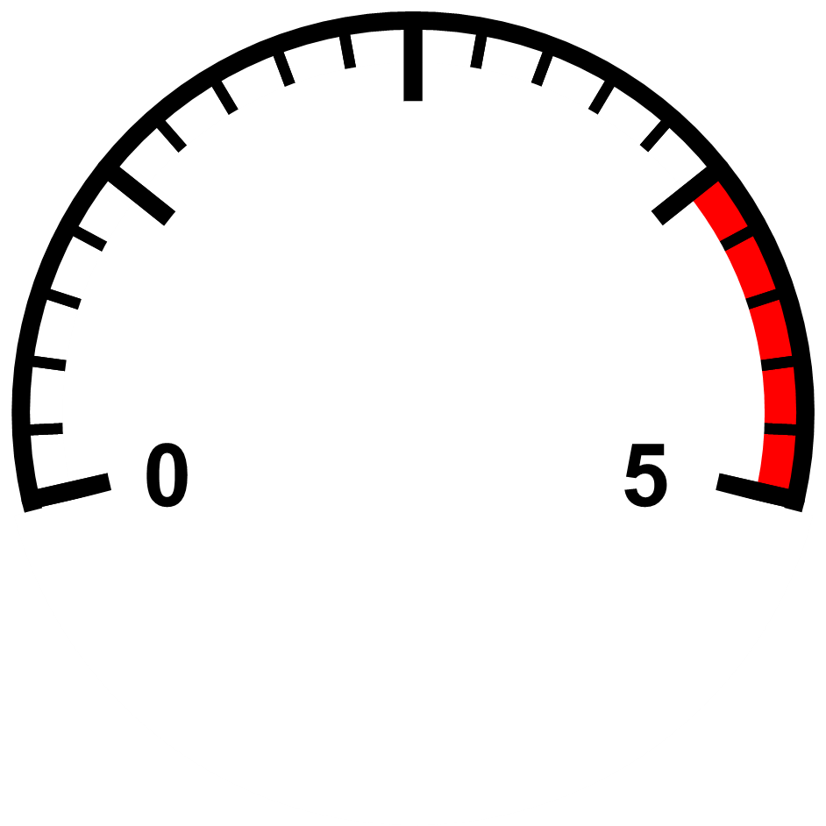

Slide 4

FLASHBACK
ARRESTOR
REGULATOR MOUNT

Slide 5
STATUS TAG
STATUS TAG
EMPTY
EMPTY
IN USE
IN USE
FULL
FULL

Slide 6
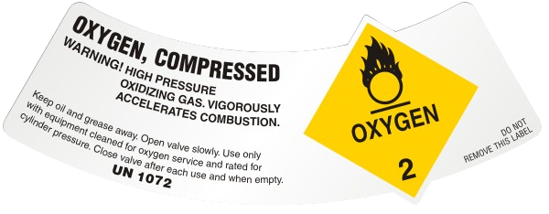
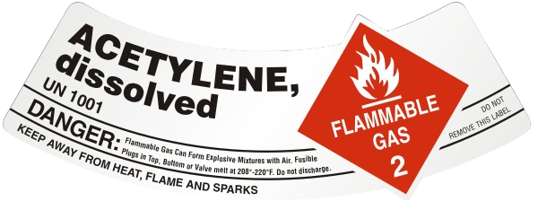
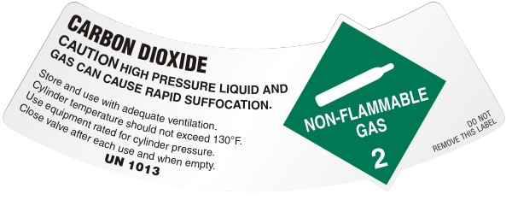

Slide 7
CERTIFICATE OF ANALYSIS
DATE: October 14th, 2024
Order Number: 42069
Supplier: KugaMaxx
Component
Unknown
Nitrogen
Specification
75 PPM
Balance
Experiments
77 PPM
Balance
Both immersive VR and 2D screen training methods, have the potential to leverage multimedia learning principles to facilitate more effective training by optimizing the integration of various visual and auditory information. While several studies point to immersive VR promoting a higher degree of learning than 2D screen solutions, others report no difference in learning effectiveness between VR and non-VR conditions. Some studies have even reported a lower degree of learning in VR conditions compared to a 2D screen solution.

