Slide 1
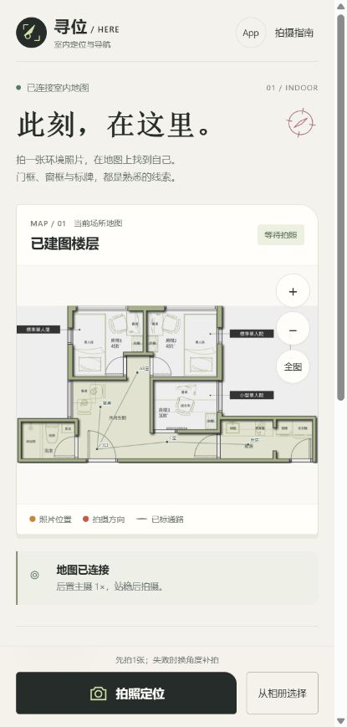
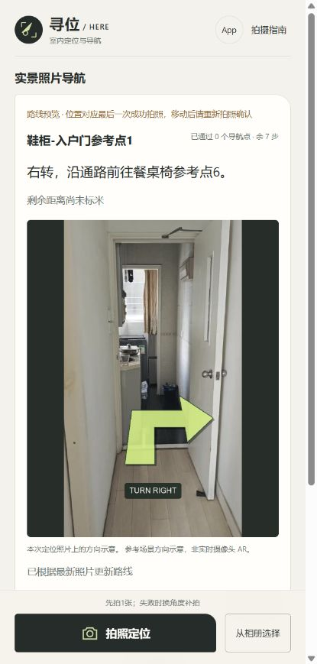
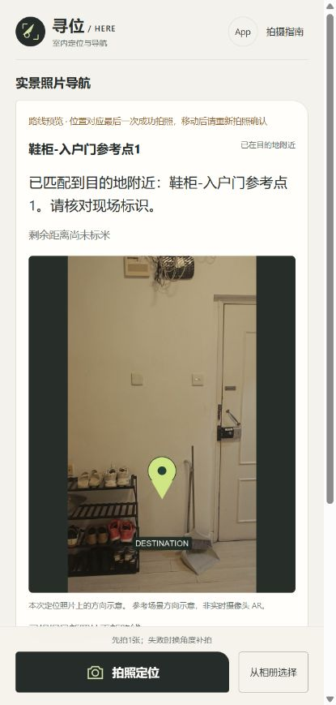
HERE / INDOOR VISUAL NAVIGATION
Working prototype
Windows processing with a mobile web interface
01 / OPEN THE MAP
02 / FOLLOW THE ROUTE
03 / RE-LOCALIZE
Indoor map
connected
Turn right
Near the
destination
Take a photo
or choose one
from the album.
Follow the path
to Dining Table
Waypoint 6.
7 steps remain.
Entrance /
shoe-cabinet
Waypoint 1.
Check the
physical sign.
Original Chinese UI; English translations shown alongside each capture.
Arrival uses a registered-image replay. On-site walking validation remains pending.
Notes:
These are unmodified captures from the actual application. The English text translates the visible task/status information. Full translation of controls and visible notices is in 05_Technical_Documents/UI_English_Translation.html. The map floorplan overlay is estimated and is separate from the original-3D-frame navigation graph. Slide 1, middle: destination Entrance / shoe-cabinet Waypoint 1; 0 waypoints passed and 7 steps remain; turn right and follow the path to Dining Table Waypoint 6. Remaining distance is not calibrated in meters. Current-photo arrow overlay is not live camera AR. The third capture confirms a controlled arrival by replaying a registered mapping image through the real localization engine. It is not a field walking trial. Sources: actual captures 01_Home.jpg, 05_Visual_Navigation.jpg and 08_Arrival.jpg, collected on 17 October 2026.

Slide 2
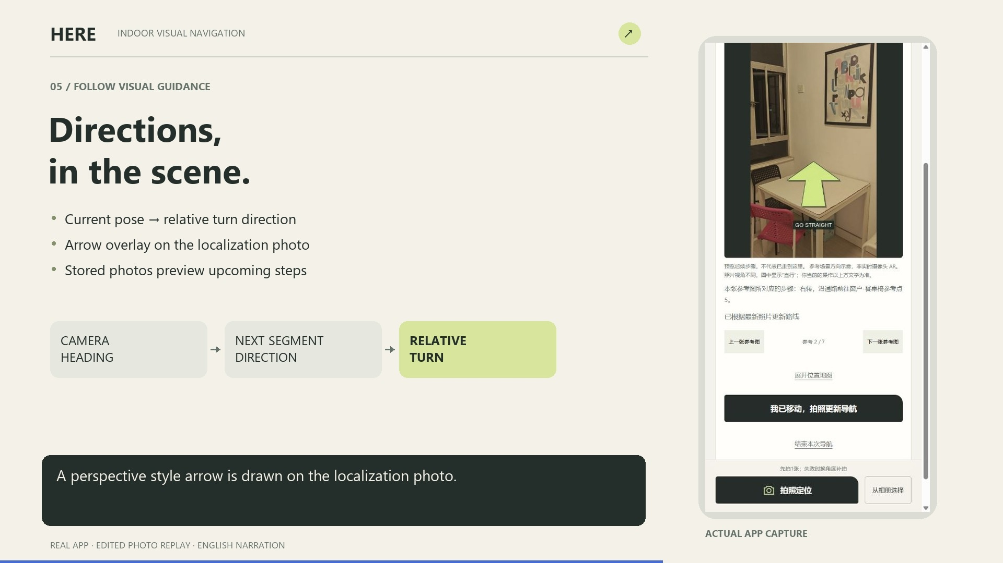

HERE / INDOOR VISUAL NAVIGATION
Demo and technical evidence
68-second English narration · real photos and computed camera poses
RECORDED LOCALIZATION
68 2D–3D correspondences
1.68 px median reprojection error
PREBUILT MAP
141 registered cameras
35,040 sparse points
SOURCE AND SETUP
GitHub: Kugel-M/Here
Source, video and map
Photo → COLMAP camera pose → A* route → scene-photo arrows
Arbitrary model scale; static photo overlays. Candidate routes require field verification.
Notes:
The video is embedded in this PPTX. Click the video in PowerPoint slide-show mode. A static PDF shows only its poster; the independent video is 02_Demo_Video/HERE_Demo_EN.mp4. Confirm playback on the presentation computer. Real query: queries/20261017_132450_6a6eaa/result.json, 68 valid 2D–3D correspondences, median reprojection error 1.681 pixels. Reprojection error is not physical localization accuracy. Prebuilt model: 141 registered reference cameras, 35,040 sparse points. A public team video URL and GitHub URL have not yet been supplied. Team source is included in 03_Application/indoor_mapper_mvp. Do not represent upstream repositories as team-owned code. Technical sources: https://github.com/colmap/colmap ; https://colmap.github.io/faq.html#register-localize-new-images-into-an-existing-reconstruction ; https://github.com/isl-org/Open3D ; https://github.com/FFmpeg/FFmpeg . The prototype uses the existing engine, an independent navigation graph, A* path planning and static photo overlays. No hloc or Gaussian-splatting implementation is claimed.

