Slide 1
AI-DRIVEN TASK MANAGER APP

Slide 2
Introduction
Efficiency in task management has become extremely necessary in today's fast-paced world. AI-powered task management app come into the picture: utilizing artificial intelligence, this app helps user in keeping tabs on their tasks and optimize productivity through intelligent recommendations, personalized scheduling, and predictive analytics.
This technology enables users to focus on what truly matters, reducing the cognitive load and increasing overall efficiency. Prioritize tasks based on urgency and importance.

Slide 3
FEATURES
The to-do checklist will help schedule and organize tasks and will ensure when the task was postponed or completed in advance.
The Pomodoro timer will help users break their study sessions into manageable intervals.
Progress Tracking: The app logs study sessions and provides statistics in the form of graphs
Customizable Interface: Users can personalize the app's appearance to suit their preferences
Calendar view: helps view the task in calendar grid fromat.
{}

Slide 4
PROBLEM STATEMENT:
Managing tasks effectively is a challenge for many people. People often struggle to stay organized, meet deadlines, and manage their workload efficiently. Users often find it challenging to maintain focus, organize their workload, and make informed decisions about which tasks to prioritize.
There is a need for a smarter solution that makes task management easier. An AI-driven task manager app could help by automatically adjusting to how users work.

Slide 5

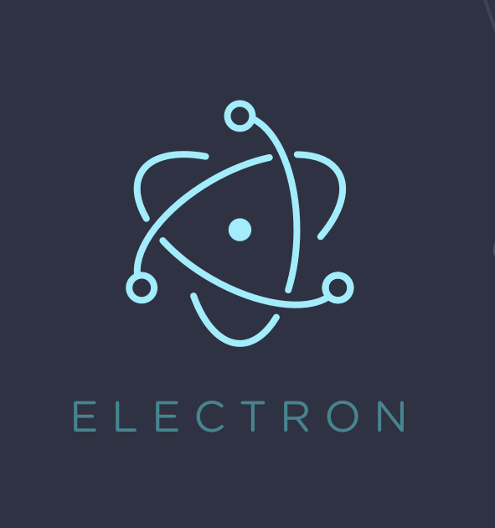

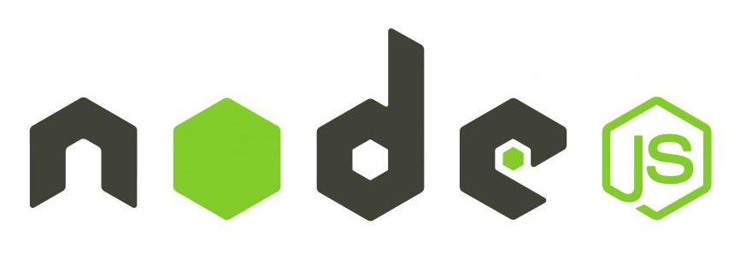


BLOCK DIAGRAM
LOGIN PAGE
MAIN PAGE
access to
-To-do checklist
-Pomodoro timer
-Report
-Goals page
-Countdown to deadline
Pop up widget
Notification / reminder

Slide 6
Sr No. | Title of Paper | Name of Authors, and Date of publication | Description
1 | Enhancing Desktop Productivity: An Approach of Virtual Assistance for Desktop Workflow | Singh, Satyam, Aryan Mahale, and Ishan Kumar. "Enhancing Desktop Productivity: An Approach of Virtual Assistance for Desktop Workflow." Kilby 100 (2023): 7th. | a system that supports users in any type of task that can be performed on the desktop, such as searching on the Internet, controlling the system, opening files and software, and much more.
2 | Project Management and AI | “How AI will Transform project management by Antonio Nieto-Rodriguez and Ricardo Viana Vargas | offers a systematic review of AI's role in project management, focusing on task automation and risk management. The study concludes that AI project management tools can reduce project risks by providing predictive insights.
3 | Advancing Student Productivity: An Introduction to Evernote | Korzaan, Melinda, and Cameron Lawrence. "Advancing student productivity: an introduction to Evernote." Information Systems Education Journal 14, no. 2 (2016): 19. | instructor notes contain additional information and resources to help colleagues introduce this extraordinary tool
4 | Maximizing Efficiency A Comprehensive Review of Daily Productivity Growth with Todo Manager | Perez, Gilberto, and Nidhaulla Sheikh. "Maximizing Efficiency A Comprehensive Review of Daily Productivity Growth with Todo Manager." Journal homepage: www. ijrpr. com ISSN 2582: 7421. | Daily To-do Manager is a user-friendly system that helps users efficiently manage their daily tasks and long-term goals
Literature Survey

Slide 7
TOOLS
Front End
HTML/CSS: HTML structures web content while. CSS styles and layouts it, creating the visual presentation of websites
JavaScript:JavaScript adds interactivity and dynamic features to websites, enabling a responsive user experience
Back End
Node.js:"Node.js is a JavaScript runtime that enables server-side development, allowing for scalable and efficient web applications
SQLite: SQLite is a lightweight, serverless database engine that stores data in a single file, ideal for small to medium-sized applications.
Both Frontend and Backend
Electron.js: Electron.js enables the development of cross-platform desktop applications using web technologies like HTML, CSS, and JavaScript."

Slide 8
IMPLIMENTATIONS
.

Slide 9
Conclusion
We aim to create this productivity app to significantly enhance our ability to manage study sessions, track progress, and stay organized.The app will help us maintain focus with a dedicated pop-up widget, manage our time better with a Pomodoro timer, and stay organized with a to-do checklist and task scheduling features. Additionally, by providing progress tracking, event countdowns, notifications, reminders, and a customizable interface, the app ensures that we can personalize our study experience and keep track of important deadlines.
Creating this app offers numerous advantages, including enhanced focus, improved time management, and increased motivation through streaks and goal-setting. The ability to access the app offline and across different platforms ensures we can stay productive regardless of our device or internet connectivity. Overall, this productivity app will be an invaluable tool in our academic journey, helping us stay organized, motivated, and on top of our studies.

