Slide 1
Checkered Fabric AOI
Digital Twin & Quality Assistant
Track 2 — Digital Twin, Data-Driven (Quality Monitoring) + Track 3 — RAG for Industrial Knowledge Management
Kuhyar Saeedi · Danial Mahmoody · Davood Jokar · Mahyar Emami · Nima Shahrokhi
Smart Factories — A.Y. 2025-2026 | Prof. Annalisa Santolamazza | Universita degli Studi di Roma Tor Vergata

Slide 2
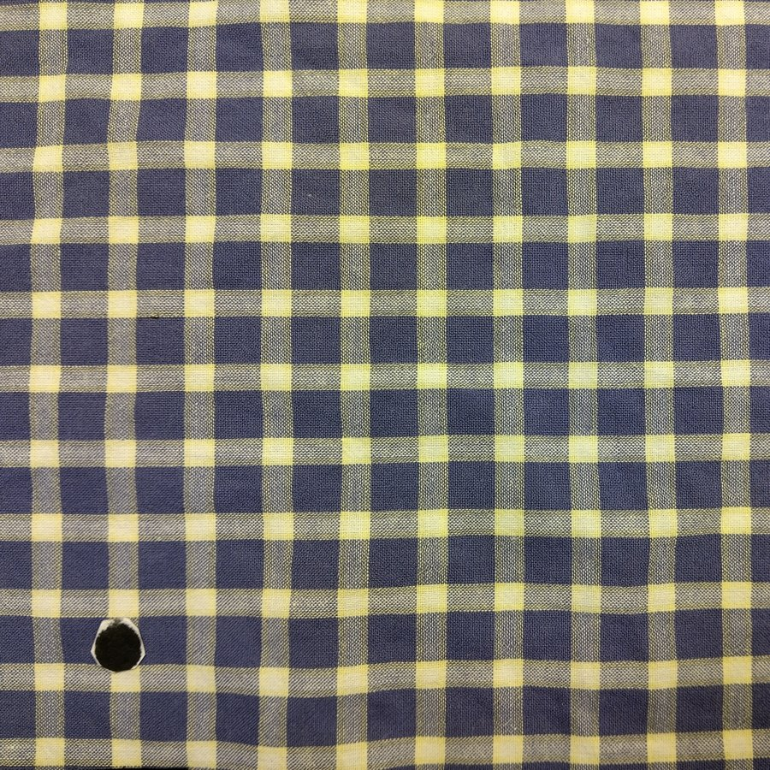
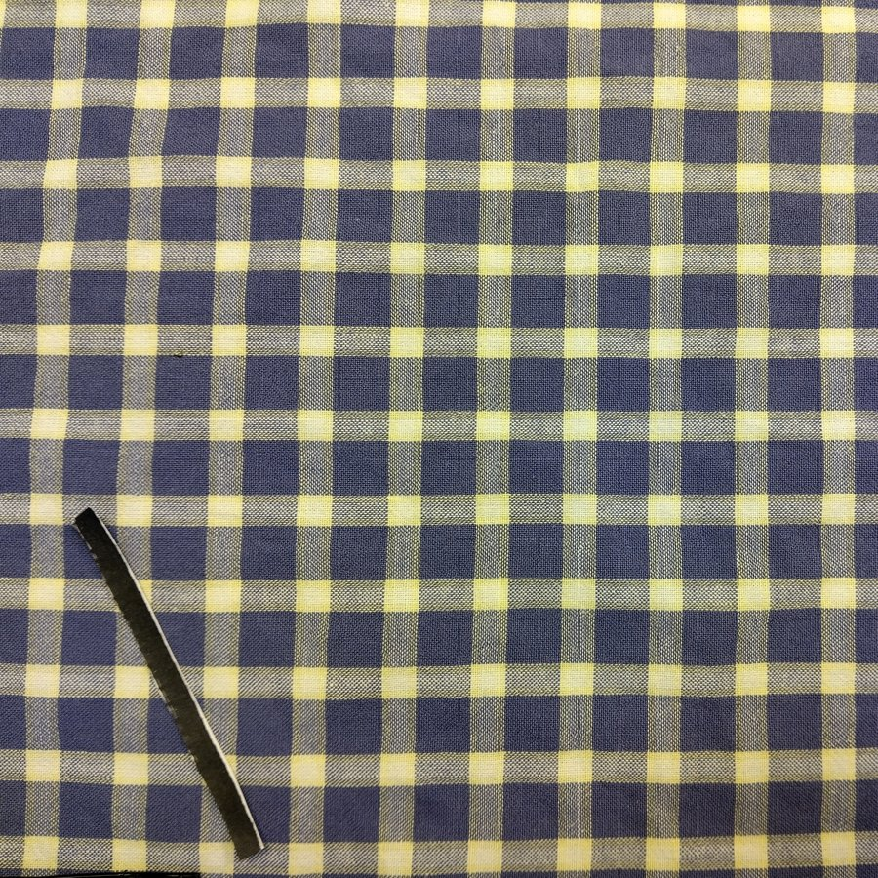
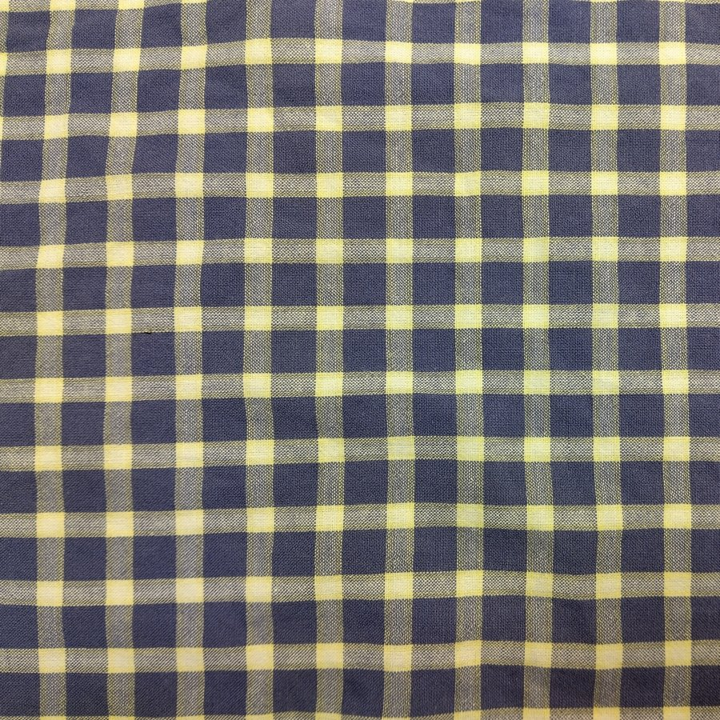
The Case: An AOI Station on a Checkered Fabric Line
Yarn is woven into a checkered (gingham) cotton fabric. A camera at the finishing/inspection frame captures images of the moving fabric surface.
▪ Each image patch must be classified into one of three categories:
– Circle — a roughly circular hole / puncture in the weave
– Line — a linear scratch, cut, or abrasion mark
– No defect — a clean, regular checkered pattern
▪ Two complementary tracks, one shared dashboard:
– Track 2: train + evaluate a defect classifier (Digital Twin Entity)
– Track 3: Quality Assistant answers “what caused this, what do I do?”
Circle
Line
No defect
The Defect Classifier (Track 2) and Quality Assistant (Track 3) are integrated into a single 5-page Streamlit dashboard: a defect prediction automatically surfaces the relevant SOP from the knowledge base.
Checkered Fabric AOI Digital Twin — Smart Factories A.Y. 2025-2026
2

Slide 3
ISO 23247 Reference Architecture Mapping
ISO 23247 defines five entity types for a manufacturing digital twin. Mapping the project onto them is what makes it a digital twin, not just an ML model.
ISO 23247 Entity | This Project
Observable Manufacturing Element (OME) | The fabric web at the inspection frame
Device Communication Entity (DCE) | AOI camera / frame grabber capturing fabric images
Data Collection & Device Control | Pre-processing: resize to 224x224, normalisation, augmentation
Digital Twin Entity (Core) | ResNet18 classifier + Grad-CAM explainability module
User Entity | Streamlit dashboard — Defect Classifier + Quality Assistant pages
Cross System Entity | MES / QMS for traceability (discussed conceptually for deployment)
Checkered Fabric AOI Digital Twin — Smart Factories A.Y. 2025-2026
3

Slide 4
TRACK 2
Digital Twin, Data-Driven — Quality Monitoring
Dataset & EDA · Model & Methodology · 5-Fold CV Results · Grad-CAM · Critical Discussion

Slide 5
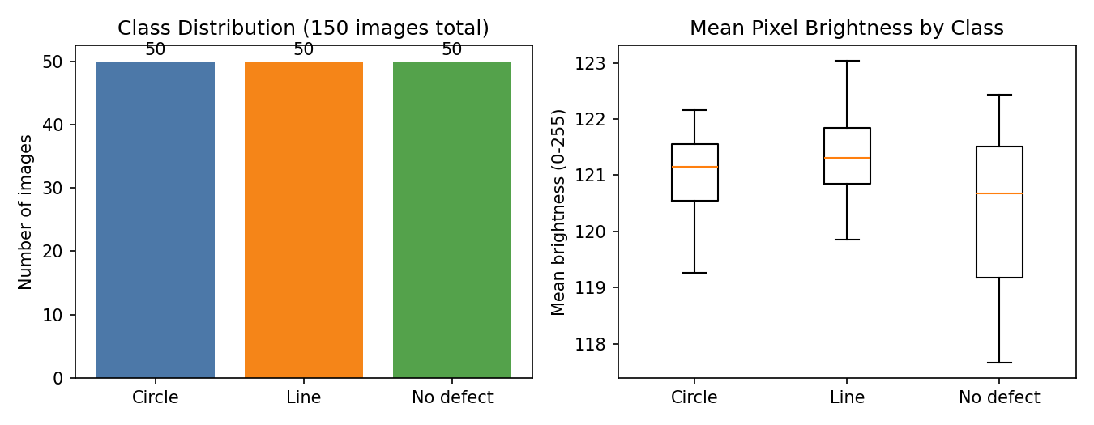
Dataset and Exploratory Data Analysis
▪ 150 images total — perfectly balanced: 50 Circle / 50 Line / 50 No defect
▪ 3072 x 3072 px photographs of the same blue/yellow checkered fabric sample
▪ Circle & Line defects created by placing a physical object (punched hole, ruler/blade) on good fabric to simulate defect signatures
▪ All images valid, readable, uniquely named, same resolution and RGB mode — no missing values or corrupt files
▪ Resized to 224x224 during pre-processing, regardless of native size
▪ EDA confirms: no class shows a systematically different mean brightness — the model cannot rely on a brightness shortcut
Checkered Fabric AOI Digital Twin — Smart Factories A.Y. 2025-2026
5

Slide 6
Model and Methodology
▪ Architecture: ResNet18 pretrained on ImageNet
– Convolutional backbone FROZEN; final layer replaced with a fresh 3-class linear head
– Only the head is trained — 8 epochs, Adam (lr = 1e-3), cross-entropy loss
▪ Why transfer learning + frozen backbone?
– With only 150 images, fine-tuning the full network would overfit badly
– ImageNet features (edges, textures, shapes) transfer well to fabric images
– The model only has to learn the final 3-class decision boundary — a much smaller, better-posed learning problem
▪ Pre-processing & augmentation
– All images resized to 224x224 and converted to tensors
– Training augmentation: random horizontal flip, random rotation (±10°), colour jitter — reduces overfitting on the small dataset
– Evaluation uses a deterministic resize-only transform
▪ Validation protocol: stratified 5-fold cross-validation (random_state = 42)
– Each fold trains on 120 images (24/class x 5), tests on 30 (10/class)
– Every image used for testing exactly once across the 5 folds
Checkered Fabric AOI Digital Twin — Smart Factories A.Y. 2025-2026
6

Slide 7
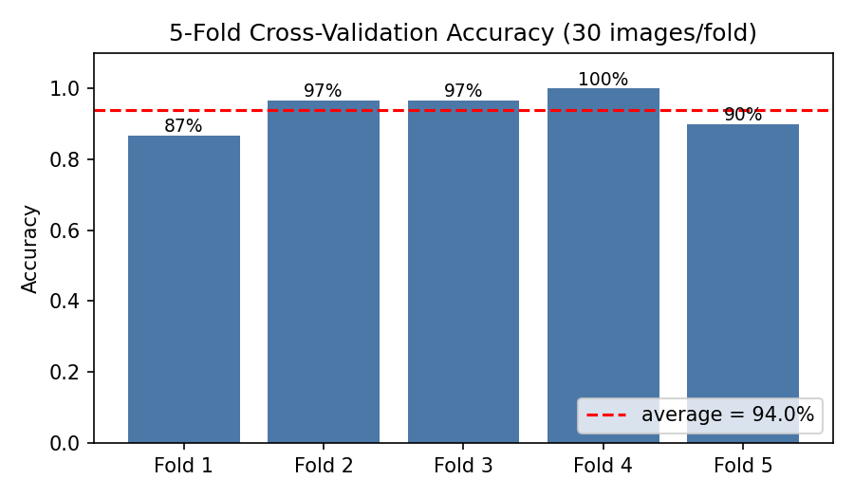
Results: 5-Fold Cross-Validation Accuracy
Average Accuracy
94.0% (±4.9%)
▪ Per-fold range: 87% – 100%
▪ 150 images, 8 epochs/fold
▪ With 30 test images/fold, one misclassification = ~3.3 pp shift
▪ The observed spread is expected sampling noise for this dataset size — not model instability
▪ Headline 94% should always be reported with its std. dev.
Checkered Fabric AOI Digital Twin — Smart Factories A.Y. 2025-2026
7

Slide 8
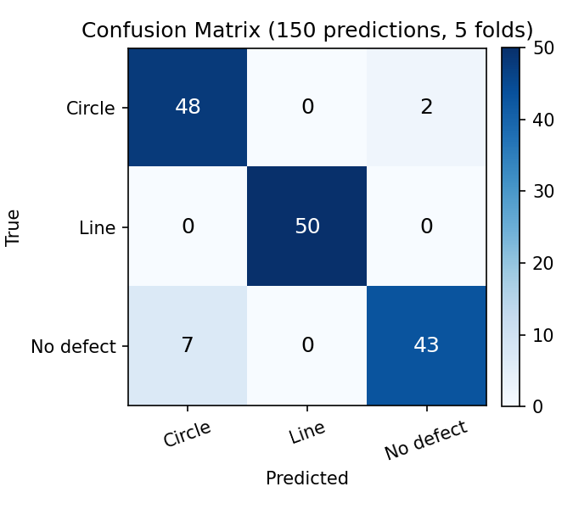
Confusion Matrix and Classification Report
Class | Precision | Recall | F1 | Support
Circle | 0.87 | 0.96 | 0.91 | 50
Line | 1.00 | 1.00 | 1.00 | 50
No defect | 0.96 | 0.86 | 0.91 | 50
macro avg | 0.94 | 0.94 | 0.94 | 150
▪ Largest confusion: 2 Circle → No defect, 7 No defect → Circle
▪ Line classified perfectly (precision = recall = 1.00)
▪ A small/faint hole can visually resemble a normal weave gap under uneven lighting — a linear scratch is more visually distinctive
Checkered Fabric AOI Digital Twin — Smart Factories A.Y. 2025-2026
8

Slide 9
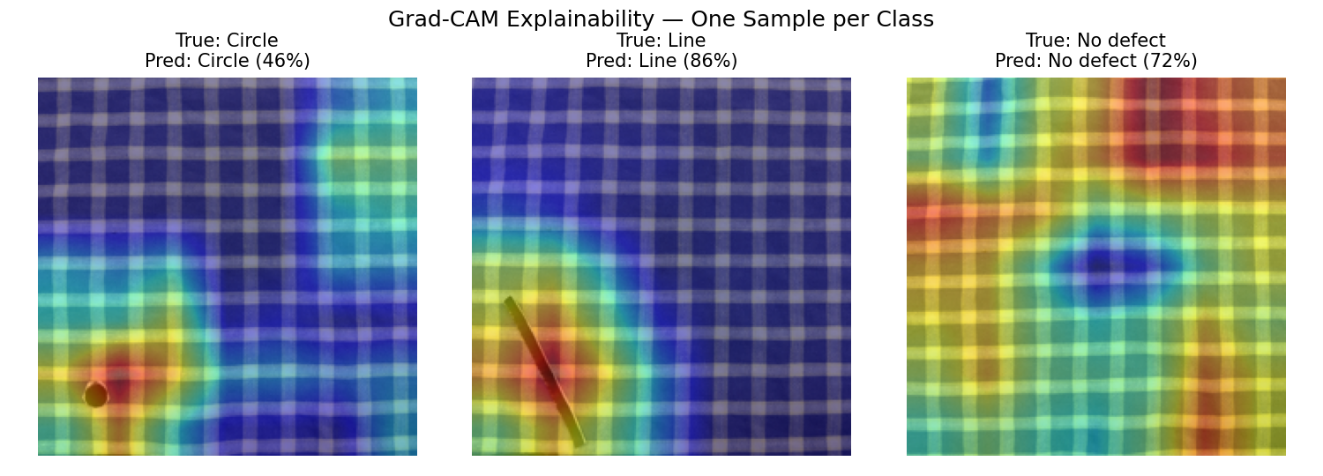
Explainability: Grad-CAM
Grad-CAM on the last residual block (layer4) highlights the image regions most responsible for the predicted class — lets an operator verify the model is reacting to the actual defect, not lighting/staging artefacts.
Checkered Fabric AOI Digital Twin — Smart Factories A.Y. 2025-2026
9

Slide 10
Critical Discussion — Track 2
▪ Dataset size: only 150 images (50/class). 5-fold CV gives a robust relative comparison, but std = 4.9% means the absolute accuracy estimate has wide uncertainty
▪ Staged vs. real defects: Circle/Line defects were created by placing physical objects on good fabric — real weaving defects (yarn pull-outs, abrasion) may have different edge/shadow signatures
▪ Frozen backbone caps achievable accuracy — fine-tuning deeper layers with more data could improve Circle vs. No-defect discrimination
▪ Single fabric pattern: the model has only seen this one blue/yellow check — a different weave/colour would need additional labelled data and retraining
▪ Real deployment: edge device runs the same pipeline at line speed; each prediction (class, confidence, Grad-CAM region, roll ID, timestamp) is logged to the MES/QMS for traceability and SPC charting
▪ A confidence threshold (e.g. 0.7-0.8) would route low-confidence predictions to human review rather than auto-classifying
Checkered Fabric AOI Digital Twin — Smart Factories A.Y. 2025-2026
10

Slide 11
TRACK 3
RAG for Industrial Knowledge Management — Quality Assistant
Use Case · Corpus Design · System Architecture · 15-Query Evaluation · Discussion

Slide 12
Use Case and User Needs
Operators and quality engineers need fast, natural-language access to SOPs, corrective actions, and quality standards — without searching paper manuals.
▪ Operator who just received a Circle/Line prediction wants to immediately know the likely root causes and corrective action — closing the loop from detection to action
▪ New operator wants to understand how the digital twin works (ISO 23247 mapping, model performance, limitations) without reading full documentation
▪ Quality engineer wants to relate AOI output to the mill's existing point-grading quality standard (4-point fabric inspection system)
▪ Technician wants the AOI station's maintenance/calibration checklist on demand at the inspection frame
Checkered Fabric AOI Digital Twin — Smart Factories A.Y. 2025-2026
12

Slide 13
Corpus Design — 12-Document Knowledge Base
Illustrative SOP/standards corpus written for this project. Each document is a short (200-400 word) retrievable unit — no chunking needed at this scale, which keeps citations interpretable.
▪ 1. Process Overview — Checkered Fabric Weaving and Inspection Line
▪ 2. ISO 23247 Mapping — Digital Twin Reference Architecture
▪ 3. What Makes This a Data-Driven Digital Twin
▪ 4. Dataset and Model — 150 Images, ResNet18, Grad-CAM
▪ 5. Model Performance — 5-Fold Cross-Validation Results
▪ 6. SOP — Circle Defect (Hole / Puncture)
▪ 7. SOP — Line Defect (Scratch / Cut Mark)
▪ 8. SOP — “No Defect” Classification and False-Negative Risk
▪ 9. Quality Standard Reference — 4-Point Fabric Inspection System
▪ 10. AOI Station Maintenance and Calibration Guide
▪ 11. Deployment and Integration in a Real Industrial System
▪ 12. Critical Discussion — Dataset and Model Limitations
Checkered Fabric AOI Digital Twin — Smart Factories A.Y. 2025-2026
13

Slide 14
System Architecture: Retrieval + Generation
1. Query
2. Retrieval
3. Generation
4. Answer + Sources
Operator asks a question
(chat input or auto-triggered
after a defect prediction)
TF-IDF vector search over
12 documents (cosine similarity)
→ top-3 ranked results
(optional: sentence-transformers
semantic embeddings)
Default: extractive — top
sentences assembled from
retrieved docs (offline, zero
hallucination risk)
Optional: Claude Haiku 4.5,
grounded by context-only prompt
Chat response with an
expandable “Sources” panel
showing retrieved docs and
relevance scores
Fully offline by default (TF-IDF + extractive). Claude path only used if ANTHROPIC_API_KEY is configured — same retrieval layer, more fluent answers.
Checkered Fabric AOI Digital Twin — Smart Factories A.Y. 2025-2026
14

Slide 15
Evaluation — 15 Representative Queries
Label | Count | Share
Correct | 12 | 80%
Partial | 2 | 13%
No answer | 1 | 7%
Hallucinated | 0 | 0%
Sample queries
▪ “What causes a Circle defect and how do I fix it?” → Correct
▪ “Why is this a data-driven Digital Twin rather than a simulation?” → Correct
▪ “Why does per-fold accuracy vary between 83% and 100%?” → Correct
▪ “How would this integrate with a factory MES/QMS?” → Correct
▪ “Is a Circle defect more severe than a Line defect?” → Partial
▪ “What confidence threshold should trigger human review?” → Partial
▪ “What is the current market price of cotton yarn?” → No answer
▪ Correct (12/15): single-document queries — SOPs, ISO mapping, model performance, maintenance, deployment — all retrieved and answered correctly
▪ Partial (2/15): severity comparison & confidence threshold — info split across two documents, not always combined
▪ No answer (1/15): out-of-scope query (cotton yarn price) — system correctly returns low-relevance docs, doesn't fabricate an answer
▪ Hallucinated (0/15): extractive composer can only return real corpus sentences; Claude path is grounded by “context-only” prompt
Checkered Fabric AOI Digital Twin — Smart Factories A.Y. 2025-2026
15

Slide 16
Benefits, Limitations and Deployment Challenges
Benefits
Limitations
Deployment Challenges
▪ Closes the loop: defect prediction → relevant SOP, no manual lookup
▪ Fully offline by default — no API cost, no data leaves the factory
▪ Source-cited answers with relevance scores — verifiable
▪ Optional Claude upgrade without changing retrieval/corpus
▪ 12-doc corpus is illustrative, not sourced from real mill manuals
▪ TF-IDF is lexical — can miss paraphrased queries
▪ Weak multi-document synthesis (seen in “partial” results)
▪ No feedback loop from operator corrections into the corpus
▪ Corpus maintenance — keeping SOPs/standards up to date
▪ Access control — some SOPs may be commercially sensitive
▪ Integration with Cross System Entity (live MES/QMS records)
▪ Offline fallback needed for unreliable shop-floor connectivity
Checkered Fabric AOI Digital Twin — Smart Factories A.Y. 2025-2026
16

Slide 17
Conclusions
▪ Track 2: ResNet18 (frozen backbone, 3-class head) reaches 94.0% (±4.9%) average accuracy on stratified 5-fold CV over 150 images, with Grad-CAM giving the operator a per-prediction view of model attention
▪ Track 3: 12-document SOP/standards knowledge base via TF-IDF retrieval, achieved 12/15 correct, 2/15 partial, 1/15 no-answer, 0/15 hallucinated on the required 15-query evaluation
▪ Both tracks integrated in a single 5-page Streamlit dashboard — a defect prediction automatically triggers the relevant SOP lookup (detection-to-action)
▪ ISO 23247 mapping situates both components as parts of one Digital Twin: OME, DCE, Digital Twin Entity, User Entity, Cross System Entity
▪ Honest limitations documented: small/staged dataset, illustrative SOP corpus, single fabric pattern — with concrete recommendations for moving from prototype to pilot (confidence-threshold human review, retraining pipeline, real mill documentation)
Checkered Fabric AOI Digital Twin — Smart Factories A.Y. 2025-2026
17

Slide 18
Live Demo
streamlit run app.py
EDA · Defect Classifier + Grad-CAM · Model Performance · Quality Assistant
Thank you

