Slide 1
DelaunaY’s Triangulation Of Simple Polygon
Przemysław Rola

Slide 2
Algorythm Description:
1 INITIAL TRIANGULATION – First place points on edges of polygon. Create triangulation based only on Delaunay’s rules.
2 EDGE RECOVERY – Next is needed to check if all Edges from input polygon are in created Triangulation. If not, they must be recovered by changing diagonals in pairs of triangles.
3 ERASING – In the end the added Points as well as all Edges not in the interior of polygon must be erased.

Slide 3
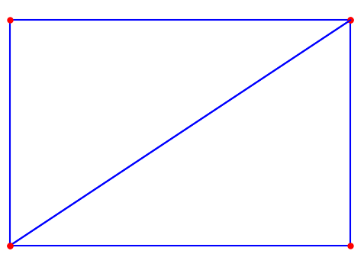
1 INITIAL TRIANGULATION
We start with basic assumption: having traingulation T_{n} with n points, which fulfills all Delaunay’s rules. Then we add another point in that way, that T_{n+1} fulfills this rules as well.
To begin with, we create starting space by making four points that are on the outermost of all points coordinates of polygon + 10% of difference between max and min in order to don’t let the point be on edges with end of working space.
Starting points

Slide 4
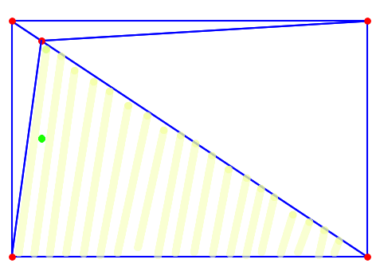
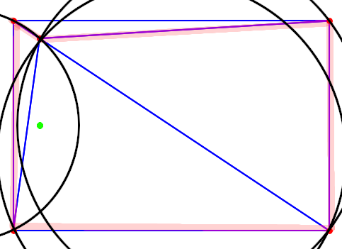
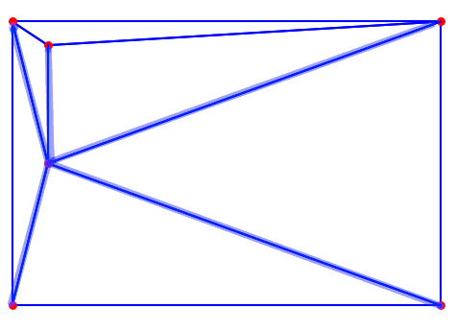
Adding new Point
1 Searching for face that covers searched point
2 Searching for all neigbouring faces which point is in their circumscribed circle
3 Connecting all points of found faces to the new point

Slide 5
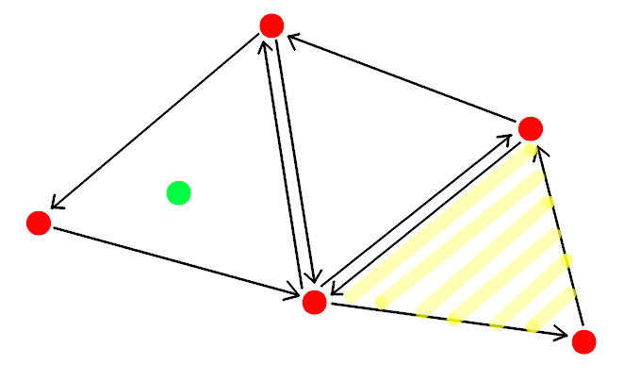
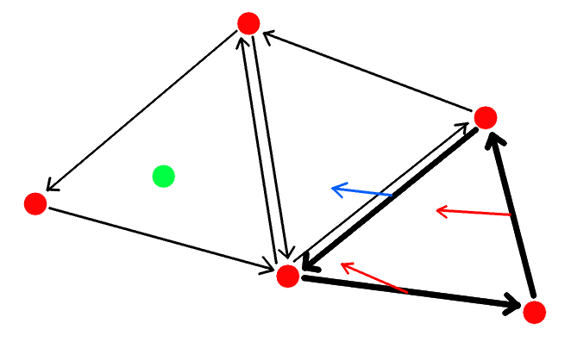
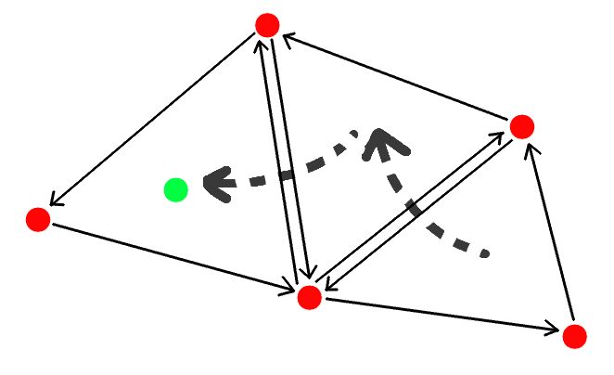
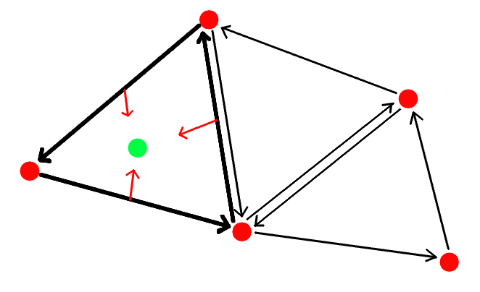
Search for point
Starting Face
The orient function can give positive, negative or value 0, depending on the position of the point relative to the edge. For a Face containing the searched point, all of its edges will have a non-negative value of the orient function. In the case of 0 we are dealing with a point lying on the edge (but this does not change our further conduct) In the case of a negative value, we go to the adjacent wall, because it is in its direction that the point is located

Slide 6
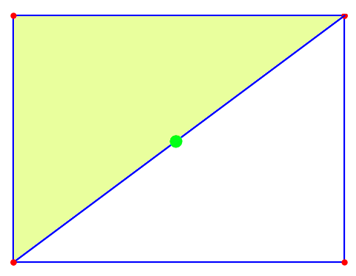
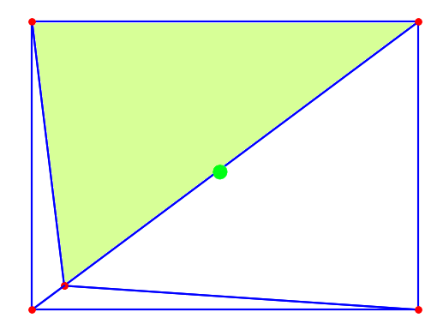
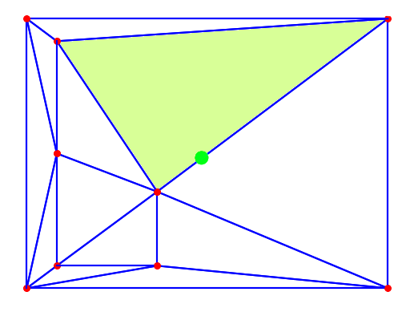
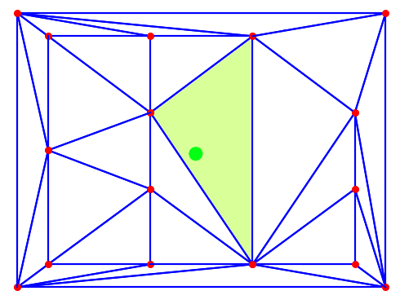
Starting Face
To shorten the number of iterations every time we look for a wall, we can always start from the middle wall. To achieve this, we store the face that is in the middle, but if we change it, we select a new middle one among the newly created ones. For simplicity's sake, I assumed that the middle wall is the one in which the geometric center of the entire triangulation field is contained.

Slide 7
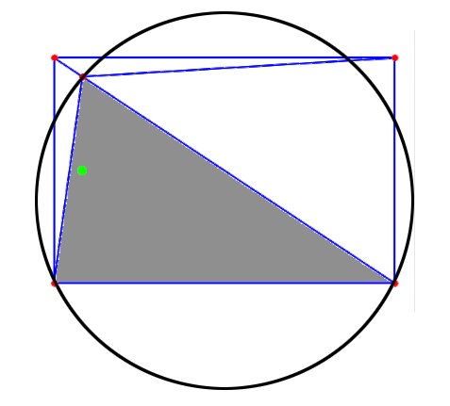
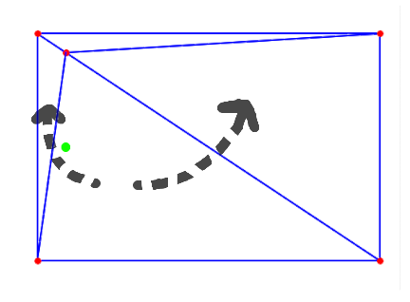
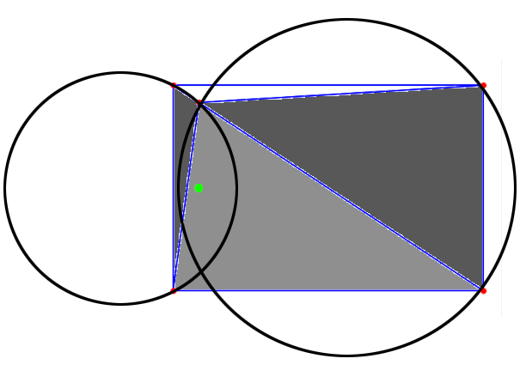
Search for all faces With circle Containing a point
After finding the Face in which the point is located, we start finding all the Faces that will need to be changed. The system is based on BFS on the face graph – we take the first face from the queue, check it for the circle condition, and if there is a point in it, then all the neigbouring faces not yet visited are added to the queue.

Slide 8
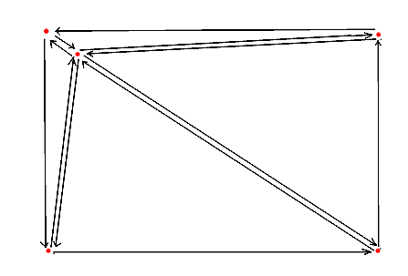
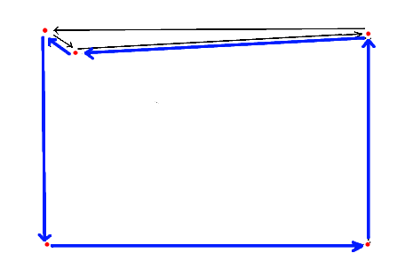
Face MERging
It consists in removing the inner edges in the resulting polygon from the adjacent Faces. The correct result is a closed cycle of Edges of the outer Edges of triangles.

Slide 9
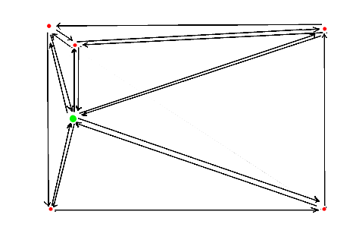
Connection of vertices
Then all the vertices of the polygon are connected to the new Point, forming new Faces.
After this step, we begin to add another point.

Slide 10
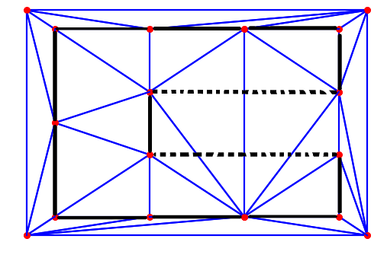
2 Edge recovery
Odzyskiwanie krawędzi jest potrzebne, ponieważ triangulacja nie ma narzuconych z góry krawędzi które ma utworzyć. Dlatego też zdarzyć się może iż taka krawędź z wielokąta może zniknąć.

Slide 11
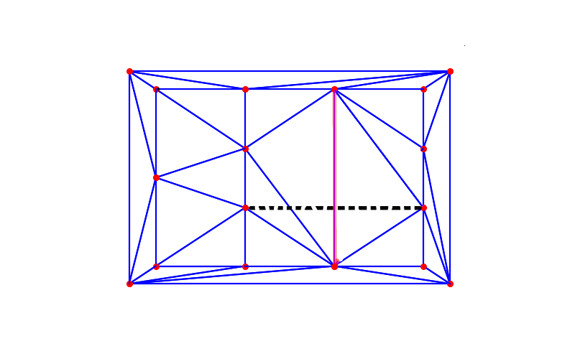
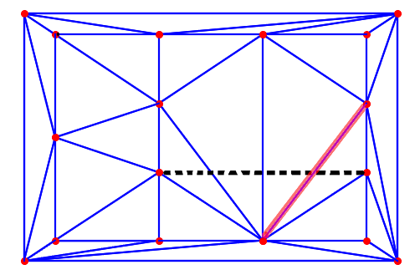
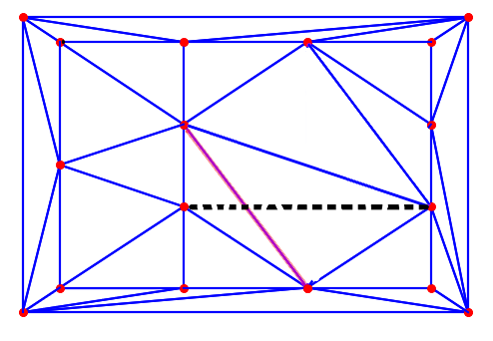
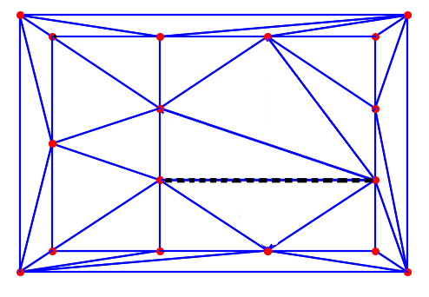
2 Odzyskiwanie Krawędzi
If the Edge of the polygon is not found, it checks what Edges intersect it. This is done by finding a Face containing the starting Point of the Edge (slightly shifted along the Edges so that the wrong choice does not occur). And then we visit the next walls that were adjacent to those. Then the diagonals in quadrilaterals formed from adjacent two Faces to colliding Edges are replaced.

Slide 12
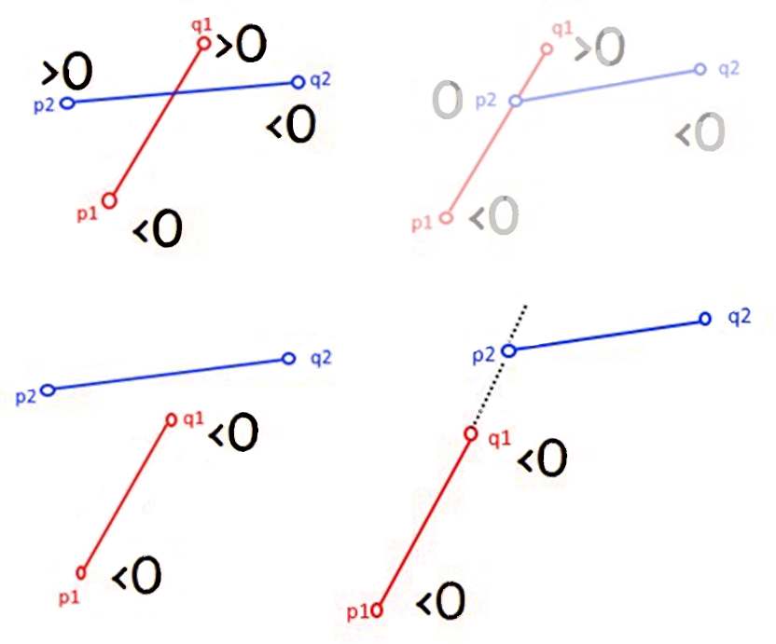
Check crossings
Again, we use the orient function, this time for pairs of points, checking if the segments created from them intersect. To determine the intersection, the results of the orient function must be different signs after for points in one segment relative to another. Due to the assumptions of a straight polygon, and the fact that we are looking for more vertices, we can exclude a situation where the point lies in the middle of the lost edge.
In the figure (p1,q1) is the lost edge and (p2,q2) is the edge of the current triangulation.

Slide 13
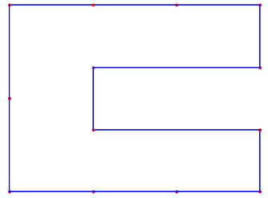
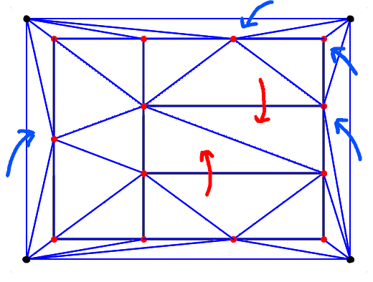
3 Removing outer triangles
Having full triangulation, you should get rid of unnecessary triangles: arising by contact with auxiliary vertices
whose vertices are part of a polygon, but their Face is outside.

Slide 14
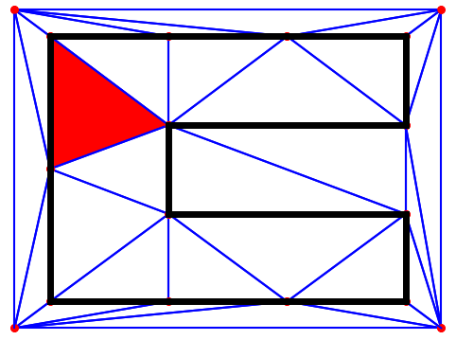
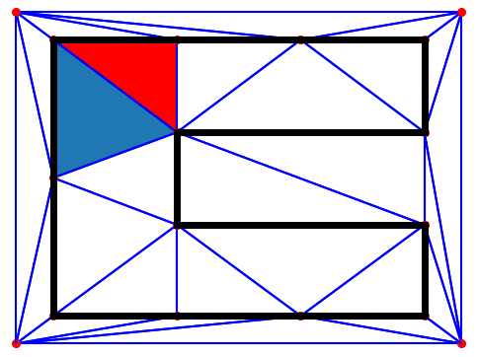
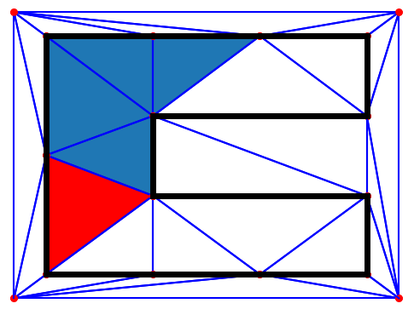
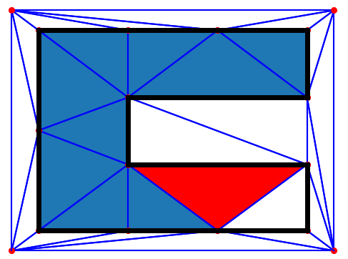
Finding Inner Faces
First, we will create a collection of all the outer edges - EDGES. Then we find the first Face that contains one of the outer edges, and proceed to the DFS on the Faces. The condition for moving to the next Face is the neighborhood with it with an edge not included in EDGES. Each visited wall is marked as visited.

Slide 15
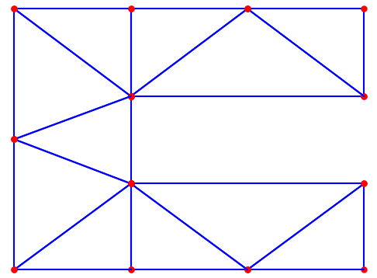
DELETE
Finally, we go through a set of edges and check which ones have not been visited. They are detached from each other and removed.
The result should be an input polygon with triangulation edges appended.

Slide 16
Source: Lectures on geometric algorithms Agh cracov phD. B. Głut Wikipedia
source
source
source

