Slide 1
Local search engine
Team: Attack on hackers

Slide 2
Step 1: preprocessing
● What should we use as keys in our index (e.g. words)? - words
● How should we store the index persistently for later usage? – database (structure: JSON, database: MongoDB)
● Optional: What kind of additional preprocessing could make our index perform better?
How can we rank or weigh the keys? – count frequency of word (article, articles)
Should some words be filtered out? – stopwords, punctuation
Can we combine words of the same meaning (e.g. walk, walking)? -lemmatization

Slide 3
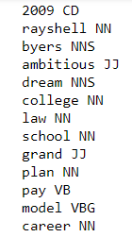
Step 1: preprocessing
- remove punctuations (e.g. ‘!’, ‘.’, ‘,’ …)
- lower case (‘Rayshell’ -> ‘rayshell’)
- remove stopwords (e.g. ‘was’, ‘an’, ‘with’…)
- tokenization
- lemmatization (get base of the word)
Word - Position tag

Slide 4
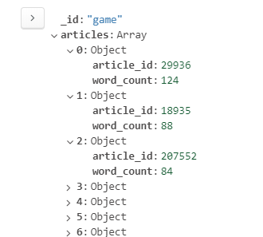
Step 1: preprocessing
For every word create an array of articles in which it exists
Sort articles bases on how frequent word is

Slide 5
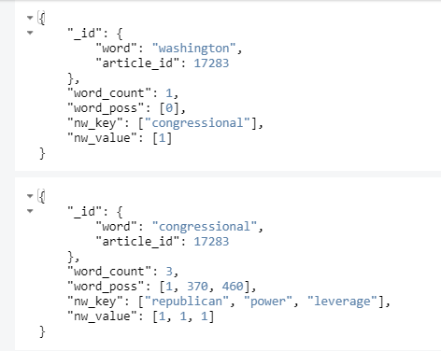
Step 1: preprocessing
Create hashtable where key is our word and article_id and value is meta data
Meta data has:
Frequency
Each position of the keyword
Next word
Next word frequency

Slide 6
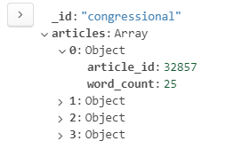
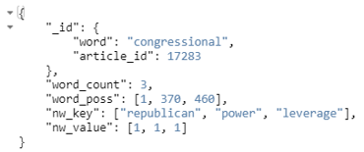
Step 2: preprocessing
1. Preprocess the input as in the preprocessing part.
2. Get a set of articles for each word.
3. Find intersection. If only 1 word – get most frequent in article.
4. Inside intersections find articles that have nearby words according to the input.
5. Article with high nearby words ranked first.
6. Sort the results and print first 5 results.

Slide 7
Future:
Problems:
Smaller the sentence – higher the search space
How to correctly rank: most frequent words or collocations (nearby words)?
Noisy data
Future :
Use positons of the word in the sentence to calculate distance with the next word of the sentence in a particular article.
*This would add some flexibility because sometimes we can change order and positions of the words and the meaning won’t change.

Slide 8
Thank you for your attention!

