Slide 1
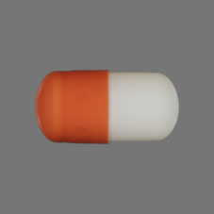
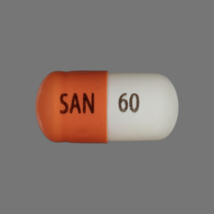
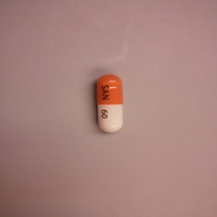
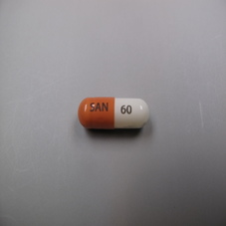
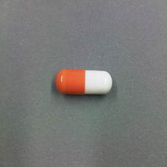
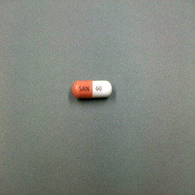
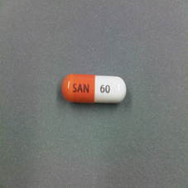
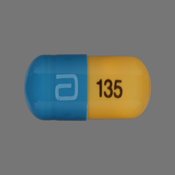
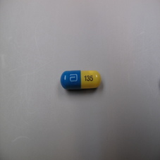
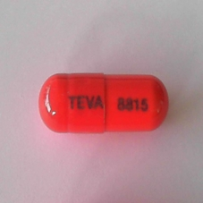
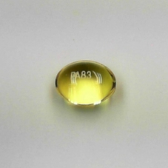
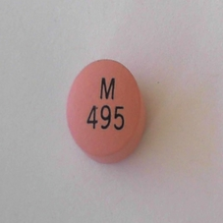
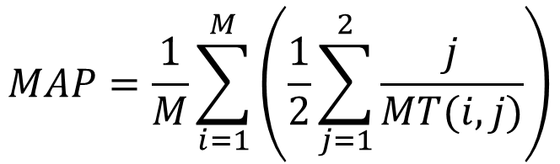
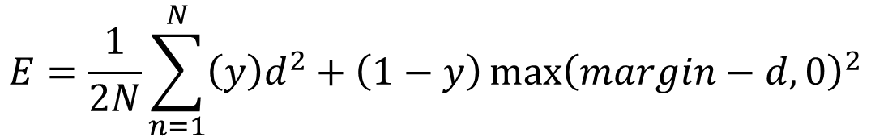
A Survey of Techniques for Fine-Grained Pill Image Matching
Adam Allevato
Andrew Sharp
The University of Texas at Austin
Pill Image Recognition
Experimental Setup
Results
- Goal: Produce a system to identify cellphone-camera pictures of consumer medication
- Input: M consumer-quality (CQ) images and N high-quality reference (Ref) images
- Output: M x N matrix of similarity ranks
Preprocessing
mAP
$$MAP=\frac{1}{M}\sum_{i=1}^{M}{\left(\frac{1}{2}\sum_{j=1}^{2}{\frac{j}{MT(i,j)}}\right)}$$
- Selective Search was used to crop consumer-quality images
- Networks were tested on selective search images (SS) and raw images (Full), as well as both together (Comb)
-Based on top 2 ranks
(pill front and back)
[J. R. R. Uijlings et al. 13]
Dataset
2 reference images
&
5 CQ images: taken by
Cellphone cameras
1000 pills, 2000 ref images, 5000 CQ images
Dataset Challenges
- Matching: Classes are unknown at training time
- Fine-Grained: Differences between pills are small
- Small Dataset: Near zero-shot matching task
- Many Classes: 1000-way matching
- Incomplete Data: Need to infer back of pill from front
Approaches
Best Matches
LeNet
CQ Ref 1 Ref 2 Ref 3 Ref 4 Ref 5
8 layers
Siamese configuration
2-dimensional mapping
Trained from scratch
20000 iterations
1 round of hard negative
Key Idea: Siamese Networks
- Learn a mapping into an arbitrary N-dim feature space
- Minimize contrastive loss (Y=1 if similar pair, else Y=0):
CaffeNet
$$E=\frac{1}{2N}\sum_{n=1}^{N}{\left(y\right)d^{2}+\left(1−y\right){\max\left(margin−d,0\right)}^{2}}$$
21 layers
Siamese configuration
20-dimensional mapping
Fine-tuned last layer
10000 iterations
Mirrored training images
[Chopra et al. 06]
TRAIN
Pair
Network
N-D Feature
Contrastive
Loss
Network
N-D Feature
Hard Negative Mining
Network
Images
- Test networks on training set
- Generate new training pairs
from false matches
Training
Matches
TEST
Network
N-D Feature
Rank
New Pairs

