Slide 1
Research Experience Overview
VLM-Driven Visual Navigation for Heterogeneous Multi-Robot Systems
Lawrence, Wang Yilin University of Macau / Electromechanical Engineering dc22897@um.edu.mo Apr. 28 2026
1/10

Slide 2
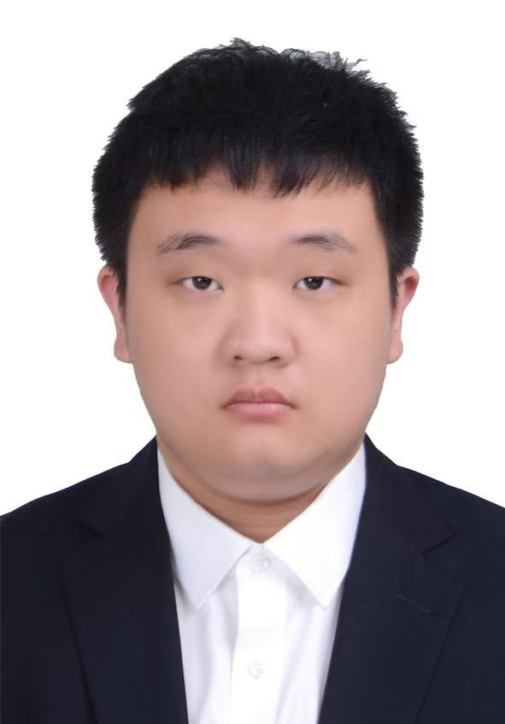
About Me
Education
● BSc. University of Macau, 2026
▸ Major: Electromechanical Engineering
▸ GPA: 3.07 / 4.0
[Photo / Skills / Awards Placeholder]
Research Interests
● Multi-modal AI × Robotics
● Vision-Language Models for Embodied Intelligence
● Autonomous Navigation & Semantic Mapping
● Multi-robot Pose Estimation
2/10

Slide 3
Early Research Experience
Project 1: Multi-Robot Pose Estimation
● Objective: Develop an pose alignment algorithm applied to unmanned aerial vehicles
● Method: Obtain the robot's pose by using motion capture equipment, and combine with the front-view image to train the GNN model for image pose alignment.
● My contribution: Test the connectivity of the CAN bus used by the robot; Test the bugs in the ROS2 workspace code. Welded circuit boards for powering CAN bus/Jetson and robomaster chassis.
Project 2: Robot path planning demo
● Objective: Show the advantages of motion capture equipment to the sponsor, hoping that they will invest in a set of motion capture equipment.
● Method: Align the target path points using the robot's pose obtained from the motion capture equipment.
● My contribution：Write the code and use motion capture to measure the position and posture of the robot.
3/10

Slide 4
Early Research Experience
[Fill in your earlier research projects before the FYP]
Project 3: Cloud Edge Intelligent Robot
● Objective: Using cloud-based models to build a VLM robot based on the MCP architecture enables it to independently and autonomously complete collaborative tasks.
● Method: VLM control robot
● My contribution: Build a robot simulation environment using Iaasc Sim, and transmit the camera view to Gemini. After Gemini's thinking, it will release the path.
[放一个云边端的视频]
4/10

Slide 5
From Passive Inference to Active Agent:
VLM-Based Navigation with Function Calling
Problem Statement
Our Approach
● Traditional robot navigation relies on pre-built maps (SLAM) and hand-coded rules — brittle in unknown environments
● Most VLM-robotics studies remain in simulation; real hardware deployment is rare
● Heterogeneous multi-robot collaboration with LLMs is largely unexplored
● Need: a map-free, vision-driven navigation system validated on real hardware
● Replace SLAM with Gemini 2.5 Flash VLM as the cognitive planner
● Two-stage architecture: single-turn pipeline → multi-turn Function Calling Agent
● Skill-based YAML framework for task-specific prompts
● Deployed on real robot (Jetson Orin Nano + depth camera)
Key Insight: A well-crafted prompt + function-calling tools can replace complex hand-tuned planning algorithms — achieving real-world indoor navigation without any pre-built map.
5/10

Slide 6
System Architecture
Four-layer modular design on ROS2 Humble
Cognitive Planning Layer
End-to-End Data Flow
Gemini 2.5 Flash API | Skill YAML Profiles | Function Calling Agent Loop
● 1. RGB frame → Gemini API
● 2. Gemini returns pixel coords / odom waypoints
● 3. Depth reprojection → 3D path (single-turn) or direct odom coords (agent mode)
● 4. PID tracker → /cmd_vel
● 5. Obstacle detected → re-trigger Gemini
● 6. Semantic labels stored in memory
▼
Perception Layer
RGB/Depth Processing | TF2 Coordinate Transform | Semantic Map Cache
▼
Control Execution Layer
Pure Pursuit + PID Tracker | Reactive Collision Avoidance (Depth ROI)
▼
Hardware Abstraction Layer
Mecanum Chassis + STM32 | Orbbec Gemini 336 Depth Camera | IMU | Jetson Orin Nano
6/10

Slide 7
Two Operating Modes
Single-Turn Pipeline vs. Multi-Turn Function Calling Agent
Mode A: Single-Turn Pipeline
Mode B: Function Calling Agent
● track_path triggers → capture RGB image
● Send image to Gemini → returns pixel coordinates
● image_conversion: depth reprojection + TF2 → 3D odom path
● PID tracker follows path → re-trigger on completion
▸ Pros: Simple, low API cost per call
▸ Cons: Passive — Gemini cannot query robot state
▸ Cons: Sensitive to perception layer data quality
● Gemini operates as an interactive agent
● Actively calls tools: get_robot_pose(), get_front_image(), publish_path()
● Computes odom waypoints via trigonometry — no depth reprojection needed
● Multi-turn loop until task complete or max turns reached
▸ Pros: Spatially grounded — knows exact pose
▸ Pros: Generates semantic labels during navigation
▸ Pros: Improve the quality of the path
▸ Cons: Higher API token consumption (~3-5× per cycle)
7/10

Slide 8
Key Technical Contributions
Skill-Based YAML Framework
System prompts defined in hot-swappable YAML files. Adding new robot behaviors (exploration, inspection, navigation) requires zero code changes — just a new YAML file.
Prompt Engineering for Perspective Compensation
Camera mounted at only 155mm height causes severe perspective compression. Engineered prompts instruct Gemini to place far way points at suitable region, achieving 3-4m per step (vs. <0.5m with naive prompt).
Function Calling Agent Architecture
7 atomic tool functions (get_pose, get_image, publish_path, label_region, etc.) enable Gemini to actively query sensors and make spatially grounded decisions. Bypasses depth camera reprojection entirely.
Real Hardware Deployment
Complete system validated on physical robot: Jetson Orin Nano + Orbbec depth camera + Mecanum chassis. Iterative debugging of depth camera issues, TF2 transforms, PID tuning, and QoS compatibility.
8/10

Slide 9
Experimental Validation
3-Group Comparative Study: Naive Prompt vs. Optimized Prompt vs. Agent Mode
Experiment Setup
● Scenario: 8m corridor with obstacle, target = exit door
● 5 trials per group, same starting pose
● Group A: Naive prompt (single-turn)
● Group B: Optimized prompt (single-turn)
● Group C: Function Calling Agent (multi-turn)
[放一个机器人自主探索的视频]
Key Metrics (to be filled after experiments)
Metric
Group A
Group B
Group C
Success Rate
[___]
[___]
[___]
Avg. Time (s)
[___]
[___]
[___]
LLM Interactions
[___]
[___]
[___]
Angular Vel. Var.
[___]
[___]
[___]
Semantic Labels
N/A
N/A
[___]
9/10

Slide 10
Research Insights & Future Directions
Key Takeaways
Future Directions
● Cloud VLMs can serve as practical path planners for real robots — not just simulation
● Prompt quality is as decisive as algorithm design in traditional planning
● Active tool-calling (Function Calling) enables spatially grounded reasoning
● Modular Skill YAML architecture → extensible to new tasks with zero code changes
● Semantic mapping emerges naturally as a side product of agent navigation
● Progressive Cognition: Scout → Inspector → Navigator multi-skill framework
● Persistent semantic memory across sessions (save/load JSON maps)
● Hybrid architecture: local lightweight model + cloud VLM to reduce latency
● Multi-robot formation: leader (perception) + followers (execution)
● Cross-domain generalization to outdoor / warehouse environments
Research Interest Alignment: This work sits at the intersection of Embodied AI, Vision-Language Models, and Multi-Robot Systems — areas where I am eager to pursue deeper research at the graduate level.
10/10

Slide 11
Why Me — Competitive Strengths
What I bring to your Robotics M.S. program
Core Strengths
Technical Skills
Cross-Disciplinary Full-Stack
Robotics
By the Numbers
EME background + AI/VLM + ROS2 software + embedded deployment (Jetson Orin Nano). Can bridge the gap between mechanical design and intelligent software.
ROS2 · PID Control · Pure Pursuit TF2 · Sensor Fusion
4
Research Projects
Real Hardware, Not Just Simulation
Programming
Built and debugged a complete autonomous navigation system on a physical robot. Diagnosed and resolved hardware-software integration issues including sensor calibration, coordinate transform errors, PID tuning, and communication QoS — problems that only surface on real hardware
Python · Ubuntu/Linux Git · API Integration
4
Layer Architecture Designed from Scratch
Cutting-Edge Technology Adoption
AI / ML
VLM (Gemini) · Function Calling Prompt Engineering · Agent Design
Implemented VLM Function Calling Agent architecture on a real robot — a technique that appeared in academic papers only in 2024-2025. Demonstrates ability to rapidly learn and apply frontier research.
7
Atomic Tool Functions for Agent System
Engineering
Systems Thinking & Modular Design
SolidWorks · CAD · Unity Jetson Orin Nano · Embedded
Designed a 4-layer architecture from scratch. Created a Skill YAML framework enabling zero-code behavioral extension. Shows I think beyond immediate problems toward scalable solutions.
Alignment with Robotics M.S.: My hands-on experience in VLM-driven autonomous systems, real hardware deployment, and modular software architecture directly prepares me to contribute to cutting-edge robotics research from day one. I am eager to deepen my expertise in embodied AI and multi-robot systems at the graduate level.

Slide 12
Thank You
Questions & Discussion
Lawrence, Wang Yilin | dc22897@um.edu.mo | University of Macau GitHub: github.com/Kuko1414

