Slide 1
Seattle Car Crash Severity Prediction
CHRISTIANA MORRISON

Slide 2
BACKGROUND
Average number of car accidents in the U.S. every year is 6 million leaving more than 90 people dead in car accidents every day. 3 million people in the U.S. are injured every year in car accidents. Also, around 2 million drivers in car accidents experience permanent injuries every year.
Seattle like any other places in the US face this same problem but looks more rampant here. Accidents happen at all times, but if the main causes of accidents aren’t determined, advance warning or mitigating methods cannot be performed. For example, certain intersections may be more susceptible to accidents due to heavy use by vehicles, as a result, better lightening systems could be created on such streets.

Slide 3
PROBLEM & TARGET AUDIENCE
The Problem
The problem is Seattle has car accidents that can be prevented. We need to build a model to predict car accident severity can help commuters, professional drivers or logistic planners to reduce the personal and/or business impact of car accidents.
TARGET AUDIENCE
The target audience of this analysis is the Seattle government and transportation department. Key causes of accidents and trends for when accidents can be prevented.

Slide 4
Data Sources
The collisions data is recorded by Seattle Department of Transportation, Traffic Management Division, Traffic Records Group and maintained by ArcGIS and can be found in the Kaggle dataset here and the metadata can be found from here.
The collisions dataset includes all types of collisions from year 2004 to present.

Slide 5
Data Cleaning
The data downloaded from the above-mentioned source was saved in a table.
There were many entries in the dataset which said that no person, pedestrian, cyclists or vehicles were involved in those collisions.
Analyzing such entries, a bit further they were found to be irrelevant and hence deleted from the dataset.
There were several columns (features) in the dataset that were added by various authorities to mainly identify the incident instance and were irrelevant to our final goal of developing a predictive model. Those columns were dropped.

Slide 6
Data Cleaning cont.
Also we want our model to be independent of the exact locations of the collisions, therefore columns indicating the exact locations of the collisions were dropped and rather the columns describing the properties of such locations were kept.

Slide 7
Feature Selection
After data cleaning there were 201786 samples and 13 features in the cleaned data. To better select the features the Pearson correlation coefficient was calculated for the dataset to getidea about the extent to which the features were correlated to the target variable „SEVERITYCODE‟.
Examining the Pearson correlation of different features with the target variable, none of the features displayed a high positive or negative correlation, with „PEDCOUNT‟ being the most positively correlated with a Pearson correlation coefficient of 0.28. This is understandable because none of the features contained continuous values and most of them were categorical and they were encoded into numerical values which were discrete in nature.

Slide 8
PREDICTIVE MODELLING
Our objective in this project was to build a machine learning model that could predict/foretell the severity level of a future accident given a feature set instance. The severity of an accident was given by five different labels/classes namely, „3‟, „2‟, „2b‟, „1‟ and „0‟. So there were multiple labels/classes there in our target variable „SEVERITYCODE” in our dataset. So this problem fell into the category of “Multi-class Classification”. Therefore, I built several classification models using different classification algorithms and the model with the highest accuracy can be selected for implementation.

Slide 9
Nearest Neighbors Classification Model
Using the “K Nearest Neighbors” classification algorithm with a cleaned large dataset was difficult hence I selected a relatively small portion of the dataset for finding the optimal “k” value and split that into training and testing data.
Finally after finding out the optimal value for “k”, I fitted the model with the whole original training data and that “k” value.

Slide 10
Decision Tree Classification Model
The training data was split into training and testing data and the mean accuracy was found out for a few values of “max_depth” by repeatedly training and testing the decision tree model with varied “max_depth” values.
The “max_depth” value which gave out the maximum mean accuracy was selected to feed the final model with. Finally a decision tree model was fitted with the whole original training data and the best “max_depth” value.

Slide 11
Logistic Regression Classification Model
As a solution to this problem the same path as the “K Nearest Neighbors” model was used and found out the best solver.
Finally a logistic regression model was fitted with the whole original training dataset.

Slide 12
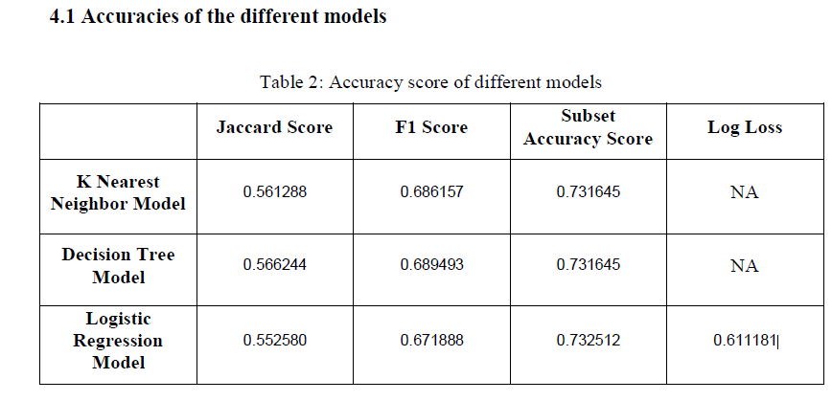

Slide 13
CONCLUSION
I analysed the relationship between the severity of car accidents and the data from SDOT on the factors that describe the overall situation the accidents took place in.
I identified vehicle count, person count, pedestrian count, weather condition, road condition, light condition among the most important features that determines the severity of a car accident.
I built three classification models to predict the severity of future car accidents and suggested to take the model with highest accuracy for implementation.
These models can be very useful helping the hospitals and police department to be better prepared for accidents in advance. For example, it can help the hospitals to maintain sufficient amount of staffs and doctors on a given day to handle such situations efficiently, etc.

