Slide 1
I'm Petrov. And I'm Boshirov
Team: Zadernovskaya Angelina
Plovneva Yuliya

Slide 2
Who and what
Who | What
 | Parsing | Else
Angelina | xml, json | Setting up Database Filling up Database
Yuliya | xlsx | DB architecture development Visual Design

Slide 3
About parsing xml and json
Firstly DB was filed with XML only data because of existence information about passenger such as passport code, full name, etc.
JSON Gives us only data about Airports

Slide 4
About parsing XLSX
The worst xlsx parsing script ever
Data set - bunch of boarding passes
Boarding | Pass |  |  |  |  | Sequence
Sex | Name |  |  |  | Code | PNR class
Flight code |  |  | City from |  |  | City to
 | Gate(N/A) |  | Airport from |  |  | Airport to
Date |  | Time |  | Flight | Operator
Boarding Info |  |  |  |  |  | Seat (N/A)
 | PNR code |  |  | E Ticket

Slide 5
About parsing csv and tab

Slide 6
About parsing yaml and pdf
No response from Vladimir

Slide 7
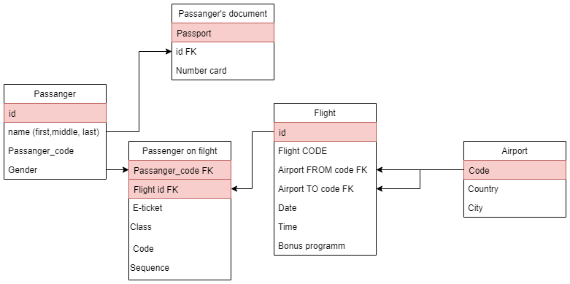
Database ARCH

Slide 8
About Setting up DB
Remote DB was established via Amazon
Direct filling up database was very slow, so decision to fill local database and load that data to remote DB

Slide 9
Interesting things that we found out
Nothing

Slide 10
Thanks

