Slide 1

SMART INDIA HACKATHON 2026
TITLE PAGE
Problem Statement ID - SIH26067
Problem Statement Title - Develop a web-based interactive 3D visualization platform that integrates numerical ocean model outputs and in-situ observations.
Theme - Disaster Management
PS Category - Software
Team ID - K26125
Team Name - Team Null

Slide 2

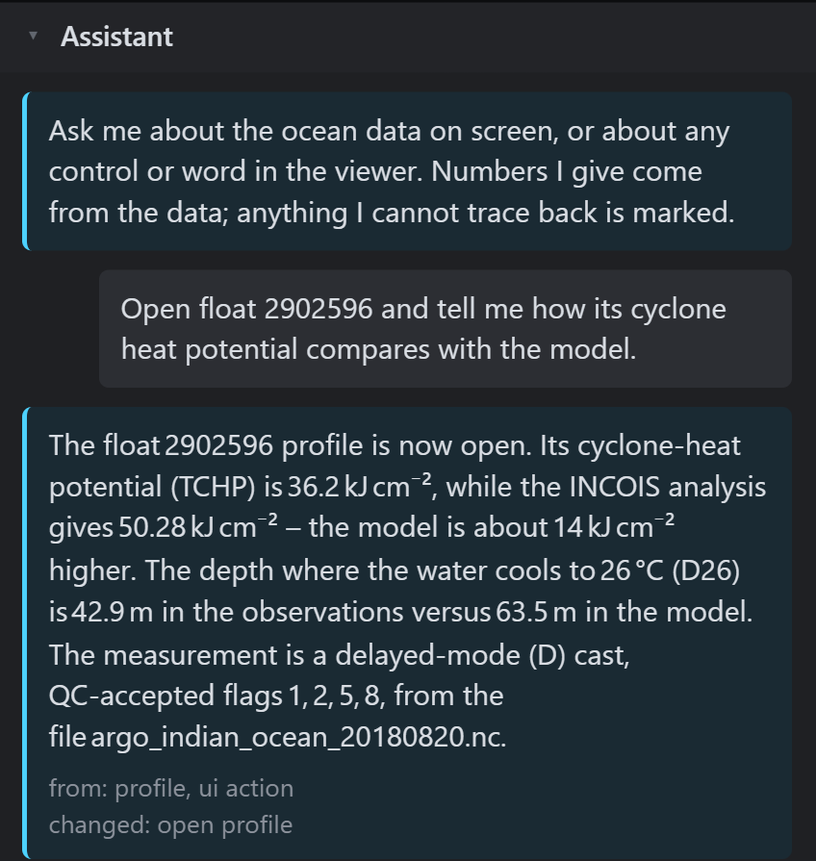
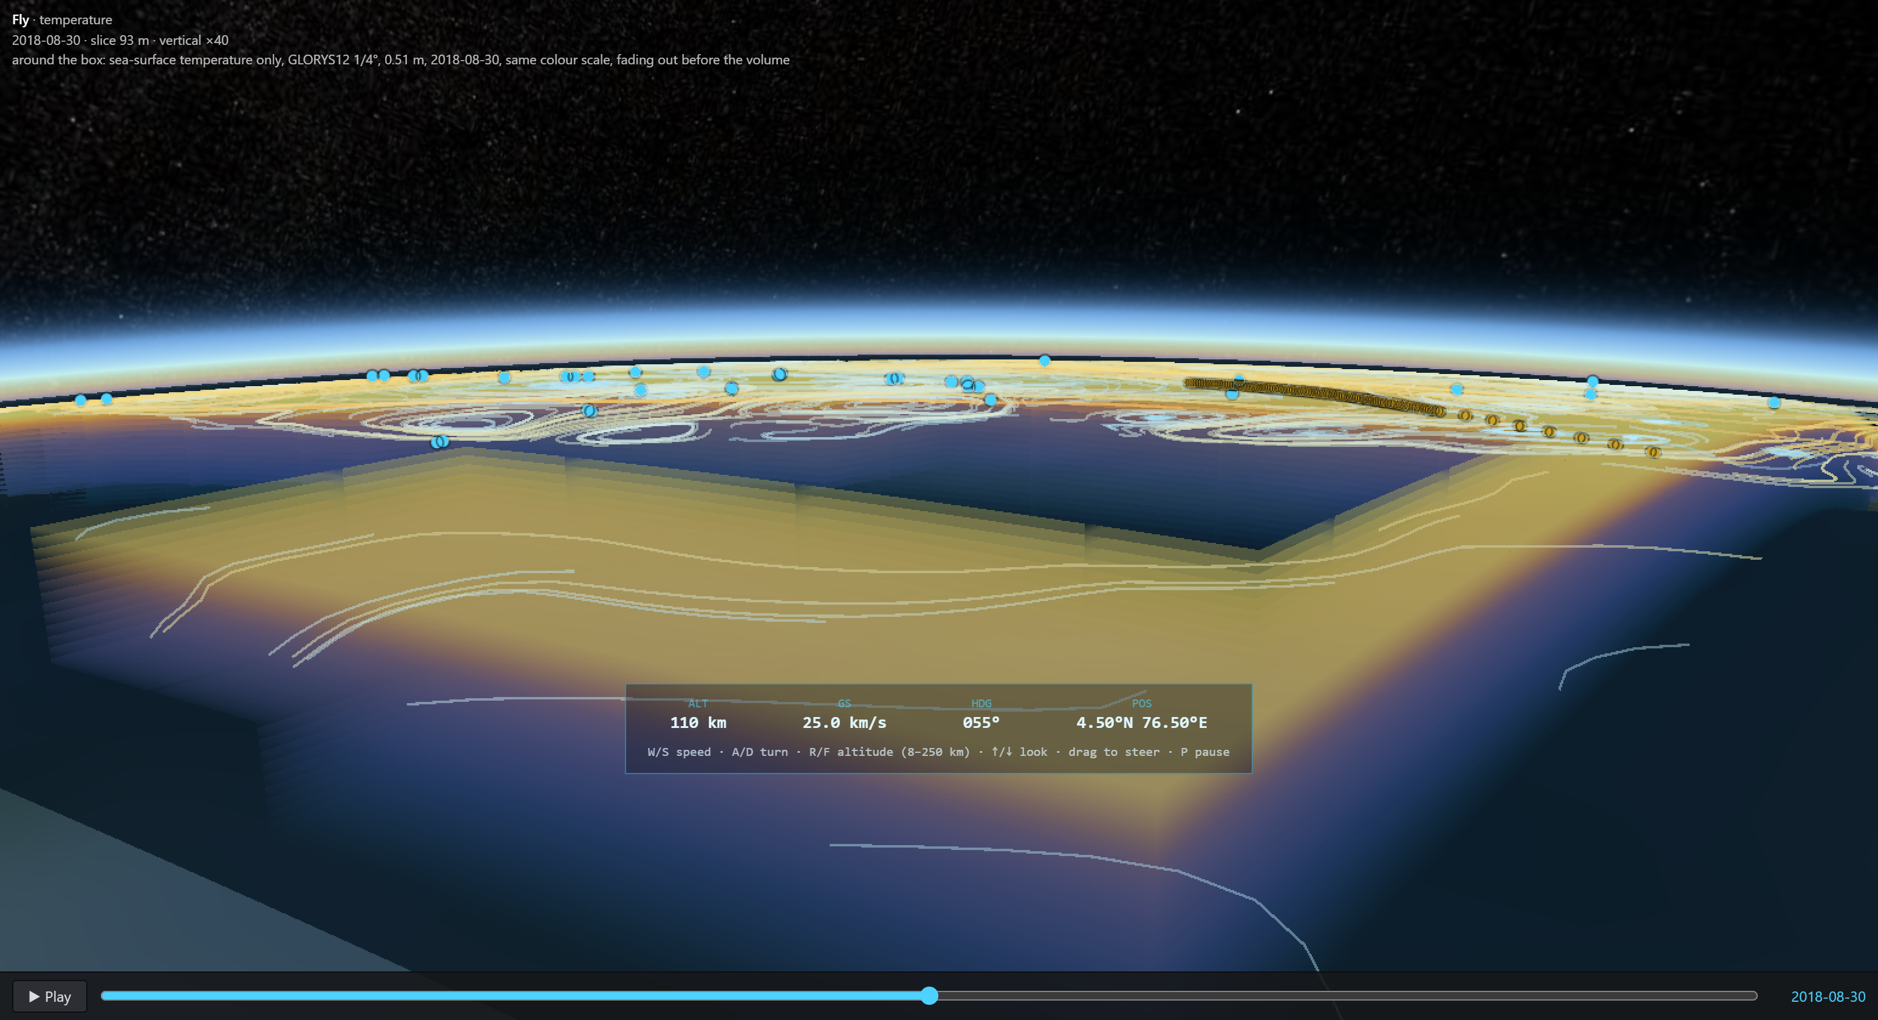
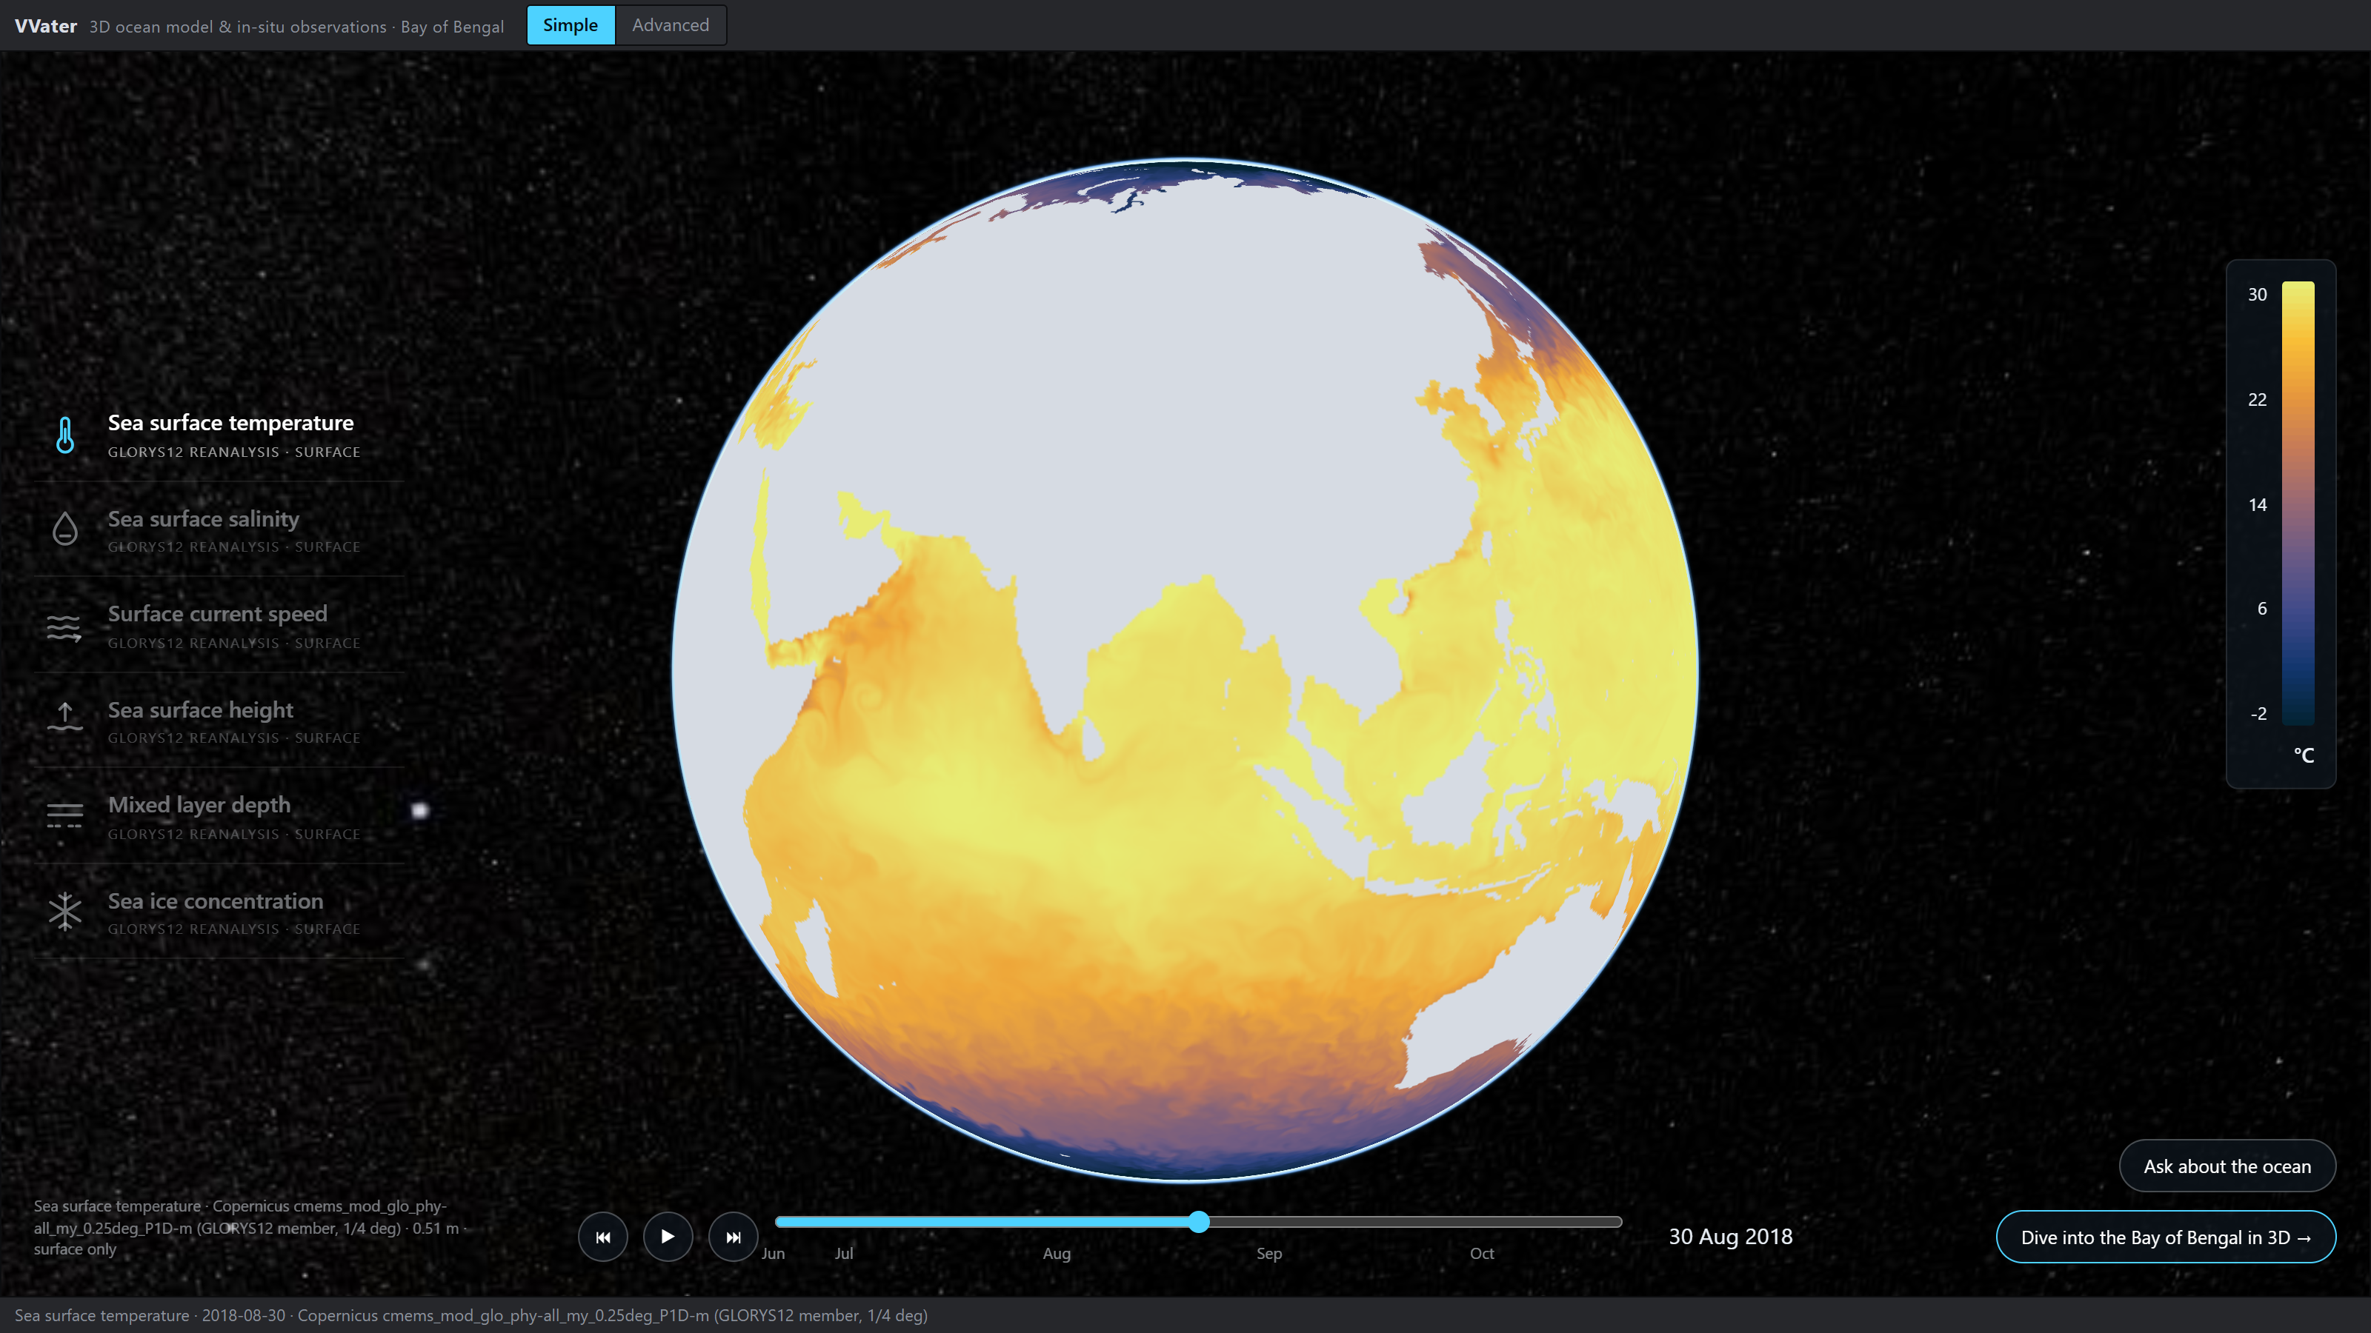
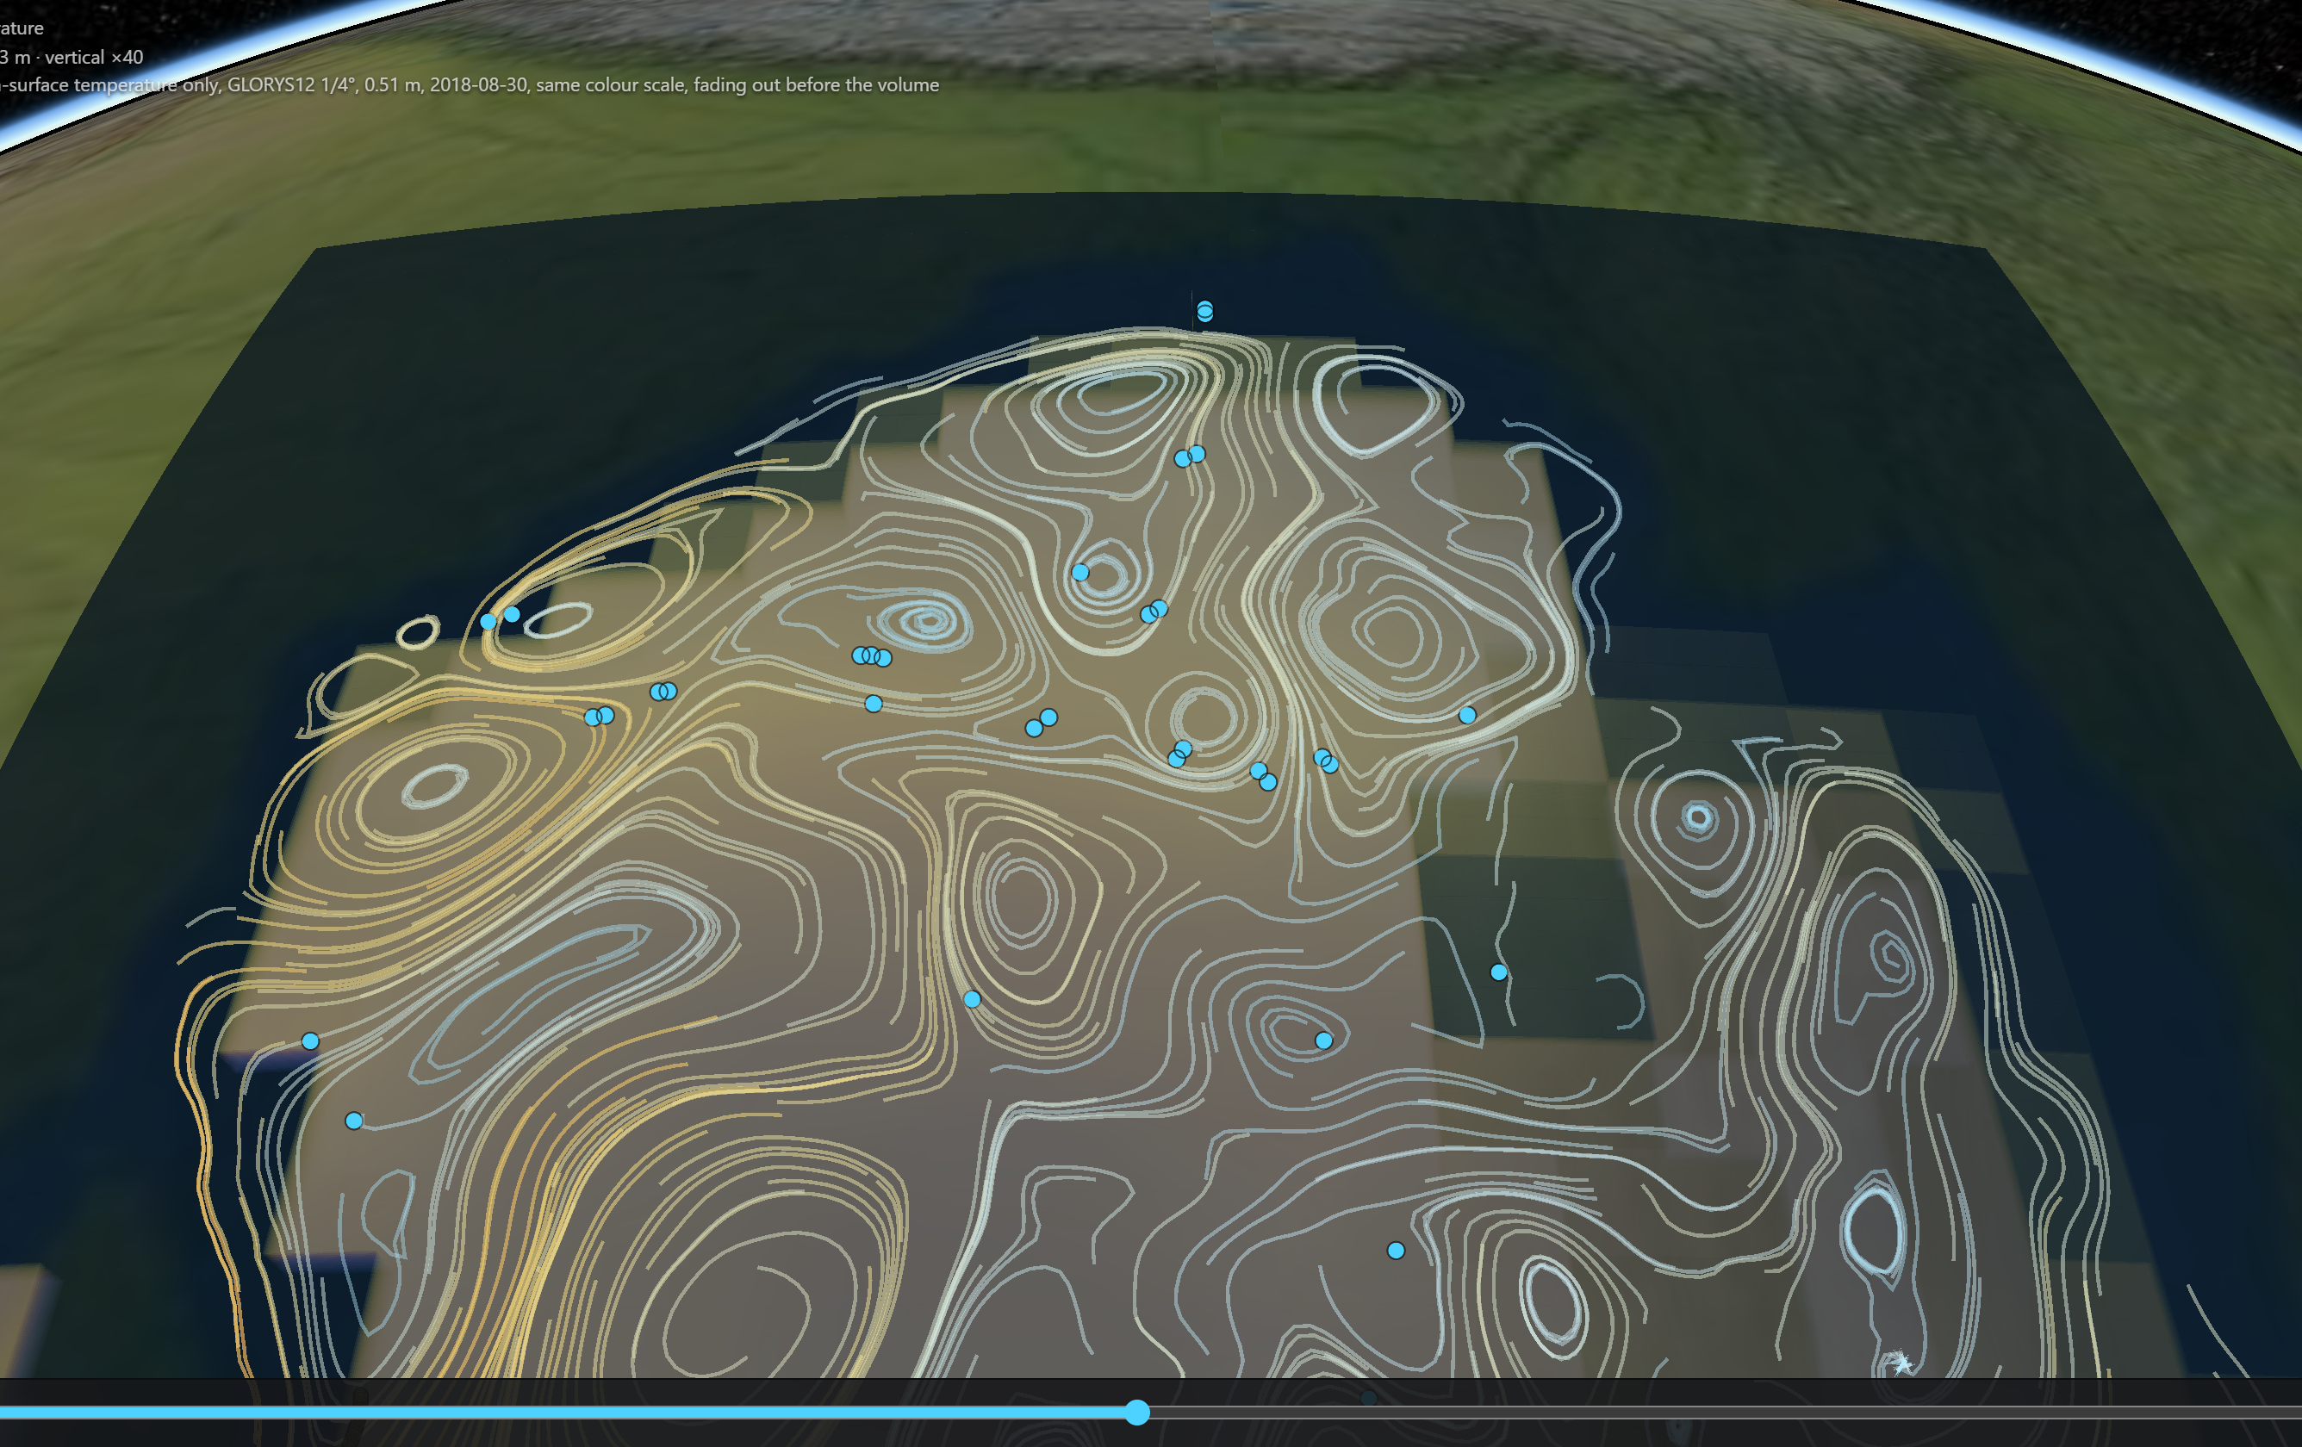
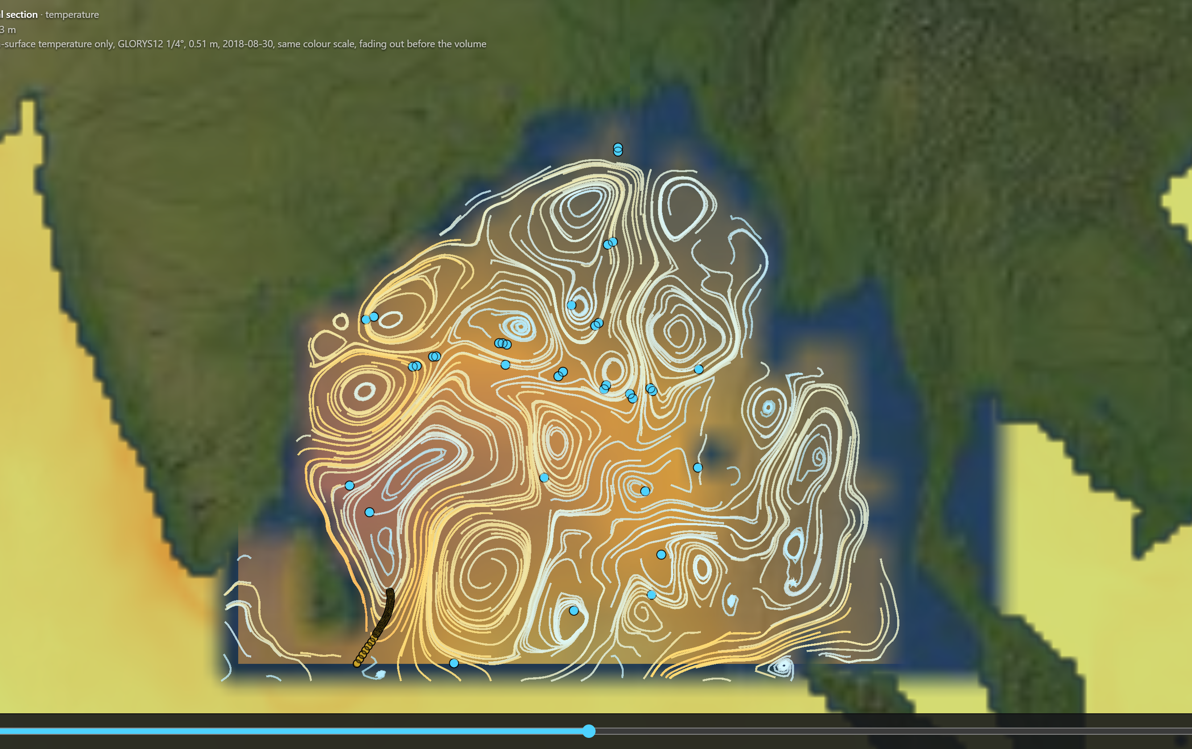
VVater: Ocean in 3D
Forecasters get the ocean model and the measurements in separate tools, as flat maps. VVater puts both in one 3D scene in the browser, and you can ask it questions or fly over it.
THE PROBLEM
WHAT IS NEW
The ocean is 3D; the tools are flat
1 · Ask the ocean in plain words
2 · Fly over the Bay like a plane
A cyclone feeds on a warm layer tens of metres thick. A surface map cannot show how thick.
Model and measurements live apart
The model in one program, float and glider files in another; comparing them is done by eye.
WHAT WE BUILT
One link, no install
any browser; deployable on INCOIS servers
Model and measurements in one 3D scene
the INCOIS model with 35 Argo float profiles and 112 glider casts
Click a float, see the gap
its profile against the model, in °C and in cyclone heat potential
Bad readings stay visible
failed quality checks drawn red, never dropped
A flight view with pilot controls: speed, turn, altitude 8–250 km. The 3D water column, the currents and every float pass underneath at 40× depth.
Answers from the data and drives the viewer. Here it opened the float, drew its profile and compared it with the model. Any number it cannot trace to the data is flagged.
Why it matters
a 2,000 m-deep ocean becomes something a student, a forecaster or a minister can see and move through, not a stack of flat maps
Simple
Region 3D
Map 2D
How to fly
the whole ocean
the water column
any depth
W/S speed · A/D turn · R/F altitude · drag to steer

Slide 3
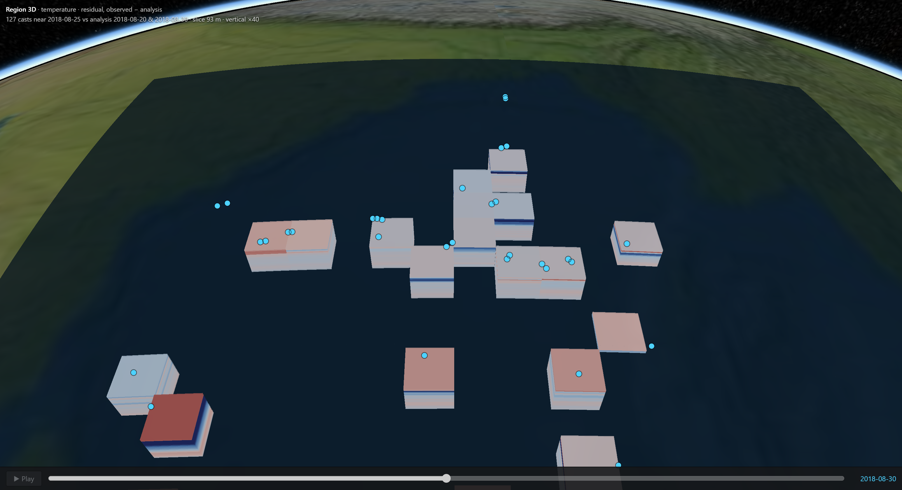
TECHNICAL APPROACH
FROM RAW FILES TO THE SCENE — AND WHAT HAPPENS TO BAD OR MISSING DATA
WHAT WE USED, AND WHY
CesiumJS
1 Fetch
a real 3D globe with a built-in volume renderer
INCOIS analysis · Copernicus GLORYS12
Source carries
yes
Streamlines
Argo floats · IOOS gliders · your CSV/TSV
currents (u, v)?
RK2 on the server,
TypeScript + Vite
at the slice depth
the viewer; no heavy UI framework
2 Read and normalise
no
Python: FastAPI + xarray
NetCDF (xarray) and text (by column name)
Control says why
odd units and axes fixed, every fix recorded
INCOIS has no u, v
reads the NetCDF and text files the brief names
Drawn red as rejected
Raw float32 volumes
Level passes
no
kept on the chart, never silently dropped
one full 3D timestep is 0.55 MB, straight to the GPU
its QC flag?
OGC WMS
yes
the same layers open in QGIS or any national portal
3 Regrid and pair
depth levels ≤ what the source has
Groq LLM + our own tools
each cast vs nearest analysis, ±5 days
the assistant can only answer through our data API
Grid cell has a
no
Left empty, not guessed
measurement?
95% of the volume, shown as such
yes
4 Compare: observed − model
residual per cell · cyclone heat potential
5 FastAPI → browser (CesiumJS)
volumes as float32 · WMS · CSV upload · assistant → Simple globe · Region 3D · Map 2D · Fly · profiles
Diamonds are decisions the code makes. The red and amber branches are where most tools quietly drop a bad reading or paint over a gap; here both stay on screen, labelled.
Step 4 on screen: each block is a place someone measured, coloured by measured minus model (red warmer, blue colder). Unmeasured water stays empty.

Slide 4
FEASIBILITY AND VIABILITY
35 + 112
0.55 MB
0.45 s
Argo float profiles and glider casts, paired with the model
one full 3D timestep, as sent to the browser
to compare 127 casts with the model and build the 3D error layer
MEASURED FINDING: MODEL ERROR BY DEPTH
RISKS WE HIT, AND WHAT WE DID
°C
2.89
RISK
HANDLED BY
Brief's data links are dead
Both are ftp:// and blocked; replaced with tested HTTPS mirrors.
Bad float readings
510 of 11,525 levels fail QC; drawn red, never dropped.
2
Files not quite standard
Odd units and axes read defensively; every fix recorded with the data.
Unknown GPUs at INCOIS
Four quality tiers, picked by measuring real frames at start-up.
1.26
1
Copernicus needs an account
INCOIS data needs none and is the default; Copernicus only adds currents.
Runs on what INCOIS has
0.35
0.31
0.23
One Python process and static files. Any modern browser, no install, no account.
0.19
0
0-300 m
300-950 m
950-2000 m
Argo (the model already used them)
Glider (independent)
Below 300 m the model and the instruments agree. In the top 300 m — the warm layer a cyclone feeds on — the independent glider finds an error of 2.89 °C. VVater makes that gap visible.

Slide 5
IMPACT AND BENEFITS
FOR THE CYCLONE FORECASTER
FOR STUDENTS, PUBLIC AND POLICY
+16.0
4.86%
kJ/cm² — model minus measured cyclone heat potential along the independent glider track (95 casts, one deployment; measured mean 9.5). Against Argo, which the model already absorbs: −3.5.
of the Bay's water column had a measurement in this window. Shown honestly, that is itself the case for more floats — a sentence a policymaker can repeat.
Fuel, in the unit already used
True scale in one click
heat above 26 °C, per float and per glider cast
the Bay really is a film of water: 2 km deep, 2,400 km wide. Then 40×, to read it
20 °C isotherm in one click
the standard proxy for how deep the warm layer goes
From planet to profile
Model and truth side by side
a simple globe, then the Bay in 3D, then fly over it, then one float's dive
Where the model is wrong. Each block is a place someone measured, coloured by measured minus model (red warmer, blue colder). Everything else is empty on purpose: 95% of the volume.
no second program, no copying numbers between tools
Runs in a school's browser
Confidence visible
exhibitions, e-learning and outreach, as the brief asks
uncertain water drawn faint; unmeasured water drawn empty
Ask it in plain words
a built-in assistant answers from the data and moves the view for you
FOR INCOIS OPERATIONS
WHERE IT GOES NEXT
Search and rescue, fisheries, climate
currents and temperature at any depth, in the same view
More regions and years
New instruments without re-engineering
the region and window are configuration, not code
drop a CSV of casts on the globe; it is paired with the model at once
More sensors
Open standards
CTD, moorings, HF radar, ADCP: each one parser
WMS layers open in QGIS and national portals
Machine-learning products
any gridded output renders as another volume
The Simple view, for everyone else. The world's ocean one layer at a time — temperature, salinity, currents, sea level, mixed layer, ice — on a timeline.

Slide 6
RESEARCH AND REFERENCES
Source code, docs and every measured number:
https://github.com/Kukyos/VVater
public repository · all links below opened 2026-09-23
DATA WE FETCHED — EACH ONE PROBED, NOT ASSUMED
STANDARDS AND METHODS THE CODE FOLLOWS
1
INCOIS ERDDAP — Argo 10-day variational analysis (incois_argo_10d_VAM), temperature and salinity with per-cell error. The primary volume; no credentials.
9
Wong et al., Argo Quality Control Manual for CTD and Trajectory Data. Range test and QC flags.
doi.org/10.13155/33951
erddap.incois.gov.in/erddap/griddap/incois_argo_10d_VAM.html
10
U.S. IOOS QARTOD manuals. Glider QC flags.
2
Copernicus Marine — GLORYS12 global reanalysis, GLOBAL_MULTIYEAR_PHY_001_030. Currents, and the global surface layer.
ioos.noaa.gov/project/qartod
data.marine.copernicus.eu/product/GLOBAL_MULTIYEAR_PHY_001_030
11
NetCDF Climate and Forecast (CF) Conventions. Read defensively; assumptions recorded.
cfconventions.org
3
Argo Global Data Assembly Centre, HTTPS mirror. Float profiles with QC flags and data mode.
12
OGC Web Map Service 1.3.0. The WMS endpoint.
data-argo.ifremer.fr
ogc.org/standards/wms
4
U.S. IOOS Glider DAC — Rutgers ru29 deployment, NetCDF and CSV. The independent check.
13
IOC, SCOR, IAPSO (2010), TEOS-10 seawater equation. Pressure to depth, heat capacity.
gliders.ioos.us/erddap
teos-10.org
5
INCOIS Live Access Server. Named in the brief; reachable, not yet ingested.
14
Leipper & Volgenau (1972), Hurricane heat potential of the Gulf of Mexico, J. Phys. Oceanogr. 2. Heat above 26 °C.
las.incois.gov.in/las
6
The brief's two ftp.ifremer.fr links. Probed: do not connect (port 21). Replaced by 3.
doi.org/10.1175/1520-0485(1972)002<0218:HHPOTG>2.0.CO;2
ftp://ftp.ifremer.fr/ifremer/argo · …/glider/v2
15
Thyng et al. (2016), True colors of oceanography, Oceanography 29(3). cmocean palettes.
7
Argo Program overview, Scripps Institution of Oceanography. What a float is and does.
doi.org/10.5670/oceanog.2016.66
argo.ucsd.edu
16
CesiumJS VoxelPrimitive reference. The volume renderer (experimental, pinned).
8
Smart India Hackathon 2026, problem statement 26067 (MoES / INCOIS Ocean Valley). Quoted verbatim in the repository.
cesium.com/learn/cesiumjs/ref-doc/VoxelPrimitive.html
github.com/Kukyos/VVater/blob/main/docs/01-problem-statement.md
17
xarray and FastAPI documentation. Ingest and API.
docs.xarray.dev · fastapi.tiangolo.com
How these links were checked
18
Unidata NetCDF. The file format the brief names.
Every URL was opened on 2026-09-23 with a browser user agent and returned HTTP 200, except the two FTP links (dead, listed as such) and the AMS journal page, which refuses scripted requests; its DOI resolves.
unidata.ucar.edu/software/netcdf

