Slide 1

SMART INDIA HACKATHON 2026
TITLE PAGE
Problem Statement ID: 26067
Problem Statement Title: Develop a web-based interactive 3D visualization platform that integrates numerical ocean model outputs and in-situ observations.
Theme: Disaster Management
PS Category: Software
Team ID:
Team Name: VVater

Slide 2
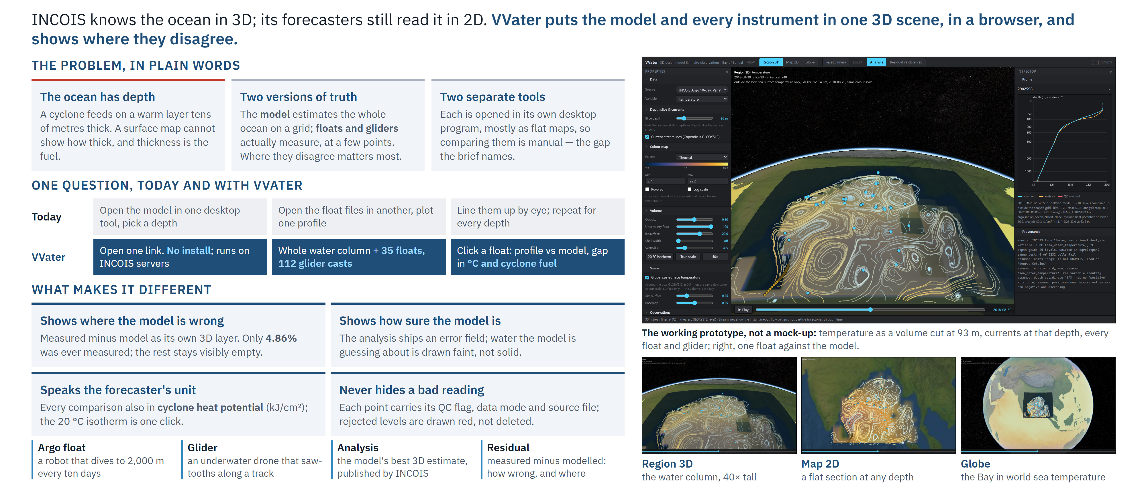
VVater: Ocean in 3D
VVater

Slide 3
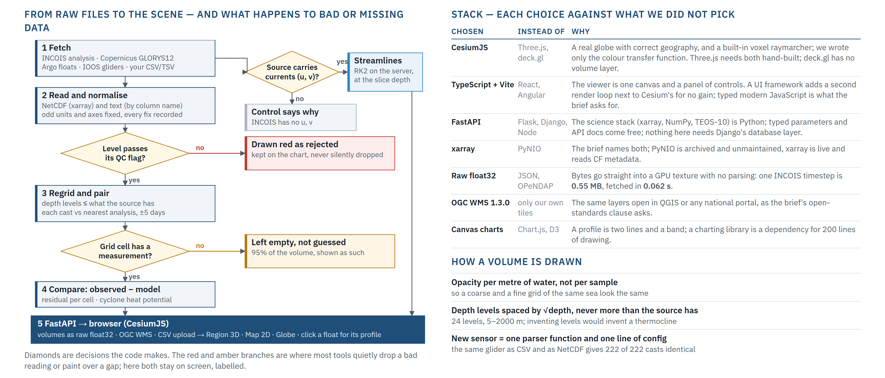
TECHNICAL APPROACH
VVater

Slide 4
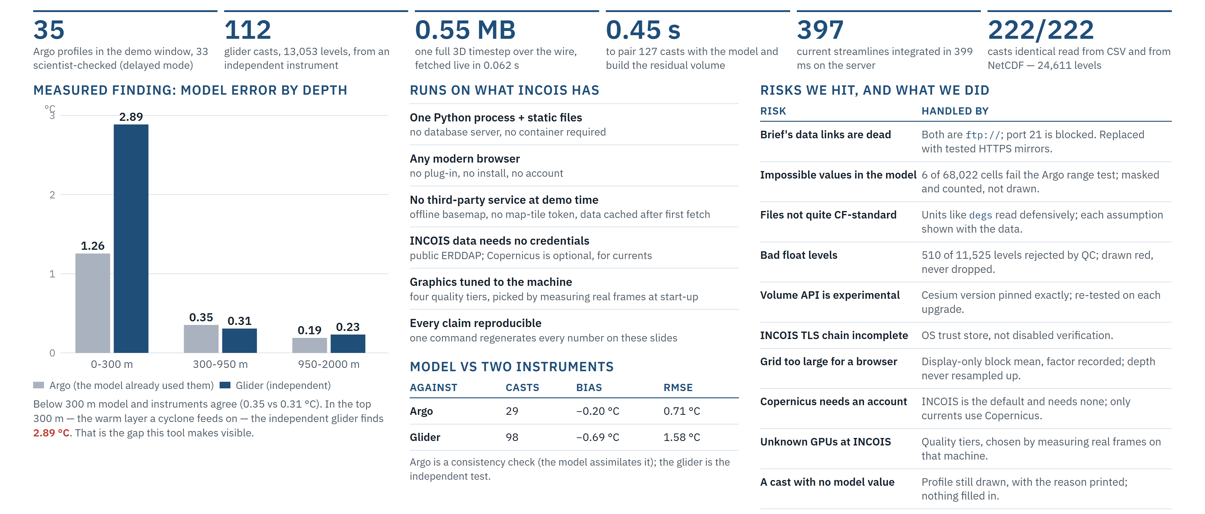
FEASIBILITY AND VIABILITY
VVater

Slide 5
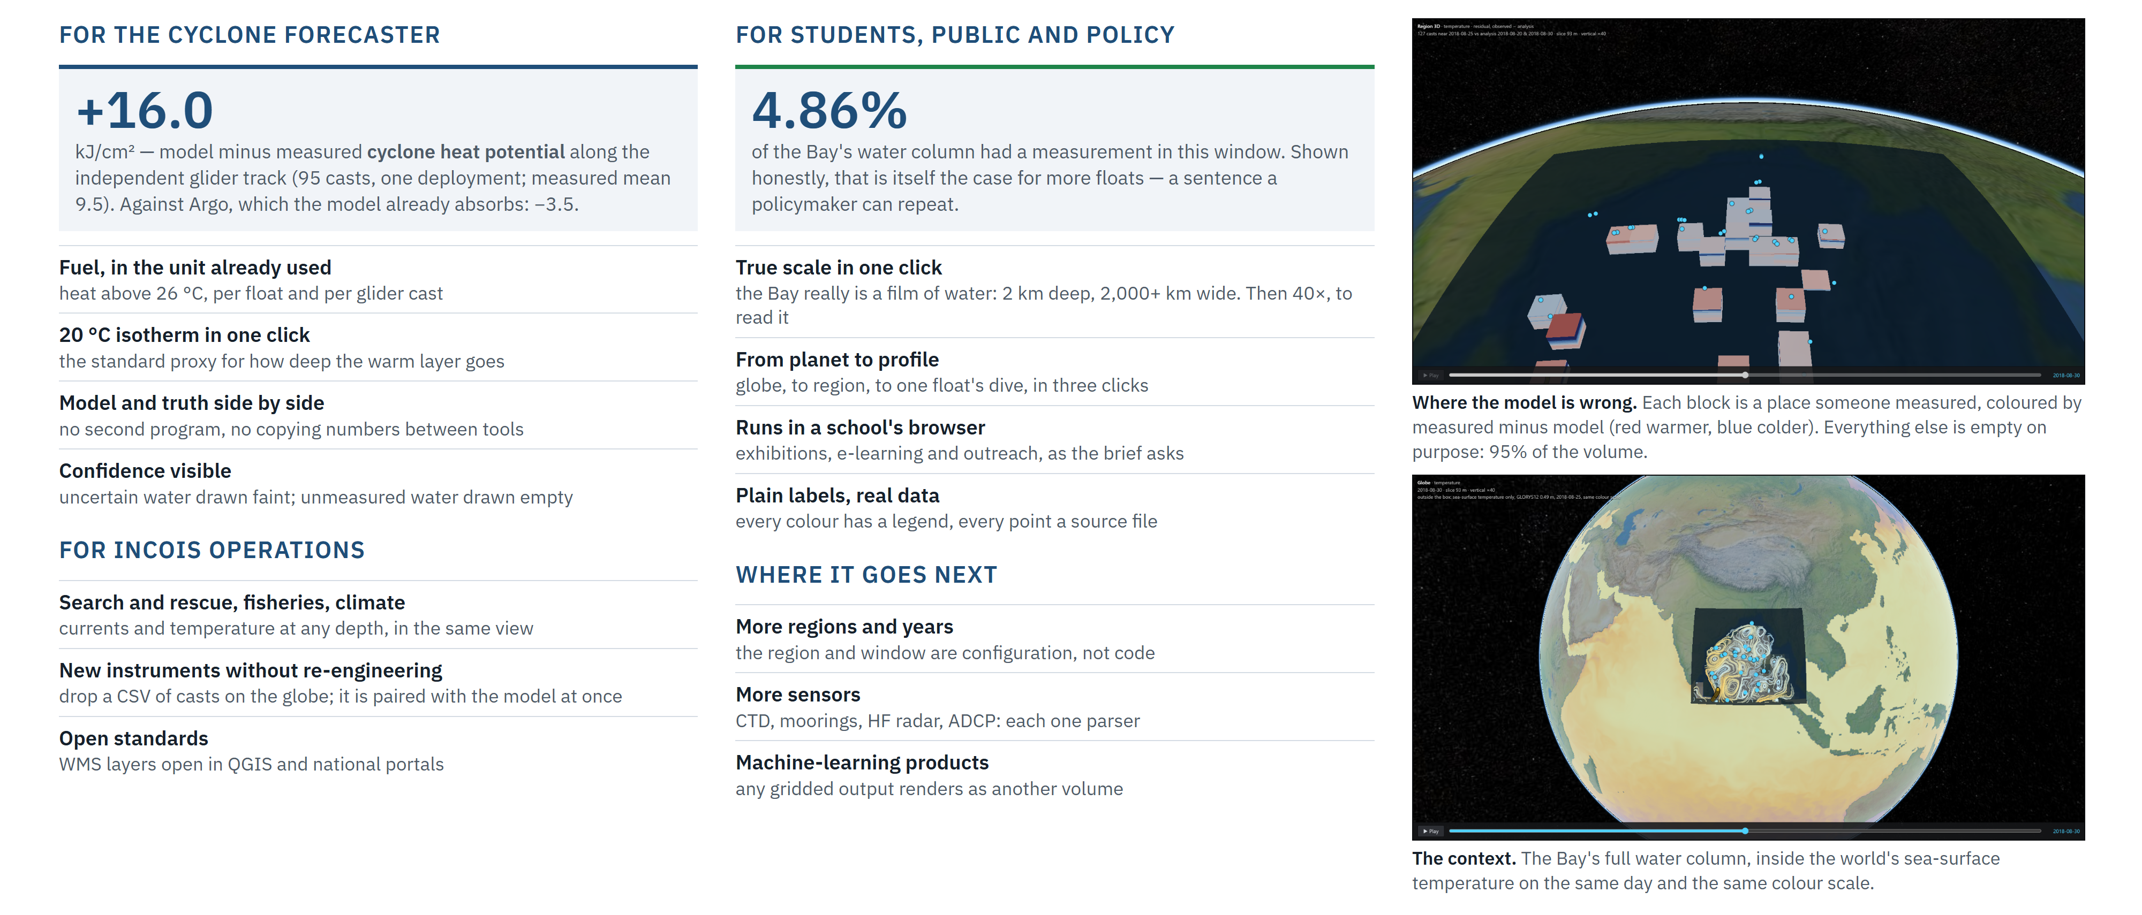
IMPACT AND BENEFITS
VVater

Slide 6
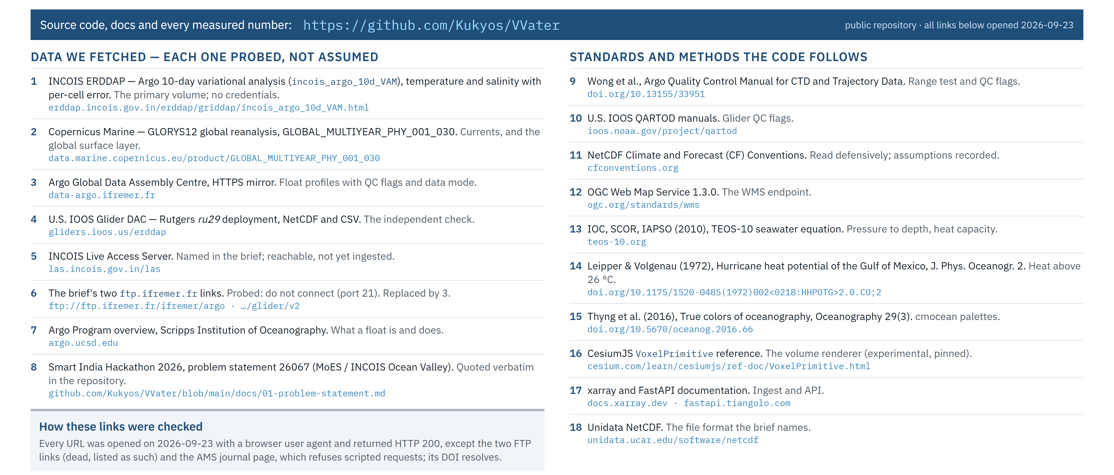
RESEARCH AND REFERENCES
VVater

