Slide 1




SMART INDIA HACKATHON 2026
TITLE PAGE
  Problem Statement ID - SIH26067
  Problem Statement Title - Develop a web-based interactive 3D visualization platform that integrates numerical ocean model outputs and in-situ observations.
  Theme - Disaster Management
  PS Category - Software
  Team ID - K26125
  Team Name - Team Null

Slide 2

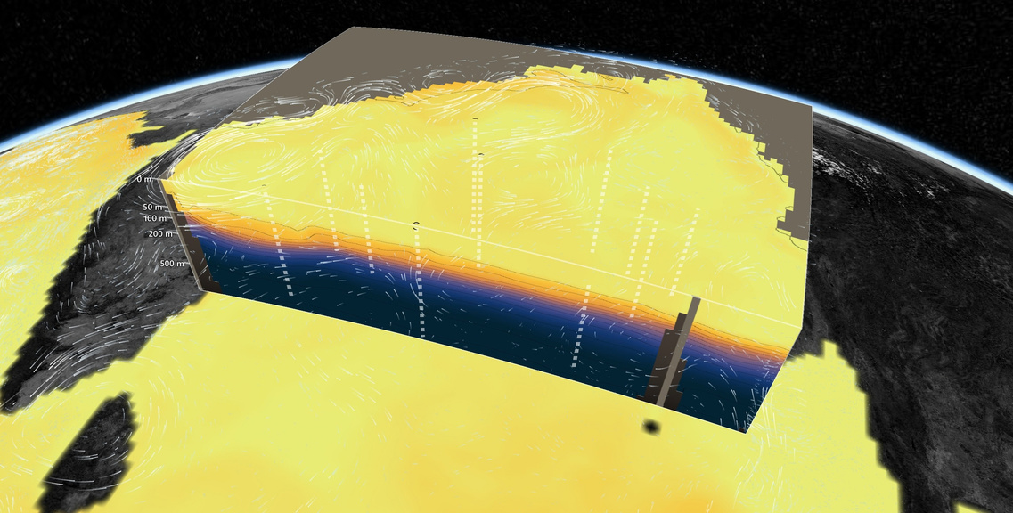
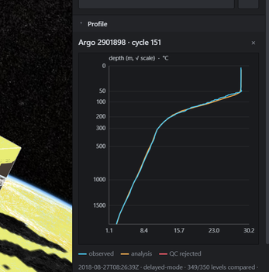
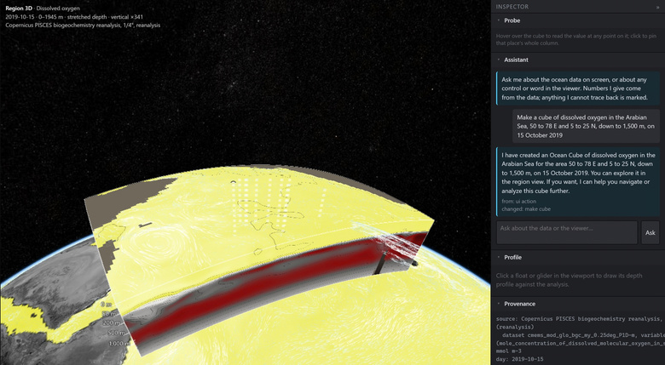
VVater: Ocean in 3D
PROPOSED SOLUTION
HOW IT ADDRESSES THE PROBLEM
INNOVATION AND UNIQUENESS
A browser platform that cuts a 3D block out of the ocean model, anywhere, on any day from 1993 to the forecast, and stands the real Argo floats inside it.
The five gaps the problem statement lists, and our answer to each.
Floats inside the model
No browser-based 3D, depth-resolved view of model fields
where model and float disagree, the colours differ on the same wall
a block of any box and day, cut open, in any browser; the INCOIS analysis as a true 3D volume
No archive to build
reads only the chunks a box needs from Copernicus's cloud stores
Argo and glider profiles not shown alongside model fields
The model is checked too
floats stand inside the model as sticks; click one for its profile against the model
impossible values masked and counted; INCOIS error drawn faint
No controls for variable, depth slice, time step, colour bar
An assistant that acts (AI Chatbot)
data only via our API tools; untraceable numbers flagged; built the asked-for cube 5 of 5 times, median 4.6 s
23 variables, cut planes, a day-by-day timeline, palette, range and log scale
A course on live data
New data streams need re-engineering
six lessons, class 8–12; quiz answers read from the cube on screen
a new variable is one catalogue line; CSV casts drop onto the globe
A flight view (surface through the sky)
fly a few kilometres above the sea and coast, as a pilot sees it
Working prototype, captured. The Bay of Bengal on 2020-05-14, before Cyclone Amphan, cut open to 1,000 m on the model's 35 native depth levels; each dashed stick is one of 17 Argo floats within two days.
No tools for rapid understanding and decisions
an AI assistant builds the view you ask for; fishing advisories; cyclone heat potential
DETAILED EXPLANATION
Model: Copernicus GLORYS12 and PISCES, read from the cloud; the INCOIS Argo analysis for the Bay
Instruments: Argo core and BGC floats, gliders, your own CSV casts, each with its QC state and source file
Also asked for by name, and built
Views: Region 3D, Map 2D, Globe, Fly, immersive; winds, waves, currents, fishing zones
Isosurface (the 20 °C isotherm, Bay volume) · layer opacity · vertical exaggeration · NetCDF and text parsers · REST API · OGC WMS for the Bay layers
a float's profile vs model
Arabian Sea, built by the assistant
Team Null · K26125
@SIH Idea submission- Template
2
Notes:
2

Slide 3









TECHNICAL APPROACH
Software architecture: three layers, end to end
User
1. Presentation layer: website
2. Application layer: server
3. Data layer (API’s)
scientist, forecaster, fisheries officer or student
runs in the browser, hosted on Vercel
Python API, on Render or run locally
public sources, read over the internet
Tech: TypeScript, Vite
Tech: Python, FastAPI, Uvicorn
Draws a box
on the map
Picks a day and a variable
1993 up to the forecast
Clicks a float
to see its readings
Asks the assistant
in plain words
Controls and timeline
Step 1: fetch only the chosen box
box only
Copernicus Marine
ocean model, 1993 to forecast
box, day, variable, colour bar, depth stretch
never the whole ocean
Tech: Copernicus Marine toolbox, Requests
INCOIS
Bay of Bengal analysis, fishing advisories
3D cube on the globe
cells coloured by value; floats as upright lines
Step 2: save a copy on disk
uses
Tech: CesiumJS, WebGL
request
the same view opens instantly next time
Ifremer
Argo floats
Tech: disk cache
Float profile chart
3D data
IOOS
ocean gliders
a float's readings next to the model's
Step 3: check quality
Tech: Canvas 2D
hide impossible values; keep each float's QC flag
NOAA
wind forecast
Only the site link is needed to access the viewer.
And it works multiplatform
Tech: Argo QC rules
Currents and winds
moving particles drawn over the map
Step 4: build the 3D block
Tech: Canvas 2D
only the model's real depths; adds density
Tech: xarray, NumPy, SciPy, GSW (seawater)
Assistant chat
ask in plain words; it can control panel properties and interact
with the viewer.
AI assistant
questions
Open-source AI model
Llama 3.1 on Ollama
free, no API cost
it can only call our own API, so it sees what the user sees
Tech: tool calling
What is calculated at each position: Longitude, latitude → where it sits on the globe Depth → how far down (can be stretched) Value → its colour on the colour bar
Team Null · K26125
@SIH Idea submission- Template
3
Notes:
1.7.2013
3
‹#›

Slide 4
FEASIBILITY AND VIABILITY
ANALYSIS OF FEASIBILITY: MEASURED BY A TEST RUN
23
0.08 s
639 MB
29 + 98
variables to 2026-10-04, forecast days labelled; 17 of them every day from 1993
to open the Amphan cube from the disk cache (1.15 MB to the browser)
peak memory over a full cold session: 97 of 97 requests answered
Argo profiles and glider casts co-located with the INCOIS model, level by level
WHAT THE PLATFORM FOUND: INCOIS MODEL ERROR BY DEPTH
CHALLENGES AND RISKS, AND OUR STRATEGIES
°C
2.89
CHALLENGE OR RISK
STRATEGY, ALREADY IN THE BUILD
The problem statement's data links are dead
Both are ftp:// and blocked; replaced with tested HTTPS sources.
The model fails QC too
6 INCOIS cells read above 40 °C at depth; masked, counted in the provenance panel.
2
Bad float readings
510 of 11,525 levels fail QC in the Bay; drawn red, never dropped.
1.26
An assistant could invent numbers
It reaches data only through our API; an untraceable number is flagged on screen.
1
A small host ran out of memory
Shared S3 client and capped caches; we ask for 1 GB, measured 639 MB peak.
0.35
SUSTAINABILITY
0 Rs running cost; free public data
Changed source = one fetch function
Test harness re-reads every source
Open source; issues and PRs open
ROADMAP
0.31
0.19
0.23
NOW
built, live
3 MO
INCOIS, school pilot
6 MO
INCOIS servers, SSO
12 MO
more basins, ML
0
0-300 m
300-950 m
950-2000 m
Argo (the model already used them)
Glider (independent)
Below 300 m the INCOIS model and the instruments agree. In the top 300 m, the warm layer a cyclone feeds on, the independent glider finds an error of 2.89 °C. A single pooled number hides it; the 3D view shows it.
Team Null · K26125
@SIH Idea submission- Template
4
Notes:
4

Slide 5
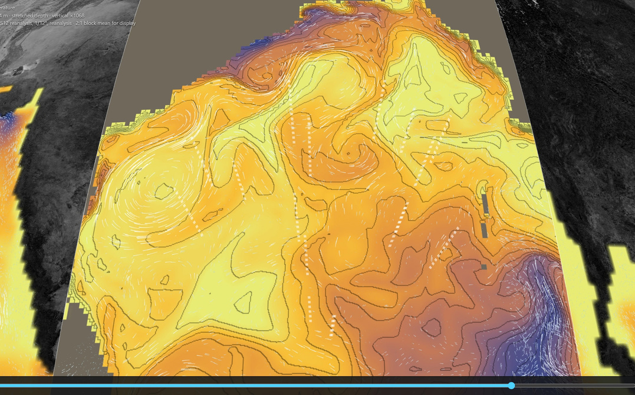
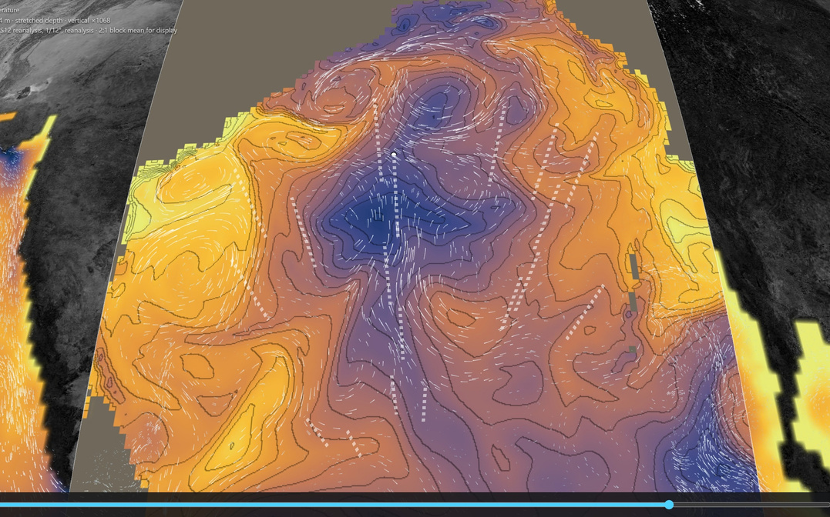
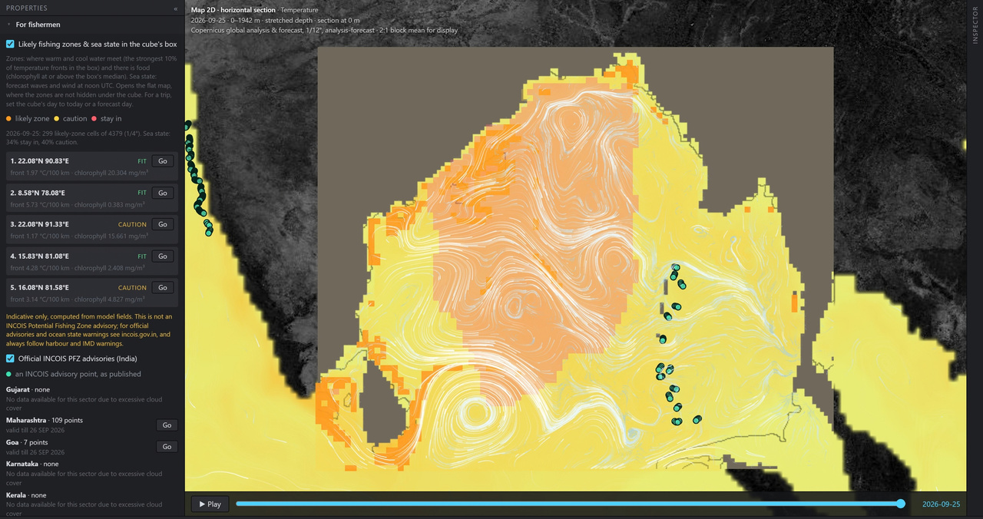
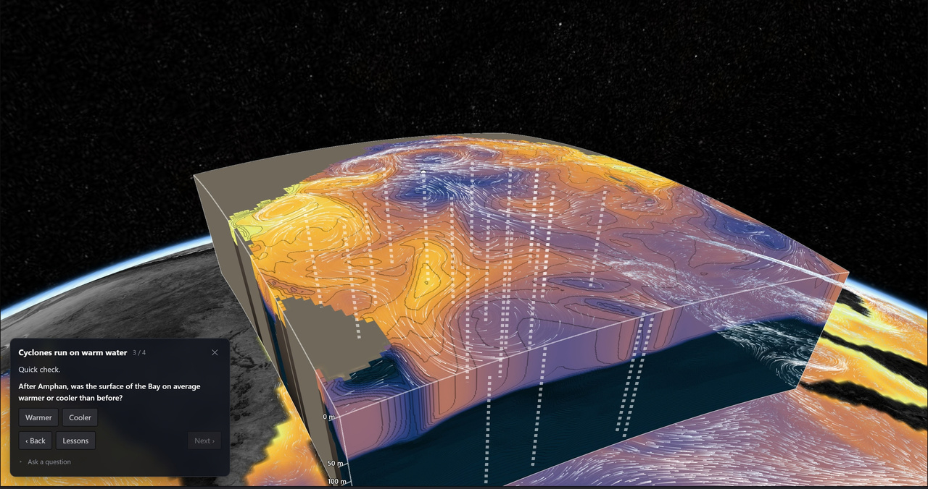
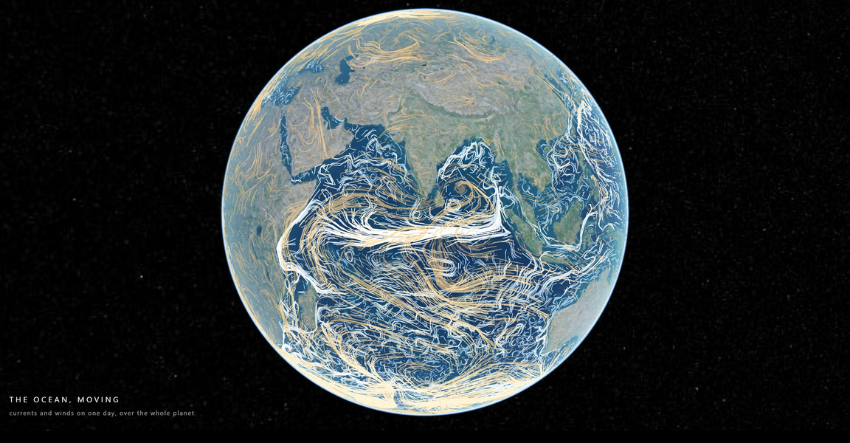
IMPACT AND BENEFITS
EACH TYPE OF USER AND THE IMPACT ON THEM
INCOIS forecasters
Fishermen
Students
Public and policymakers
2020-05-14
2020-05-22
INCOIS's own fishing-zone advisories, all fourteen sectors as published, beside today's waves and wind. Our indicator says "not an advisory".
Six lessons for class 8–12 on real data; quiz answers are read from the cube on screen, never from the language model.
Immersive view and cinematic tour: one day of the planet's currents and winds, for exhibitions and awareness campaigns.
Before and after Cyclone Amphan, one 28–31.5 °C bar: the cold wake shows; the box's mean surface temperature is 0.77 °C lower after.
BENEFITS
Scale: any box on Earth, not only the Bay; 6 other regions measured, under 0.4 s cached. Next: marine heatwaves, oil-spill drift.
Social
Economic
Environmental
Disaster preparedness: the warm layer a cyclone feeds on, seen in 3D, with cyclone heat potential per float
Open source, no licences; a static site and one server (1 GB of memory measured enough)
Climate monitoring: every day since 1993 for 17 variables, in one view
Safety at sea: the official advisory first, with the sea state beside it
No archive to buy or store: public data is read where it lives, a day at a time
Oxygen-poor layers, chlorophyll and nutrients as 3D blocks, not flat maps
Ocean literacy: a course in any school browser, on the same data forecasters use
Fishing advisories exist to cut search time at sea; here they sit where boats plan
Where the model is uncertain or unmeasured is shown, so decisions know the limits
Team Null · K26125
@SIH Idea submission- Template
5
Notes:
5

Slide 6
RESEARCH AND REFERENCES
Source code, docs and every measured number:
https://github.com/Kukyos/VVater
DATA, EACH SOURCE PROBED
STANDARDS AND METHODS
WHAT THE COURSE CITES
1
Copernicus Marine GLORYS12 and global analysis & forecast, physics and biogeochemistry, as ARCO stores. The cube.
9
Wong et al., Argo Quality Control Manual. QC flags, range test.
17
Gray (1968), Mon. Weather Rev. 96, 669–700. Cyclones need water above ~26 °C.
doi.org/10.13155/33951
data.marine.copernicus.eu/product/GLOBAL_MULTIYEAR_PHY_001_030
10
U.S. IOOS QARTOD manuals. Glider QC.
2
INCOIS ERDDAP, Argo 10-day variational analysis with per-cell error. The Bay volume.
ioos.noaa.gov/project/qartod
18
Price (1981), J. Phys. Oceanogr. 11, 153–175. A cyclone cools the sea.
erddap.incois.gov.in/erddap
11
CF Conventions for NetCDF. Read defensively.
19
Schott & McCreary (2001), Prog. Oceanogr. 51, 1–123. The monsoon current reverses.
cfconventions.org
3
Ifremer Argo ERDDAP, core and synthetic BGC floats. Floats anywhere.
12
OGC Web Map Service 1.3.0. The WMS endpoint.
erddap.ifremer.fr/erddap
ogc.org/standards/wms
20
India Meteorological Department, report on Super Cyclonic Storm Amphan (2020). Landfall, 20 May.
4
Argo GDAC, HTTPS mirror. Float files, QC flags, data mode.
13
IOC, SCOR, IAPSO (2010), TEOS-10. Density, sound speed.
data-argo.ifremer.fr
teos-10.org
21
WMO Guide to Wave Analysis and Forecasting (WMO-No. 702). Wind makes waves.
5
U.S. IOOS Glider DAC, Rutgers ru29. The independent check.
14
Leipper & Volgenau (1972), J. Phys. Oceanogr. 2. Heat above 26 °C.
gliders.ioos.us/erddap
doi.org/10.1175/1520-0485(1972)002<0218:HHPOTG>2.0.CO;2
22
Argo Program, "How Argo floats work". Floats.
6
INCOIS Potential Fishing Zone advisories. Read as published.
argo.ucsd.edu
incois.gov.in/MarineFisheries/TextDataHome?mfid=1
15
Thyng et al. (2016), Oceanography 29(3). cmocean palettes.
23
SIH 2026 problem statement 26067, quoted verbatim.
doi.org/10.5670/oceanog.2016.66
github.com/Kukyos/VVater/blob/main/docs/01-problem-statement.md
7
NCEP GFS 10 m wind via UCAR THREDDS. Wind forecast.
16
CesiumJS. The globe and renderer.
thredds.ucar.edu
cesium.com/platform/cesiumjs
8
NASA GIBS Blue Marble relief. Land.
gibs.earthdata.nasa.gov
Team Null · K26125
@SIH Idea submission- Template
6
Notes:
6

